Slide 1
CS 388:
Natural Language Processing:
Part-Of-Speech Tagging,
Sequence Labeling, and
Hidden Markov Models (HMMs)
Raymond J. Mooney
University of Texas at Austin

Slide 2
Part Of Speech Tagging
Annotate each word in a sentence with a part-of-speech marker.
Lowest level of syntactic analysis.
Useful for subsequent syntactic parsing and word sense disambiguation.
John saw the saw and decided to take it to the table.
NNP VBD DT NN CC VBD TO VB PRP IN DT NN

Slide 3
English POS Tagsets
Original Brown corpus used a large set of 87 POS tags.
Most common in NLP today is the Penn Treebank set of 45 tags.
  Tagset used in these slides.
  Reduced from the Brown set for use in the context of a parsed corpus (i.e. treebank).
The C5 tagset used for the British National Corpus (BNC) has 61 tags.

Slide 4
English Parts of Speech
Noun (person, place or thing)
  Singular (NN): dog, fork
  Plural (NNS): dogs, forks
  Proper (NNP, NNPS): John, Springfields
  Personal pronoun (PRP): I, you, he, she, it
  Wh-pronoun (WP): who, what
Verb (actions and processes)
  Base, infinitive (VB): eat
  Past tense (VBD): ate
  Gerund (VBG): eating
  Past participle (VBN): eaten
  Non 3rd person singular present tense (VBP): eat
  3rd person singular present tense: (VBZ): eats
  Modal (MD): should, can
  To (TO): to (to eat)

Slide 5
English Parts of Speech (cont.)
Adjective (modify nouns)
  Basic (JJ): red, tall
  Comparative (JJR): redder, taller
  Superlative (JJS): reddest, tallest
Adverb (modify verbs)
  Basic (RB): quickly
  Comparative (RBR): quicker
  Superlative (RBS): quickest
Preposition (IN): on, in, by, to, with
Determiner:
  Basic (DT) a, an, the
  WH-determiner (WDT): which, that
Coordinating Conjunction (CC): and, but, or,
Particle (RP): off (took off), up (put up)

Slide 6
Closed vs. Open Class
Closed class categories are composed of a small, fixed set of grammatical function words for a given language.
  Pronouns, Prepositions, Modals, Determiners, Particles, Conjunctions
Open class categories have large number of words and new ones are easily invented.
  Nouns (Googler, textlish), Verbs (Google), Adjectives (geeky), Abverb (chompingly)

Slide 7
Ambiguity in POS Tagging
“Like” can be a verb or a preposition
  I like/VBP candy.
  Time flies like/IN an arrow.
“Around” can be a preposition, particle, or adverb
  I bought it at the shop around/IN the corner.
  I never got around/RP to getting a car.
  A new Prius costs around/RB $25K.

Slide 8
POS Tagging Process
Usually assume a separate initial tokenization process that separates and/or disambiguates punctuation, including detecting sentence boundaries.
Degree of ambiguity in English (based on Brown corpus)
  11.5% of word types are ambiguous.
  40% of word tokens are ambiguous.
Average POS tagging disagreement amongst expert human judges for the Penn treebank was 3.5%
  Based on correcting the output of an initial automated tagger, which was deemed to be more accurate than tagging from scratch.
Baseline: Picking the most frequent tag for each specific word type gives about 90% accuracy
  93.7% if use model for unknown words for Penn Treebank tagset.

Slide 9
POS Tagging Approaches
Rule-Based: Human crafted rules based on lexical and other linguistic knowledge.
Learning-Based: Trained on human annotated corpora like the Penn Treebank.
  Statistical models: Hidden Markov Model (HMM), Maximum Entropy Markov Model (MEMM), Conditional Random Field (CRF)
  Rule learning: Transformation Based Learning (TBL)
Generally, learning-based approaches have been found to be more effective overall, taking into account the total amount of human expertise and effort involved.

Slide 10
Classification Learning
Typical machine learning addresses the problem of classifying a feature-vector description into a fixed number of classes.
There are many standard learning methods for this task:
  Decision Trees and Rule Learning
  Naïve Bayes and Bayesian Networks
  Logistic Regression / Maximum Entropy (MaxEnt)
  Perceptron and Neural Networks
  Support Vector Machines (SVMs)
  Nearest-Neighbor / Instance-Based

Slide 11
Beyond Classification Learning
Standard classification problem assumes individual cases are disconnected and independent (i.i.d.: independently and identically distributed).
Many NLP problems do not satisfy this assumption and involve making many connected decisions, each resolving a different ambiguity, but which are mutually dependent.
More sophisticated learning and inference techniques are needed to handle such situations in general.

Slide 12
Sequence Labeling Problem
Many NLP problems can viewed as sequence labeling.
Each token in a sequence is assigned a label.
Labels of tokens are dependent on the labels of other tokens in the sequence, particularly their neighbors (not i.i.d).
foo bar blam zonk zonk bar blam

Slide 13
Information Extraction
Identify phrases in language that refer to specific types of entities and relations in text.
Named entity recognition is task of identifying names of people, places, organizations, etc. in text.
people organizations places
  Michael Dell is the CEO of Dell Computer Corporation and lives in Austin Texas.
Extract pieces of information relevant to a specific application, e.g. used car ads:
make model year mileage price
  For sale, 2002 Toyota Prius, 20,000 mi, $15K or best offer. Available starting July 30, 2006.

Slide 14
Semantic Role Labeling
For each clause, determine the semantic role played by each noun phrase that is an argument to the verb.
  agent patient source destination instrument
  John drove Mary from Austin to Dallas in his Toyota Prius.
  The hammer broke the window.
Also referred to a “case role analysis,” “thematic analysis,” and “shallow semantic parsing”

Slide 15
Bioinformatics
Sequence labeling also valuable in labeling genetic sequences in genome analysis.
  extron intron
  AGCTAACGTTCGATACGGATTACAGCCT

Slide 16
Sequence Labeling as Classification
Classify each token independently but use as input features, information about the surrounding tokens (sliding window).
John saw the saw and decided to take it to the table.
classifier
NNP

Slide 17
Sequence Labeling as Classification
Classify each token independently but use as input features, information about the surrounding tokens (sliding window).
John saw the saw and decided to take it to the table.
classifier
VBD

Slide 18
Sequence Labeling as Classification
Classify each token independently but use as input features, information about the surrounding tokens (sliding window).
John saw the saw and decided to take it to the table.
classifier
DT

Slide 19
Sequence Labeling as Classification
Classify each token independently but use as input features, information about the surrounding tokens (sliding window).
John saw the saw and decided to take it to the table.
classifier
NN

Slide 20
Sequence Labeling as Classification
Classify each token independently but use as input features, information about the surrounding tokens (sliding window).
John saw the saw and decided to take it to the table.
classifier
CC

Slide 21
Sequence Labeling as Classification
Classify each token independently but use as input features, information about the surrounding tokens (sliding window).
John saw the saw and decided to take it to the table.
classifier
VBD

Slide 22
Sequence Labeling as Classification
Classify each token independently but use as input features, information about the surrounding tokens (sliding window).
John saw the saw and decided to take it to the table.
classifier
TO

Slide 23
Sequence Labeling as Classification
Classify each token independently but use as input features, information about the surrounding tokens (sliding window).
John saw the saw and decided to take it to the table.
classifier
VB

Slide 24
Sequence Labeling as Classification
Classify each token independently but use as input features, information about the surrounding tokens (sliding window).
John saw the saw and decided to take it to the table.
classifier
PRP

Slide 25
Sequence Labeling as Classification
Classify each token independently but use as input features, information about the surrounding tokens (sliding window).
John saw the saw and decided to take it to the table.
classifier
IN

Slide 26
Sequence Labeling as Classification
Classify each token independently but use as input features, information about the surrounding tokens (sliding window).
John saw the saw and decided to take it to the table.
classifier
DT

Slide 27
Sequence Labeling as Classification
Classify each token independently but use as input features, information about the surrounding tokens (sliding window).
John saw the saw and decided to take it to the table.
classifier
NN

Slide 28
Sequence Labeling as Classification
Using Outputs as Inputs
Better input features are usually the categories of the surrounding tokens, but these are not available yet.
Can use category of either the preceding or succeeding tokens by going forward or back and using previous output.

Slide 29
Forward Classification
John saw the saw and decided to take it to the table.
classifier
NNP

Slide 30
Forward Classification
NNP
John saw the saw and decided to take it to the table.
classifier
VBD

Slide 31
Forward Classification
NNP VBD
John saw the saw and decided to take it to the table.
classifier
DT

Slide 32
Forward Classification
NNP VBD DT
John saw the saw and decided to take it to the table.
classifier
NN

Slide 33
Forward Classification
NNP VBD DT NN
John saw the saw and decided to take it to the table.
classifier
CC

Slide 34
Forward Classification
NNP VBD DT NN CC
John saw the saw and decided to take it to the table.
classifier
VBD

Slide 35
Forward Classification
NNP VBD DT NN CC VBD
John saw the saw and decided to take it to the table.
classifier
TO

Slide 36
Forward Classification
NNP VBD DT NN CC VBD TO
John saw the saw and decided to take it to the table.
classifier
VB

Slide 37
Forward Classification
NNP VBD DT NN CC VBD TO VB
John saw the saw and decided to take it to the table.
classifier
PRP

Slide 38
Forward Classification
NNP VBD DT NN CC VBD TO VB PRP
John saw the saw and decided to take it to the table.
classifier
IN

Slide 39
Forward Classification
NNP VBD DT NN CC VBD TO VB PRP IN
John saw the saw and decided to take it to the table.
classifier
DT

Slide 40
Forward Classification
NNP VBD DT NN CC VBD TO VB PRP IN DT
John saw the saw and decided to take it to the table.
classifier
NN

Slide 41
Backward Classification
Disambiguating “to” in this case would be even easier backward.
John saw the saw and decided to take it to the table.
classifier
NN

Slide 42
Backward Classification
Disambiguating “to” in this case would be even easier backward.
NN
John saw the saw and decided to take it to the table.
classifier
DT

Slide 43
Backward Classification
Disambiguating “to” in this case would be even easier backward.
DT NN
John saw the saw and decided to take it to the table.
classifier
IN

Slide 44
Backward Classification
Disambiguating “to” in this case would be even easier backward.
IN DT NN
John saw the saw and decided to take it to the table.
classifier
PRP

Slide 45
Backward Classification
Disambiguating “to” in this case would be even easier backward.
PRP IN DT NN
John saw the saw and decided to take it to the table.
classifier
VB

Slide 46
Backward Classification
Disambiguating “to” in this case would be even easier backward.
VB PRP IN DT NN
John saw the saw and decided to take it to the table.
classifier
TO

Slide 47
Backward Classification
Disambiguating “to” in this case would be even easier backward.
TO VB PRP IN DT NN
John saw the saw and decided to take it to the table.
classifier
VBD

Slide 48
Backward Classification
Disambiguating “to” in this case would be even easier backward.
VBD TO VB PRP IN DT NN
John saw the saw and decided to take it to the table.
classifier
CC

Slide 49
Backward Classification
Disambiguating “to” in this case would be even easier backward.
CC VBD TO VB PRP IN DT NN
John saw the saw and decided to take it to the table.
classifier
NN

Slide 50
Backward Classification
Disambiguating “to” in this case would be even easier backward.
VBD CC VBD TO VB PRP IN DT NN
John saw the saw and decided to take it to the table.
classifier
DT

Slide 51
Backward Classification
Disambiguating “to” in this case would be even easier backward.
DT VBD CC VBD TO VB PRP IN DT NN
John saw the saw and decided to take it to the table.
classifier
VBD

Slide 52
Backward Classification
Disambiguating “to” in this case would be even easier backward.
VBD DT VBD CC VBD TO VB PRP IN DT NN
John saw the saw and decided to take it to the table.
classifier
NNP

Slide 53
Problems with Sequence Labeling as Classification
Not easy to integrate information from category of tokens on both sides.
Difficult to propagate uncertainty between decisions and “collectively” determine the most likely joint assignment of categories to all of the tokens in a sequence.

Slide 54
Probabilistic Sequence Models
Probabilistic sequence models allow integrating uncertainty over multiple, interdependent classifications and collectively determine the most likely global assignment.
Two standard models
  Hidden Markov Model (HMM)
  Conditional Random Field (CRF)

Slide 55
Markov Model / Markov Chain
A finite state machine with probabilistic state transitions.
Makes Markov assumption that next state only depends on the current state and independent of previous history.

Slide 56
Sample Markov Model for POS
0.1
Det
Noun
0.95
0.5
0.9
stop
0.05
Verb
0.25
0.1
PropNoun
0.8
0.4
0.5
0.1
0.25
0.1
start

Slide 57
Sample Markov Model for POS
0.1
Det
Noun
0.95
0.5
0.9
stop
0.05
Verb
0.25
0.1
PropNoun
0.8
0.4
0.5
0.1
0.25
0.1
start
P(PropNoun Verb Det Noun) = 0.4*0.8*0.25*0.95*0.1=0.0076

Slide 58
Hidden Markov Model
Probabilistic generative model for sequences.
Assume an underlying set of hidden (unobserved) states in which the model can be (e.g. parts of speech).
Assume probabilistic transitions between states over time (e.g. transition from POS to another POS as sequence is generated).
Assume a probabilistic generation of tokens from states (e.g. words generated for each POS).

Slide 59
Sample HMM for POS
the
cat
0.1
a
the
dog
a
the
car
bed
the
a
apple
that
pen
0.95
0.5
Det
Noun
0.9
bit
saw
stop
0.05
ate
played
Tom
0.25
hit
gave
0.1
John
Verb
Mary
Alice
0.8
0.4
Jerry
0.5
PropNoun
0.1
0.25
0.1
start

Slide 60
Sample HMM Generation
the
cat
0.1
a
the
dog
a
the
car
bed
the
a
apple
that
pen
0.95
0.5
Det
Noun
0.9
bit
saw
stop
0.05
ate
played
Tom
0.25
hit
gave
0.1
John
Verb
Mary
Alice
0.8
0.4
Jerry
0.5
PropNoun
0.1
0.25
0.1
start

Slide 61
Sample HMM Generation
the
cat
0.1
a
the
dog
a
the
car
bed
the
a
apple
that
pen
0.95
0.5
Det
Noun
0.9
bit
saw
stop
0.05
ate
played
Tom
0.25
hit
gave
0.1
John
Verb
Mary
Alice
0.8
0.4
Jerry
0.5
PropNoun
0.1
0.1
start

Slide 62
Sample HMM Generation
the
cat
0.1
a
the
dog
a
the
car
bed
the
a
apple
that
pen
0.95
0.5
Det
Noun
0.9
bit
saw
stop
0.05
ate
played
Tom
0.25
hit
gave
0.1
John
Verb
Mary
Alice
0.8
0.4
Jerry
0.5
PropNoun
0.1
0.25
0.1
start
John

Slide 63
Sample HMM Generation
the
cat
0.1
a
the
dog
a
the
car
bed
the
a
apple
that
pen
0.95
0.5
Det
Noun
0.9
bit
saw
stop
0.05
ate
played
Tom
0.25
hit
gave
0.1
John
Verb
Mary
Alice
0.8
0.4
Jerry
0.5
PropNoun
0.1
0.25
0.1
start
John

Slide 64
Sample HMM Generation
the
cat
0.1
a
the
dog
a
the
car
bed
the
a
apple
that
pen
0.95
0.5
Det
Noun
0.9
bit
saw
stop
0.05
ate
played
Tom
0.25
hit
gave
0.1
John
Verb
Mary
Alice
0.8
0.4
Jerry
0.5
PropNoun
0.1
0.25
0.1
start
John bit

Slide 65
Sample HMM Generation
the
cat
0.1
a
the
dog
a
the
car
bed
the
a
apple
that
pen
0.95
0.5
Det
Noun
0.9
bit
saw
stop
0.05
ate
played
Tom
0.25
hit
gave
0.1
John
Verb
Mary
Alice
0.8
0.4
Jerry
0.5
PropNoun
0.1
0.25
0.1
start
John bit

Slide 66
Sample HMM Generation
the
cat
0.1
a
the
dog
a
the
car
bed
the
a
apple
that
pen
0.95
0.5
Det
Noun
0.9
bit
saw
stop
0.05
ate
played
Tom
0.25
hit
gave
0.1
John
Verb
Mary
Alice
0.8
0.4
Jerry
0.5
PropNoun
0.1
0.25
0.1
start
John bit the

Slide 67
Sample HMM Generation
the
cat
0.1
a
the
dog
a
the
car
bed
the
a
apple
that
pen
0.95
0.5
Det
Noun
0.9
bit
saw
stop
0.05
ate
played
Tom
0.25
hit
gave
0.1
John
Verb
Mary
Alice
0.8
0.4
Jerry
0.5
PropNoun
0.1
0.25
0.1
start
John bit the

Slide 68
Sample HMM Generation
the
cat
0.1
a
the
dog
a
the
car
bed
the
a
apple
that
pen
0.95
0.5
Det
Noun
0.9
bit
saw
stop
0.05
ate
played
Tom
0.25
hit
gave
0.1
John
Verb
Mary
Alice
0.8
0.4
Jerry
0.5
PropNoun
0.1
0.25
0.1
start
John bit the apple

Slide 69
Sample HMM Generation
the
cat
0.1
a
the
dog
a
the
car
bed
the
a
apple
that
pen
0.95
0.5
Det
Noun
0.9
bit
saw
stop
0.05
ate
played
Tom
0.25
hit
gave
0.1
John
Verb
Mary
Alice
0.8
0.4
Jerry
0.5
PropNoun
0.1
0.25
0.1
start
John bit the apple

Slide 70
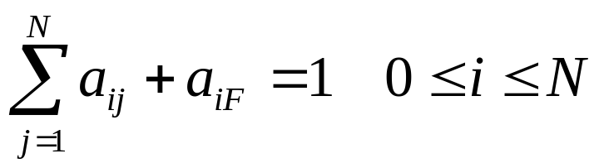
Formal Definition of an HMM
A set of N +2 states S={s₀,s₁,s₂, … s_{N,} s_{F}}
  Distinguished start state: s₀
  Distinguished final state: s_{F}
A set of M possible observations V={v₁,v₂…v_{M}}
A state transition probability distribution A={a_{ij}}
Observation probability distribution for each state j B={b_{j}(k)}
Total parameter set λ={A,B}

Slide 71
HMM Generation Procedure
To generate a sequence of T observations: O = o₁ o₂ … o_{T}
Set initial state q₁=s₀
For t = 1 to T
Transit to another state q_{t+1}=s_{j} based on transition
distribution a_{ij} for state q_{t}
Pick an observation o_{t}=v_{k} based on being in state q_{t} using
distribution b_{qt}(k)

Slide 72
Three Useful HMM Tasks
Observation Likelihood: To classify and order sequences.
Most likely state sequence (Decoding): To tag each token in a sequence with a label.
Maximum likelihood training (Learning): To train models to fit empirical training data.

Slide 73
HMM: Observation Likelihood
Given a sequence of observations, O, and a model with a set of parameters, λ, what is the probability that this observation was generated by this model: P(O| λ) ?
Allows HMM to be used as a language model: A formal probabilistic model of a language that assigns a probability to each string saying how likely that string was to have been generated by the language.
Useful for two tasks:
  Sequence Classification
  Most Likely Sequence

Slide 74
Sequence Classification
Assume an HMM is available for each category (i.e. language).
What is the most likely category for a given observation sequence, i.e. which category’s HMM is most likely to have generated it?
Used in speech recognition to find most likely word model to have generate a given sound or phoneme sequence.
O
ah s t e n
?
?
Austin
P(O | Austin) > P(O | Boston) ?
Boston

Slide 75
Most Likely Sequence
Of two or more possible sequences, which one was most likely generated by a given model?
Used to score alternative word sequence interpretations in speech recognition.
O₁
?
dice precedent core
?
vice president Gore
O₂
Ordinary English
P(O₂ | OrdEnglish) > P(O₁ | OrdEnglish) ?

Slide 76
HMM: Observation Likelihood
Naïve Solution
Consider all possible state sequences, Q, of length T that the model could have traversed in generating the given observation sequence.
Compute the probability of a given state sequence from A, and multiply it by the probabilities of generating each of given observations in each of the corresponding states in this sequence to get P(O,Q| λ) = P(O| Q, λ) P(Q| λ) .
Sum this over all possible state sequences to get P(O| λ).
Computationally complex: O(TN^{T}).

Slide 77
HMM: Observation Likelihood
Efficient Solution
Due to the Markov assumption, the probability of being in any state at any given time t only relies on the probability of being in each of the possible states at time t−1.
Forward Algorithm: Uses dynamic programming to exploit this fact to efficiently compute observation likelihood in O(TN²) time.
  Compute a forward trellis that compactly and implicitly encodes information about all possible state paths.

Slide 78
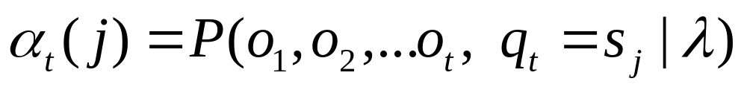
Forward Probabilities
Let α_{t}(j) be the probability of being in state j after seeing the first t observations (by summing over all initial paths leading to j).

Slide 79
Forward Step
Consider all possible ways of getting to s_{j} at time t by coming from all possible states s_{i} and determine probability of each.
Sum these to get the total probability of being in state s_{j} at time t while accounting for the first t −1 observations.
Then multiply by the probability of actually observing o_{t} in s_{j.}
s₁
a_{1j}
s₂
a_{2j}
•
•
•
a_{2j}
s_{j}
a_{Nj}
s_{N}
α_{t-1}(i)
α_{t}(i)

Slide 80
Forward Trellis
s₁
• • •
s₂
• • •
•
•
•
•
•
•
•
•
•
•
•
•
•
•
•
s₀
• • •
s_{F}
s_{N}
• • •
t₁
t₂
t₃
t_{T-1}
t_{T}
Continue forward in time until reaching final time point and sum probability of ending in final state.

Slide 81
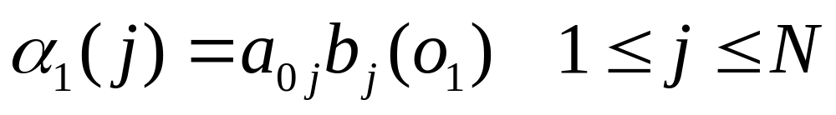
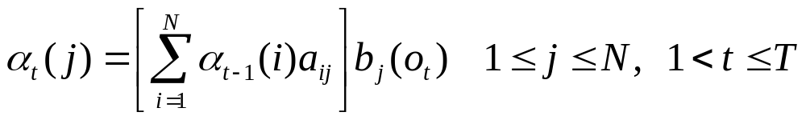
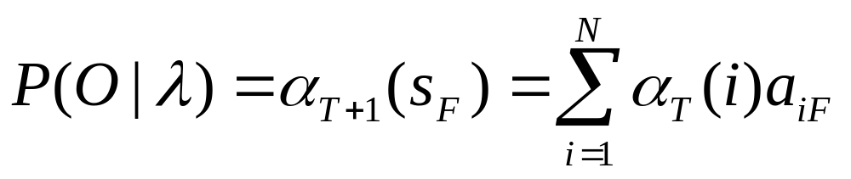
Computing the Forward Probabilities
Initialization
Recursion
Termination

Slide 82
Forward Computational Complexity
Requires only O(TN²) time to compute the probability of an observed sequence given a model.
Exploits the fact that all state sequences must merge into one of the N possible states at any point in time and the Markov assumption that only the last state effects the next one.

Slide 83
Most Likely State Sequence (Decoding)
Given an observation sequence, O, and a model, λ, what is the most likely state sequence,Q=q₁,q₂,…q_{T}, that generated this sequence from this model?
Used for sequence labeling, assuming each state corresponds to a tag, it determines the globally best assignment of tags to all tokens in a sequence using a principled approach grounded in probability theory.
John gave the dog an apple.

Slide 84
Most Likely State Sequence
Given an observation sequence, O, and a model, λ, what is the most likely state sequence,Q=q₁,q₂,…q_{T}, that generated this sequence from this model?
Used for sequence labeling, assuming each state corresponds to a tag, it determines the globally best assignment of tags to all tokens in a sequence using a principled approach grounded in probability theory.
John gave the dog an apple.
Det Noun PropNoun Verb

Slide 85
Most Likely State Sequence
Given an observation sequence, O, and a model, λ, what is the most likely state sequence,Q=q₁,q₂,…q_{T}, that generated this sequence from this model?
Used for sequence labeling, assuming each state corresponds to a tag, it determines the globally best assignment of tags to all tokens in a sequence using a principled approach grounded in probability theory.
John gave the dog an apple.
Det Noun PropNoun Verb

Slide 86
Most Likely State Sequence
Given an observation sequence, O, and a model, λ, what is the most likely state sequence,Q=q₁,q₂,…q_{T}, that generated this sequence from this model?
Used for sequence labeling, assuming each state corresponds to a tag, it determines the globally best assignment of tags to all tokens in a sequence using a principled approach grounded in probability theory.
John gave the dog an apple.
Det Noun PropNoun Verb

Slide 87
Most Likely State Sequence
Given an observation sequence, O, and a model, λ, what is the most likely state sequence,Q=q₁,q₂,…q_{T}, that generated this sequence from this model?
Used for sequence labeling, assuming each state corresponds to a tag, it determines the globally best assignment of tags to all tokens in a sequence using a principled approach grounded in probability theory.
John gave the dog an apple.
Det Noun PropNoun Verb

Slide 88
Most Likely State Sequence
Given an observation sequence, O, and a model, λ, what is the most likely state sequence,Q=q₁,q₂,…q_{T}, that generated this sequence from this model?
Used for sequence labeling, assuming each state corresponds to a tag, it determines the globally best assignment of tags to all tokens in a sequence using a principled approach grounded in probability theory.
John gave the dog an apple.
Det Noun PropNoun Verb

Slide 89
Most Likely State Sequence
Given an observation sequence, O, and a model, λ, what is the most likely state sequence,Q=q₁,q₂,…q_{T}, that generated this sequence from this model?
Used for sequence labeling, assuming each state corresponds to a tag, it determines the globally best assignment of tags to all tokens in a sequence using a principled approach grounded in probability theory.
John gave the dog an apple.
Det Noun PropNoun Verb

Slide 90
HMM: Most Likely State Sequence
Efficient Solution
Obviously, could use naïve algorithm based on examining every possible state sequence of length T.
Dynamic Programming can also be used to exploit the Markov assumption and efficiently determine the most likely state sequence for a given observation and model.
Standard procedure is called the Viterbi algorithm (Viterbi, 1967) and also has O(N²T) time complexity.

Slide 91
Viterbi Scores
Recursively compute the probability of the most likely subsequence of states that accounts for the first t observations and ends in state s_{j}.
Also record “backpointers” that subsequently allow backtracing the most probable state sequence.
  bt_{t}(j) stores the state at time t-1 that maximizes the probability that system was in state s_{j} at time t (given the observed sequence).

Slide 92
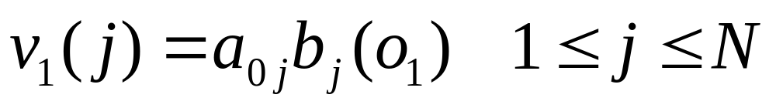
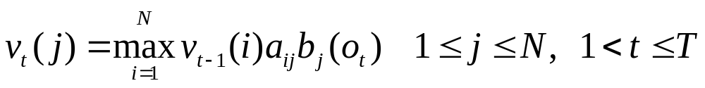
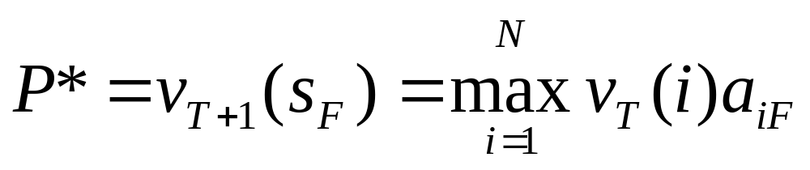
Computing the Viterbi Scores
Initialization
Recursion
Termination
Analogous to Forward algorithm except take max instead of sum

Slide 93
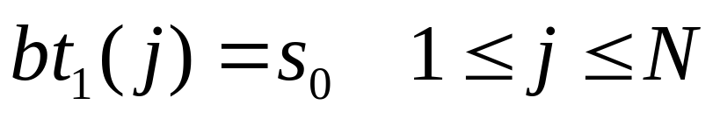
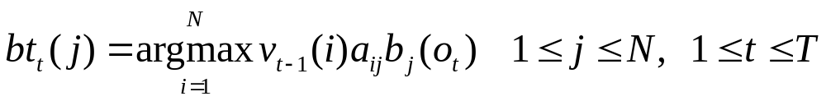
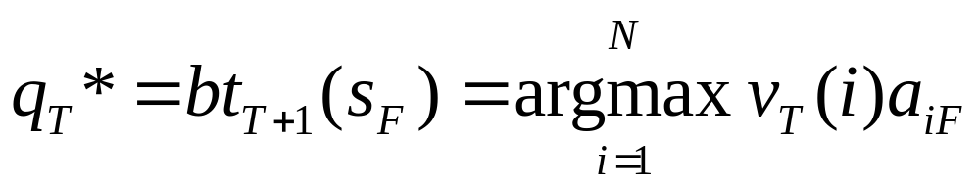
Computing the Viterbi Backpointers
Initialization
Recursion
Termination
Final state in the most probable state sequence. Follow
backpointers to initial state to construct full sequence.

Slide 94
Viterbi Backpointers
s₁
• • •
s₂
• • •
•
•
•
•
•
•
•
•
•
•
•
•
•
•
•
s₀
• • •
s_{F}
s_{N}
• • •
t₁
t₂
t₃
t_{T-1}
t_{T}

Slide 95
Viterbi Backtrace
s₁
• • •
s₂
• • •
•
•
•
•
•
•
•
•
•
•
•
•
•
•
•
s₀
• • •
s_{F}
s_{N}
• • •
t₁
t₂
t₃
t_{T-1}
t_{T}
Most likely Sequence: s₀ s_{N} s₁ s₂ …s₂ s_{F}

Slide 96
HMM Learning
Supervised Learning: All training sequences are completely labeled (tagged).
Unsupervised Learning: All training sequences are unlabelled (but generally know the number of tags, i.e. states).
Semisupervised Learning: Some training sequences are labeled, most are unlabeled.

Slide 97
Supervised HMM Training
If training sequences are labeled (tagged) with the underlying state sequences that generated them, then the parameters, λ={A,B} can all be estimated directly.
Training Sequences
John ate the apple
A dog bit Mary
Mary hit the dog
John gave Mary the cat.
Supervised
HMM
Training
.
.
.
Det Noun PropNoun Verb

Slide 98
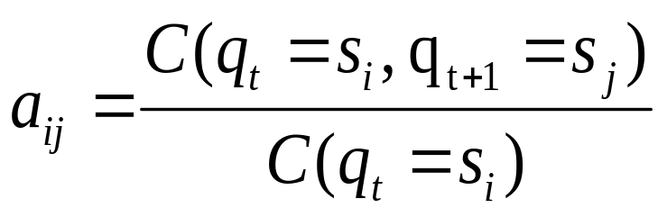
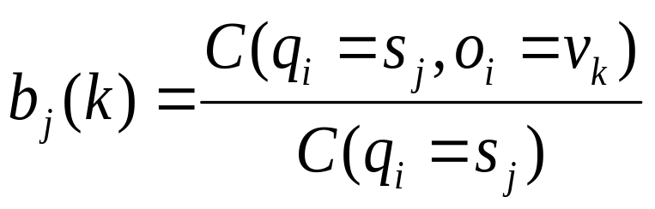
Supervised Parameter Estimation
Estimate state transition probabilities based on tag bigram and unigram statistics in the labeled data.
Estimate the observation probabilities based on tag/word co-occurrence statistics in the labeled data.
Use appropriate smoothing if training data is sparse.

Slide 99
Learning and Using HMM Taggers
Use a corpus of labeled sequence data to easily construct an HMM using supervised training.
Given a novel unlabeled test sequence to tag, use the Viterbi algorithm to predict the most likely (globally optimal) tag sequence.

Slide 100
Evaluating Taggers
Train on training set of labeled sequences.
Possibly tune parameters based on performance on a development set.
Measure accuracy on a disjoint test set.
Generally measure tagging accuracy, i.e. the percentage of tokens tagged correctly.
Accuracy of most modern POS taggers, including HMMs is 96−97% (for Penn tagset trained on about 800K words) .
  Generally matching human agreement level.

Slide 101
Unsupervised
Maximum Likelihood Training
Training Sequences
ah s t e n
a s t i n
oh s t u n
eh z t en
HMM
Training
.
.
.
Austin

Slide 102
Maximum Likelihood Training
Given an observation sequence, O, what set of parameters, λ, for a given model maximizes the probability that this data was generated from this model (P(O| λ))?
Used to train an HMM model and properly induce its parameters from a set of training data.
Only need to have an unannotated observation sequence (or set of sequences) generated from the model. Does not need to know the correct state sequence(s) for the observation sequence(s). In this sense, it is unsupervised.

Slide 103
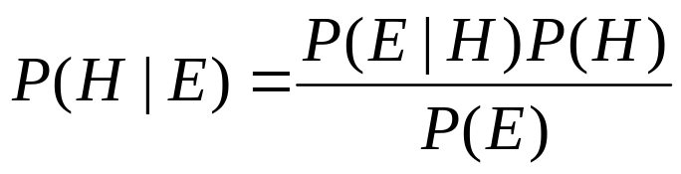
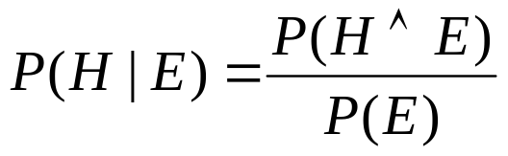
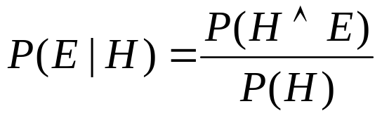

Bayes Theorem
Simple proof from definition of conditional probability:
(Def. cond. prob.)
(Def. cond. prob.)
QED:

Slide 104
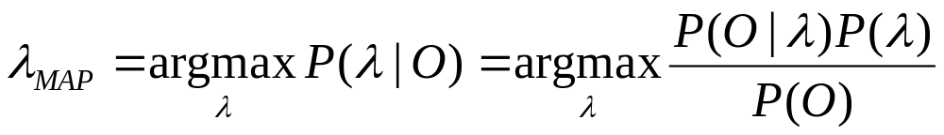
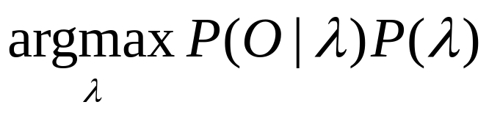
Maximum Likelihood vs.
Maximum A Posteriori (MAP)
The MAP parameter estimate is the most likely given the observed data, O.
If all parameterizations are assumed to be equally likely a priori, then MLE and MAP are the same.
If parameters are given priors (e.g. Gaussian or Lapacian with zero mean), then MAP is a principled way to perform smoothing or regularization.

Slide 105
HMM: Maximum Likelihood Training
Efficient Solution
There is no known efficient algorithm for finding the parameters, λ, that truly maximizes P(O| λ).
However, using iterative re-estimation, the Baum-Welch algorithm (a.k.a. forward-backward) , a version of a standard statistical procedure called Expectation Maximization (EM), is able to locally maximize P(O| λ).
In practice, EM is able to find a good set of parameters that provide a good fit to the training data in many cases.

Slide 106
EM Algorithm
Iterative method for learning probabilistic categorization model from unsupervised data.
Initially assume random assignment of examples to categories.
Learn an initial probabilistic model by estimating model parameters θ from this randomly labeled data.
Iterate following two steps until convergence:
  Expectation (E-step): Compute P(c_{i} | E) for each example given the current model, and probabilistically re-label the examples based on these posterior probability estimates.
  Maximization (M-step): Re-estimate the model parameters, θ, from the probabilistically re-labeled data.

Slide 107
EM
Initialize:
Assign random probabilistic labels to unlabeled data
Unlabeled Examples
+
−
+
−
+
−
+
−
+
−

Slide 108
EM
Initialize:
Give soft-labeled training data to a probabilistic learner
+
−
+
−
Prob. Learner
+
−
+
−
+
−

Slide 109
EM
Initialize:
Produce a probabilistic classifier
+
−
+
−
Prob. Learner
Prob.
Classifier
+
−
+
−
+
−

Slide 110
EM
E Step:
Relabel unlabled data using the trained classifier
+
−
Prob. Learner
Prob.
Classifier
+
−
+
−
+
−
+
−

Slide 111
EM
M step:
Retrain classifier on relabeled data
+
−
Prob. Learner
Prob.
Classifier
+
−
+
−
+
−
+
−
Continue EM iterations until probabilistic labels on unlabeled data converge.

Slide 112
Sketch of Baum-Welch (EM) Algorithm for Training HMMs
Assume an HMM with N states.
Randomly set its parameters λ=(A,B)
(making sure they represent legal distributions)
Until converge (i.e. λ no longer changes) do:
E Step: Use the forward/backward procedure to
determine the probability of various possible
state sequences for generating the training data
M Step: Use these probability estimates to
re-estimate values for all of the parameters λ

Slide 113
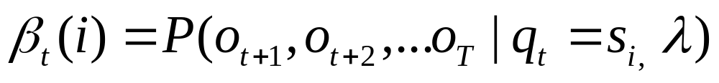
Backward Probabilities
Let β_{t}(i) be the probability of observing the final set of observations from time t+1 to T given that one is in state i at time t.

Slide 114
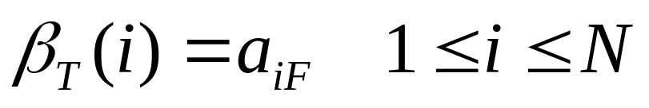
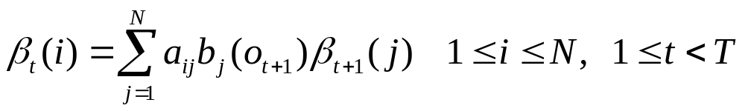
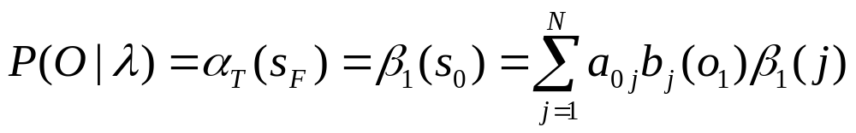
Computing the Backward Probabilities
Initialization
Recursion
Termination

Slide 115
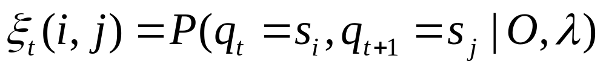
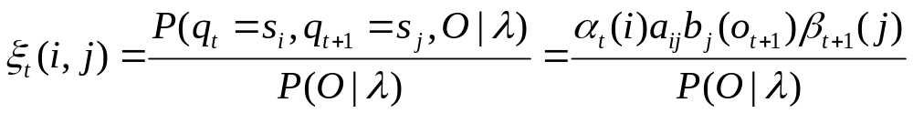
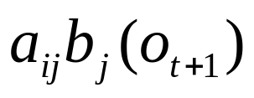


Estimating Probability of State Transitions
Let ξ_{t}(i,j) be the probability of being in state i at time t and state j at time t + 1
s₁
a_{1i}
a_{j1}
s₁
s₂
a_{2i}
a_{j2}
s₂
•
•
•
a_{3i}
a_{j3}
•
•
•
s_{i}
s_{j}
a_{Ni}
a_{jN}
s_{N}
s_{N}
t-1
t
t+1
t+2

Slide 116
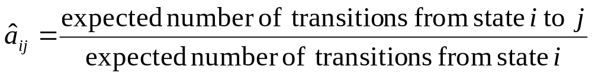
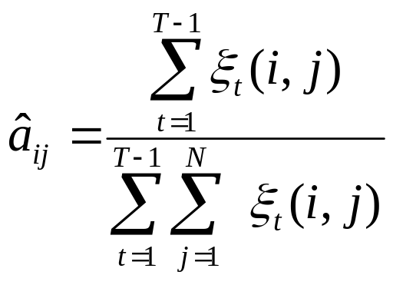
Re-estimating A

Slide 117
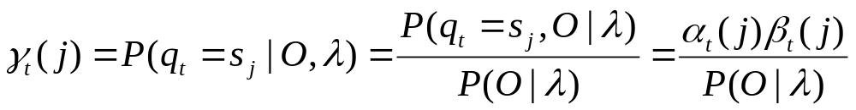
Estimating Observation Probabilities
Let γ_{t}(i) be the probability of being in state i at time t given the observations and the model.

Slide 118
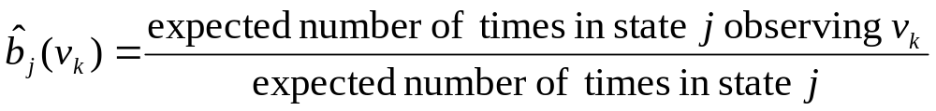
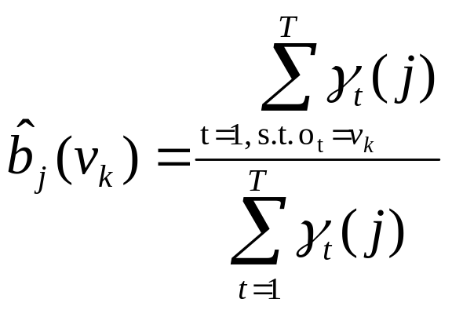
Re-estimating B

Slide 119
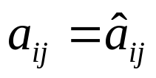
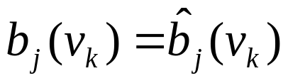
Pseudocode for Baum-Welch (EM) Algorithm for Training HMMs
Assume an HMM with N states.
Randomly set its parameters λ=(A,B)
(making sure they represent legal distributions)
Until converge (i.e. λ no longer changes) do:
E Step:
Compute values for γ_{t}(j) and ξ_{t}(i,j) using current
values for parameters A and B.
M Step:
Re-estimate parameters:

Slide 120
EM Properties
Each iteration changes the parameters in a way that is guaranteed to increase the likelihood of the data: P(O|λ).
Anytime algorithm: Can stop at any time prior to convergence to get approximate solution.
Converges to a local maximum.

Slide 121
Semi-Supervised Learning
EM algorithms can be trained with a mix of labeled and unlabeled data.
EM basically predicts a probabilistic (soft) labeling of the instances and then iteratively retrains using supervised learning on these predicted labels (“self training”).
EM can also exploit supervised data:
  1) Use supervised learning on labeled data to initialize the parameters (instead of initializing them randomly).
  2) Use known labels for supervised data instead of predicting soft labels for these examples during retraining iterations.

Slide 122
Semi-Supervised EM
Training Examples
Unlabeled Examples
+
+
−
-
Prob. Learner
Prob.
Classifier
+
−
-
+
−
+
+
−
+
+
−

Slide 123
Semi-Supervised EM
Training Examples
+
+
−
-
Prob. Learner
Prob.
Classifier
+
−
-
+
−
+
+
−
+
+
−

Slide 124
Semi-Supervised EM
Training Examples
+
-
Prob. Learner
Prob.
Classifier
-
+
+
+
−
+
−
+
−
+
−
+
−

Slide 125
Semi-Supervised EM
Training Examples
Unlabeled Examples
+
+
−
-
Prob. Learner
Prob.
Classifier
+
−
-
+
−
+
+
−
+
+
−

Slide 126
Semi-Supervised EM
Training Examples
+
+
−
-
Prob. Learner
Prob.
Classifier
+
−
-
+
−
+
+
−
+
+
−
Continue retraining iterations until probabilistic labels on unlabeled data converge.

Slide 127
Semi-Supervised Results
Use of additional unlabeled data improves on supervised learning when amount of labeled data is very small and amount of unlabeled data is large.
Can degrade performance when there is sufficient labeled data to learn a decent model and when unsupervised learning tends to create labels that are incompatible with the desired ones.
  There are negative results for semi-supervised POS tagging since unsupervised learning tends to learn semantic labels (e.g. eating verbs, animate nouns) that are better at predicting the data than purely syntactic labels (e.g. verb, noun).

Slide 128
Conclusions
POS Tagging is the lowest level of syntactic analysis.
It is an instance of sequence labeling, a collective classification task that also has applications in information extraction, phrase chunking, semantic role labeling, and bioinformatics.
HMMs are a standard generative probabilistic model for sequence labeling that allows for efficiently computing the globally most probable sequence of labels and supports supervised, unsupervised and semi-supervised learning.

