Slide 1
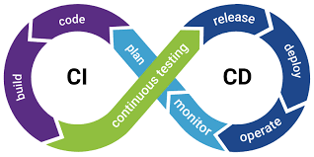


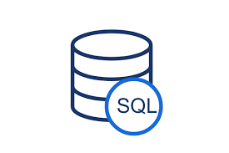










Sources
RAW DataLake
Flights
Cleansed and Mart
Publish
Plane
Azure Data Factory
Airport
Cancellation
Azure DataBricks
Airlines
Airlines
Unique_Carriers

