Slide 1

Covid-19 Vaccine Analysis
Project 1, Group 1
Dalton Curtis
Ulises Dominguez
Patricia Sarco Lira
Joseph Mills Jr.

Slide 2
Determine the safety of COVID19 vaccine by analyzing deaths from VAERS.
OBJECTIVE:
Group 1 attempted to answer the following questions:
What is the mortality rate by State?
Is there a relationship between the vaccine manufacturer and mortality?
Does biological gender have an impact on mortality rate?
Does patient age impact vaccine related death?

Slide 3
Methodology
Merging
Cleaning
Exploration + Analysis
Merged 2 Datasets on VAERS ID.
Merged 3rd Dataset to include demographic information.
Dropped NA/NAN values.
Dropped columns outside scope of project.
Qualitatively determined (and dropped) outliers.
Filtered by Vaccine Manufacturer.
Formulated questions to ask of the dataset.
Performed statistical analyses.
Generated output images.

Slide 4

Data Sources
Data is publicly available from the Center for Disease Control and Prevention (CDC) through the Vaccine Adverse Event Reporting System (VAERS).
Data was acquired from the CDC website links below.
Sources: https://www.cdc.gov/coronavirus/2019-ncov/vaccines/distributing/about-vaccine-data.html, https://www.cdc.gov/vaccinesafety/ensuringsafety/monitoring/vaers/index.html

Slide 5
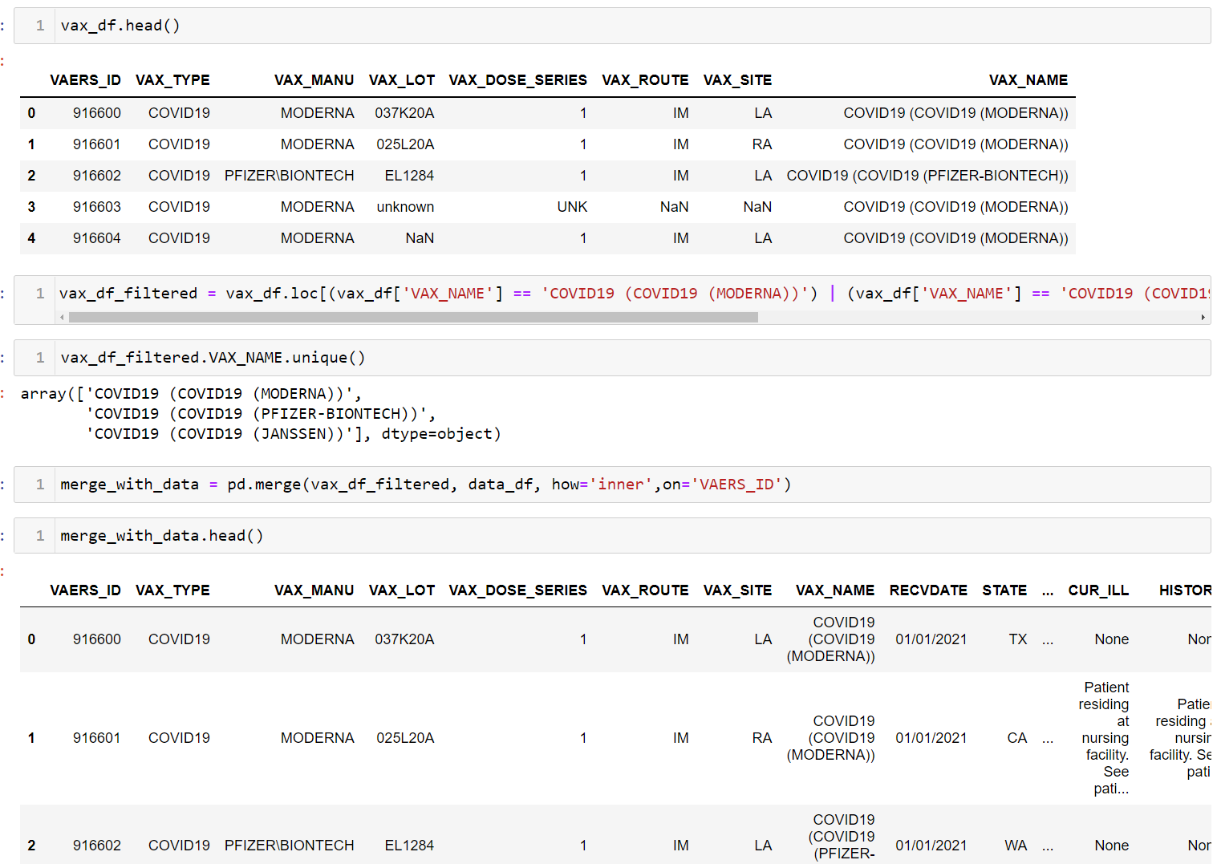
Example of Cleaning Merging Jupyter Notebook
Sources: https://www.cdc.gov/coronavirus/2019-ncov/vaccines/distributing/about-vaccine-data.html, https://www.cdc.gov/vaccinesafety/ensuringsafety/monitoring/vaers/index.html

Slide 6
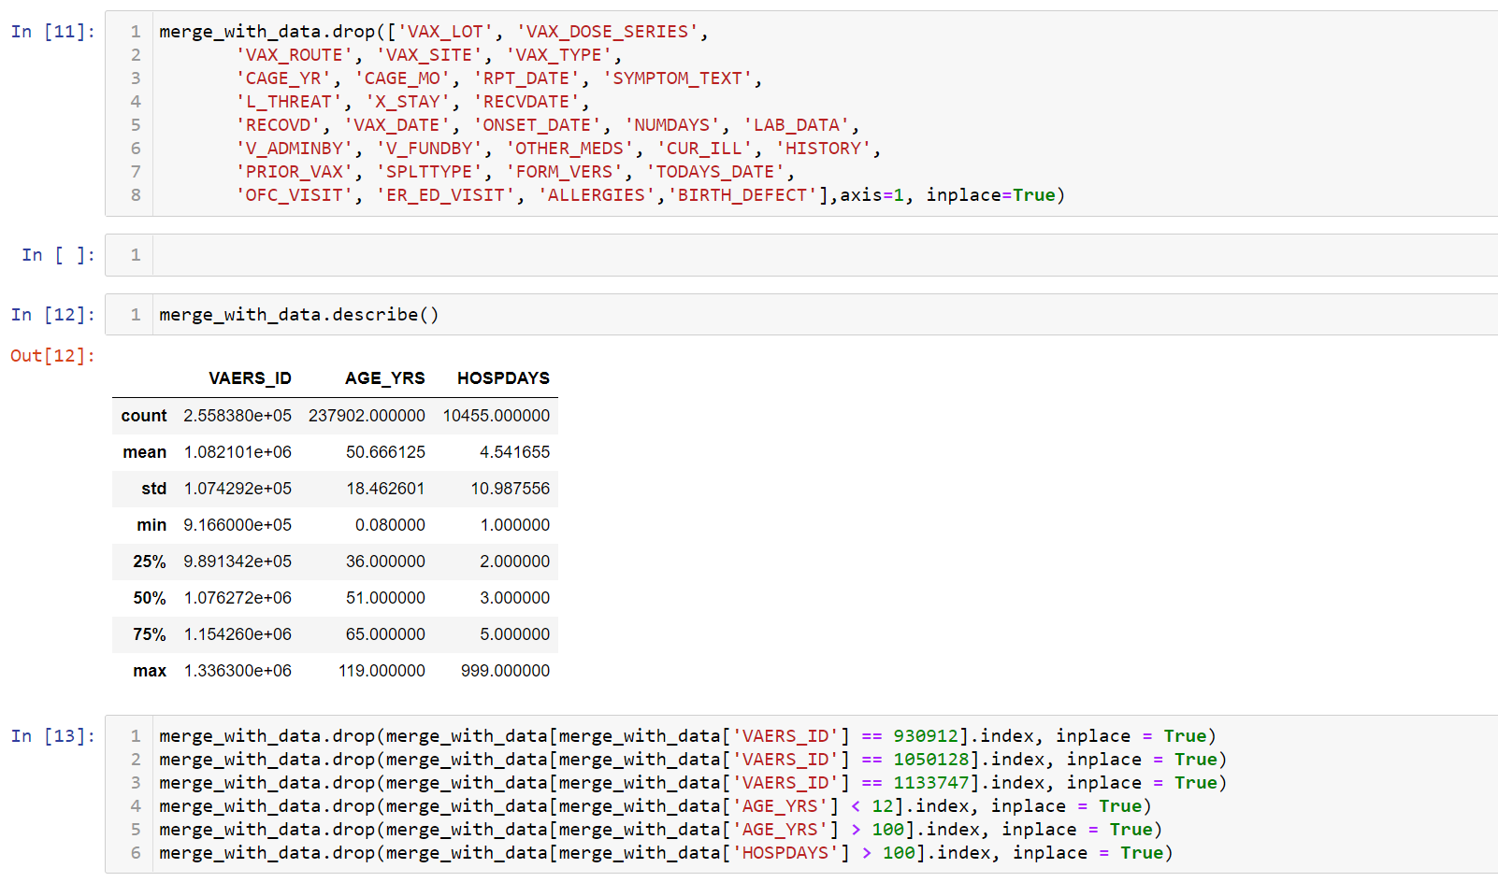
Example of Analysis Jupyter Notebook
Sources: https://www.cdc.gov/coronavirus/2019-ncov/vaccines/distributing/about-vaccine-data.html, https://www.cdc.gov/vaccinesafety/ensuringsafety/monitoring/vaers/index.html

Slide 7
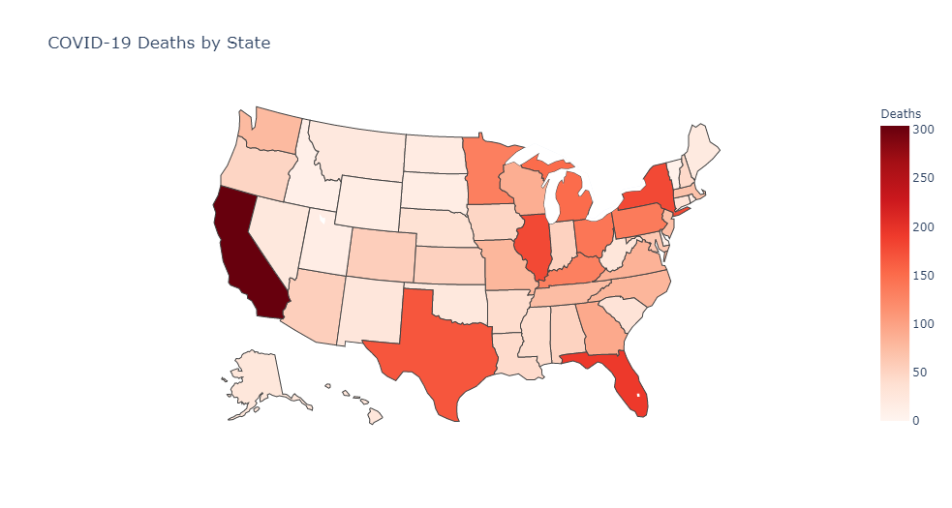
What is the Total Number of Vaccine Related Deaths by State?
Notes:
We created a map to easily visualize the number of vaccine-related deaths across each state in the US using a library called plotly.graph_objects
Unsurprisingly, these figures are the highest in states with the largest populations
California: 304 deaths, Florida: 192 deaths, Illinois and NY: 179 deaths each and Texas: 168 deaths
But do these states have the highest mortality rate? Let’s see...

Slide 8
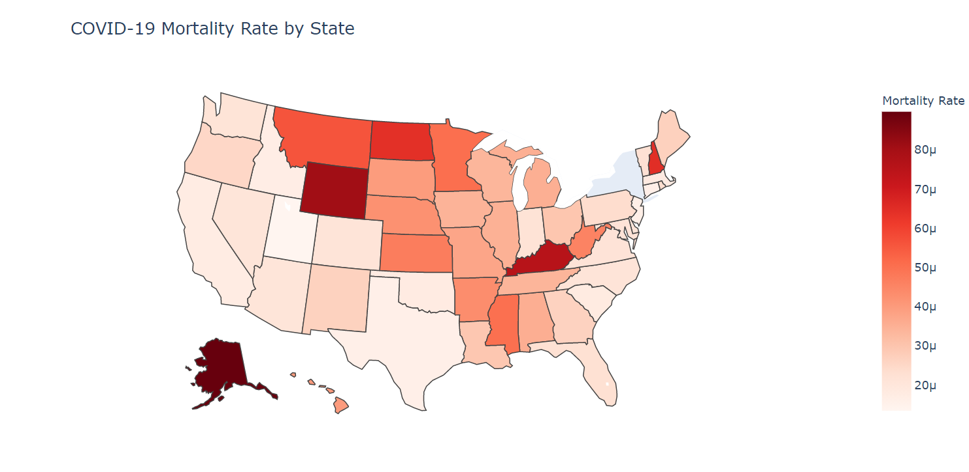
What is the Mortality Rate by State (normalized)?
Total number of people fully vaccinated in NY was not available in the CDC dataset, and hence, could not be normalized
Notes:
Despite having the highest numbers of deaths, those previous states don’t have the highest mortality rates, here we can see that Alaska has the highest mortality rate
With only 26 deaths, the mortality rate in Alaska is 0.00009 which means that 9 out of 100,000 people die after being fully vaccinated; followed by Wyoming and Kentucky with a rate of 0.00008, then New Hampshire and North Dakota with a rate of 0.00006
This is why normalizing the data is very important, in this case it help us understand the number of deaths out of the total number of fully vaccinated people instead of considering only the deaths by state
Data for New York was not included in the dataset (total number of people fully vaccinated in NY was not available in the CDC dataset, and hence, could not be normalized)

Slide 9
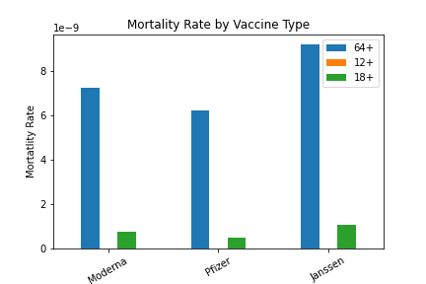
Is there a relationship between the vaccine manufacturer and mortality?
Notes:
3 bins were created for examining age related mortality, 12-18 years old, 18 to 65 years old, and 65 to 100 years old, corresponding to the cohorts the CDC tracks. Vaccine mortality was statistically insignificant in the under 18 bin and minimal in the 18-65 bin. The bulk of mortality observed for all 3 vaccines was observed in patients older than 65.

Slide 10
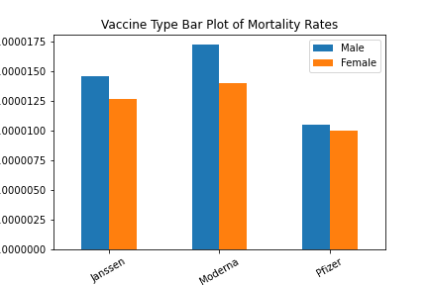
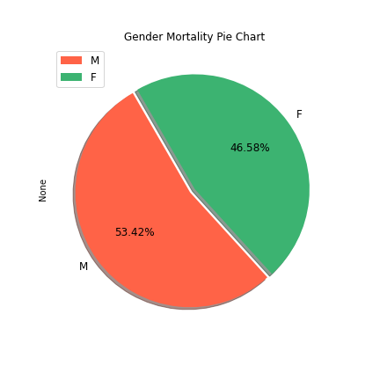
Does Gender have an impact on mortality rate?
47%
53%
Notes:
Merging datasets available from the CDC, we plotted the mortality rate for biological genders male/female for Janssen (J&J), Moderna, and Pfizer vaccines. All 3 manufacturers had statistically minimal adverse reactions resulting in death, with Pfizer being least associated with mortality and, somewhat surprisingly, the J&J vaccine having a lower mortality rate than the Moderna. Recall that both Pfizer and Moderna vaccines use and MRNA mechanism to induce an immune system response in patients while J&J uses an adenovirus vector.

Slide 11
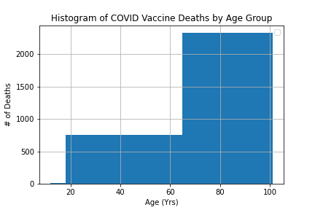
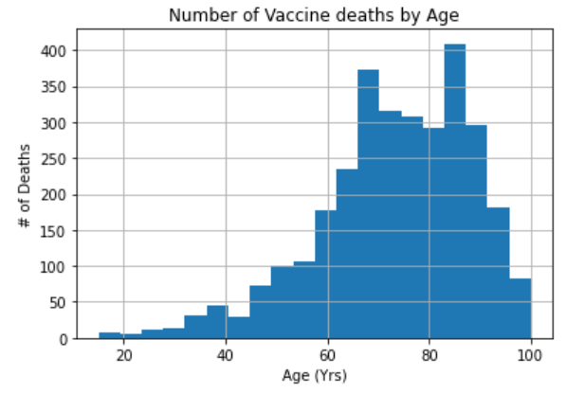
As Age Increases so do the Amount of Deaths
Notes:
We also created a histogram for the 3 age bins.

Slide 12
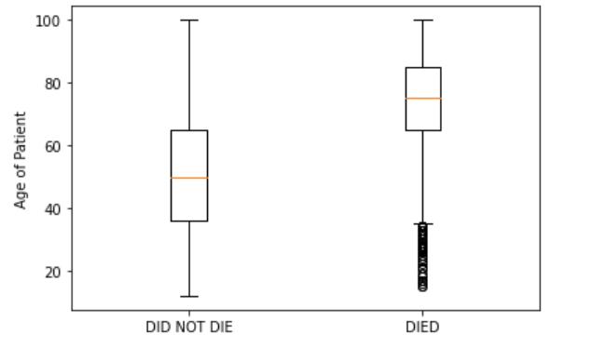
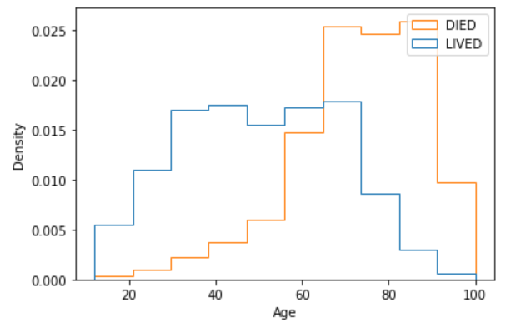
Hypothesis Testing – Those Who Died were Older
H0: The average age for those who died and did not die are equal.
H1: The average age for those who died are not equal.
t-stat: 32.7, p : 3.9e-187
Note* This analysis assumes that all age groups were vaccinated at the same rate.

Slide 13
Key Points and Takeaways
Pfizer vaccine seems to be the safest vaccine in regard to mortality rate
Females on average are less likely to die than men from vaccine
Age is statistically significant assuming all age groups were vaccinated equally.
Any Questions?

