Slide 1
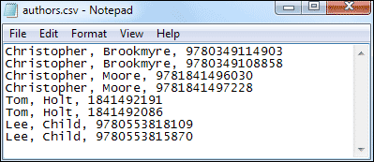
Text and CSV files
Text and CSV files are quite common and frequently data engineers and data scientists received text and CSV files to work upon.

Slide 2
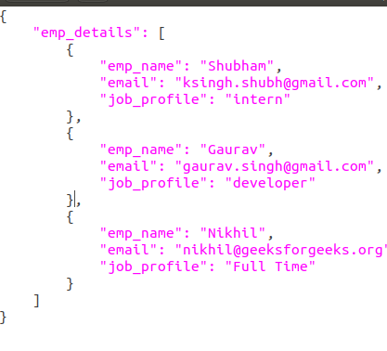
JSON Records
JSON records contain JSON files where each line is its own JSON datum. In the case of JSON files.

Slide 3
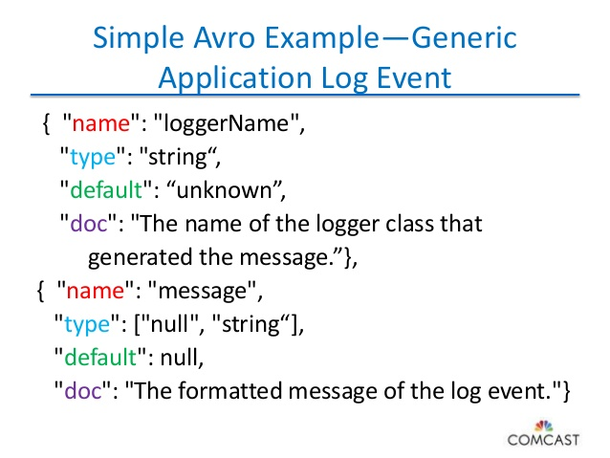
AVRO Files
Avro is quickly becoming the top choice for the developers due to its multiple benefits. Avro stores metadata with the data itself and allows specification of an independent schema for reading the file.

Slide 4
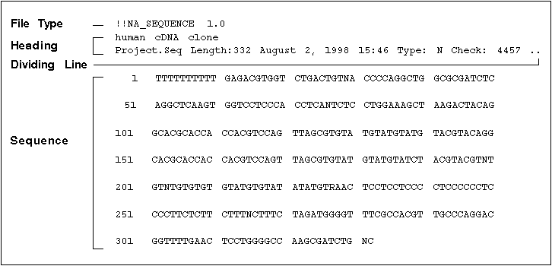
Sequence File
Sequence file stores data in binary format and has a similar structure to CSV file with some differences.

Slide 5
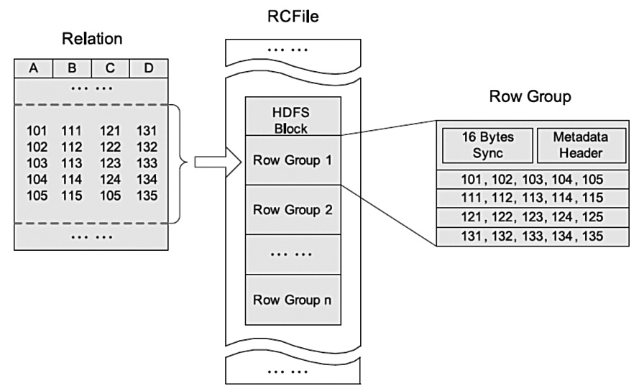
RC File (Record Columnar Files)
RC file was the first columnar file in Hadoop and query performance benefits.

Slide 6
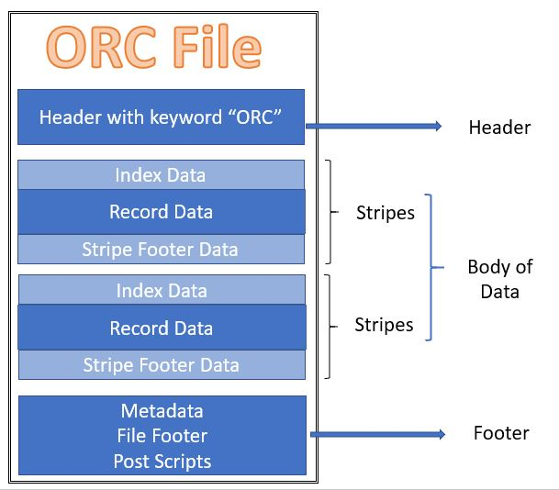
ORC File (Optimized RC Files)
ORC is the compressed version of RC file and supports all the benefits of RC file with some enhancements like ORC files compress better than RC files, enabling faster queries.

Slide 7
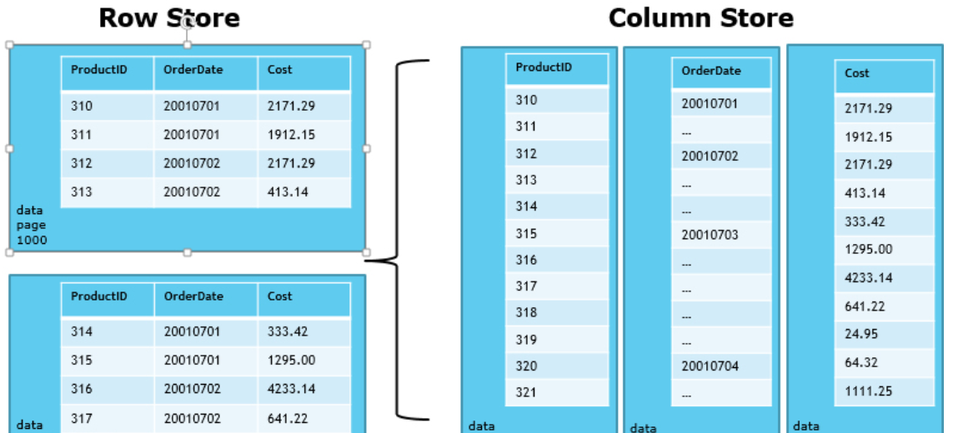
Parquet Files
Parquet file is another columnar file given by Hadoop founder Doug Cutting during his Trevni project Like another Columnar file RC & ORC, Parquet also enjoys the features like compression and query performance benefits but is generally slower to write than non-columnar file formats.

