Slide 1
Fundamentals of Data Visualization for Education
2021 US Conference on Teaching Statistics
June 30, 2021
Silas Bergen
Chris Malone
Jerzy Wieczorek

Slide 2
Part 2: Using Gestalt principles to help students design effective graphs
Because not all grammatical specifications are equal

Slide 3
Find the fives
6
3
1
2
1
9
5
3
2
8
5
5
7
5
5
4
9
5
5
4
3
6
5
3
9
4
3
5
8
2
2
1
5
7
4
3
1
5
5
7
6
5
9
8
4
2
4

Slide 4
Find the fives
6
3
1
2
1
9
5
3
2
8
5
5
7
5
5
4
9
5
5
4
3
6
5
3
9
4
3
5
8
2
2
1
5
7
4
3
1
5
5
7
6
5
9
8
4
2
4
Inspired by Fig 6.2, The Functional Art by Alberto Cairo

Slide 5
gestalt = form or pattern
Gestalt philosophy: the whole is greater than the sum of the parts
Gestalt principles: predictable ways by which we organize sensory information
Developed by Max Wertheimer & followers; early 20th century

Slide 6

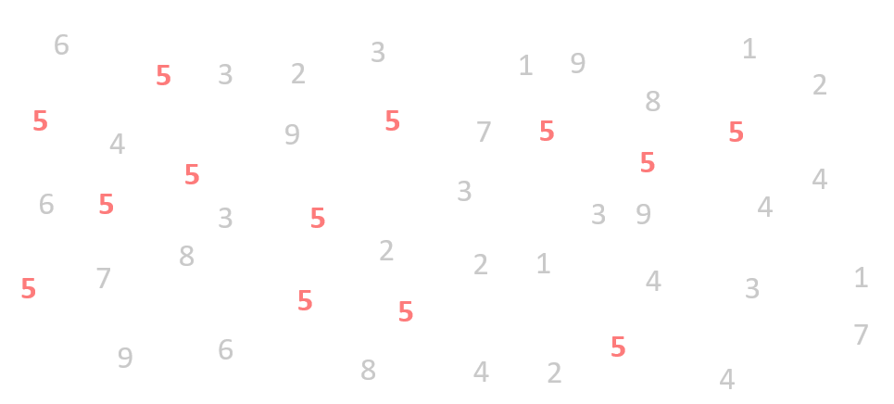
Figure and ground
Pittsburgh Zoo & PPG Aquarium logo

Slide 7
Similarity
Rows or columns?

Slide 8
Similarity
Rows or columns?

Slide 9
Proximity
Rows or columns?

Slide 10
Connection
Rows or columns?

Slide 11
Enclosure
Rows or columns?

Slide 12
Some principles are stronger than others

Slide 13
Rows or columns?

Slide 15
Notes:
Left/right
Within left: columns; within right: rows

Slide 16
Notes:
Left/right
Within left: columns; within right: rows

Slide 17
Gestalt hierarchy
Graphs
Tables
Enclosure
Connection
Proximity
Similarity
Facets
Lines
White space
Color/shape
Grids/cell shading
Rules
White space
Font properties

Slide 18
Implications for practice
1. Know how we perceive groups
2. Know that we perceive some groups before others
3. Design to facilitate and emphasize the most important comparisons
What are these??
Depends on the message!

Slide 19
Example: Hospital stays
Suppose a hospital launched an initiative to shorten hospital stays following surgeries.
Has the initiative worked?
Where is there most room for improvement?
Data:
 | Duration of stay (in hours)
Quarter | <=24 | 24 -36 | 36 - 48 | 48 - 59 | >=60 | Unknown
Q1 | 12.20% | 53.90% | 6.30% | 18.90% | 6.90% | 1.80%
Q2 | 14.30% | 58.30% | 4.10% | 16.70% | 5.90% | 0.70%
Q3 | 19.50% | 52.20% | 2.80% | 17.40% | 7.00% | 1.10%
Q4 | 25.40% | 50.30% | 2.70% | 14.40% | 5.60% | 1.70%
Source: https://community.storytellingwithdata.com/exercises/how-can-we-improve-this-graph
Knaflic, Cole. storytellingwithdata.com.

Slide 20
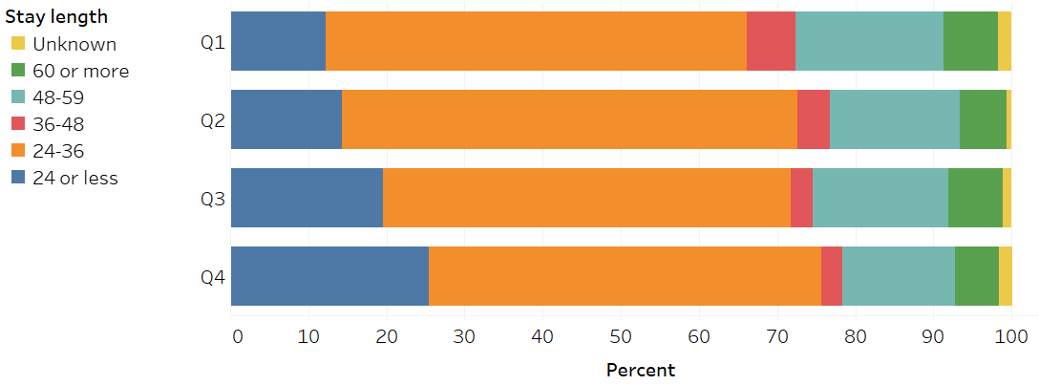
Take 1
Has the initiative worked?
Where is there most room for improvement?
Geom: Bar
Aesthetic mapping:
X: Percent
Y: Quarter
Color: Length Stay
Modifier: Stack

Slide 21
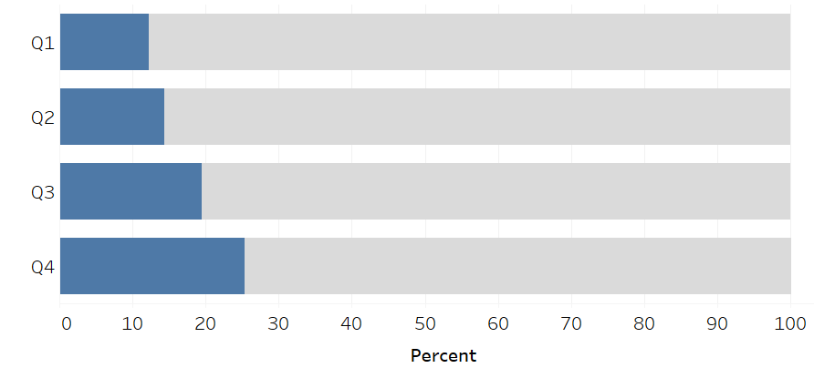
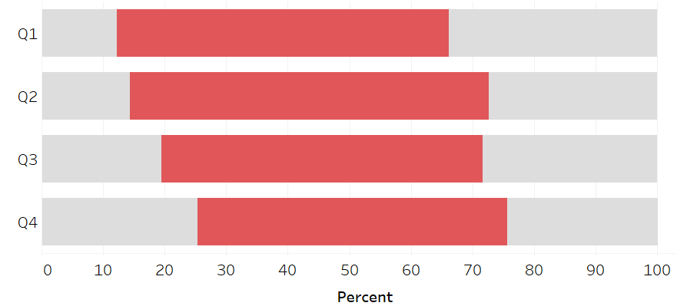

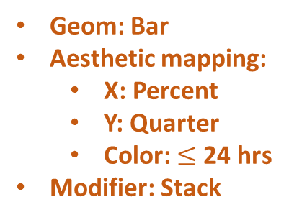
Take 2
Has the initiative worked?
Where is there most room for improvement?
The rate of stays $≤$ 24 hours has increased
In each quarter > 50% of stays are 24-36 hrs
Geom: Bar
Aesthetic mapping:
X: Percent
Y: Quarter
Color: $≤$ 24 hrs
Modifier: Stack
Geom: Bar
Aesthetic mapping:
X: Percent
Y: Quarter
Color: 24-36 hrs
Modifier: Stack

Slide 22
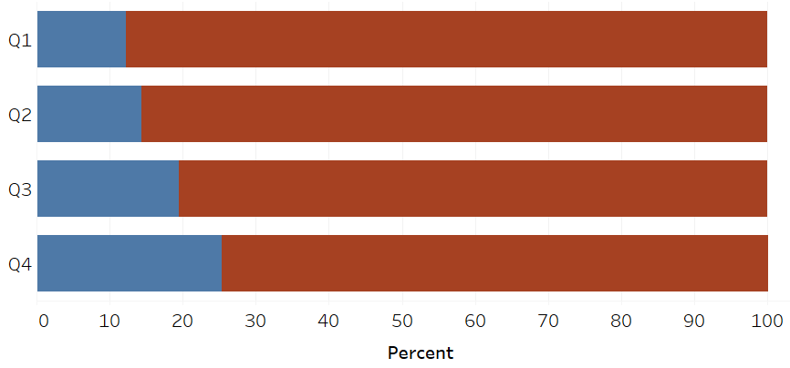


Which is a stronger design?
The rate of stays $≤$ 24 hours has increased
The rate of stays $≤$ 24 hours has increased

Slide 23

You must always begin with a clear sense of what belongs together, that is, what your readers should perceive as belonging to the same group because those units of information have something in common….
…It’s your job to make this grouping obvious to your readers. It shouldn’t be up to your readers to do the work of arranging the content into meaningful groups when you can do this in advance for them.
-Show me the numbers pg. 145.

Slide 24
What belongs together?
Define elemental groupings: an individual or small collection of data values where interest lies in comparing this individual or collection across levels of one or more grouping variable
Use Gestalt hierarchy to emphasize elemental groupings and facilitate important comparisons
Enclosure
Connection
Proximity
Similarity

Slide 25
Implications for practice
1. Know how we perceive groups
2. Know that we perceive some groups before others
3. Design to facilitate and emphasize the most important comparisons
Identify the elemental groupings
These depend on the message!

Slide 26
Case study
Stats consulting class data

Slide 27


Slide 28
79ºF
52ºF
Minutes since swim

Slide 29
loc | in_out | time | Avg temp
cheek | indoor | pre | 95.2
cheek | indoor | post1 | 84.3
cheek | indoor | post2 | 86.2
elbow | indoor | pre | 95.4
elbow | indoor | post1 | 89.1
elbow | indoor | post2 | 91.4
palm | indoor | pre | 91.7
palm | indoor | post1 | 84.1
palm | indoor | post2 | 89.3
pec | indoor | pre | 93.3
pec | indoor | post1 | 84.2
pec | indoor | post2 | 87.6
cheek | outdoor | pre | 76.0
cheek | outdoor | post1 | 53.0
cheek | outdoor | post2 | 61.6
elbow | outdoor | pre | 92.5
elbow | outdoor | post1 | 61.9
elbow | outdoor | post2 | 80.6
palm | outdoor | pre | 74.6
palm | outdoor | post1 | 48.6
palm | outdoor | post2 | 58.5
pec | outdoor | pre | 87.2
pec | outdoor | post1 | 52.9
pec | outdoor | post2 | 69.6
4 body locations
x 2 water temperatures
x 3 time points
= 24 body temperature averages
3 grouping variables

Slide 30
Client question:
Does the body temperature recovery as recorded at the four body points depend on water temperature?
Consultant questions:
What are the elemental groupings? (What belongs together?)
How do we design for effective emphasis?

Slide 31
Breakout rooms
loc | in_out | time | Avg temp
cheek | indoor | pre | 95.2
cheek | indoor | post1 | 84.3
cheek | indoor | post2 | 86.2
elbow | indoor | pre | 95.4
elbow | indoor | post1 | 89.1
elbow | indoor | post2 | 91.4
palm | indoor | pre | 91.7
palm | indoor | post1 | 84.1
palm | indoor | post2 | 89.3
pec | indoor | pre | 93.3
pec | indoor | post1 | 84.2
pec | indoor | post2 | 87.6
cheek | outdoor | pre | 76.0
cheek | outdoor | post1 | 53.0
cheek | outdoor | post2 | 61.6
elbow | outdoor | pre | 92.5
elbow | outdoor | post1 | 61.9
elbow | outdoor | post2 | 80.6
palm | outdoor | pre | 74.6
palm | outdoor | post1 | 48.6
palm | outdoor | post2 | 58.5
pec | outdoor | pre | 87.2
pec | outdoor | post1 | 52.9
pec | outdoor | post2 | 69.6
What are the elemental groupings?
Indicate via highlight/circle/etc.
Design a graph (or graphs) to answer client question:
Does the body temperature recovery as recorded at the four body points depend on water temperature?
Keep hierarchy of Gestalt principles in mind to effectively emphasize and compare the elemental groupings
What grammatical specification(s) are you using?

Slide 32
loc | in_out | time | Avg temp
cheek | indoor | pre | 95.2
cheek | indoor | post1 | 84.3
cheek | indoor | post2 | 86.2
elbow | indoor | pre | 95.4
elbow | indoor | post1 | 89.1
elbow | indoor | post2 | 91.4
palm | indoor | pre | 91.7
palm | indoor | post1 | 84.1
palm | indoor | post2 | 89.3
pec | indoor | pre | 93.3
pec | indoor | post1 | 84.2
pec | indoor | post2 | 87.6
cheek | outdoor | pre | 76.0
cheek | outdoor | post1 | 53.0
cheek | outdoor | post2 | 61.6
elbow | outdoor | pre | 92.5
elbow | outdoor | post1 | 61.9
elbow | outdoor | post2 | 80.6
palm | outdoor | pre | 74.6
palm | outdoor | post1 | 48.6
palm | outdoor | post2 | 58.5
pec | outdoor | pre | 87.2
pec | outdoor | post1 | 52.9
pec | outdoor | post2 | 69.6
What are the elemental groupings?
Does the body temperature recovery as recorded at the four body points depend on water temperature?

Slide 33
loc | in_out | time | Avg temp
elbow | indoor | pre | 95.4
elbow | indoor | post1 | 89.1
elbow | indoor | post2 | 91.4
palm | indoor | pre | 91.7
palm | indoor | post1 | 84.1
palm | indoor | post2 | 89.3
pec | indoor | pre | 93.3
pec | indoor | post1 | 84.2
pec | indoor | post2 | 87.6
elbow | outdoor | pre | 92.5
elbow | outdoor | post1 | 61.9
elbow | outdoor | post2 | 80.6
palm | outdoor | pre | 74.6
palm | outdoor | post1 | 48.6
palm | outdoor | post2 | 58.5
pec | outdoor | pre | 87.2
pec | outdoor | post1 | 52.9
pec | outdoor | post2 | 69.6
cheek | indoor | pre | 95.2
cheek | indoor | post1 | 84.3
cheek | indoor | post2 | 86.2
Which elemental groupings do we want to compare?
Does the body temperature recovery as recorded at the four body points depend on water temperature?
cheek | outdoor | pre | 76.0
cheek | outdoor | post1 | 53.0
cheek | outdoor | post2 | 61.6

Slide 34
loc | in_out | time | Avg temp
palm | indoor | pre | 91.7
palm | indoor | post1 | 84.1
palm | indoor | post2 | 89.3
pec | indoor | pre | 93.3
pec | indoor | post1 | 84.2
pec | indoor | post2 | 87.6
palm | outdoor | pre | 74.6
palm | outdoor | post1 | 48.6
palm | outdoor | post2 | 58.5
pec | outdoor | pre | 87.2
pec | outdoor | post1 | 52.9
pec | outdoor | post2 | 69.6
Which elemental groupings do we want to compare?
Does the body temperature recovery as recorded at the four body points depend on water temperature?
elbow | indoor | pre | 95.4
elbow | indoor | post1 | 89.1
elbow | indoor | post2 | 91.4
elbow | outdoor | pre | 92.5
elbow | outdoor | post1 | 61.9
elbow | outdoor | post2 | 80.6

Slide 35
loc | in_out | time | Avg temp
cheek | indoor | pre | 95.2
cheek | indoor | post1 | 84.3
cheek | indoor | post2 | 86.2
elbow | indoor | pre | 95.4
elbow | indoor | post1 | 89.1
elbow | indoor | post2 | 91.4
palm | indoor | pre | 91.7
palm | indoor | post1 | 84.1
palm | indoor | post2 | 89.3
pec | indoor | pre | 93.3
pec | indoor | post1 | 84.2
pec | indoor | post2 | 87.6
cheek | outdoor | pre | 76.0
cheek | outdoor | post1 | 53.0
cheek | outdoor | post2 | 61.6
elbow | outdoor | pre | 92.5
elbow | outdoor | post1 | 61.9
elbow | outdoor | post2 | 80.6
palm | outdoor | pre | 74.6
palm | outdoor | post1 | 48.6
palm | outdoor | post2 | 58.5
pec | outdoor | pre | 87.2
pec | outdoor | post1 | 52.9
pec | outdoor | post2 | 69.6
Single average
Time triplets
Swim location
Body location
Most elemental
Least elemental

Slide 36
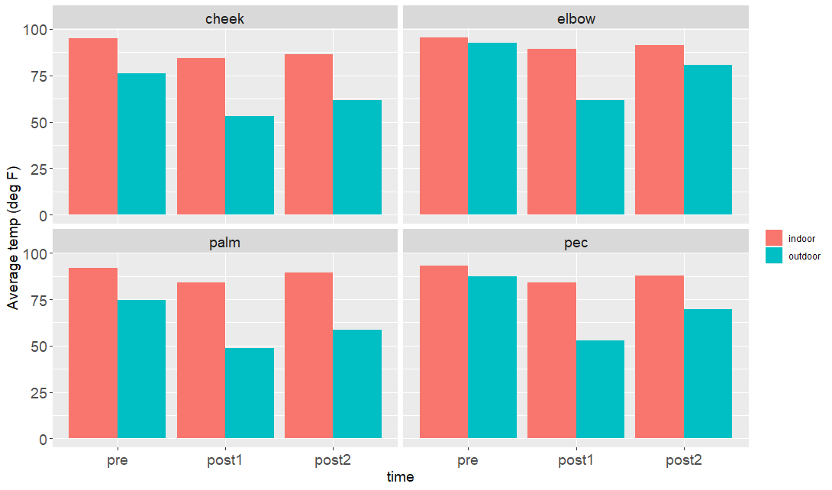
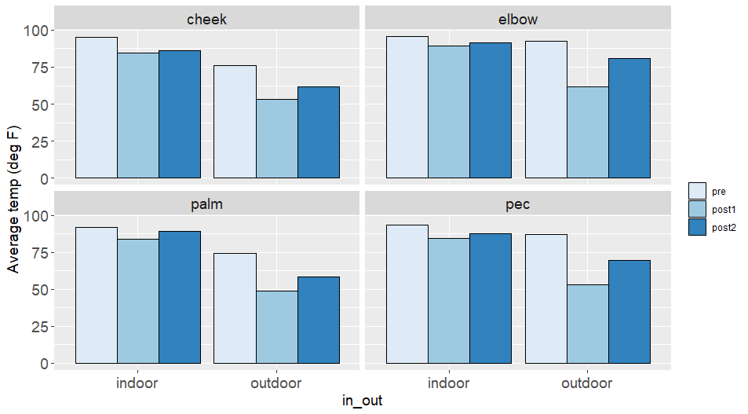
Some graphs
Geom: Bar
Aesthetic mapping:
X: Time
Y: Avg temp
Color: Twim loc
Facet: Body loc
Modifier: Dodge
Geom: Bar
Aesthetic mapping:
X: Swim loc
Y: Avg temp
Color: Time
Facet: Body loc
Modifier: Dodge

Slide 37
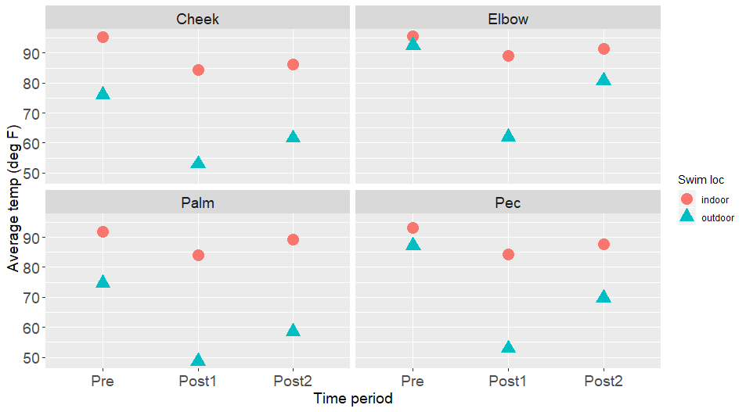
Some graphs
Geom: Point
Aesthetic mapping:
X: Time
Y: Avg temp
Color: Swim loc
Shape: Swim loc
Facet: Body loc

Slide 38
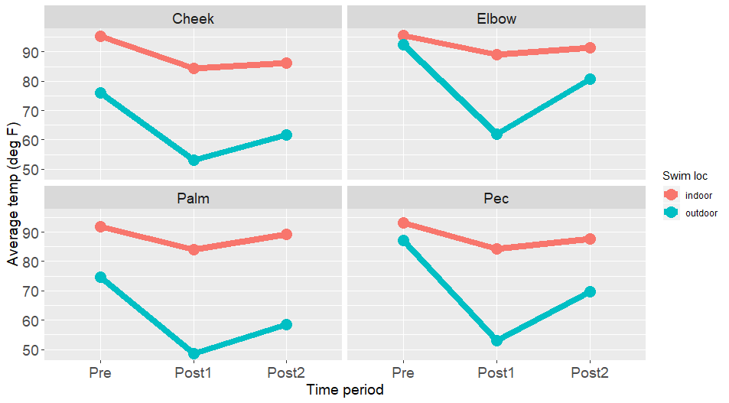
Some graphs
[Geom: Point
Aesthetic mapping:
X: Time
Y: Avg temp
Color: Swim loc
]
[Geom: Line
Aesthetic mapping:
X: Time
Y: Avg temp
Color: Swim loc
]
Facet: Body loc

Slide 39
Sources
Stephen Few. 2012. Show Me the Numbers: Designing Tables and Graphs to Enlighten. Analytics Press; Second edition, Burlingame, CA.
Deborah Nolan and James Perrett. 2016. Teaching and learning data visualization: Ideas and assignments. The American Statistician, 70(3):260-269.

