Slide 1

Trends and Patterns in Cancer Incidence Rates in Maine from 1999 to 2020: An Epidemiological Study
Olawale Olaniyan

Slide 2
Table of contents
01
03
02
04
Exploratory Data Analysis (EDA)
Comparative Analysis and Visualization
Trend Analysis Over Time
Confidence Intervals and Interpretation

Slide 3
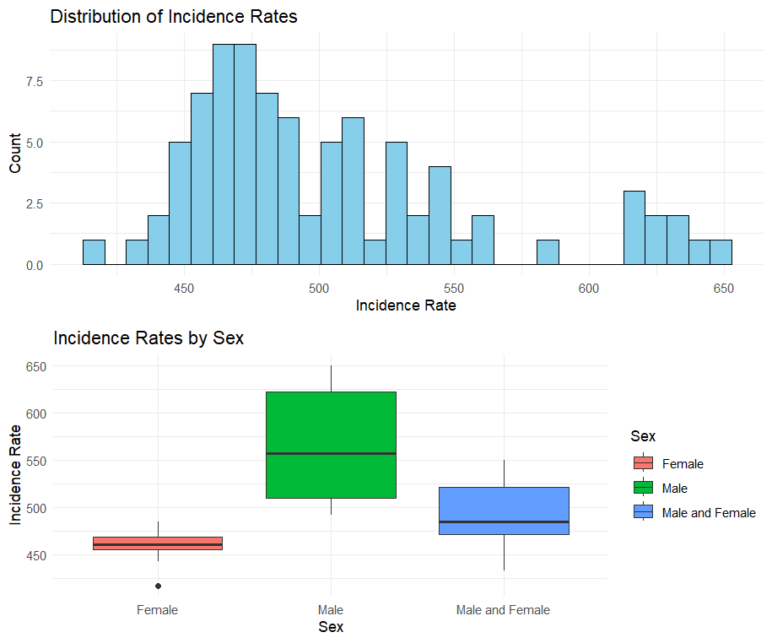
Exploratory Data Analysis
Overall Summary of Age-Adjusted Incidence Rate:
Min | 1st Qu. | Median | Mean | 3rd Qu. | Max.
417.6 | 464.6 | 485.3 | 503.6 | 529.4 | 649.9
Frequency of Counties:
All Counties | Others
69 | 16
Frequency of Sex categories:
Female | Male | Female and Male
23 | 23 | 39

Slide 4
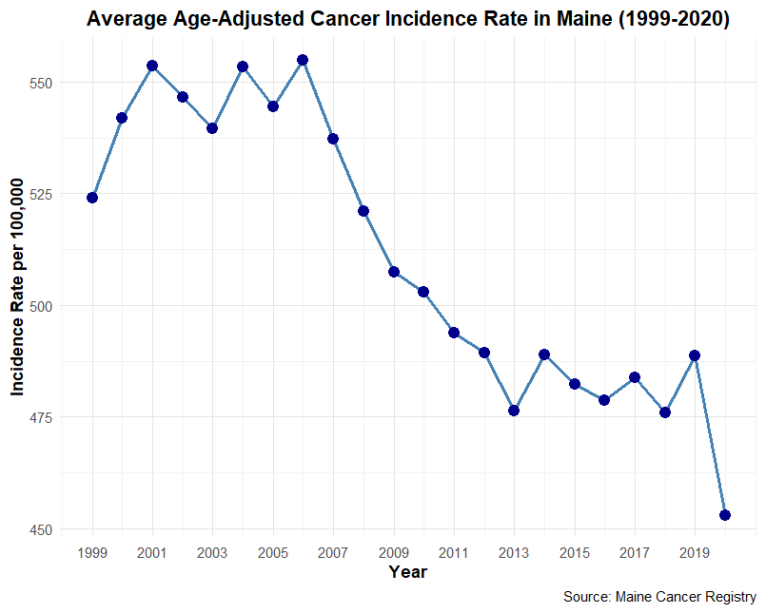
Trend Analysis Over Time
General upward trend observed in the early 2000s with a peak around 2006
Gradual decline until around 2013, then a slight increase again towards 2020
The implication of changes in incidence rates could be a result of geographic variations and demographic differences

Slide 5
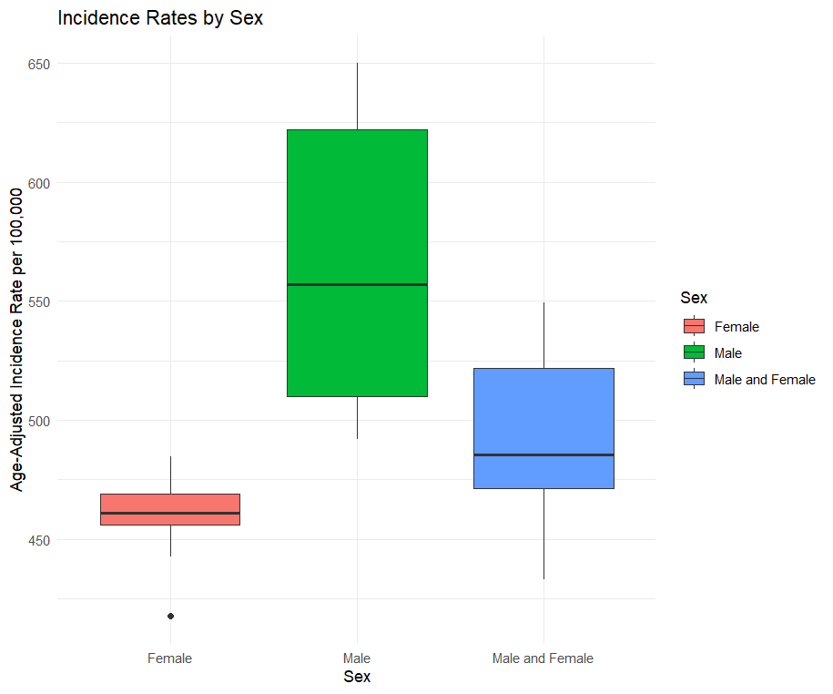
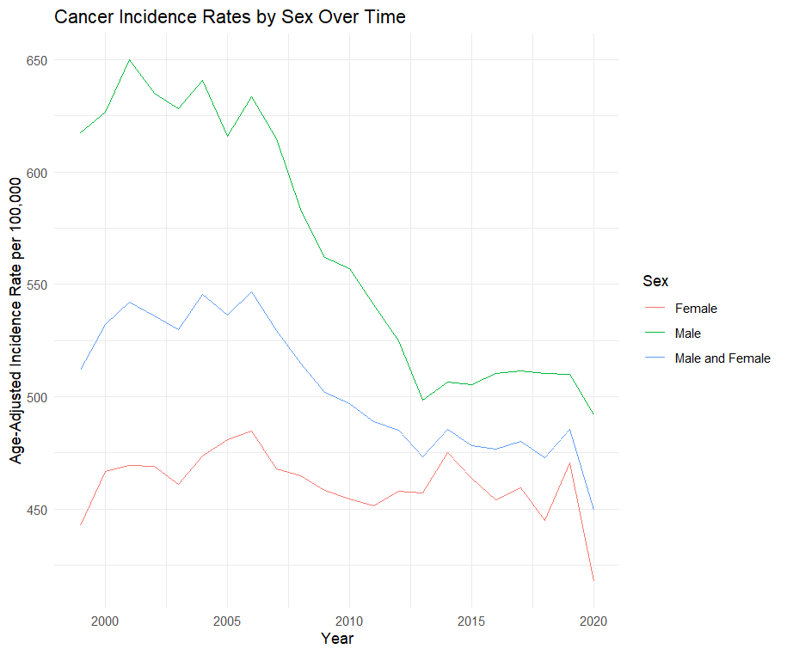
Comparative Analysis
Age-adjusted incidence rate by Sex

Slide 6
Summary Statistics for Confidence Intervals
The average range of the confidence intervals is approximately 31.2, with a median of 29.5. This indicates that on average, the confidence intervals are relatively narrow, suggesting a reasonable level of precision in the incidence rate estimates.
Mean CI Range: 31.2
Median CI Range: 29.5
Min CI Range: 9
Max CI Range: 85.5
The minimum range of 9 indicates that some estimates are very precise, while the maximum range of 85.5 suggests that there are instances where the estimates are less reliable. This variability can be due to lower case counts in certain years or cancer types.

Slide 7
Citation
U.S. Cancer Statistics Working Group. U.S. Cancer Statistics Data Visualizations Tool, based on 2022 submission data (1999-2020): U.S. Department of Health and Human Services, Centers for Disease Control and Prevention and National Cancer Institute; https://www.cdc.gov/cancer/dataviz, released in November 2023.

Slide 8
Thank You for Listening

