Slide 1

Retail Store Sales Analysis for 2011
Insights for CEO & CMO
Presented by: Shiva Sai Pradyumna Erroju

Slide 2
Data Cleaning & Preparation
Filtered out invalid quantities (Quantity >= 1)
Filtered out invalid prices (UnitPrice >= 0)
Calculated Revenue as UnitPrice * Quantity
Filled missing CustomerIDs with 'Unknown'
Exported cleaned data for Tableau analysis

Slide 3
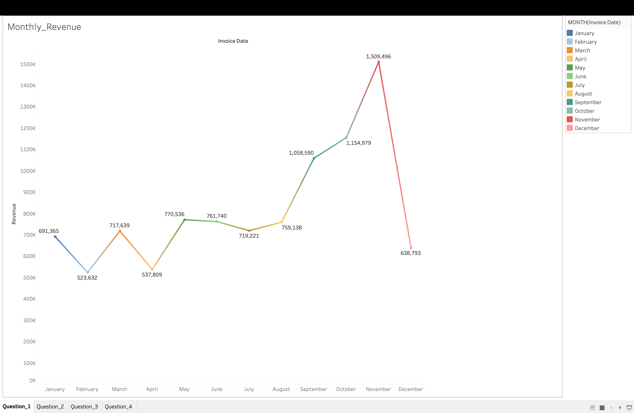
Monthly Revenue Trends (CEO Question 1)
Visualized revenue trends for each month in 2011
Identified seasonal peaks in March, May, September, and November
Insights aid in forecasting and marketing planning

Slide 4
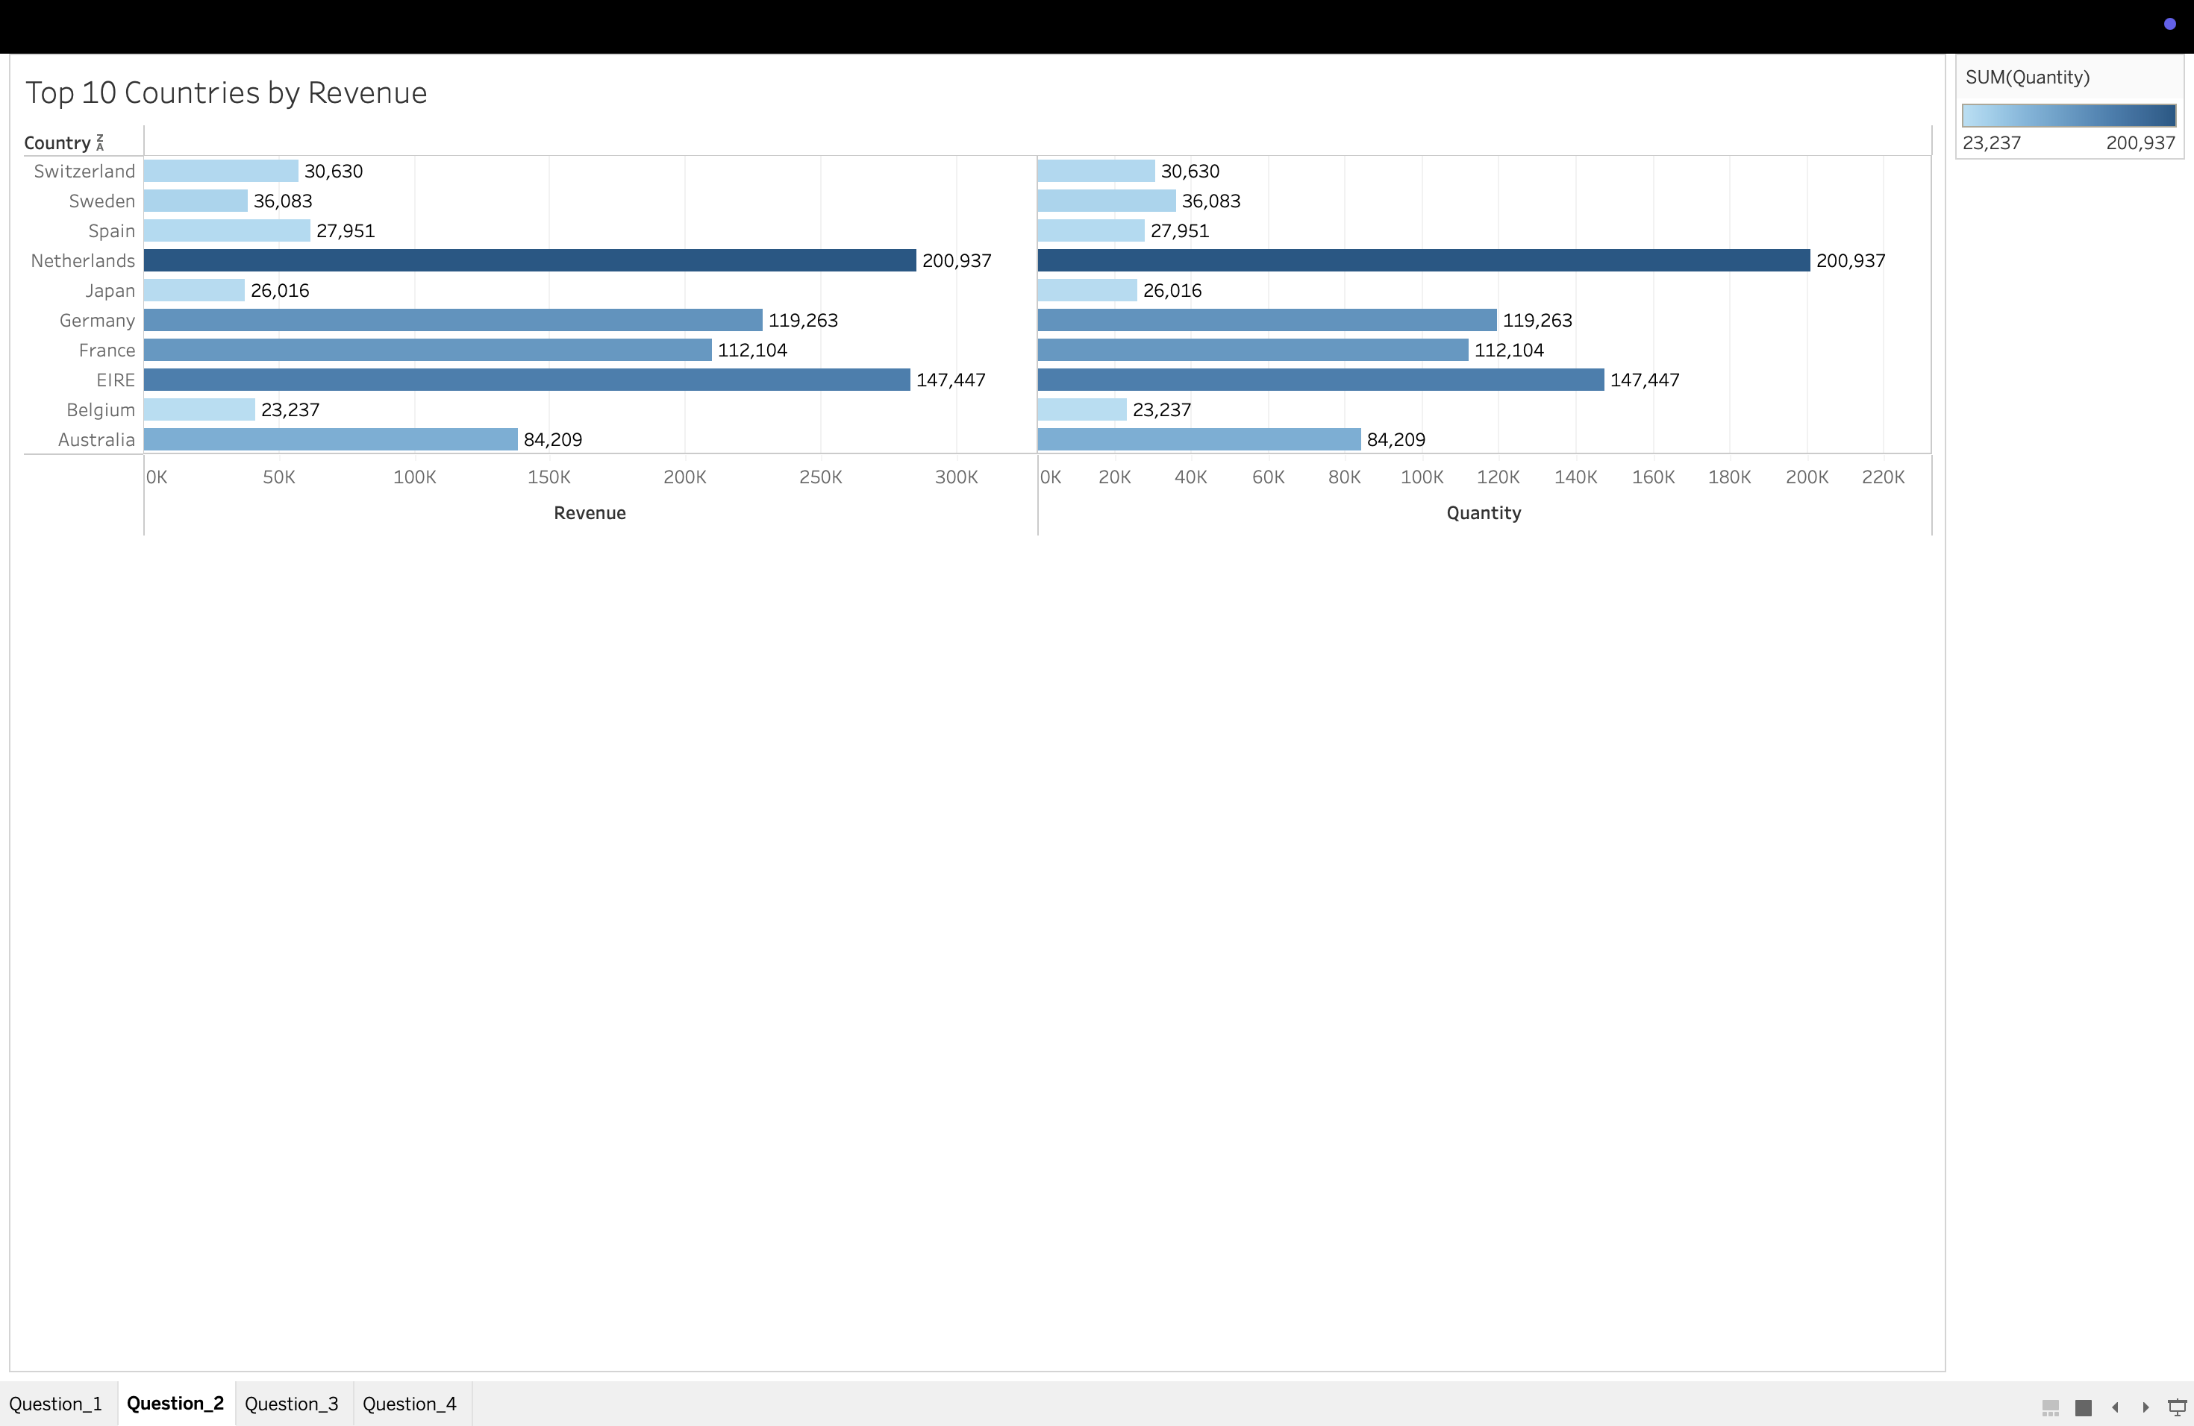
Top 10 Countries by Revenue (CMO Question 2)
Compared revenue and quantity sold excluding UK
Netherlands, Eire, Germany, and France lead in revenue
Highlights key markets for focused marketing

Slide 5
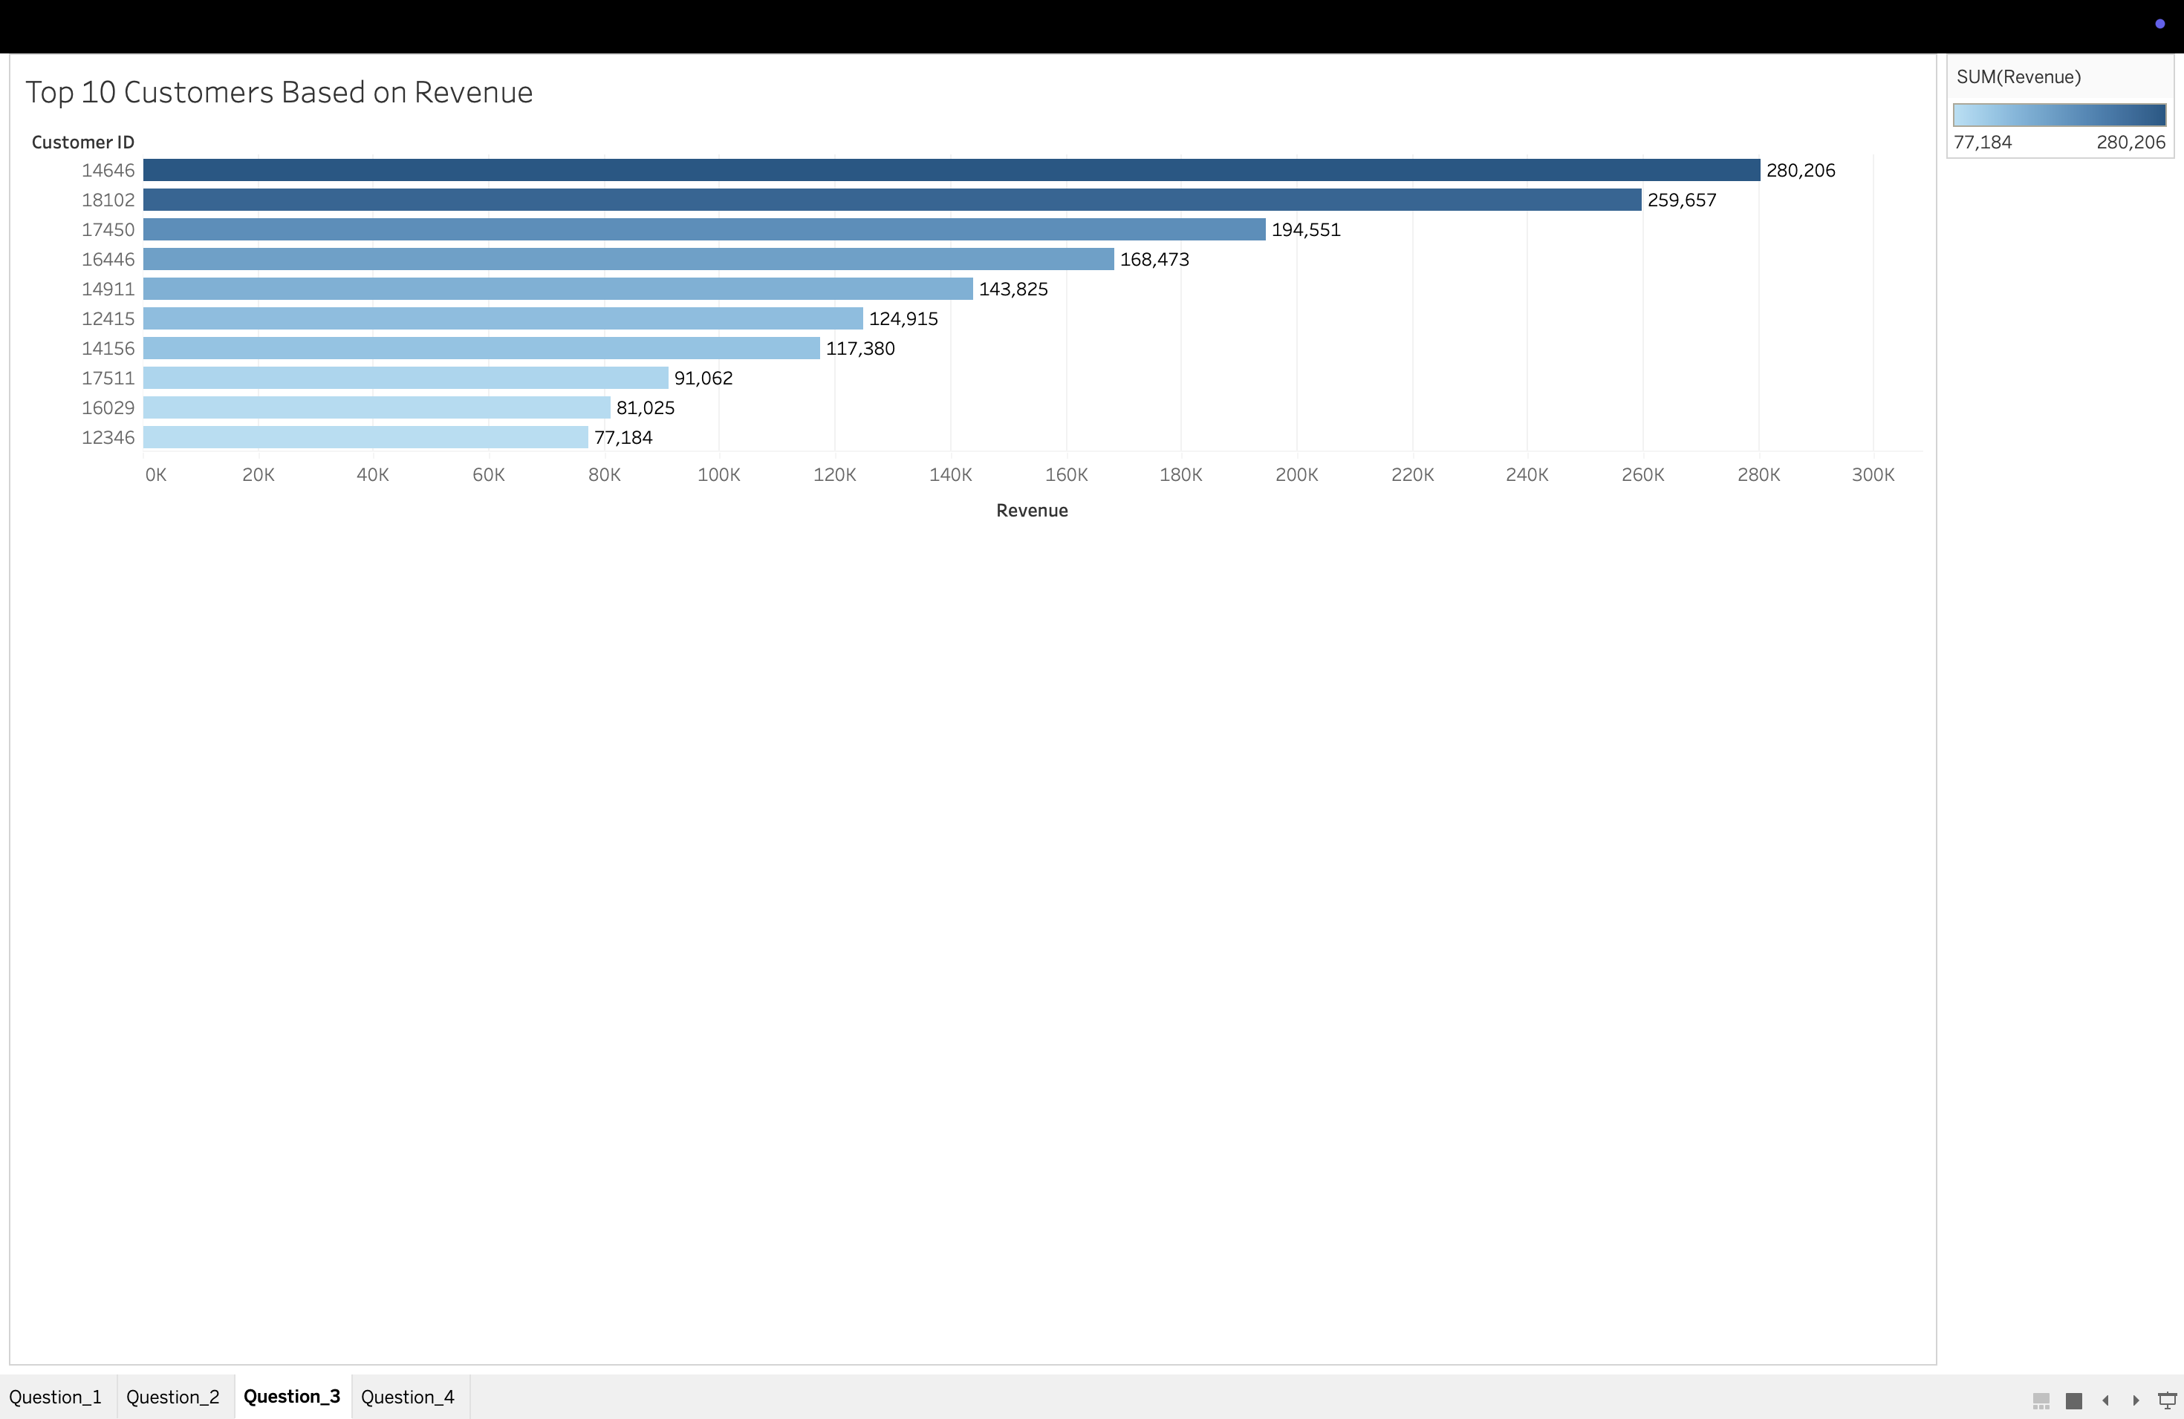
Top 10 Customers by Revenue (CMO Question 3)
Ranked customers by revenue contribution
Top customers contribute significantly to sales
Useful for prioritizing customer retention efforts

Slide 6
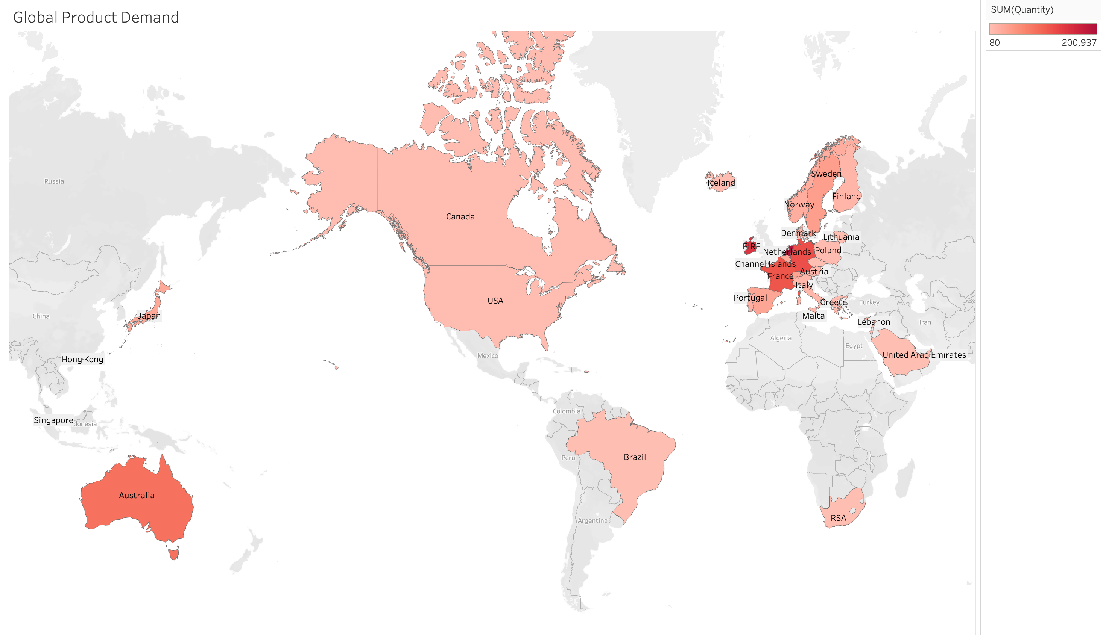
Global Product Demand Heatmap (CEO Question 4)
Heatmap showing product demand by country excluding UK
US, Canada, Australia, and Europe show strong demand
Identifies expansion opportunities geographically

Slide 7
Summary & Recommendations
Seasonal trends inform forecasting & marketing timing
Top countries & customers guide marketing & retention
Heatmap supports data-driven geographic expansion

Slide 8


Thank You

