Slide 1
A Study on the Gesture Spotting from Continuous Hand Motion with a Threshold Model
임계치 모델을 이용한
연속적인 손동작으로부터의
제스처 추출에 관한 연구
Lee, Hyeon-Kyu
AI Lab, Dept. of CS, KAIST
Feb. 1998

Slide 2
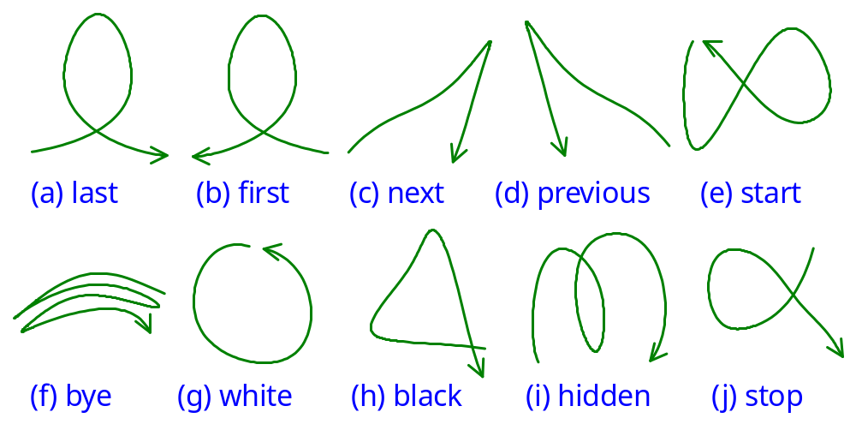
Gestures Used
Experimental Results
10 commands for PowerPointTM

Slide 3
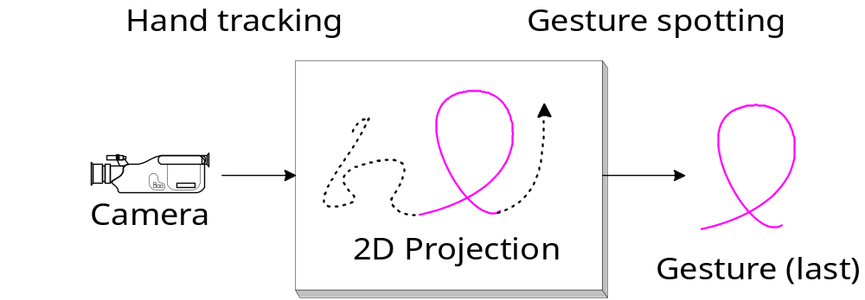
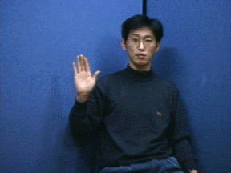
Gesture Spotting Problem
Introduction
Extract gestures from continuous hand motion

Slide 4
Difficulties of the Problem (1)
Introduction
Spatio-temporal variances
  Subject by subject variances
  Same subject variances
    Spatial variation (shape of a gesture)
    Temporal variation (playing time of a gesture)

Slide 5
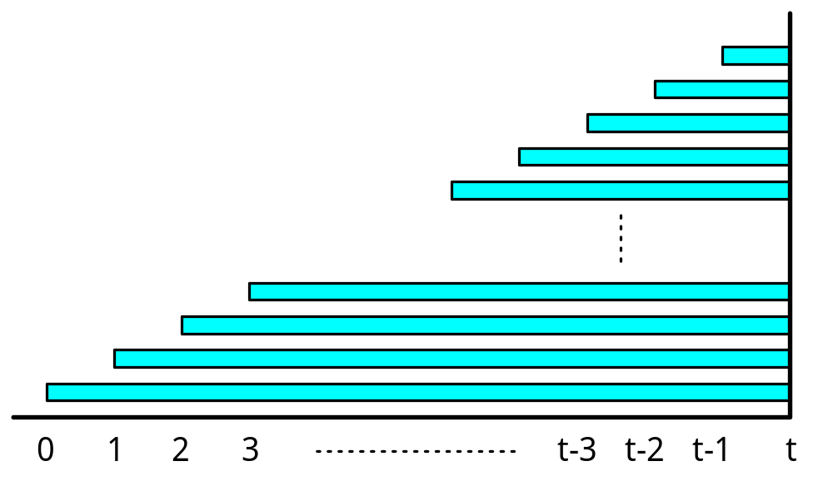
Difficulties of the Problem (2)
Introduction
Segmentation
  All time points can be end-point of a gesture

Slide 6
Contents
Introduction
Related Works
Gesture Spotting with HMM
Experimental Results
Conclusions

Slide 7
Gesture Recognition
Related Works
Body and hand gestures
  Interpreting gesture sequence in video
    [Brand 1995]
  Parsing temporal structure of natural gesture
    [Wilson 1996]
Hand Gestures
  Navigating & manipulating virtual env.
    [Maggioni 1993]
  Constructing 3D interface [Quek 1994]
  Recognizing ASL [Starner 1995]
  TV control [Freeman 1995]
  Window system control [Kjeldson 1995]
  Gesture Spotting [Seki 1993, Nagaya 1996]

Slide 8
Conclusions
Conclusions
Gesture spotting with GSN
  Continuous gesture spotting
  Threshold model
    Separates non-gesture from the observation sequence
      Serves adaptive threshold for the likelihood of gesture models
    No extra training
    State reduction using relative entropy
  End-point detector
    Find start and end point of a gesture
    Remove observation sequence for spotted gesture

