Slide 1






HR Analytic Data Presentation for Attrition
Prepared by: Rahul Bhadauria
Python
Power-BI
SQL
Used pandas NumPy, matplotlib and seaborn to find the meaningful insights
Presentation and the data visualization using Power-BI.
Used SQL queries to see the patterns and general reasons.

Slide 2


SQL queries and insights driven from it
Number of queries and findings driven from SQL
Write the sql query to find the details of the employees under attrition having 5+ years of experience.
Fetch the details of employees having maximum and minimum salary working in different departments who received -- less than 13% salary hike.
Calculate the average monthly income of all employees who worked more than 3 years whose education background is medical.
4. Calculate the avg monthly income, avg of the total years of experience, avg of rating , avg of total years of working in this -- company and of each age group order by age group
5. Identify the total no of male and female employees under attrition whose marital status is -- married and haven't received promotion in the last 2 years.
6. Employee with max performance rating but no promotion for 4 years and above and their count.
7. Employee details with maximum and maximum percentage hike Who max and min percentage salary hike where attrition is Yes then for No.
8 . No of employees work overtime but given min salary hike and are more than 5 years with company and their count.

Slide 3
Python (Pandas, Matplotlib, Seaborn)
Queries and findings driven
For different departments find the mean age of the employees who have left the company.
For different departments find the distance from home which is covered by the maximum number of employees to get to the company. ( Hint: Use Mode).
The company wants to compare the average salary of employees who have left the job and those who haven’t.
Note: Do the analysis for different Departments.
4. The company wants to analyse the median of job satisfaction ratings for different marital statuses.
5. Find the mean of environment satisfaction rating for the employees with different Education Field.
6. The company wants to know if the employees who have spent good number of years in their company are leaving the company or not. For that, they want to know the average year spent in the company by the employees in different departments.
7. Find the mean, median, and mode of work-life balance ratings for the employees who are married and are from the medical field.
8 . Find the mean, median, and mode of the number of companies the employee has worked for before joining ABC for the employees whose monthly salary is greater than 3000 and are from Research & Development department.
9. Create a Correlation matrix as well as the correlation heatmap and find out the following correlation values: 9a.What is the correlation value between the monthly salary and the number of years the employee has worked in that company 10.What is the correlation value between the monthly salary and the age of the employee.

Slide 4

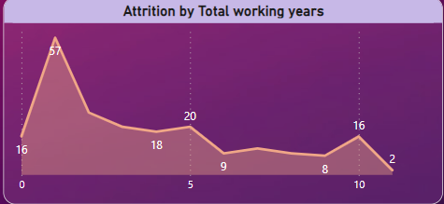

Power BI : Used to create the dashboard
1.

Slide 5
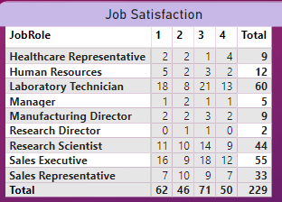
Power BI : Used to create the dashboard
2.

Slide 6
Conclusion:
Concluder remarks are shared below
The company has total number of employees 1413
Total number of attrition is 229 with an attrition rate of 16.29%
Average salary of employees is 6520 and average age of employee is 27.
Laboratory Technician has seen the maximum attrition followed by Sales Executive.

