Slide 1
Text Illustrations
To Accompany
Database Design and Implementation
Edward Sciore, Boston College
ISBN: 978-0-471-75716-0
Chapter 12. Memory Management

Slide 2

co_12
co_12

Slide 3
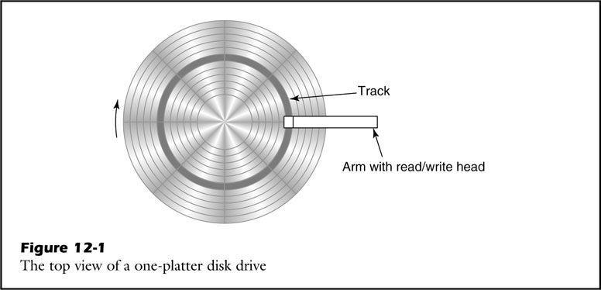
fig_12_01
fig_12_01

Slide 4
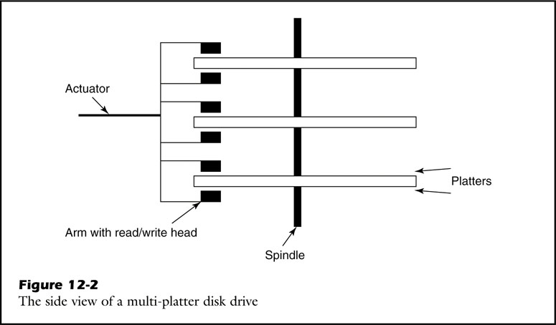
fig_12_02
fig_12_02

Slide 5
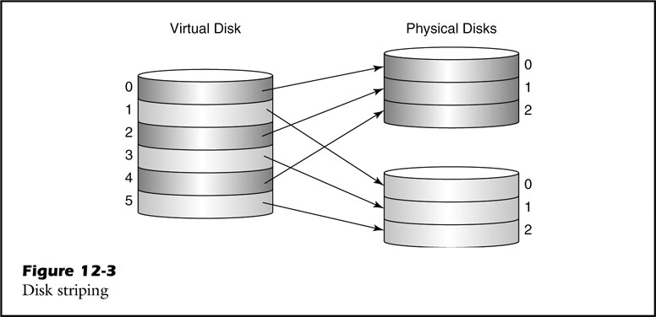
fig_12_03
fig_12_03

Slide 6
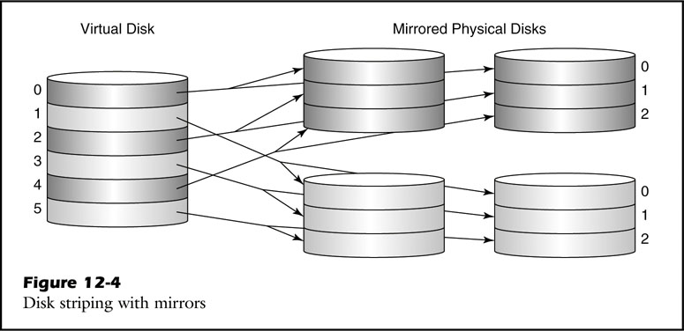
fig_12_04
fig_12_04

Slide 7
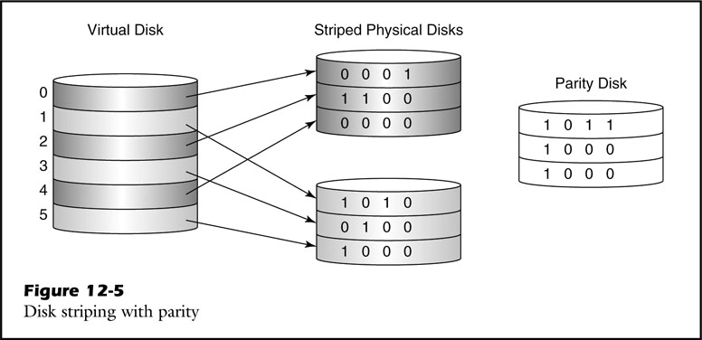
fig_12_05
fig_12_05

Slide 8
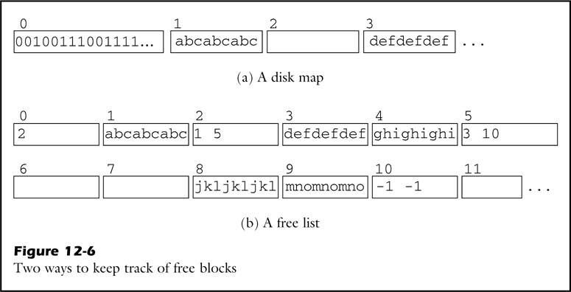
fig_12_06
fig_12_06

Slide 9
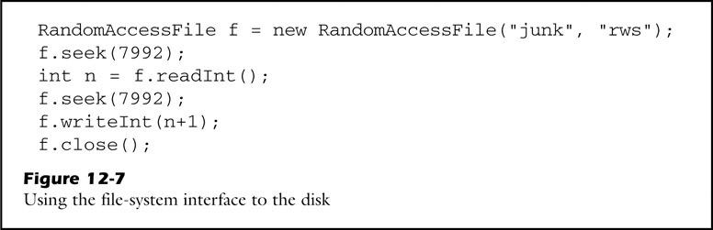
fig_12_07
fig_12_07

Slide 10
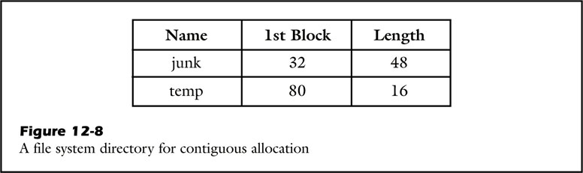
fig_12_08
fig_12_08

Slide 11
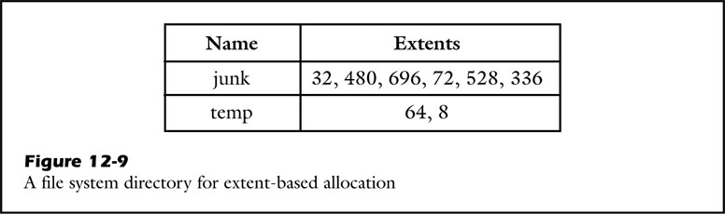
fig_12_09
fig_12_09

Slide 12
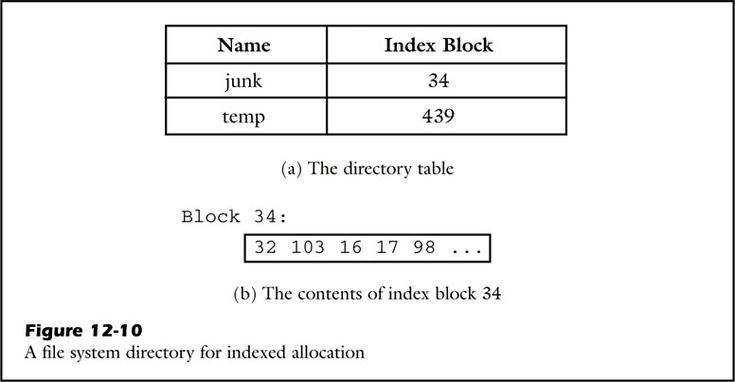
fig_12_10
fig_12_10

Slide 13
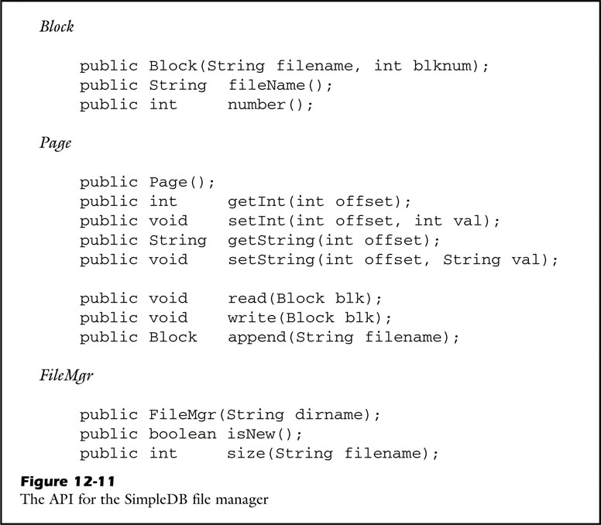
fig_12_11
fig_12_11

Slide 14
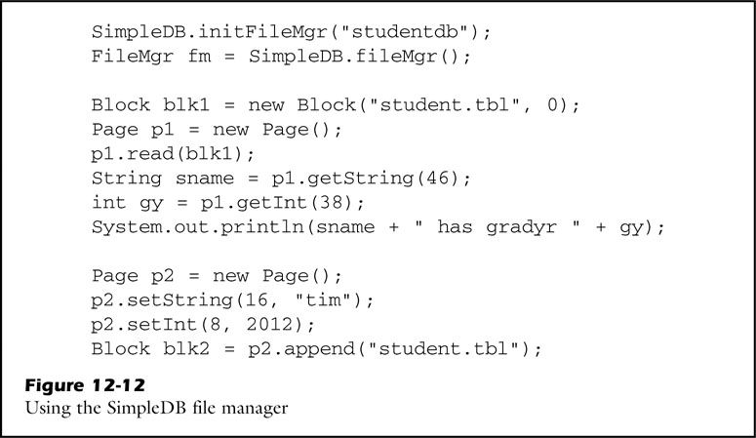
fig_12_12
fig_12_12

Slide 15
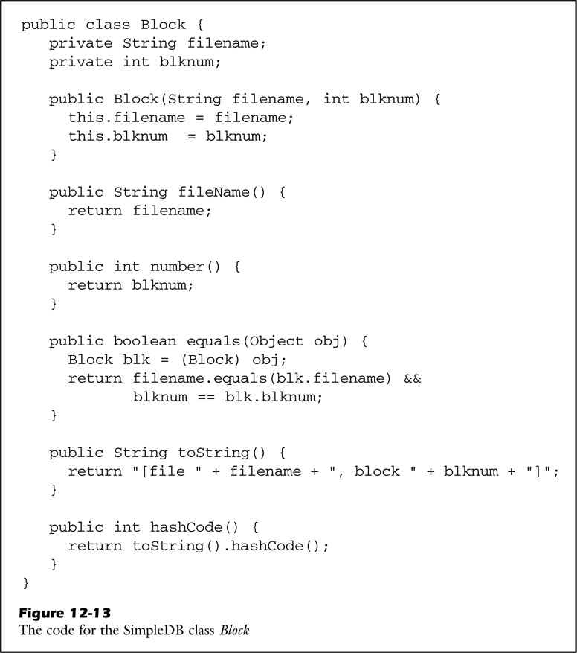
fig_12_13
fig_12_13

Slide 16
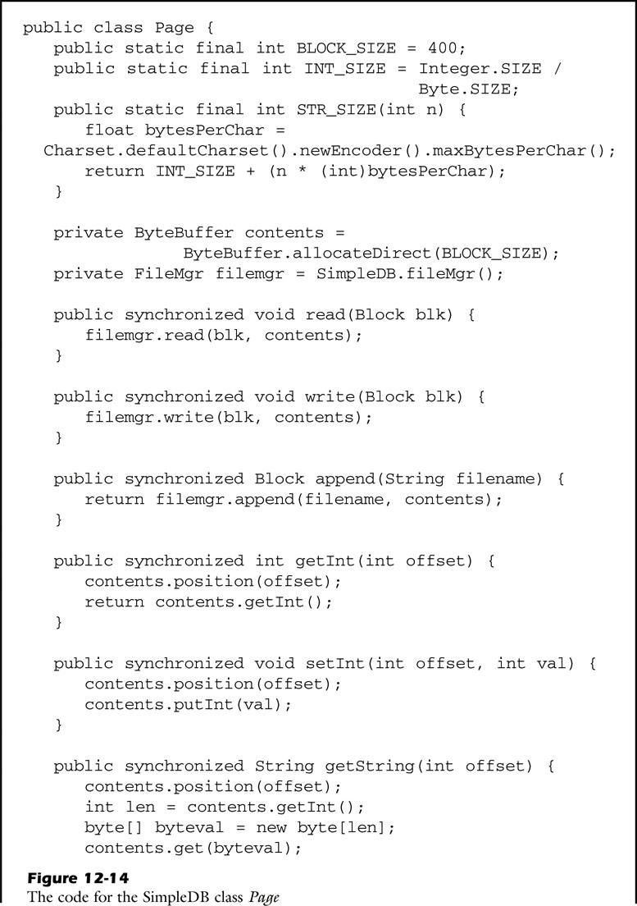
fig_12_14a
fig_12_14a

Slide 17
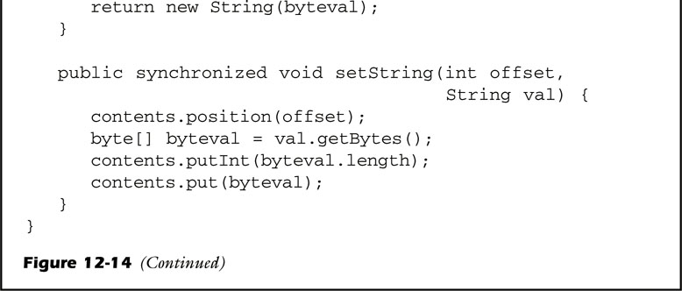
fig_12_14b
fig_12_14b

Slide 18
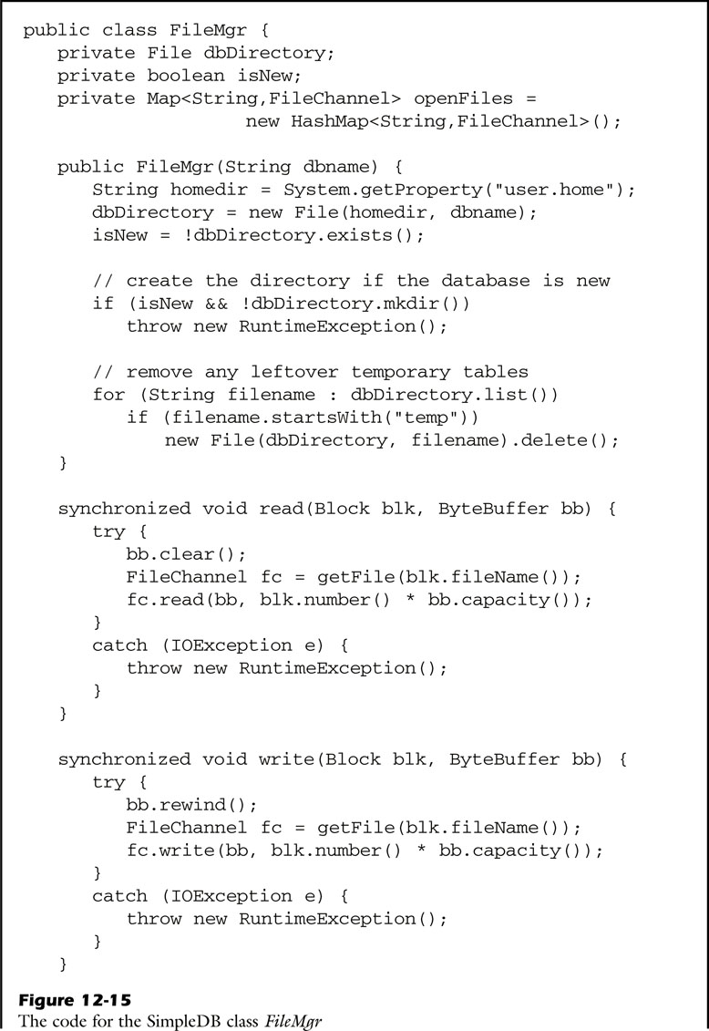
fig_12_15a
fig_12_15a

Slide 19
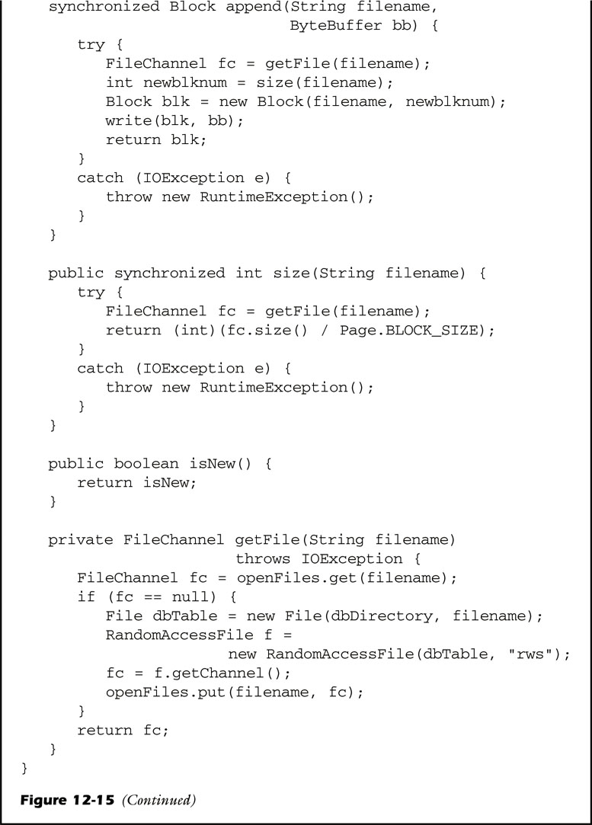
fig_12_15b
fig_12_15b

Slide 20
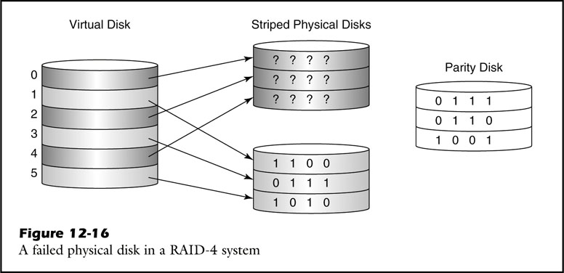
fig_12_16
fig_12_16

Slide 21

po_12
po_12

Slide 22
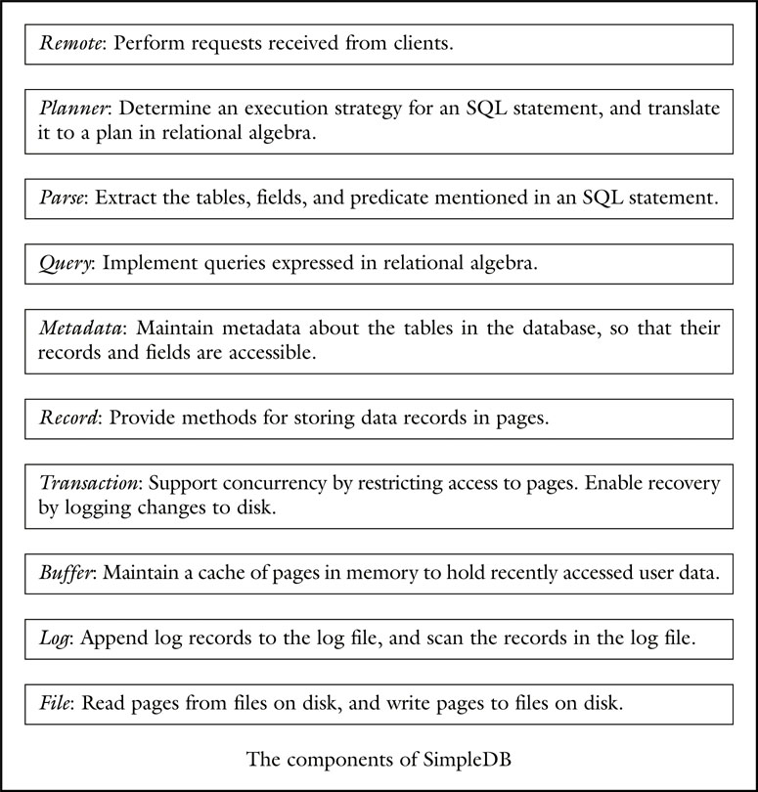
unfig_12_01
unfig_12_01

Slide 23
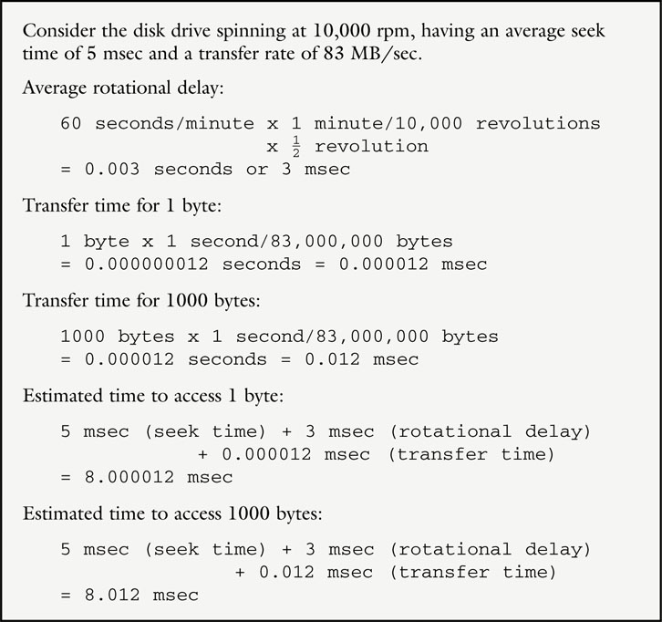
unfig_12_02
unfig_12_02

