Slide 1
Text Illustrations
To Accompany
Database Design and Implementation
Edward Sciore, Boston College
ISBN: 978-0-471-75716-0
Chapter 13. Data Exchange

Slide 2

co_13
co_13

Slide 3
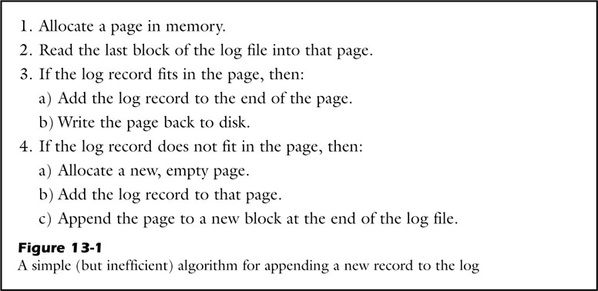
fig_13_01
fig_13_01

Slide 4
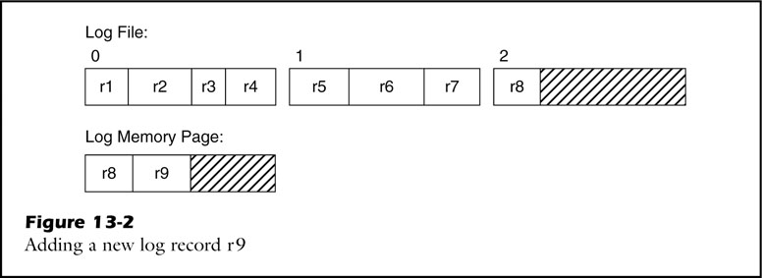
fig_13_02
fig_13_02

Slide 5
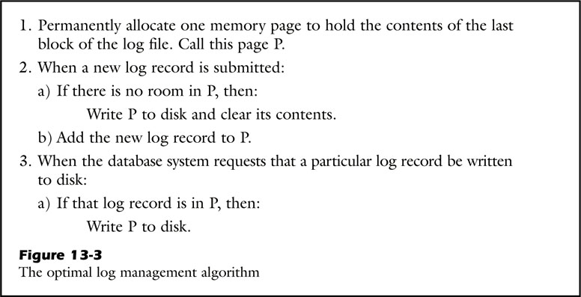
fig_13_03
fig_13_03

Slide 6
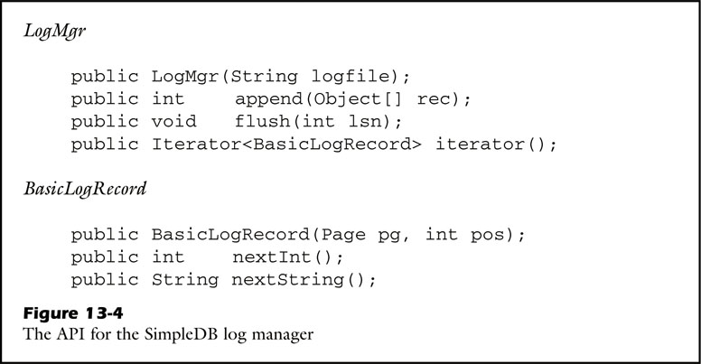
fig_13_04
fig_13_04

Slide 7
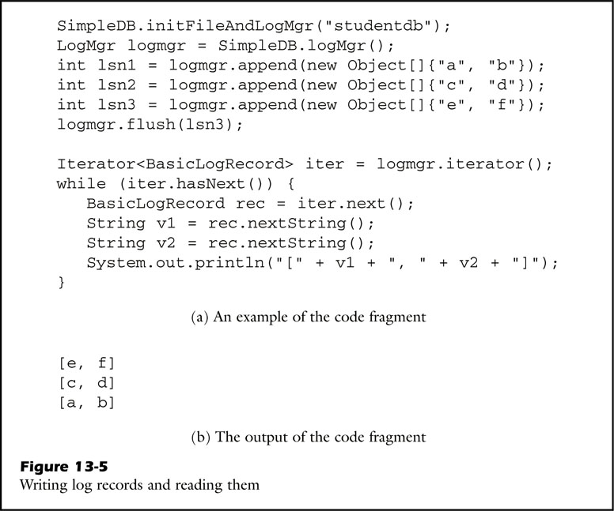
fig_13_05
fig_13_05

Slide 8
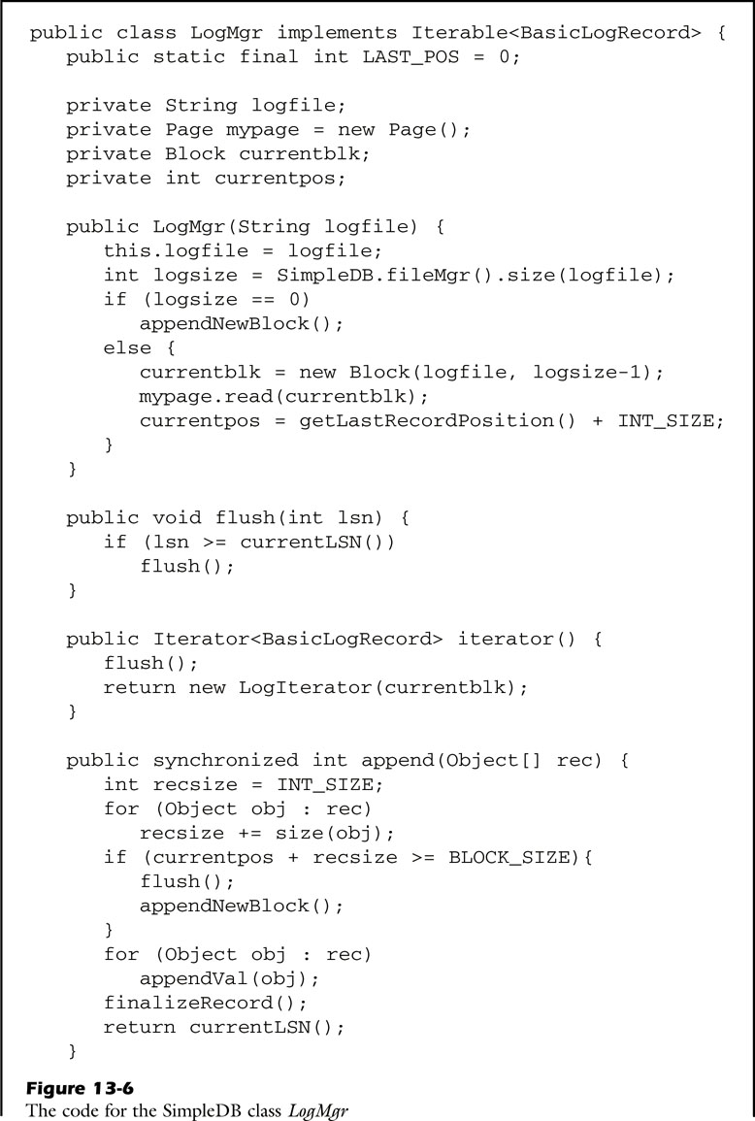
fig_13_06a
fig_13_06a

Slide 9
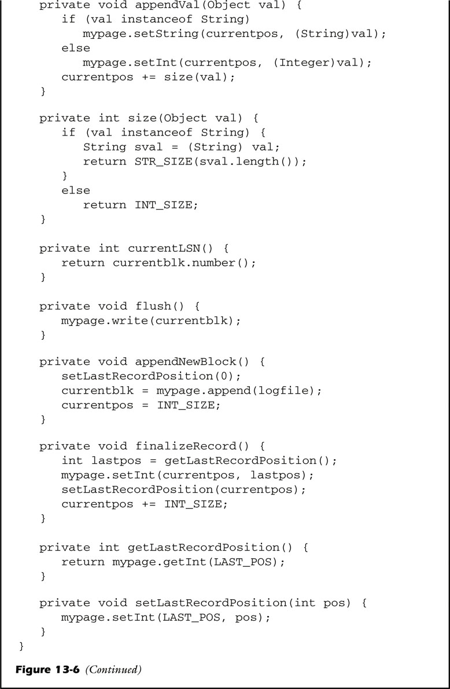
fig_13_06b
fig_13_06b

Slide 10
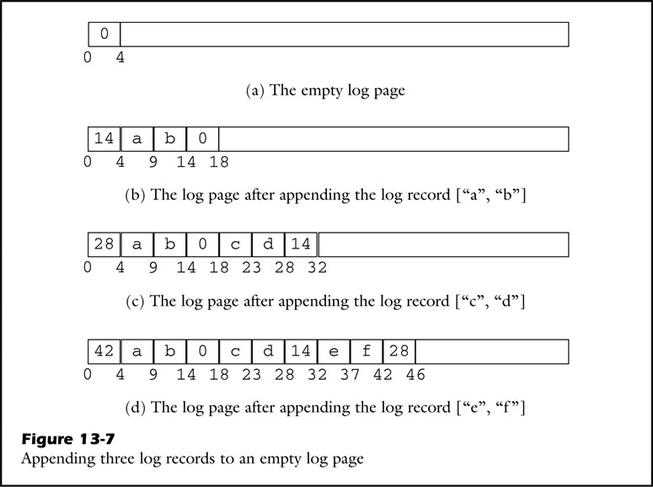
fig_13_07
fig_13_07

Slide 11
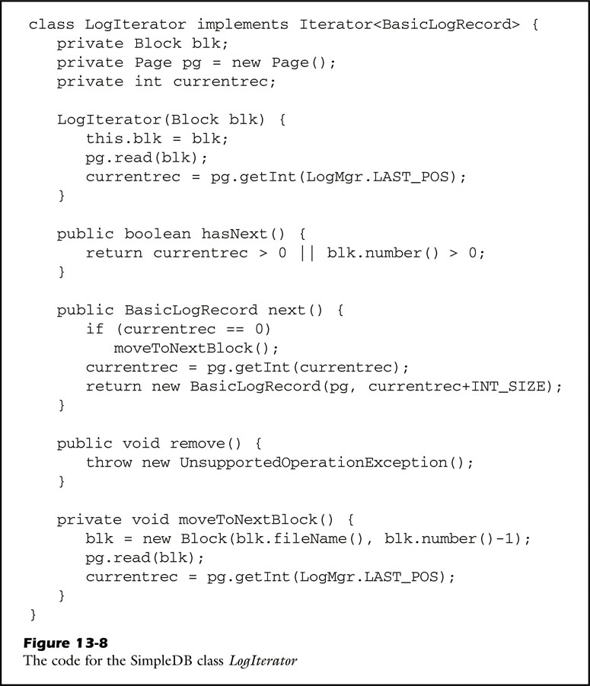
fig_13_08
fig_13_08

Slide 12
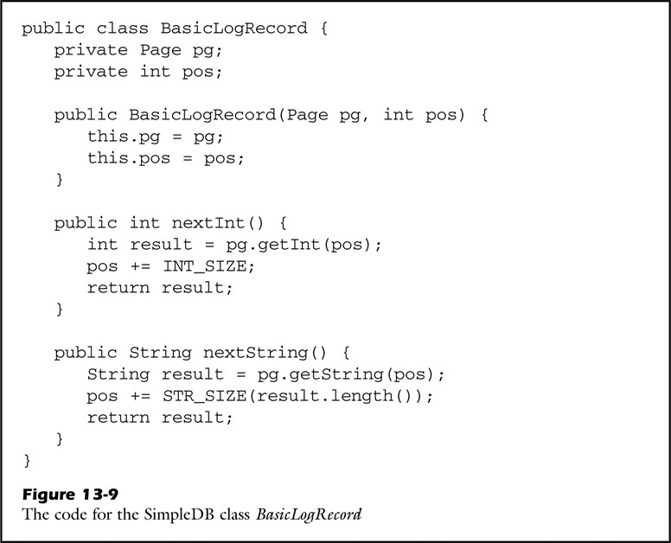
fig_13_09
fig_13_09

Slide 13

fig_13_10
fig_13_10

Slide 14
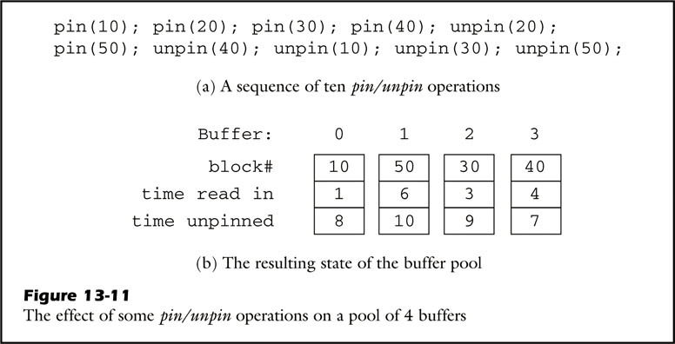
fig_13_11
fig_13_11

Slide 15
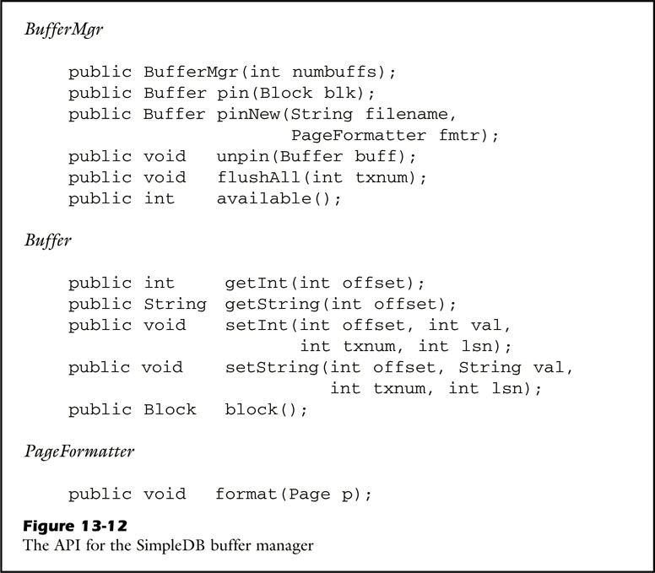
fig_13_12
fig_13_12

Slide 16
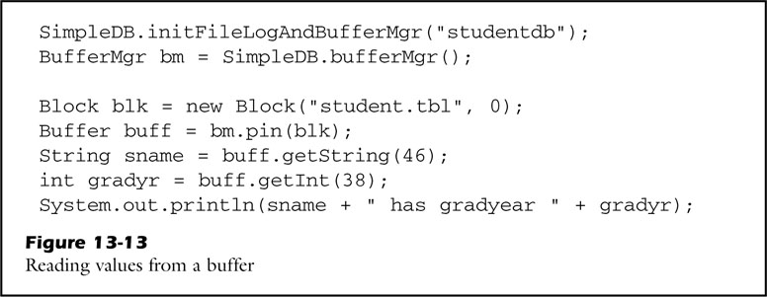
fig_13_13
fig_13_13

Slide 17
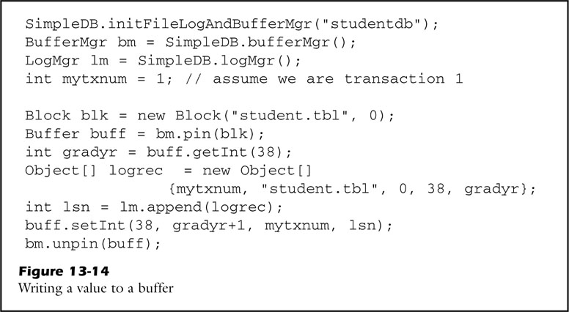
fig_13_14
fig_13_14

Slide 18
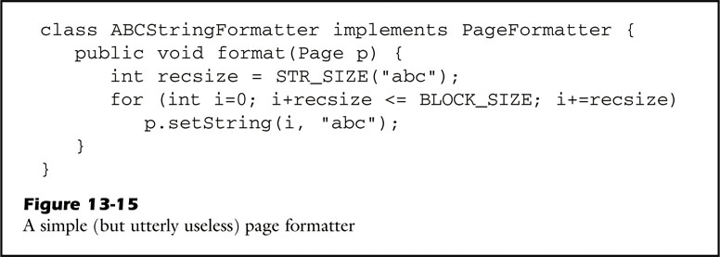
fig_13_15
fig_13_15

Slide 19
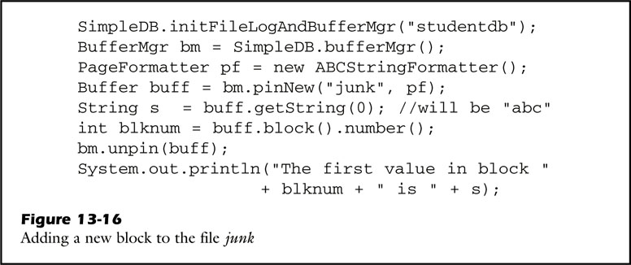
fig_13_16
fig_13_16

Slide 20
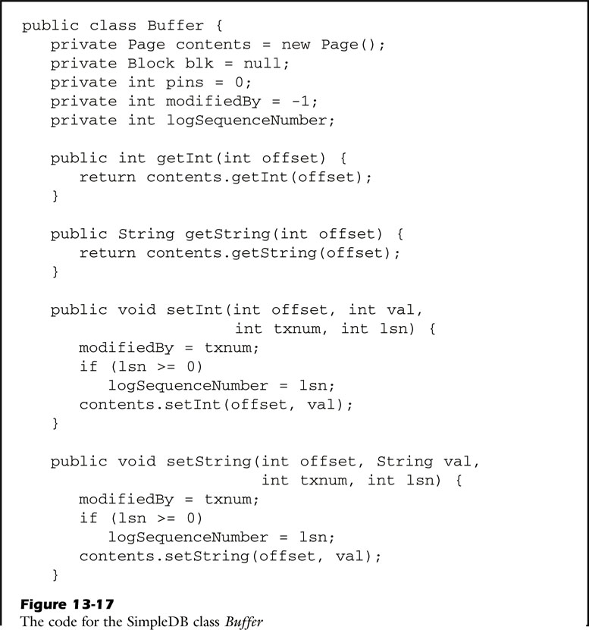
fig_13_17a
fig_13_17a

Slide 21
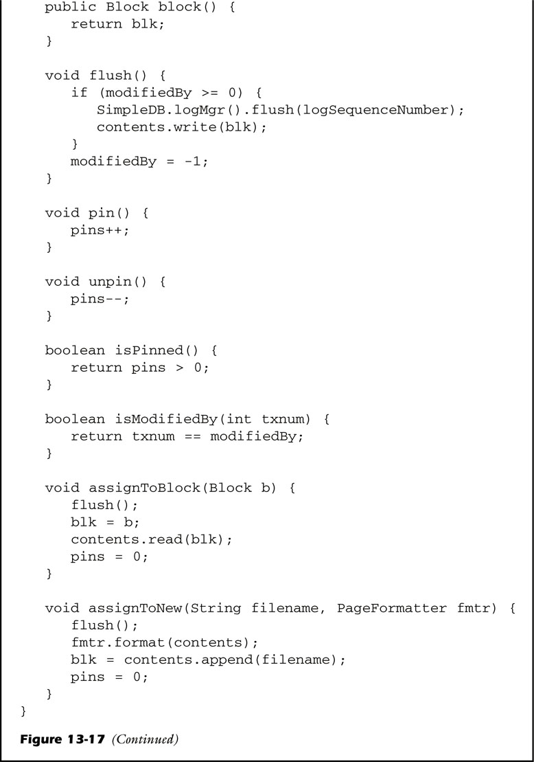
fig_13_17b
fig_13_17b

Slide 22
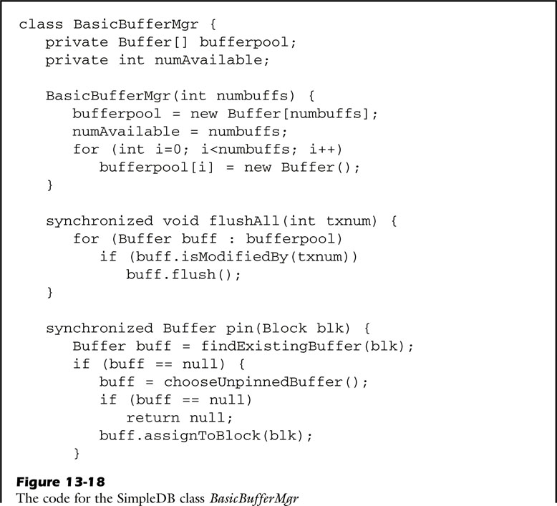
fig_13_18a
fig_13_18a

Slide 23
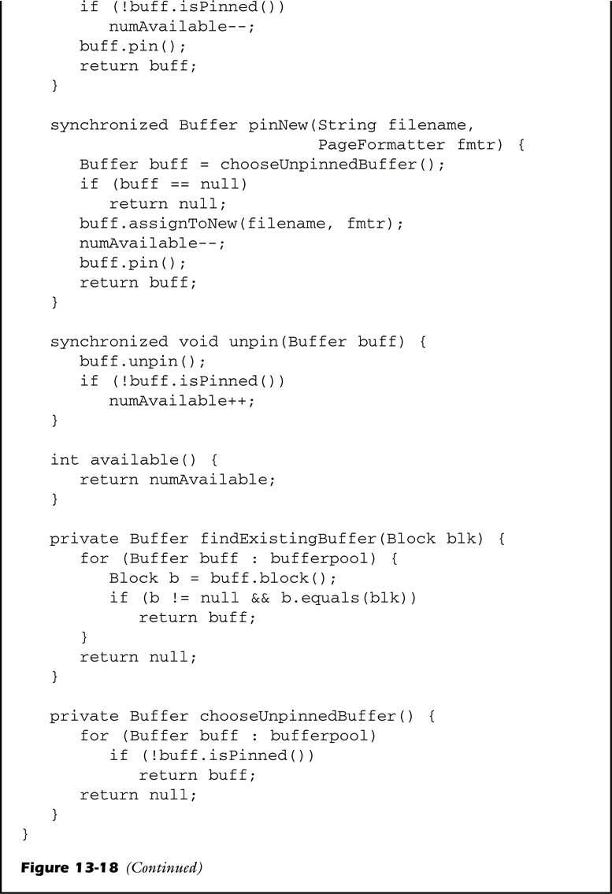
fig_13_18b
fig_13_18b

Slide 24
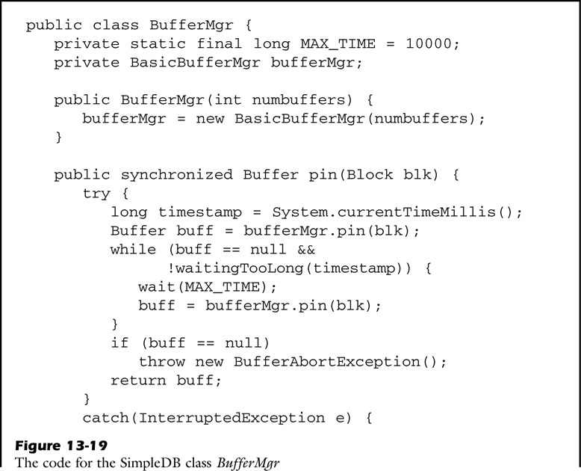
fig_13_19a
fig_13_19a

Slide 25
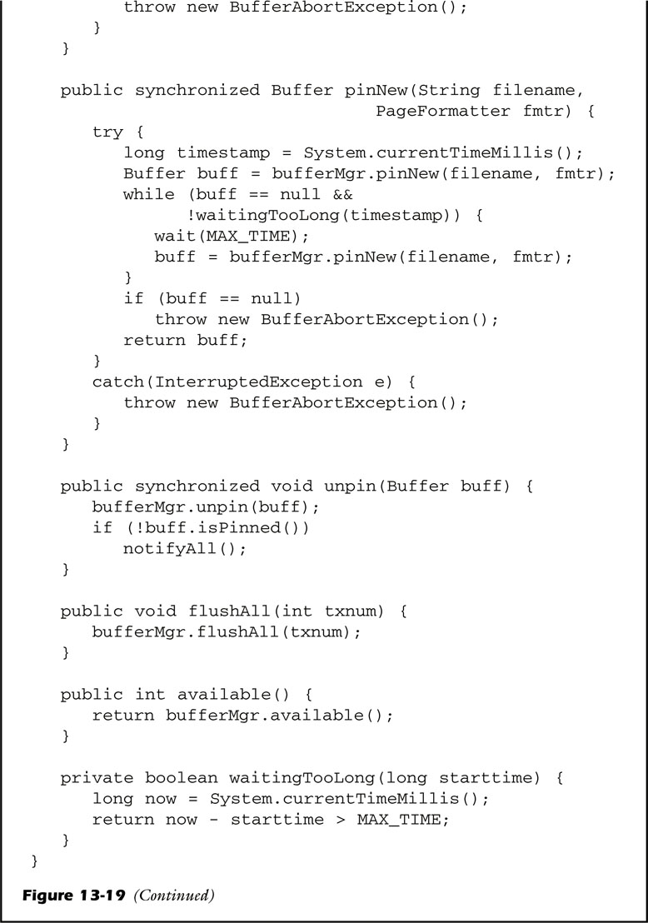
fig_13_19b
fig_13_19b

