Slide 1
Text Illustrations
To Accompany
Database Design and Implementation
Edward Sciore, Boston College
ISBN: 978-0-471-75716-0
Chapter 14. Transaction Management

Slide 2

co_14
co_14

Slide 3
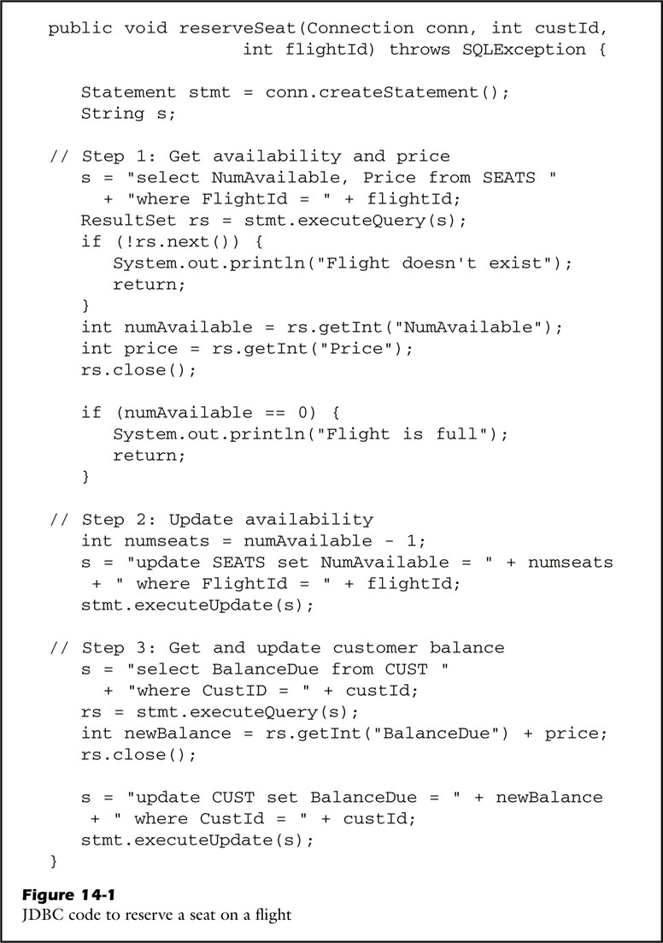
fig_14_01
fig_14_01

Slide 4
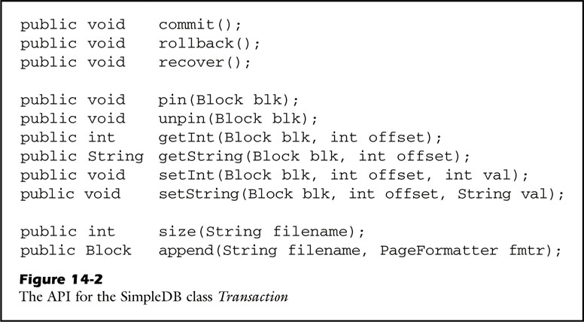
fig_14_02
fig_14_02

Slide 5
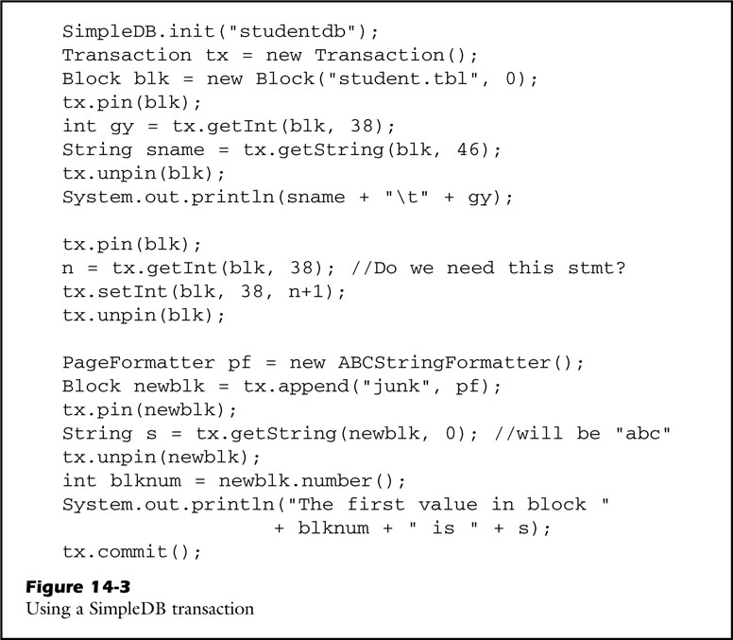
fig_14_03
fig_14_03

Slide 6
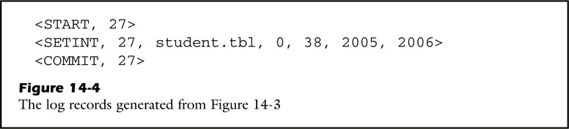
fig_14_04
fig_14_04

Slide 7
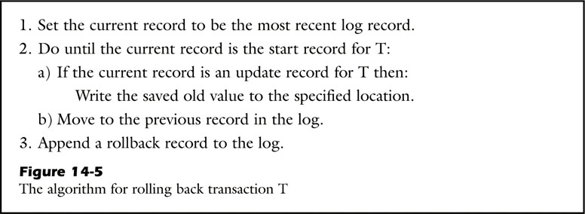
fig_14_05
fig_14_05

Slide 8
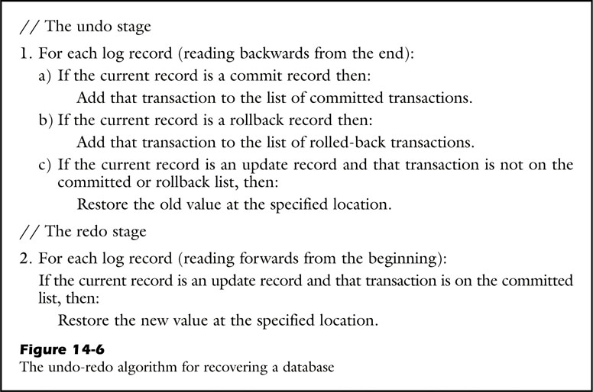
fig_14_06
fig_14_06

Slide 9
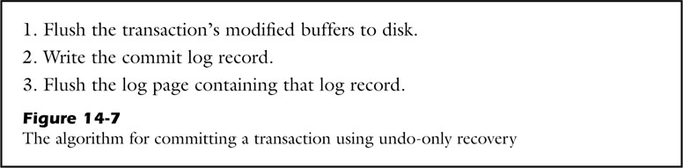
fig_14_07
fig_14_07

Slide 10
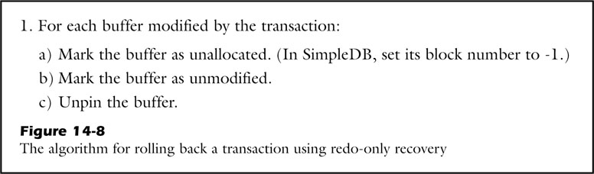
fig_14_08
fig_14_08

Slide 11
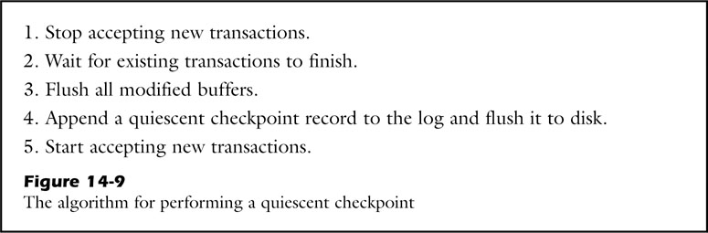
fig_14_09
fig_14_09

Slide 12
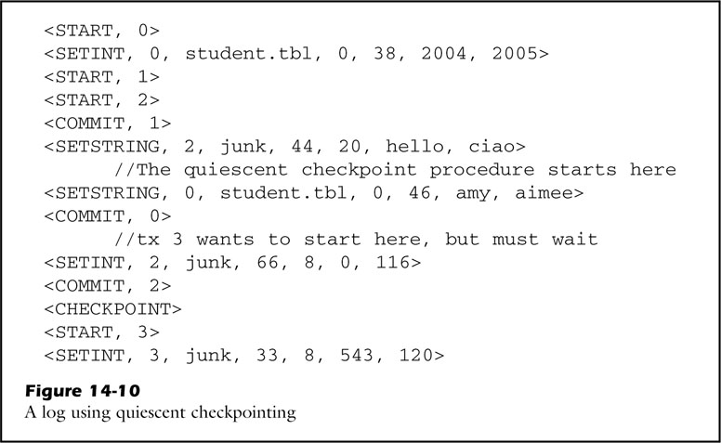
fig_14_10
fig_14_10

Slide 13
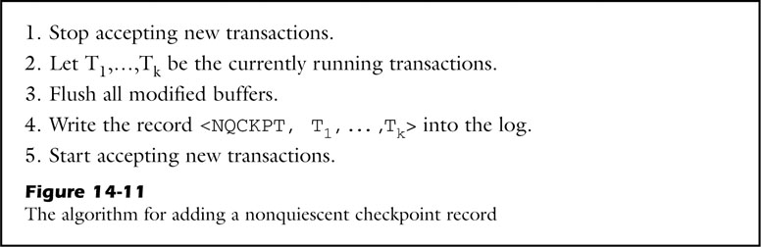
fig_14_11
fig_14_11

Slide 14
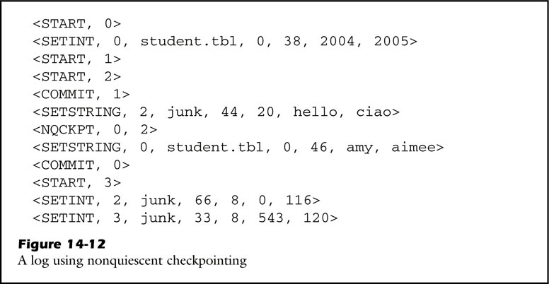
fig_14_12
fig_14_12

Slide 15
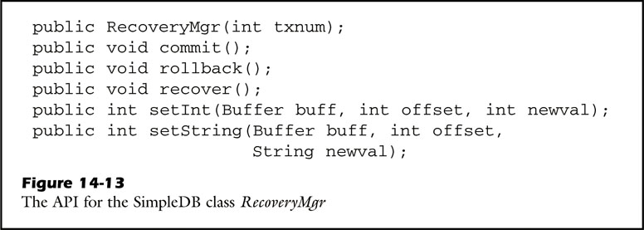
fig_14_13
fig_14_13

Slide 16
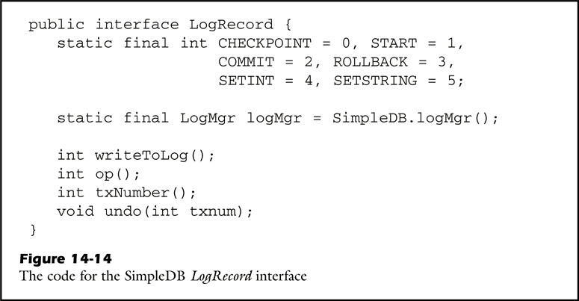
fig_14_14
fig_14_14

Slide 17
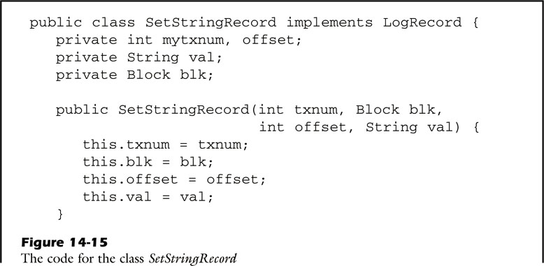
fig_14_15a
fig_14_15a

Slide 18
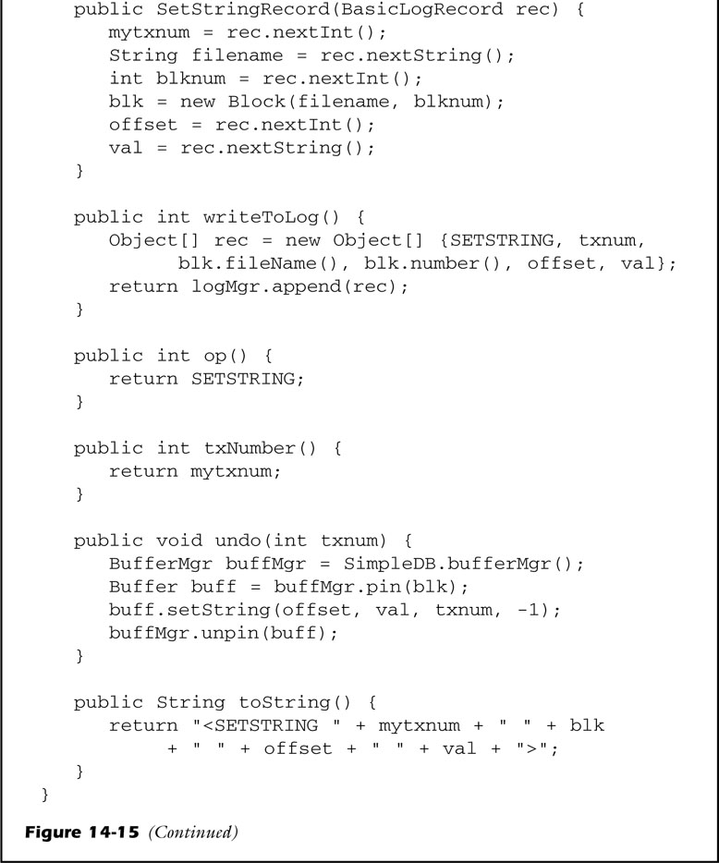
fig_14_15b
fig_14_15b

Slide 19
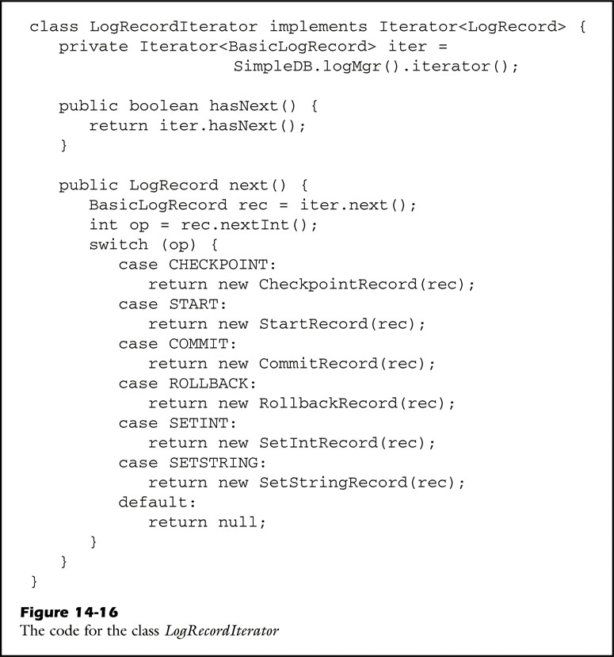
fig_14_16
fig_14_16

Slide 20
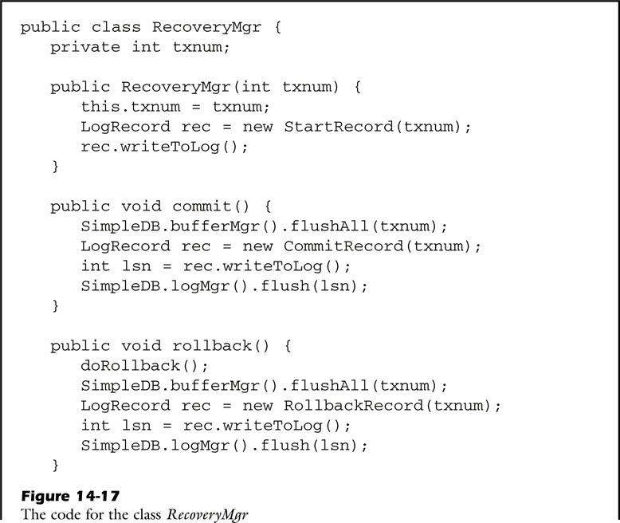
fig_14_17a
fig_14_17a

Slide 21
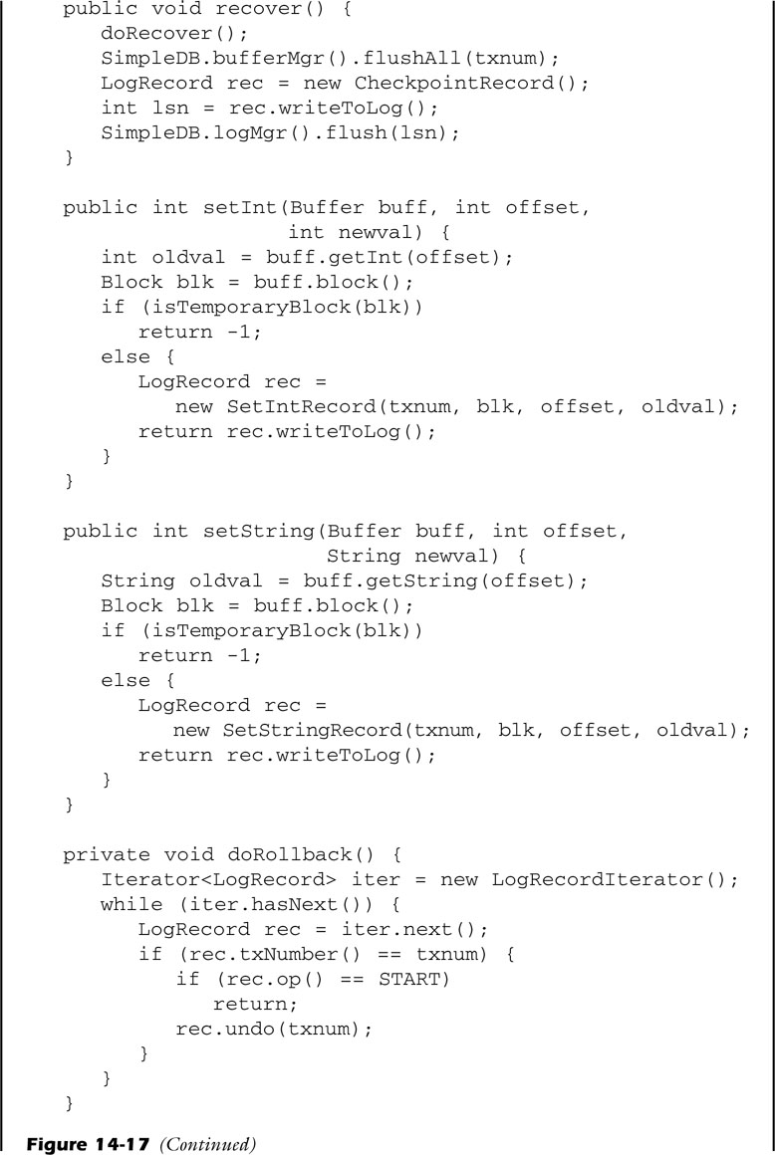
fig_14_17b
fig_14_17b

Slide 22
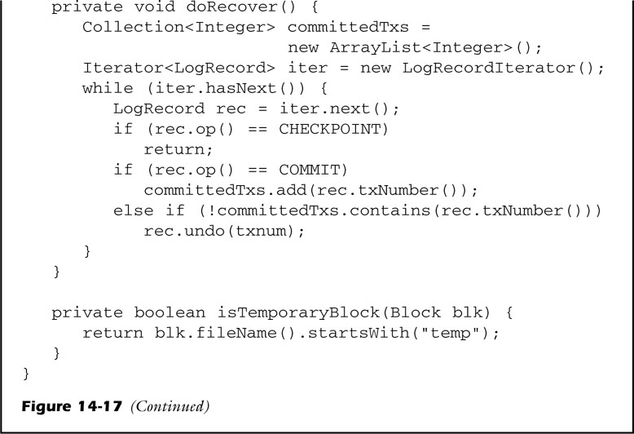
fig_14_17c
fig_14_17c

Slide 23

fig_14_18
fig_14_18

Slide 24
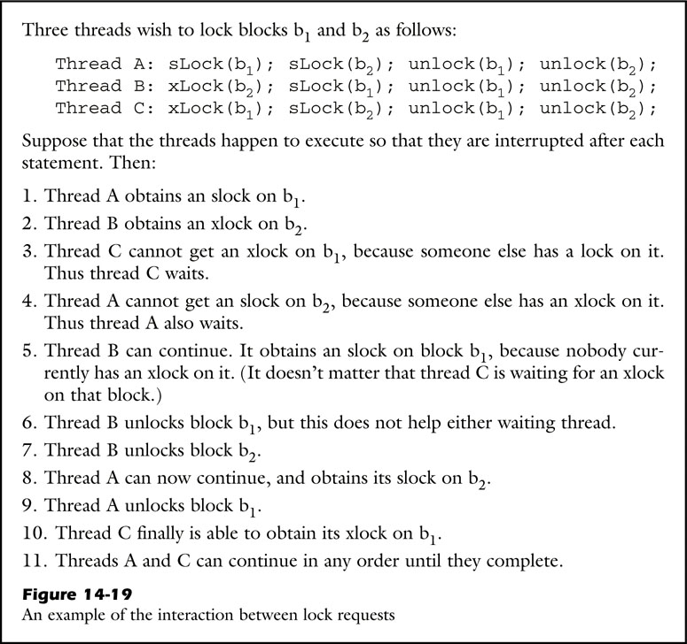
fig_14_19
fig_14_19

Slide 25

fig_14_20
fig_14_20

Slide 26

fig_14_21
fig_14_21

Slide 27
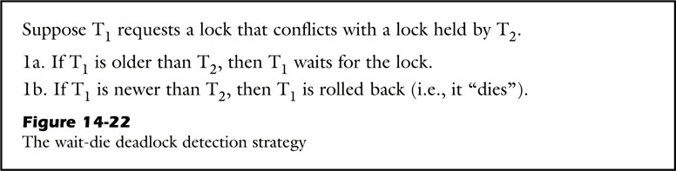
fig_14_22
fig_14_22

Slide 28
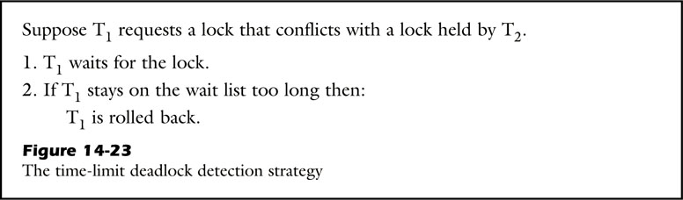
fig_14_23
fig_14_23

Slide 29
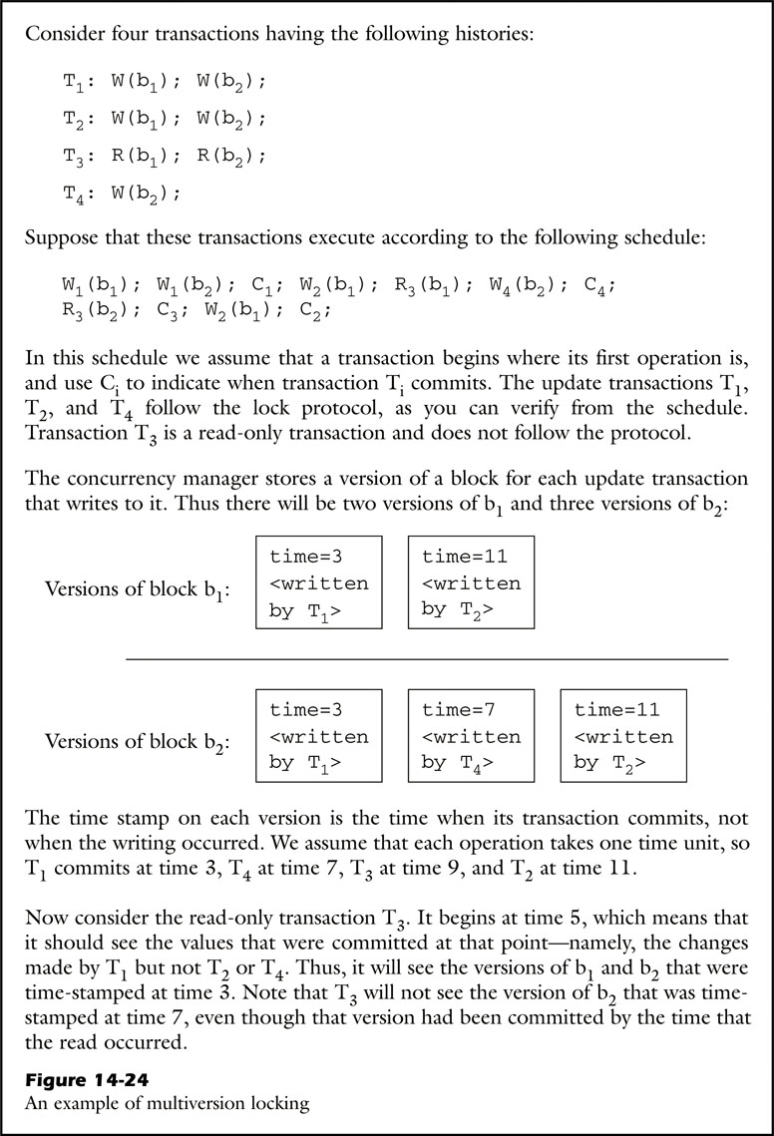
fig_14_24
fig_14_24

Slide 30
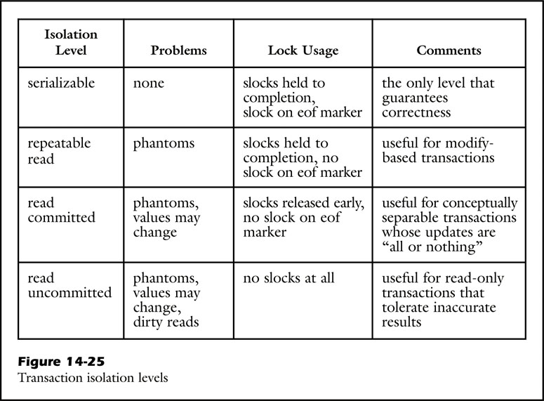
fig_14_25
fig_14_25

Slide 31

fig_14_26
fig_14_26

Slide 32
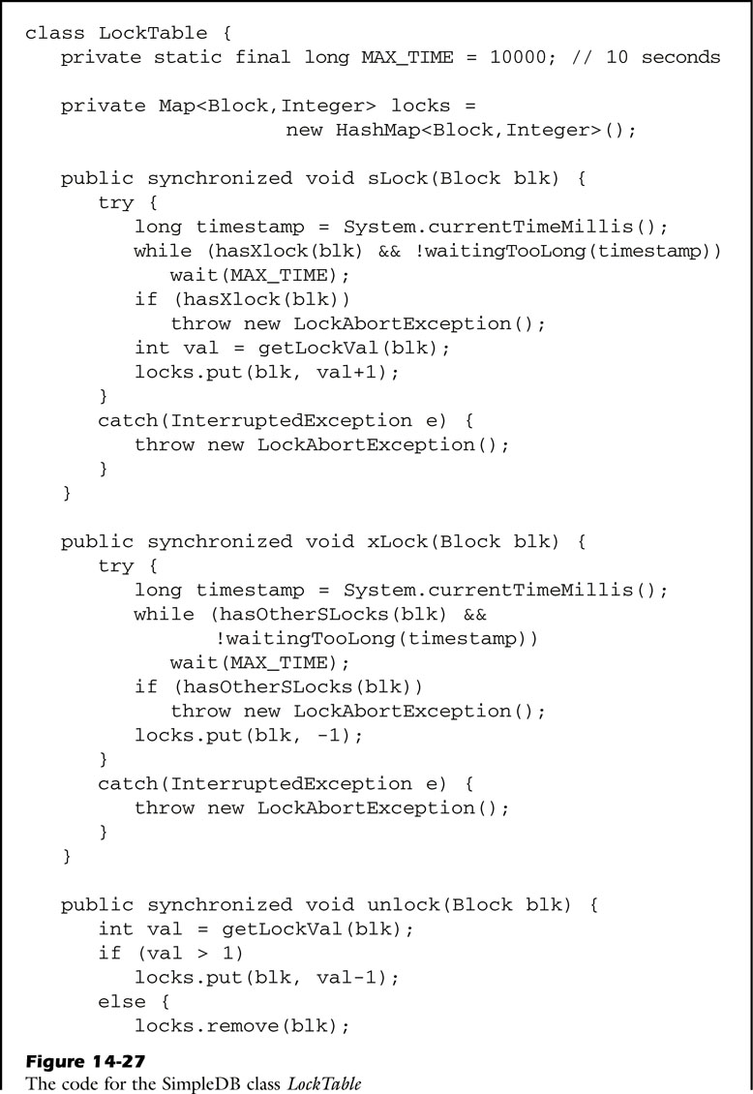
fig_14_27a
fig_14_27a

Slide 33
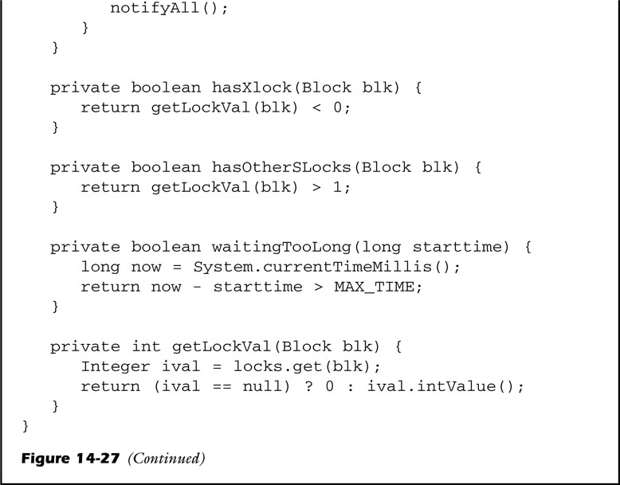
fig_14_27b
fig_14_27b

Slide 34
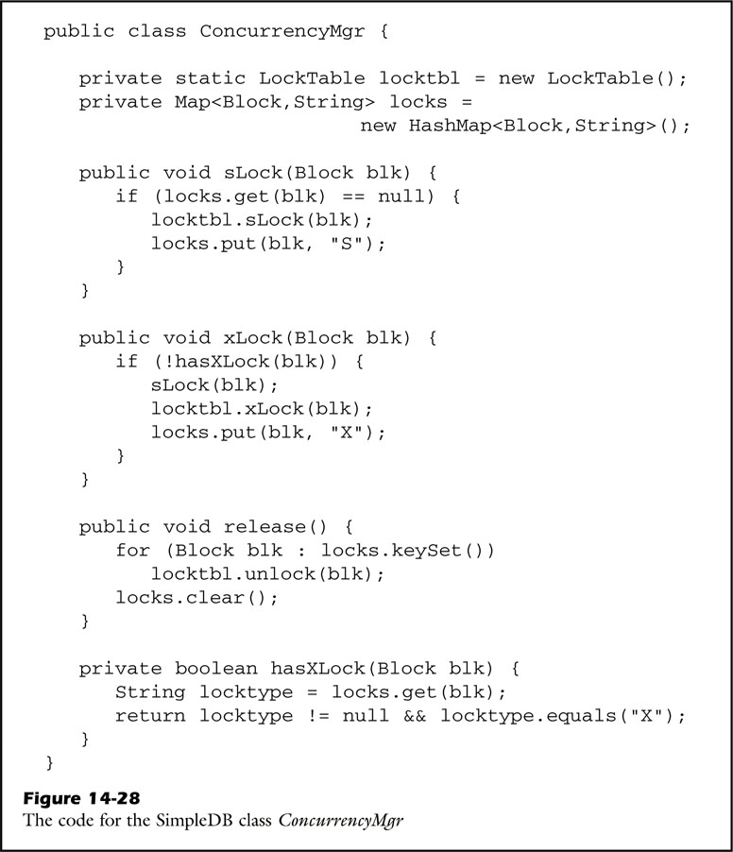
fig_14_28
fig_14_28

Slide 35
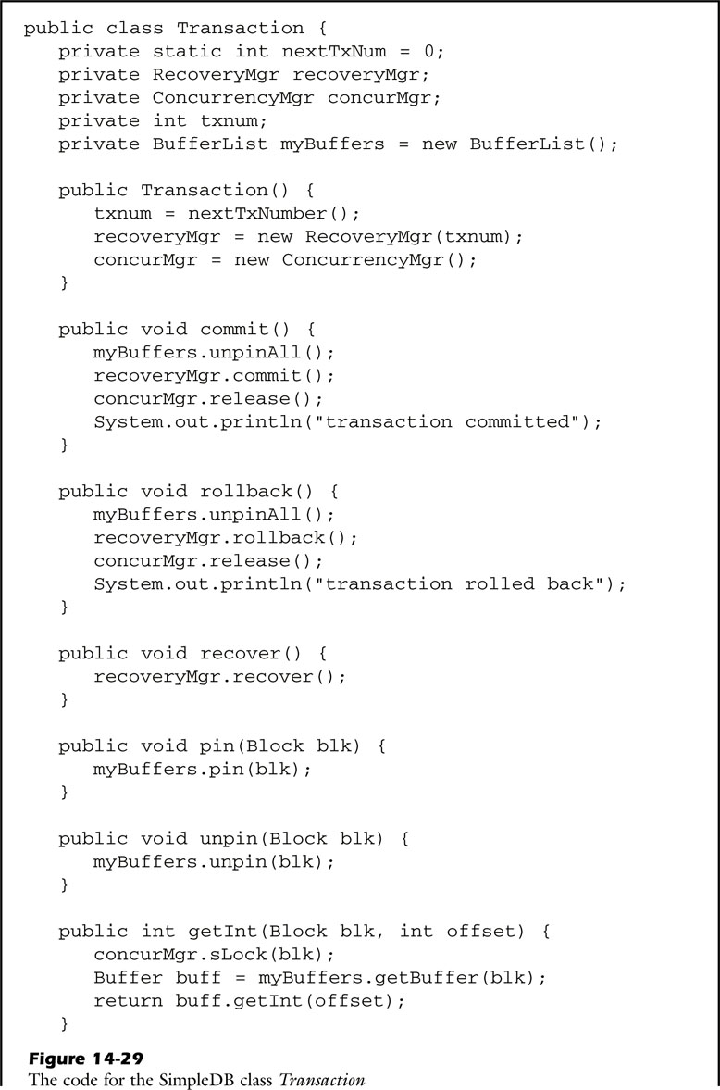
fig_14_29a
fig_14_29a

Slide 36
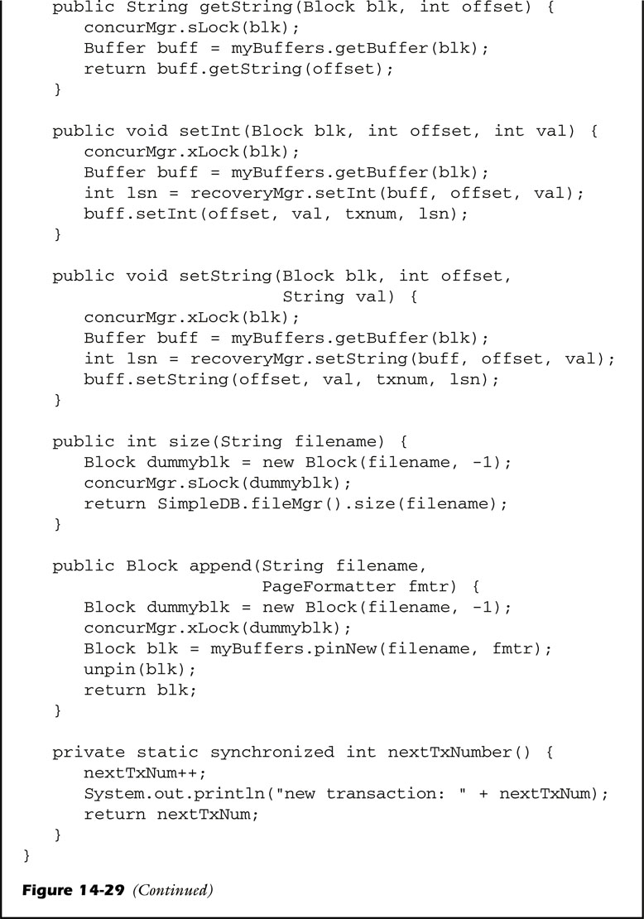
fig_14_29b
fig_14_29b

Slide 37
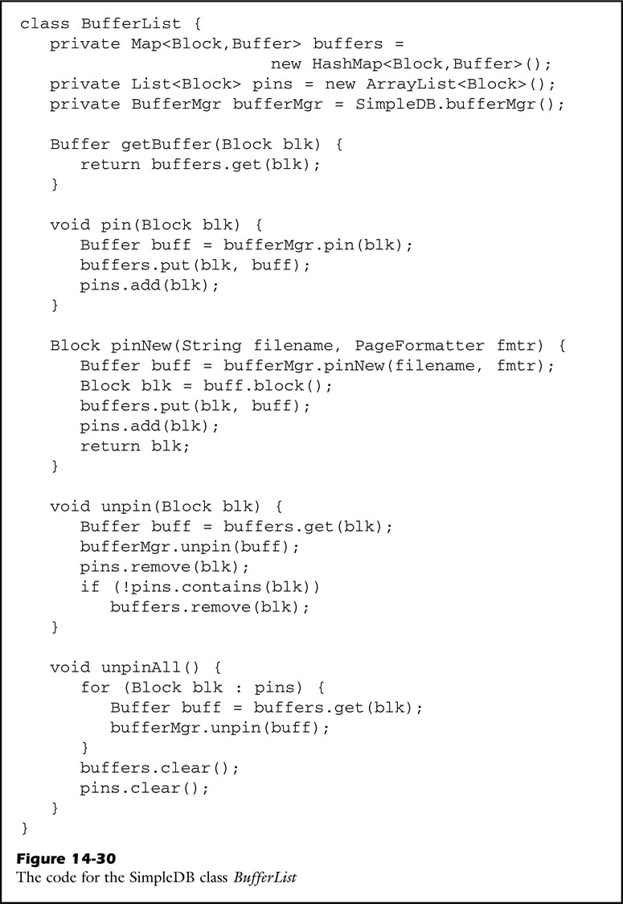
fig_14_30
fig_14_30

Slide 38
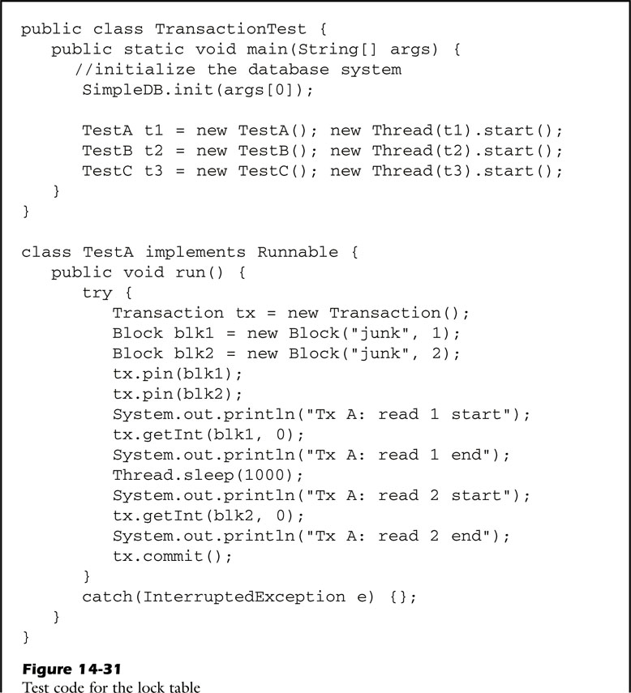
fig_14_31a
fig_14_31a

Slide 39
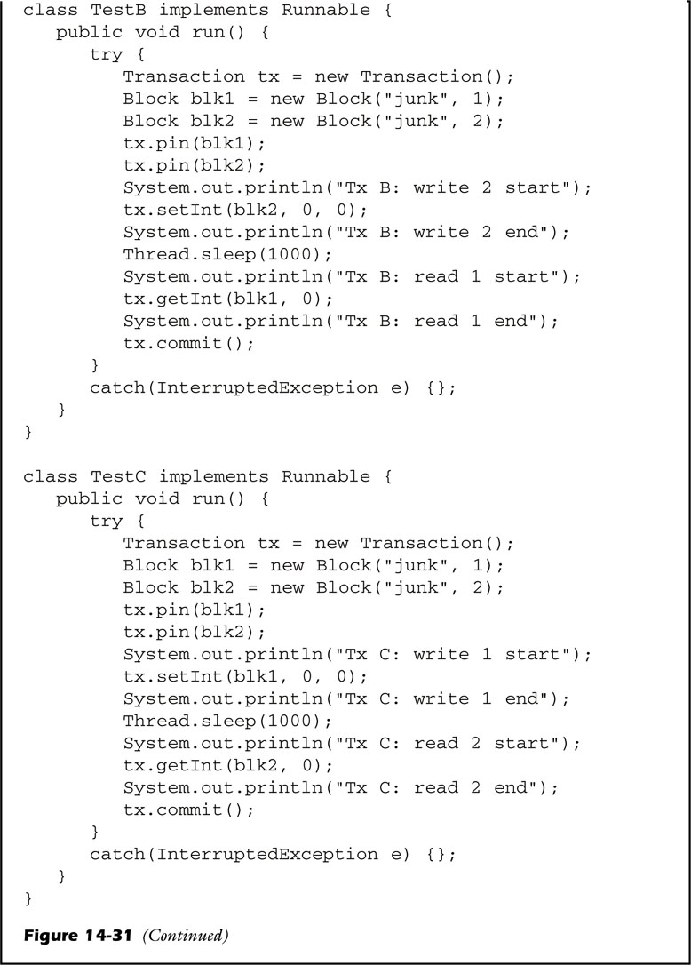
fig_14_31b
fig_14_31b

