Slide 1
Text Illustrations
To Accompany
Database Design and Implementation
Edward Sciore, Boston College
ISBN: 978-0-471-75716-0
Chapter 15. Record Management

Slide 2

co_15
co_15

Slide 3
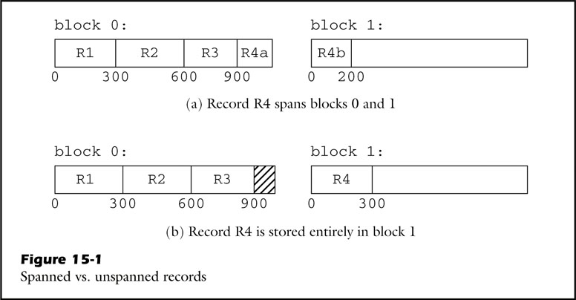
fig_15_01
fig_15_01

Slide 4
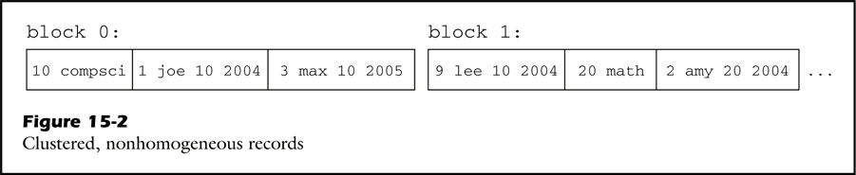
fig_15_02
fig_15_02

Slide 5
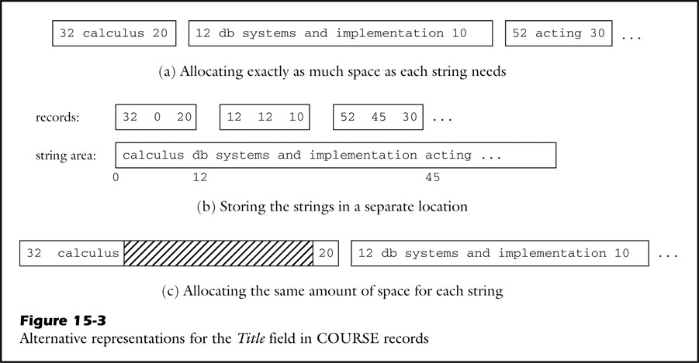
fig_15_03
fig_15_03

Slide 6
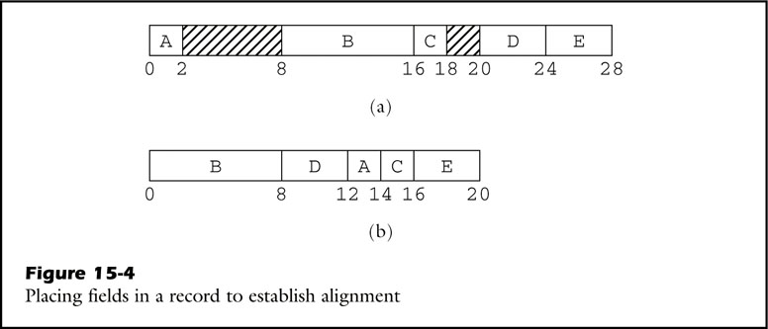
fig_15_04
fig_15_04

Slide 7
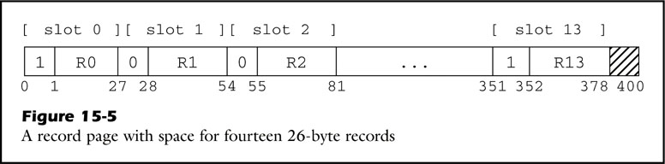
fig_15_05
fig_15_05

Slide 8
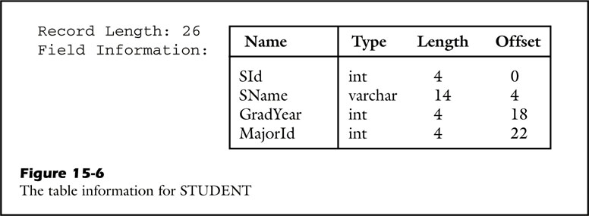
fig_15_06
fig_15_06

Slide 9
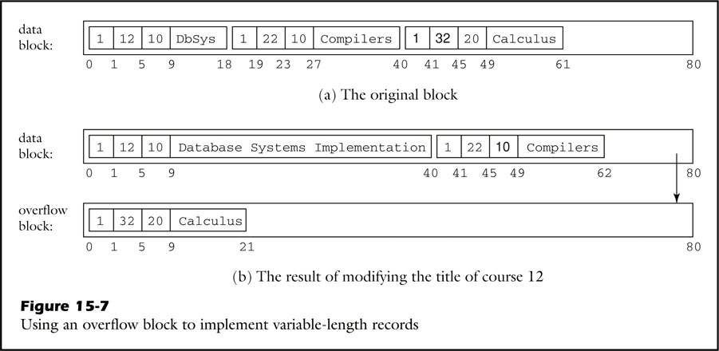
fig_15_07
fig_15_07

Slide 10
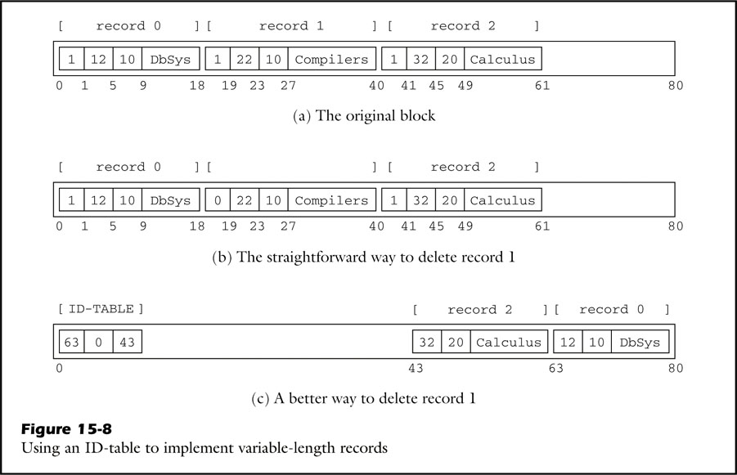
fig_15_08
fig_15_08

Slide 11
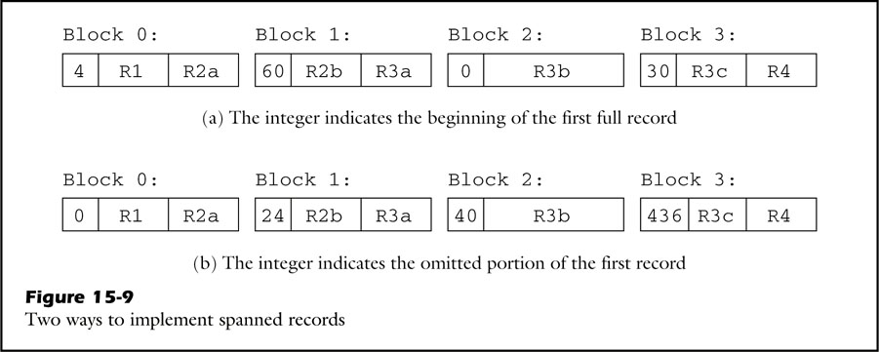
fig_15_09
fig_15_09

Slide 12
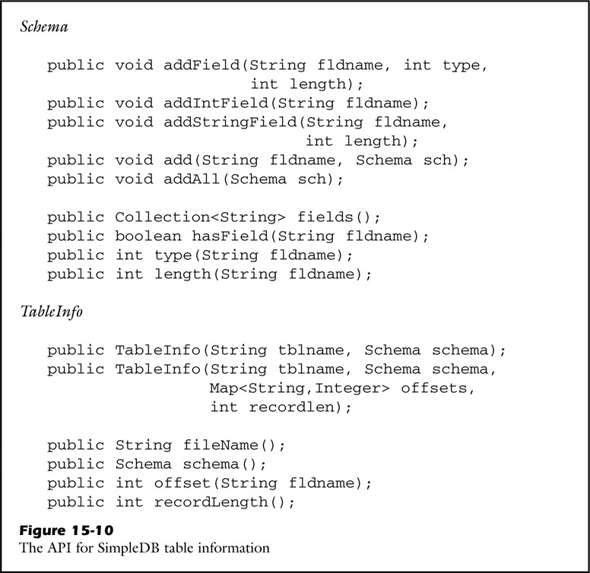
fig_15_10
fig_15_10

Slide 13
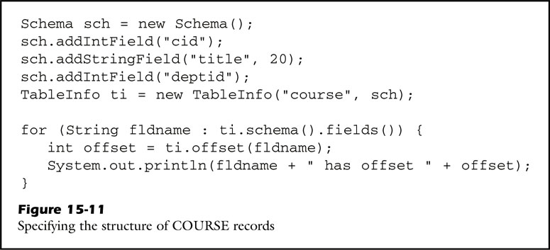
fig_15_11
fig_15_11

Slide 14
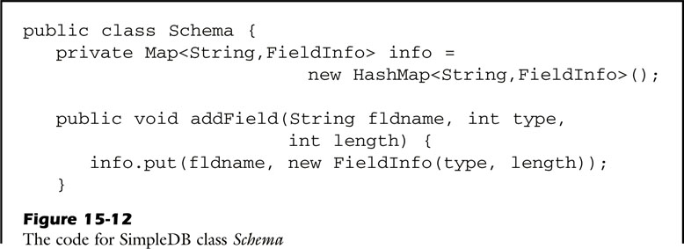
fig_15_12a
fig_15_12a

Slide 15
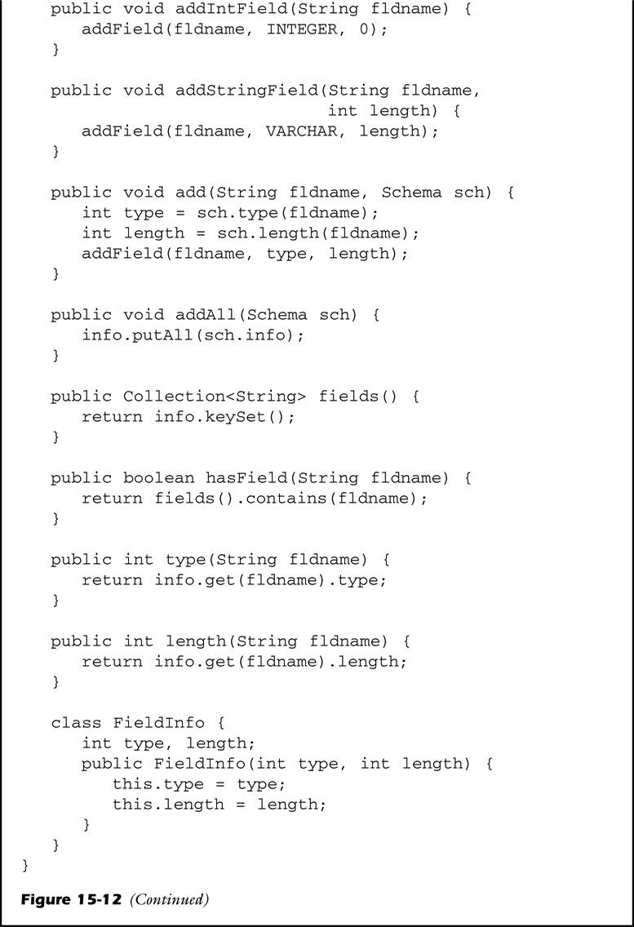
fig_15_12b
fig_15_12b

Slide 16
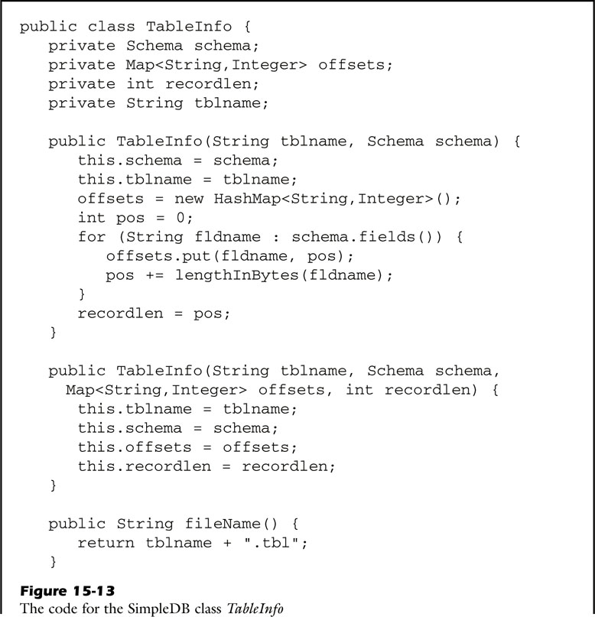
fig_15_13a
fig_15_13a

Slide 17
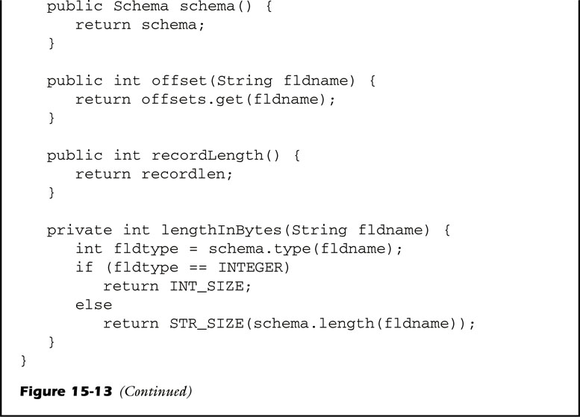
fig_15_13b
fig_15_13b

Slide 18
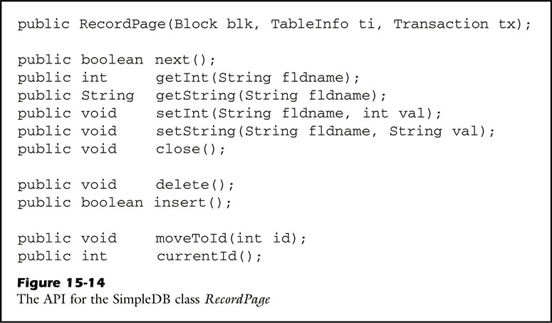
fig_15_14
fig_15_14

Slide 19
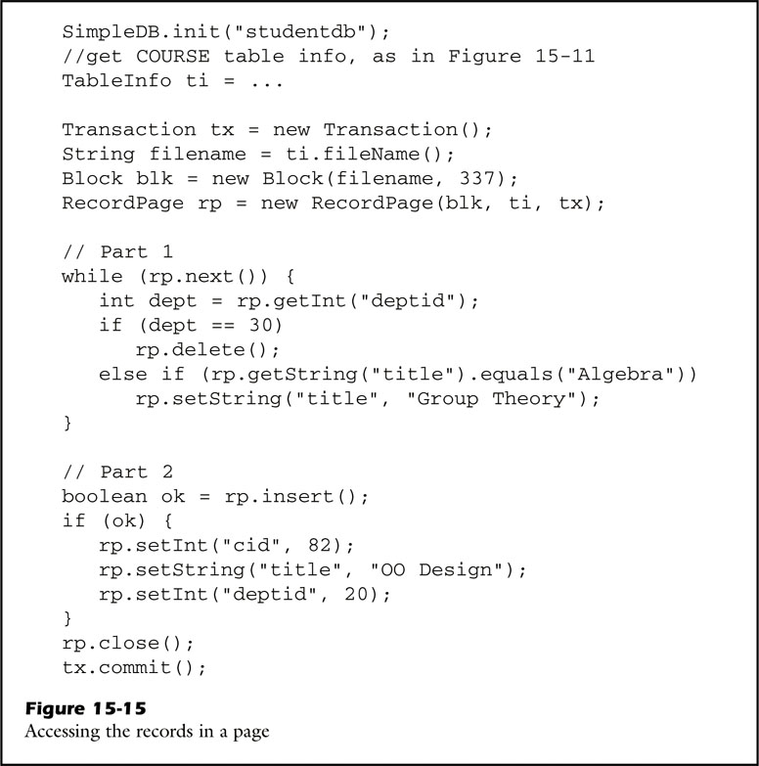
fig_15_15
fig_15_15

Slide 20
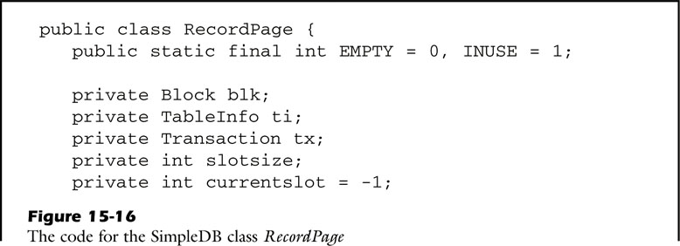
fig_15_16a
fig_15_16a

Slide 21
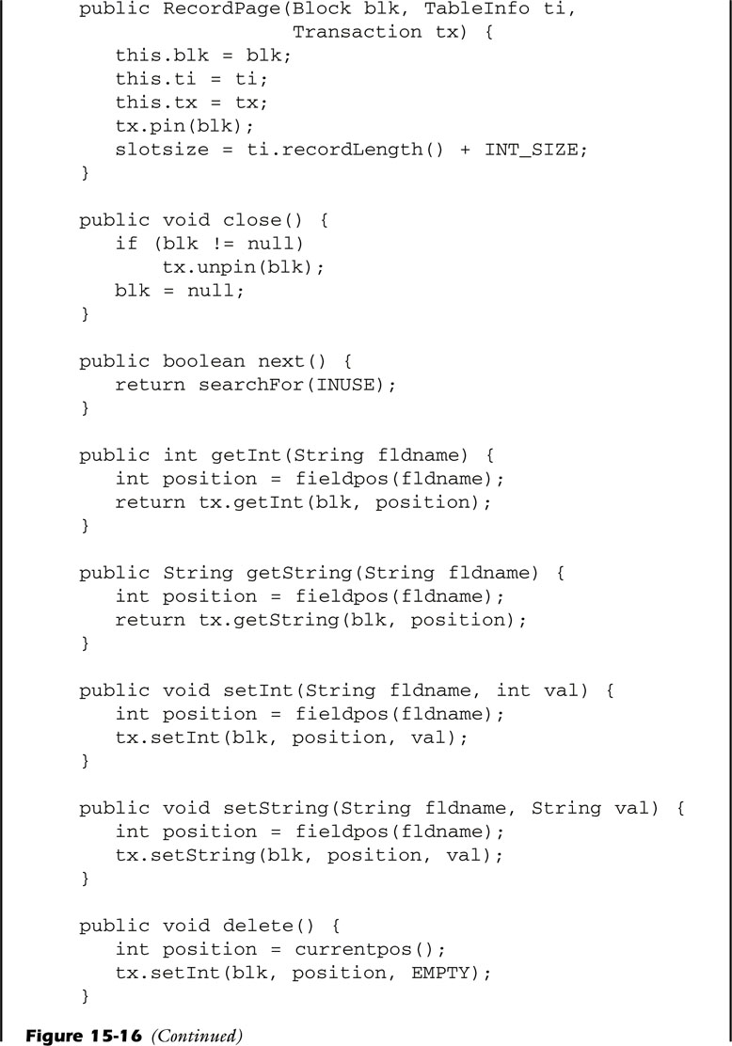
fig_15_16b
fig_15_16b

Slide 22
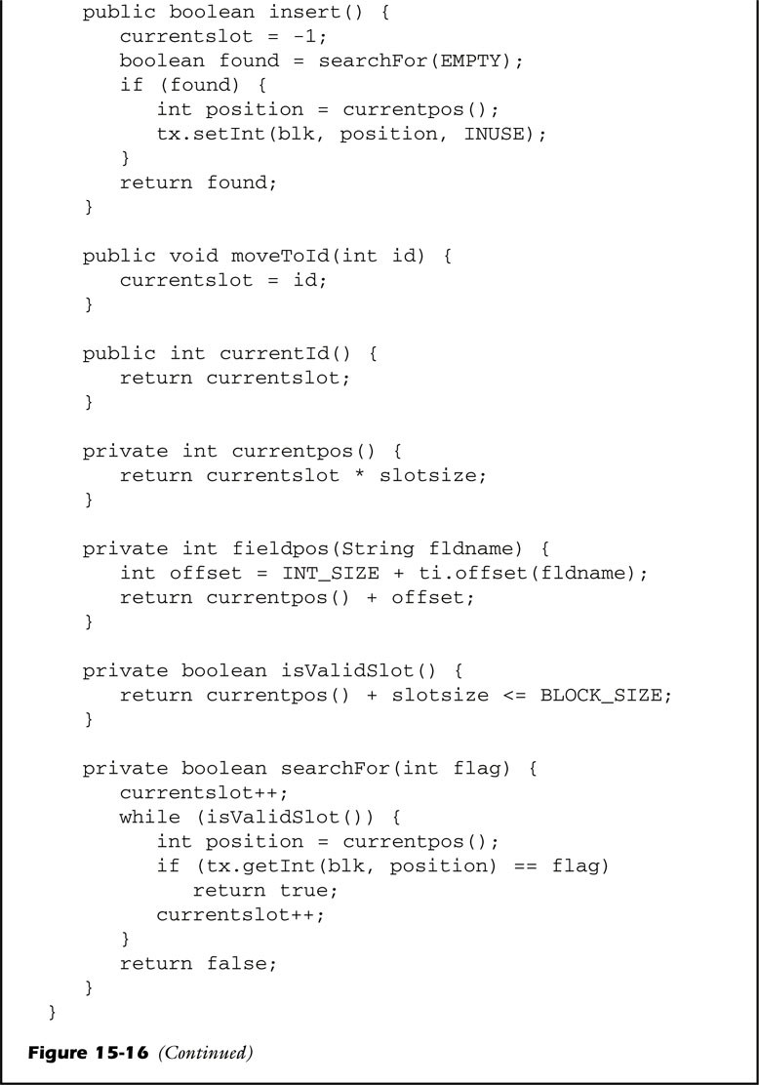
fig_15_16c
fig_15_16c

Slide 23
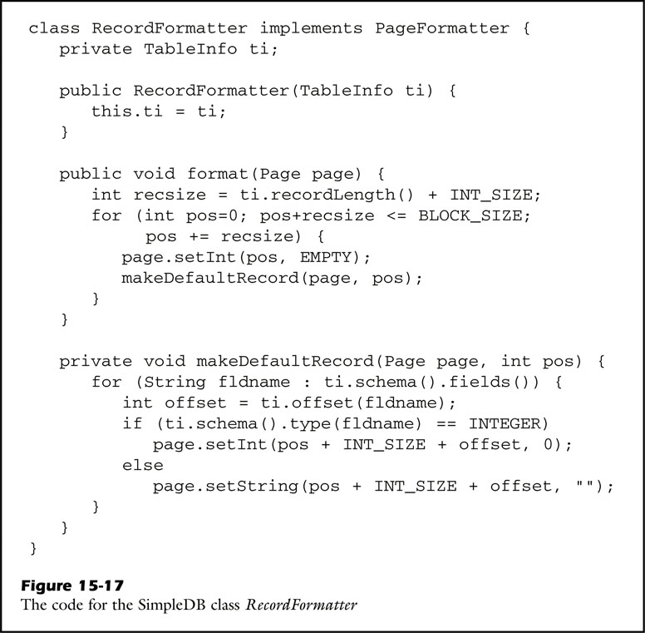
fig_15_17
fig_15_17

Slide 24
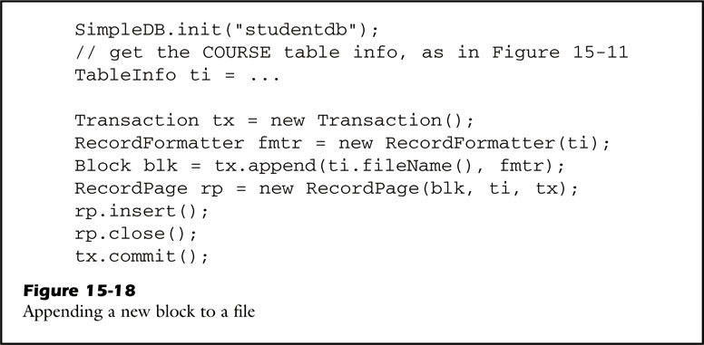
fig_15_18
fig_15_18

Slide 25
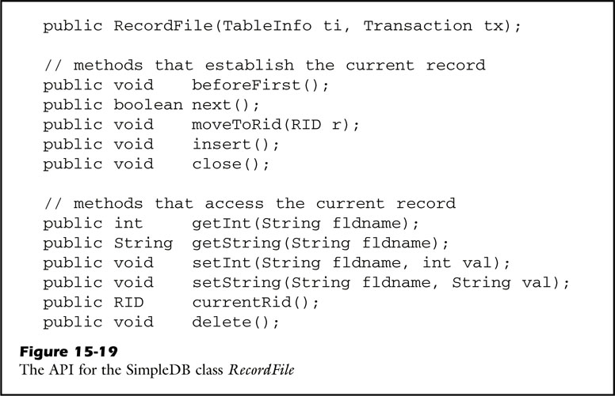
fig_15_19
fig_15_19

Slide 26
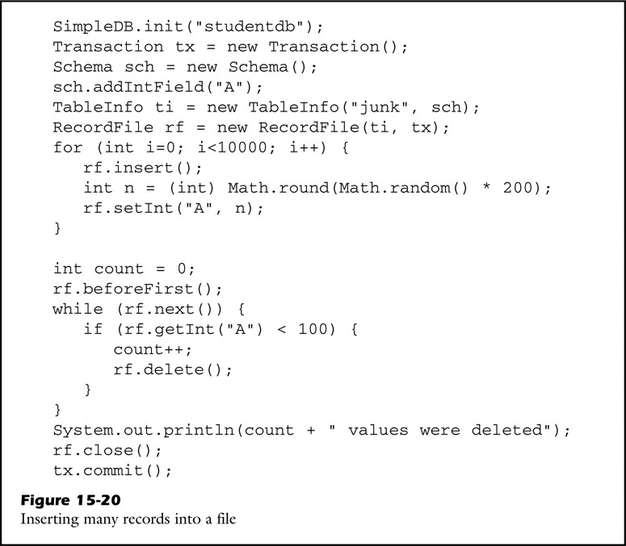
fig_15_20
fig_15_20

Slide 27
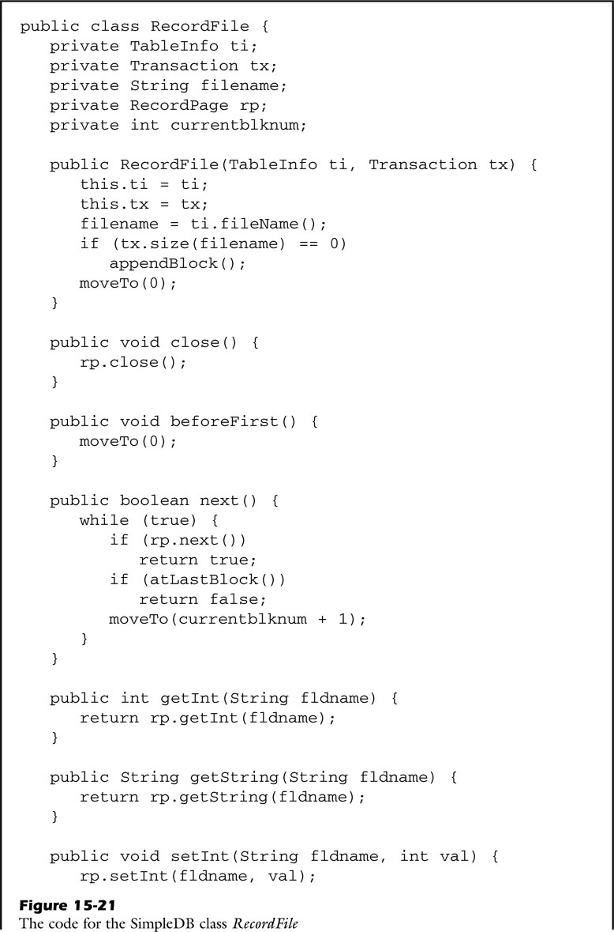
fig_15_21a
fig_15_21a

Slide 28
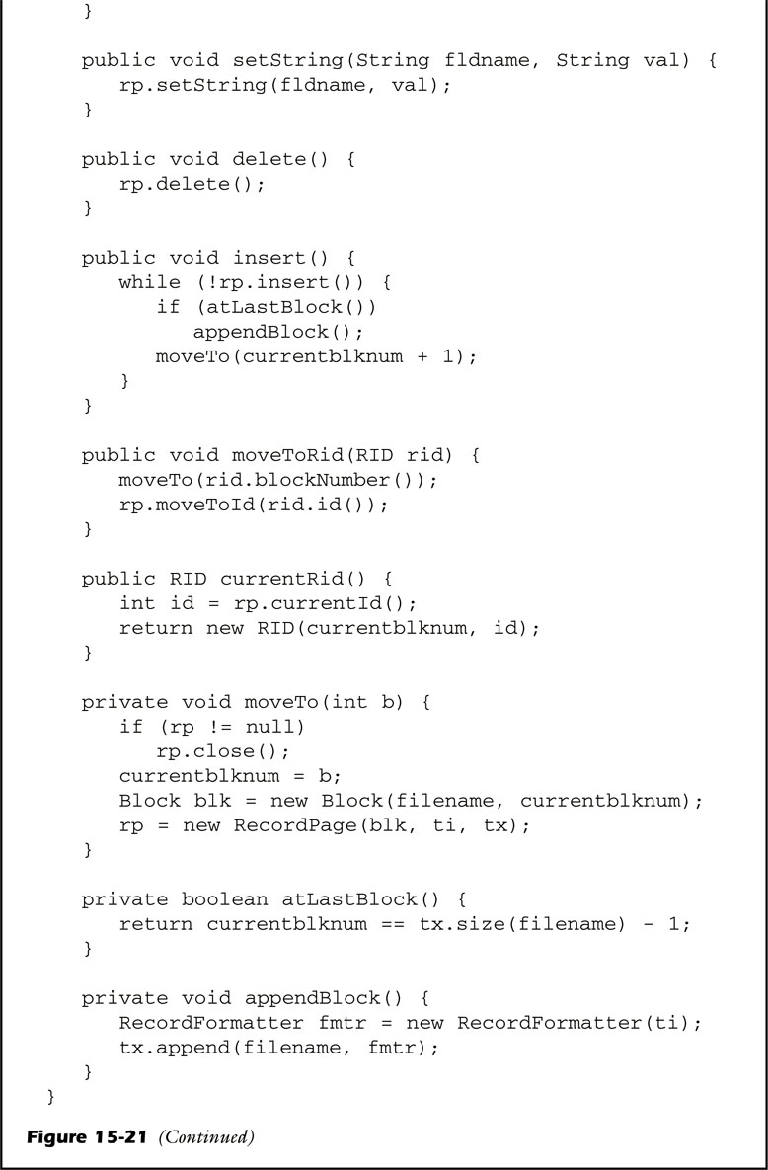
fig_15_21b
fig_15_21b

Slide 29
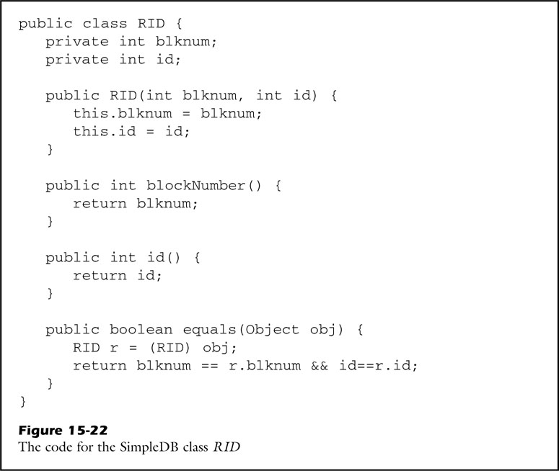
fig_15_22
fig_15_22

Slide 30

unfig_15_01
unfig_15_01

