Slide 1
Text Illustrations
To Accompany
Database Design and Implementation
Edward Sciore, Boston College
ISBN: 978-0-471-75716-0
Chapter 16. Metadata Management

Slide 2

co_16
co_16

Slide 3
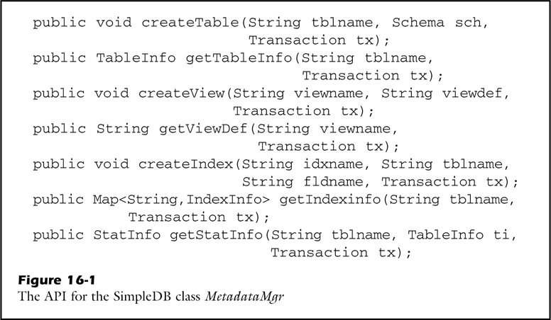
fig_16_01
fig_16_01

Slide 4
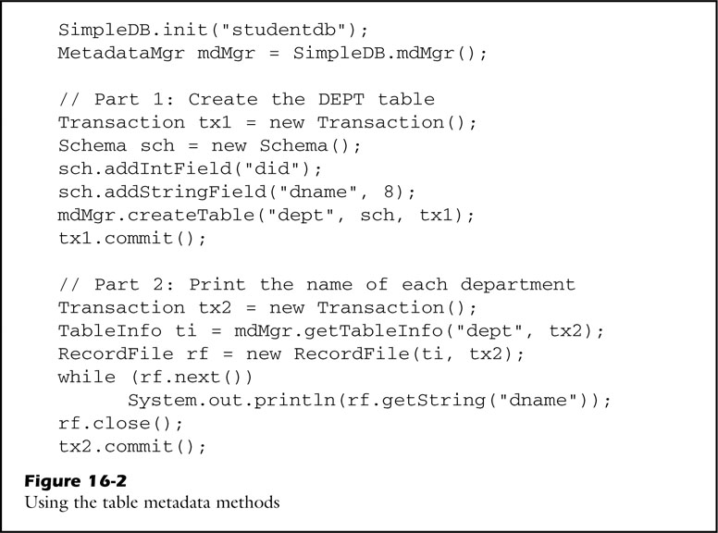
fig_16_02
fig_16_02

Slide 5
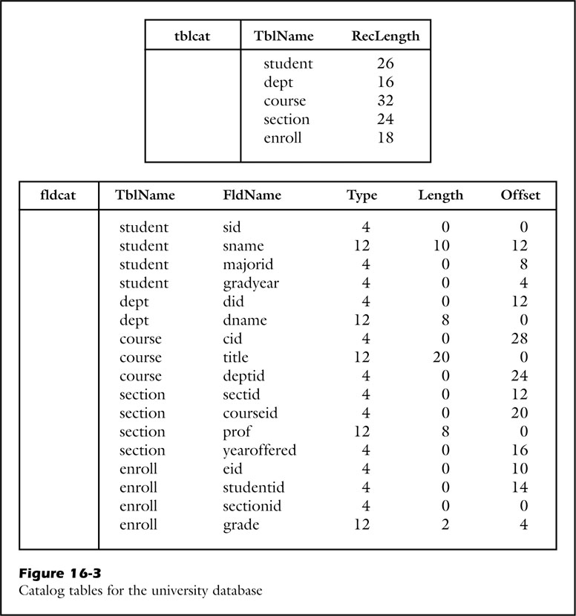
fig_16_03
fig_16_03

Slide 6

fig_16_04
fig_16_04

Slide 7
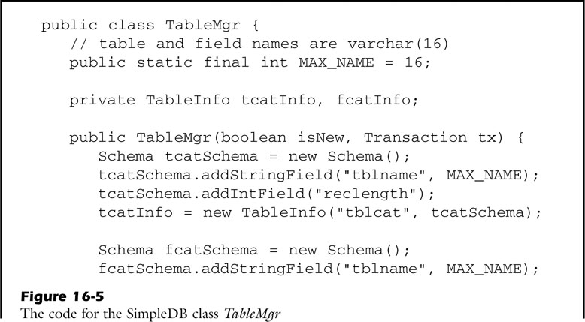
fig_16_05a
fig_16_05a

Slide 8
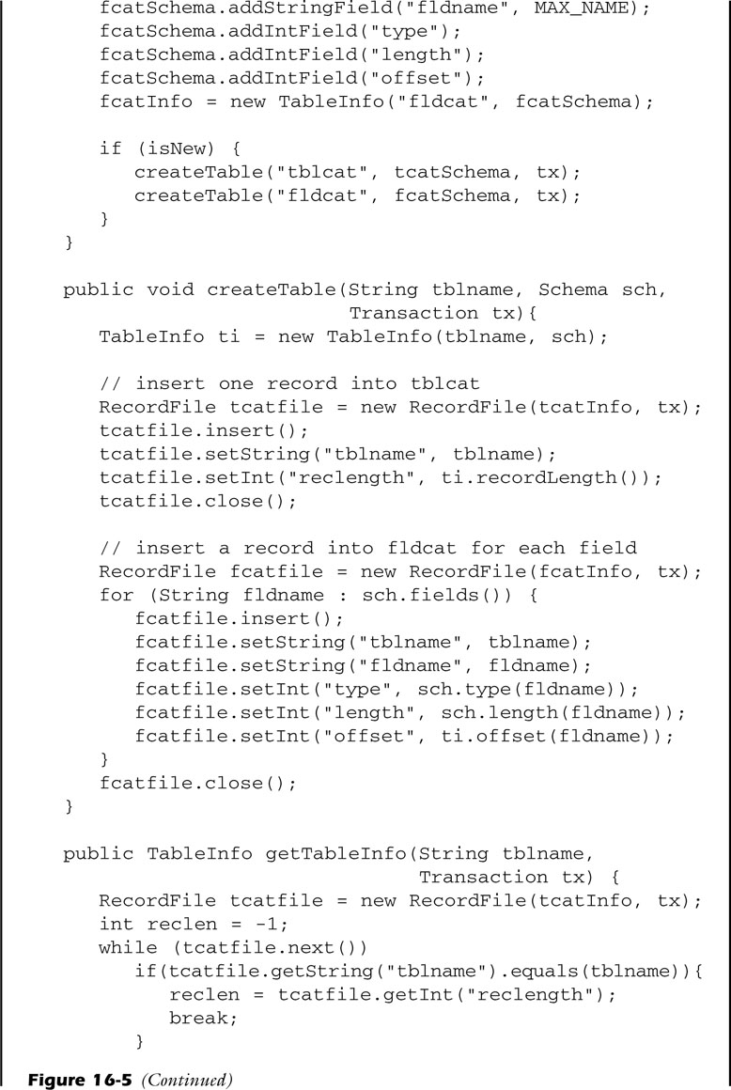
fig_16_05b
fig_16_05b

Slide 9
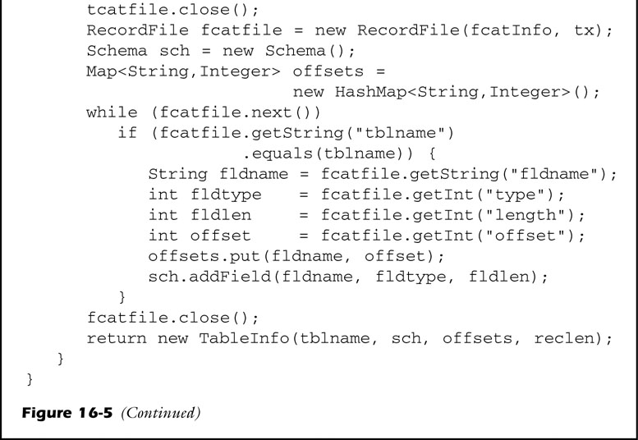
fig_16_05c
fig_16_05c

Slide 10
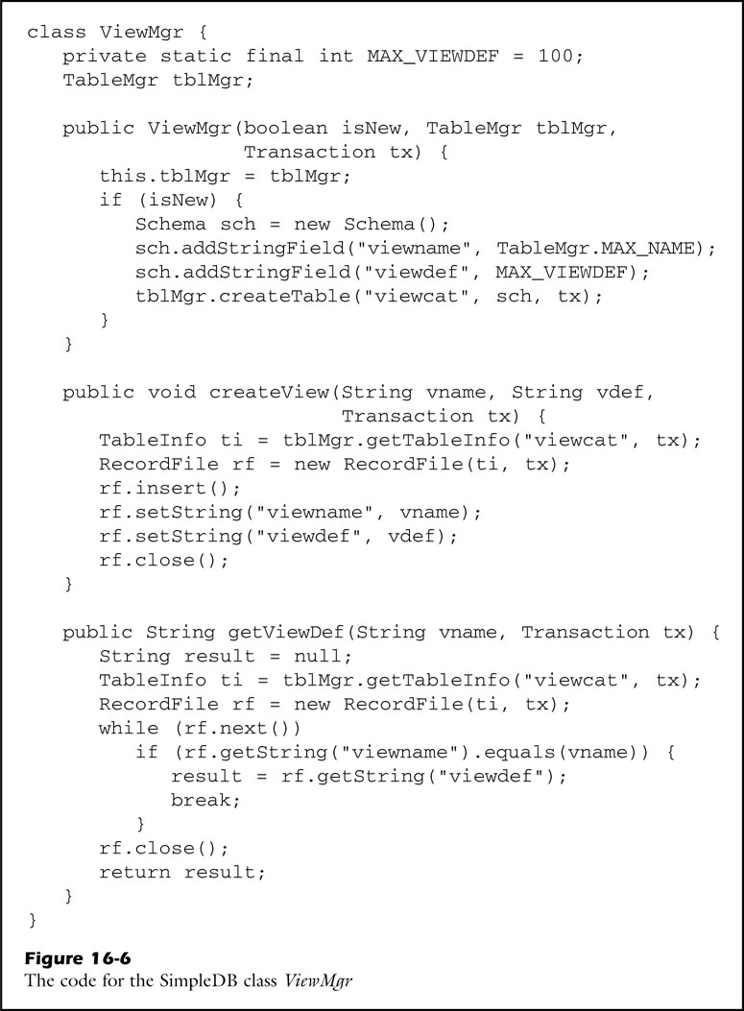
fig_16_06
fig_16_06

Slide 11
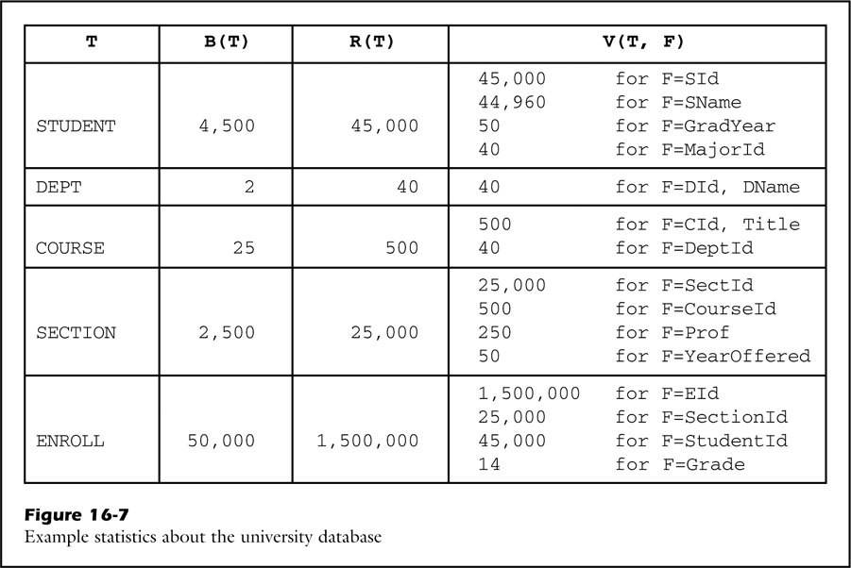
fig_16_07
fig_16_07

Slide 12

fig_16_08
fig_16_08

Slide 13
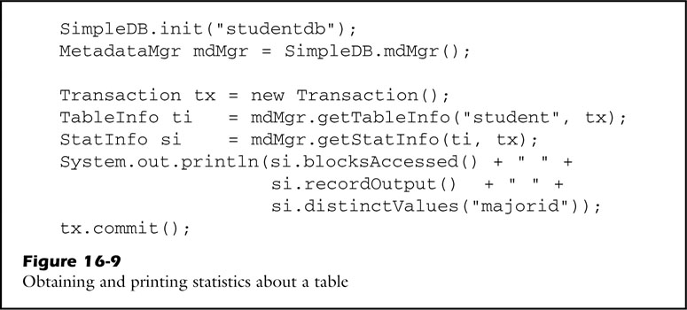
fig_16_09
fig_16_09

Slide 14
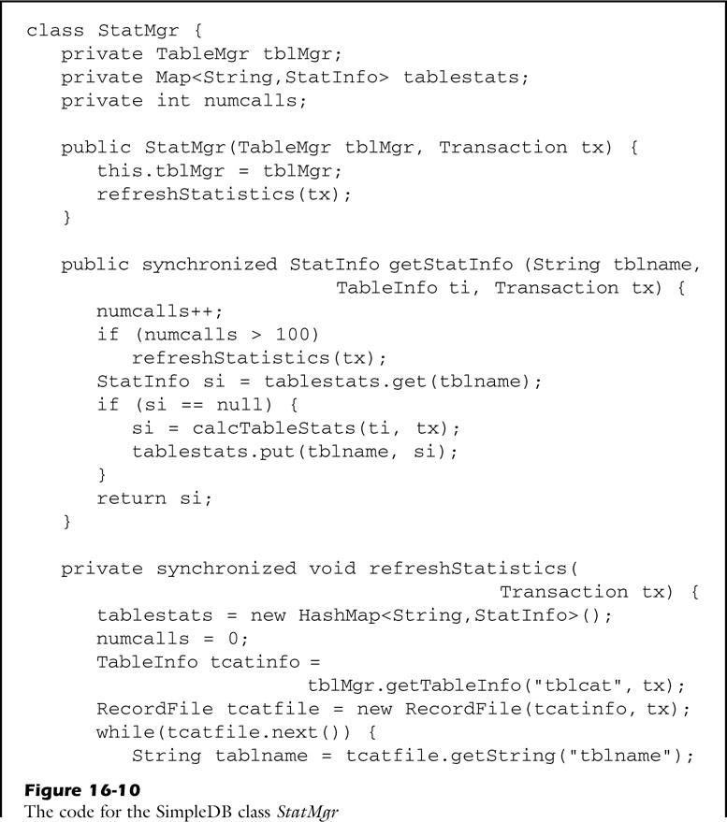
fig_16_10a
fig_16_10a

Slide 15
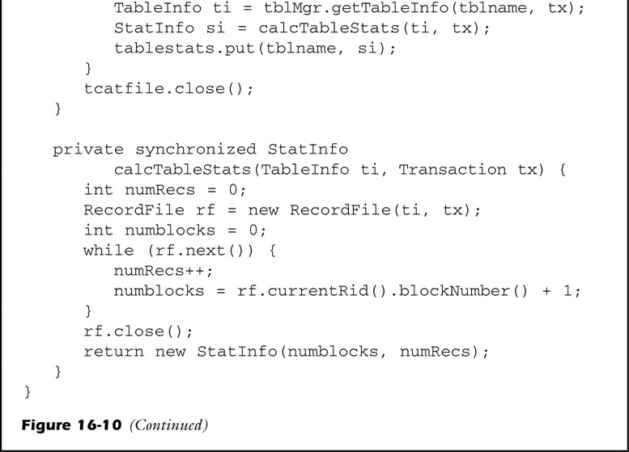
fig_16_10b
fig_16_10b

Slide 16
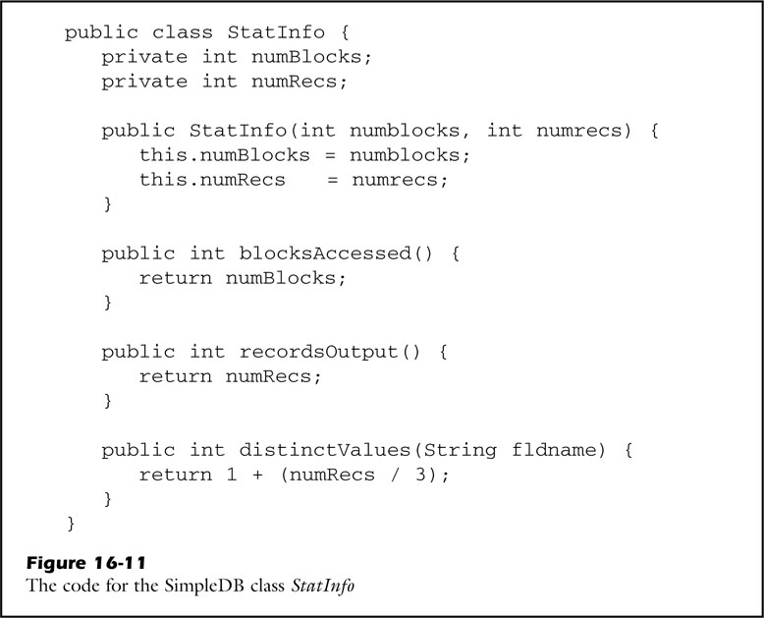
fig_16_11
fig_16_11

Slide 17
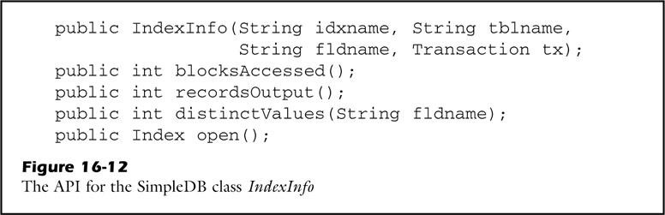
fig_16_12
fig_16_12

Slide 18
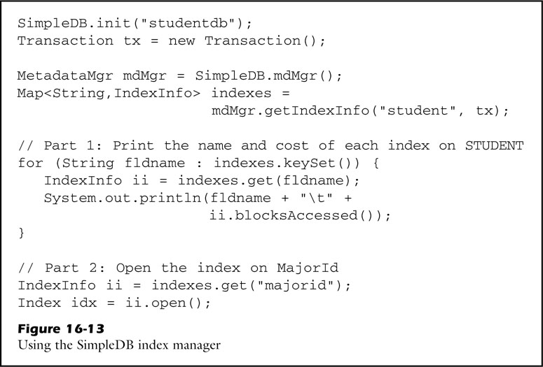
fig_16_13
fig_16_13

Slide 19
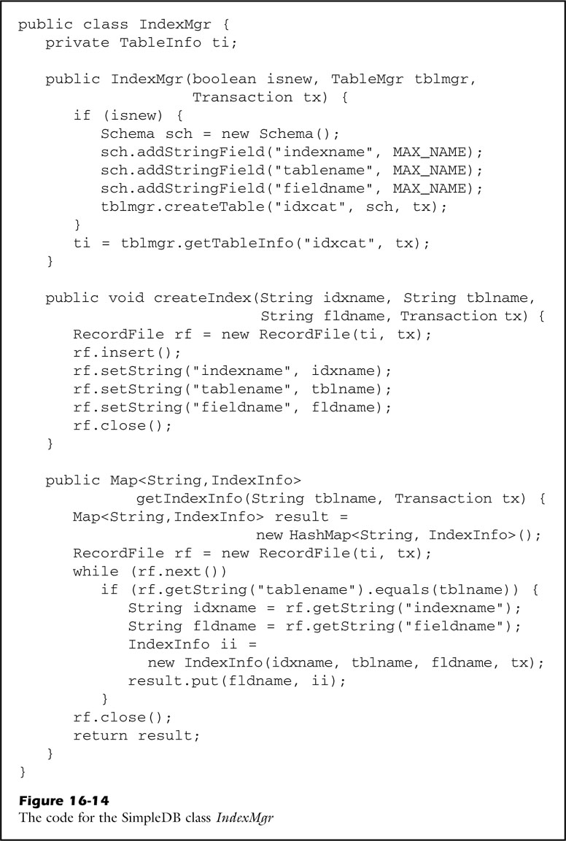
fig_16_14
fig_16_14

Slide 20
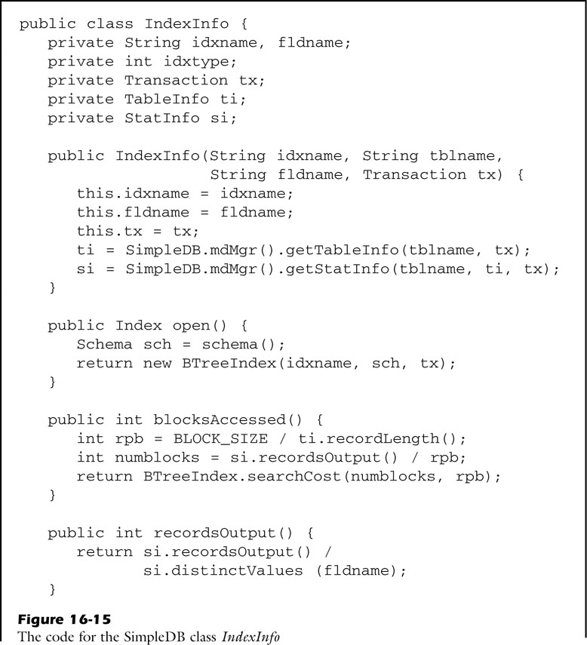
fig_16_15a
fig_16_15a

Slide 21
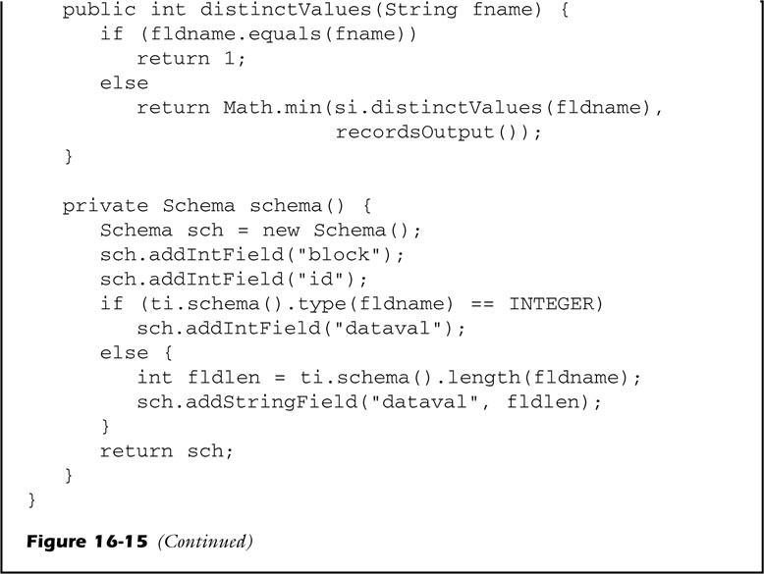
fig_16_15b
fig_16_15b

Slide 22
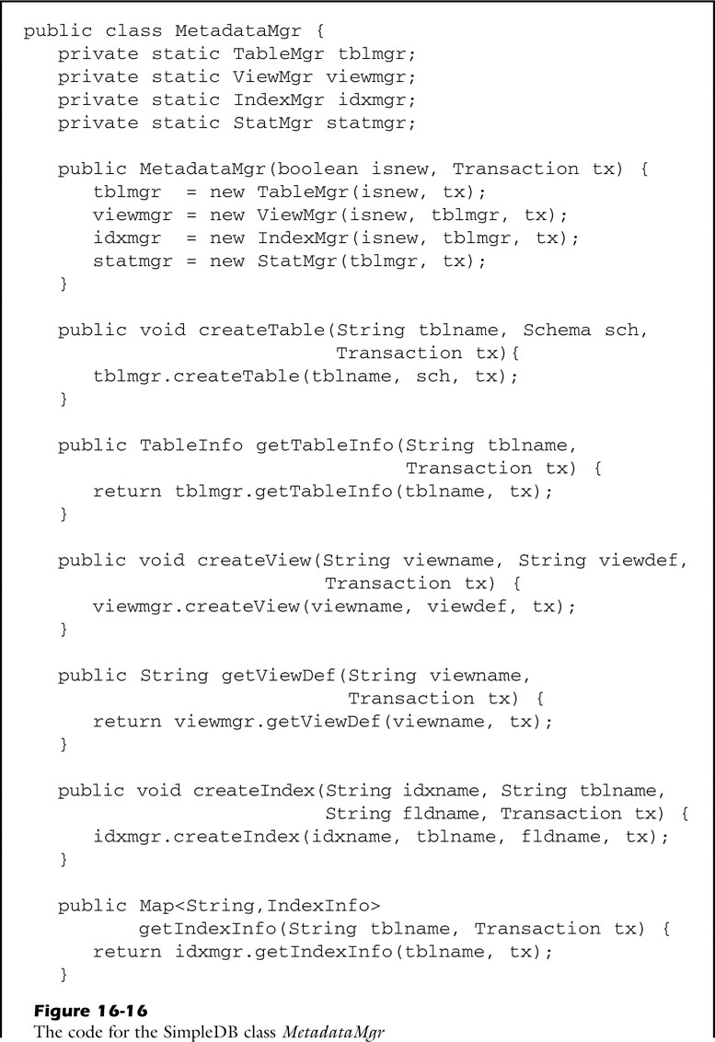
fig_16_16a
fig_16_16a

Slide 23

fig_16_16b
fig_16_16b

