Slide 1
Text Illustrations
To Accompany
Database Design and Implementation
Edward Sciore, Boston College
ISBN: 978-0-471-75716-0
Chapter 17. Query Processing

Slide 2
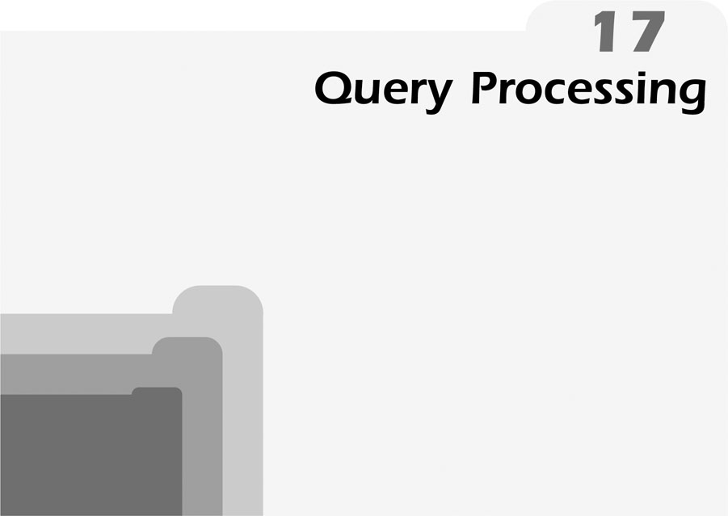
co_17
co_17

Slide 3
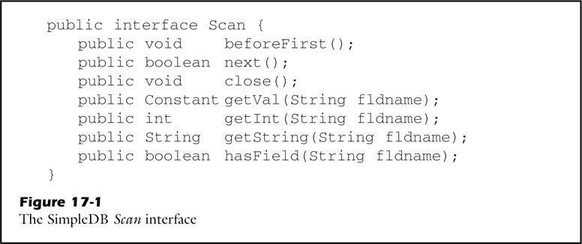
fig_17_01
fig_17_01

Slide 4
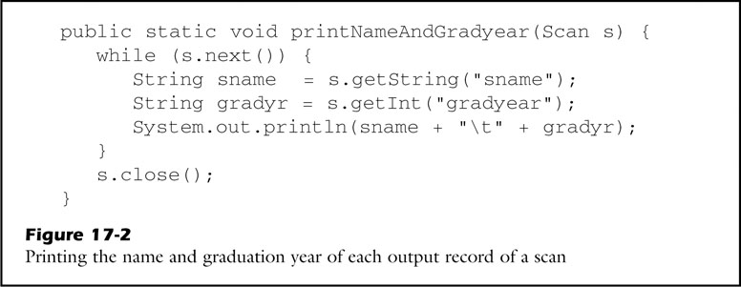
fig_17_02
fig_17_02

Slide 5
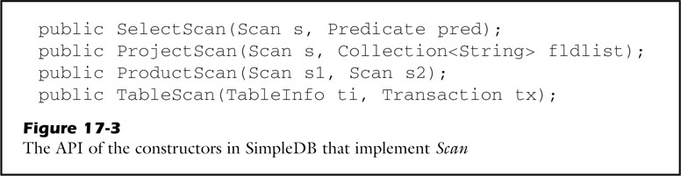
fig_17_03
fig_17_03

Slide 6
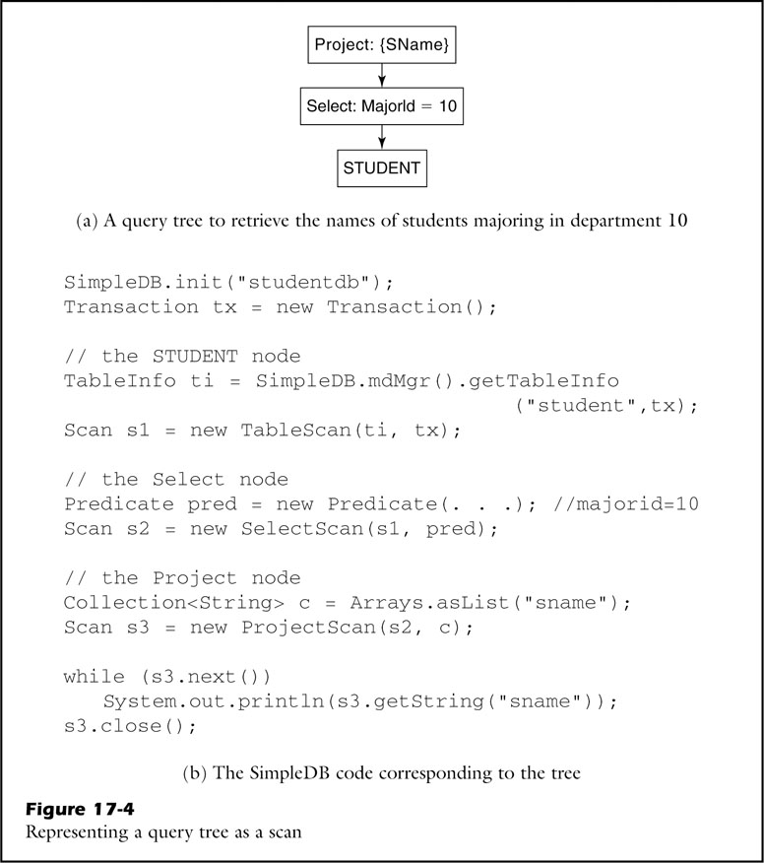
fig_17_04
fig_17_04

Slide 7
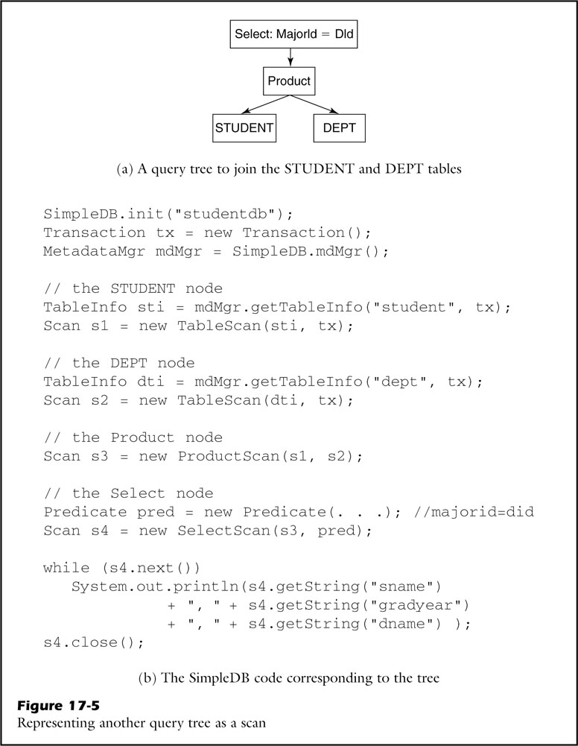
fig_17_05
fig_17_05

Slide 8
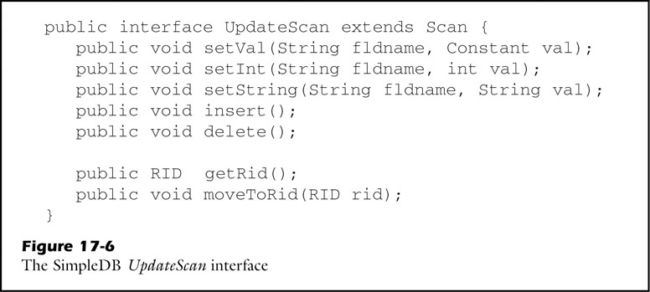
fig_17_06
fig_17_06

Slide 9
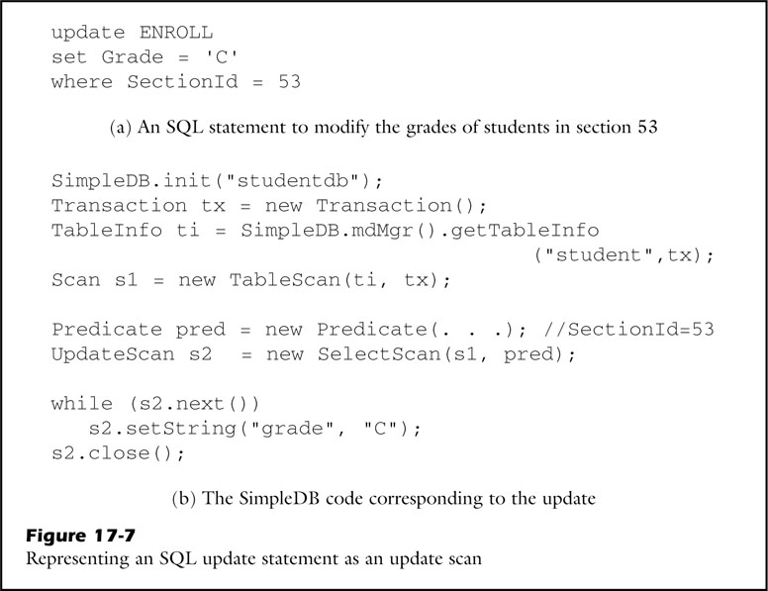
fig_17_07
fig_17_07

Slide 10
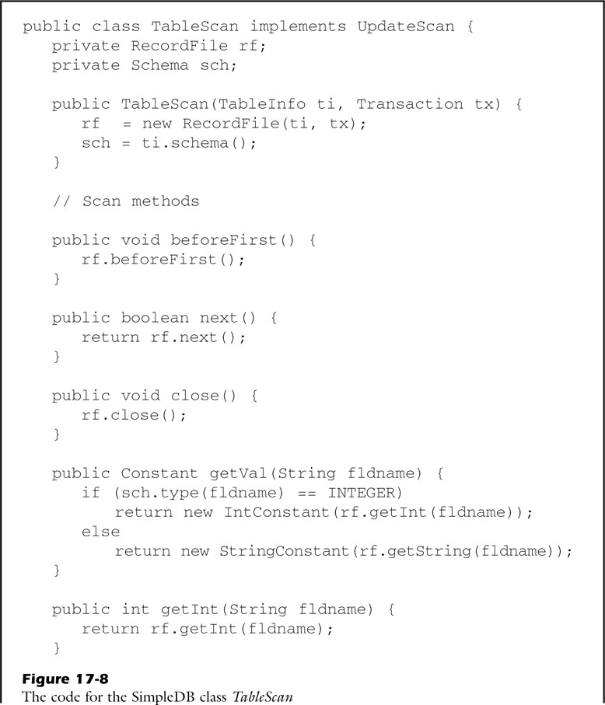
fig_17_08a
fig_17_08a

Slide 11
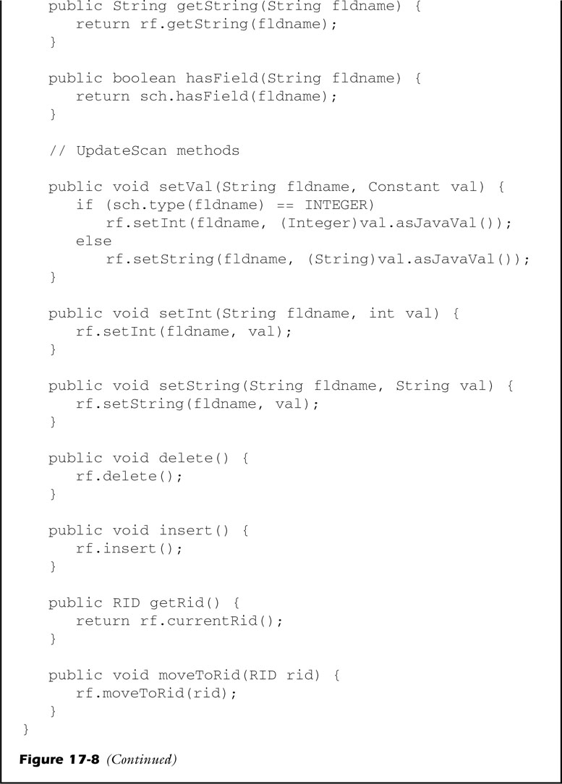
fig_17_08b
fig_17_08b

Slide 12
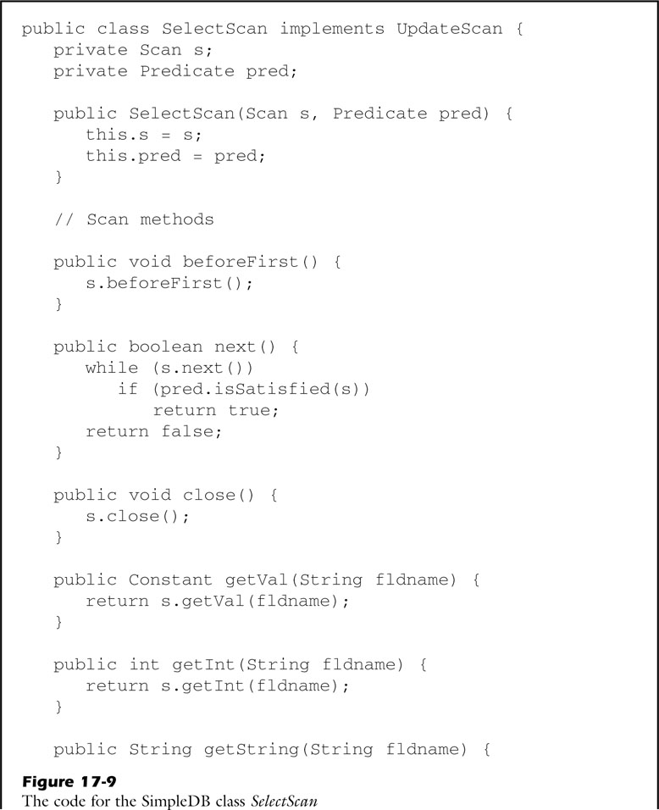
fig_17_09a
fig_17_09a

Slide 13
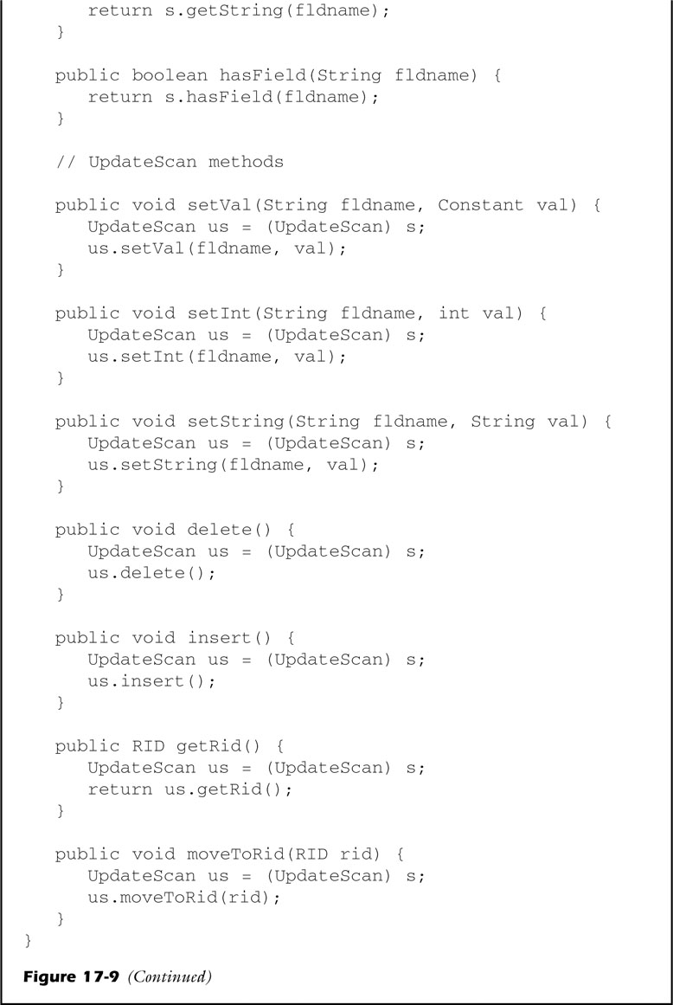
fig_17_09b
fig_17_09b

Slide 14
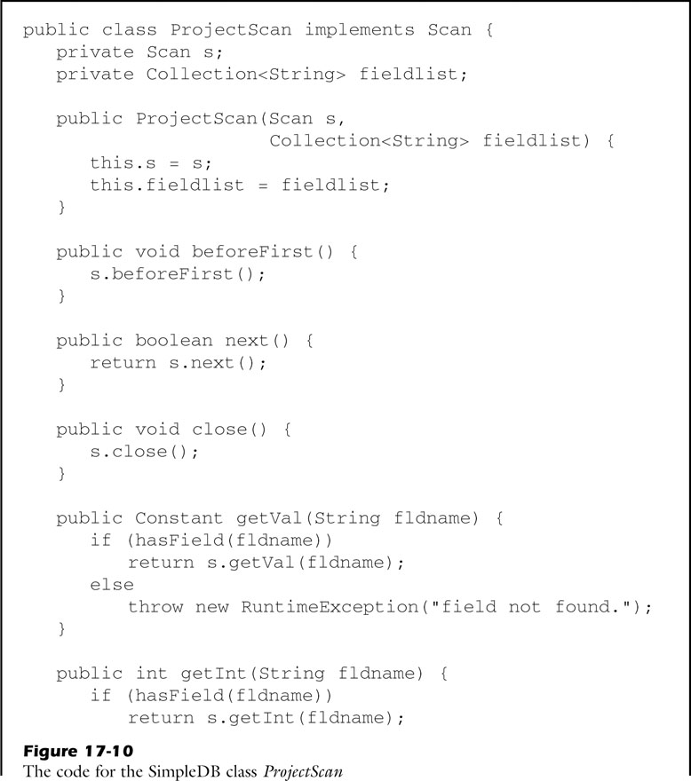
fig_17_10a
fig_17_10a

Slide 15
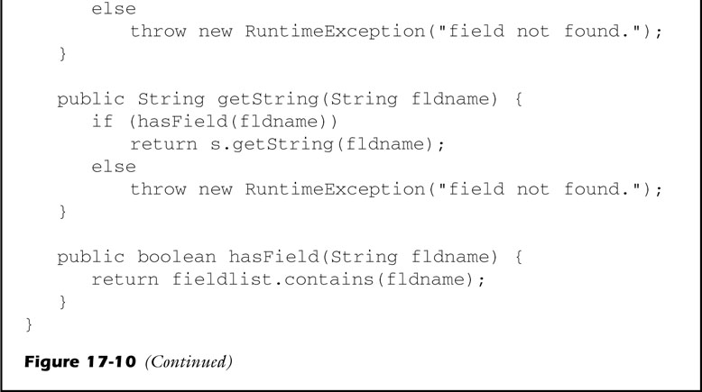
fig_17_10b
fig_17_10b

Slide 16
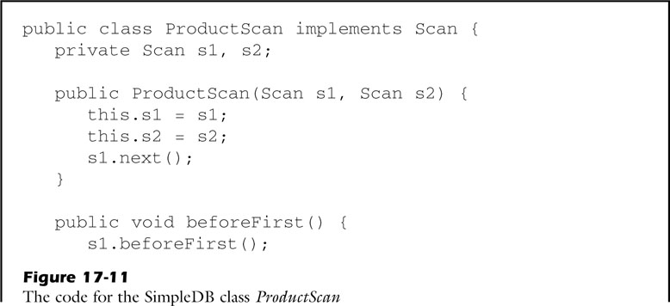
fig_17_11a
fig_17_11a

Slide 17
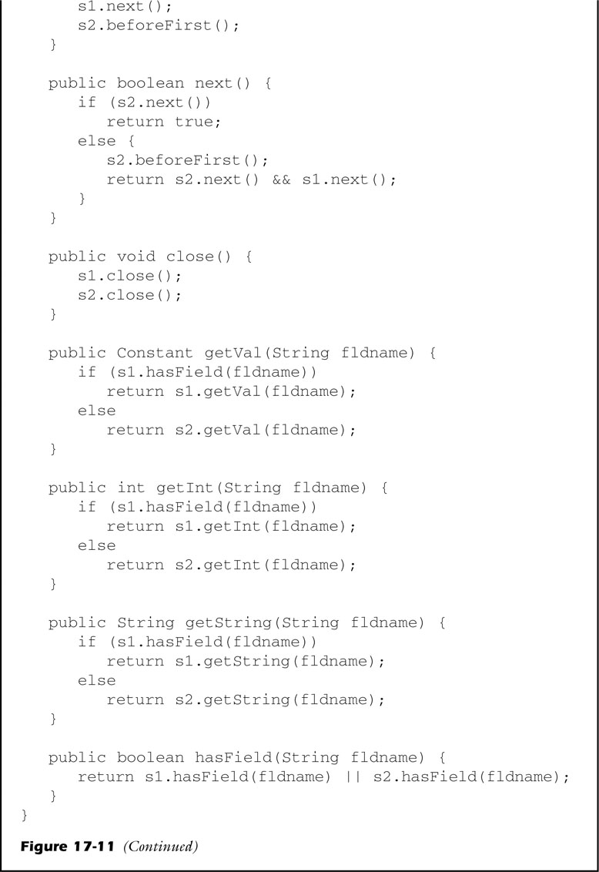
fig_17_11b
fig_17_11b

Slide 18
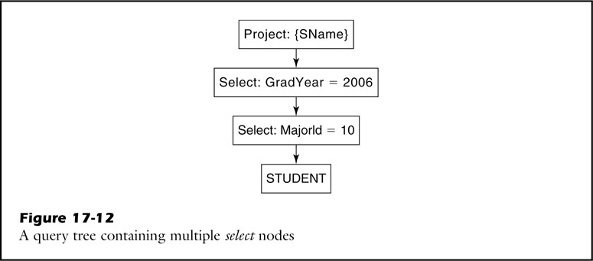
fig_17_12
fig_17_12

Slide 19
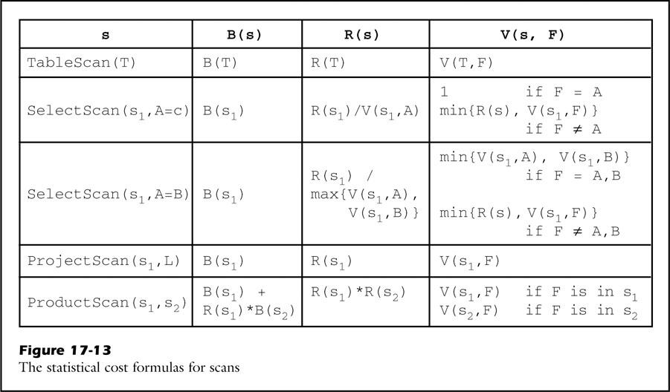
fig_17_13
fig_17_13

Slide 20
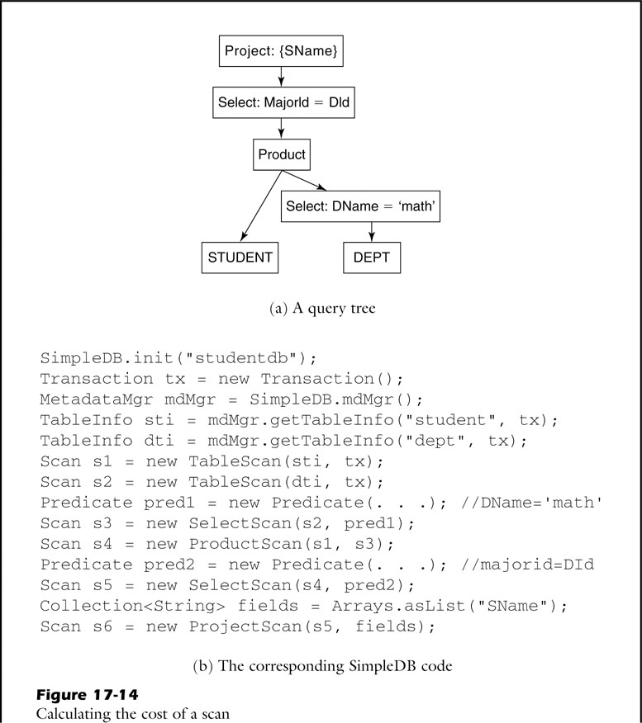
fig_17_14a
fig_17_14a

Slide 21
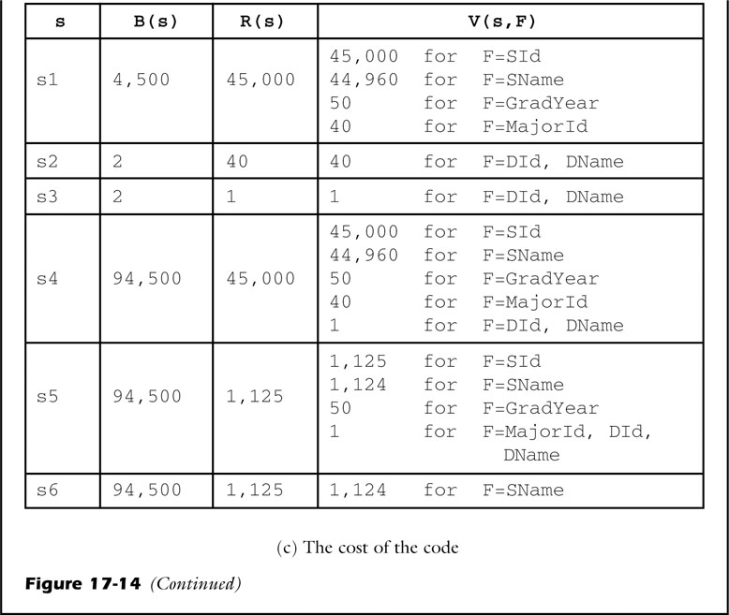
fig_17_14b
fig_17_14b

Slide 22
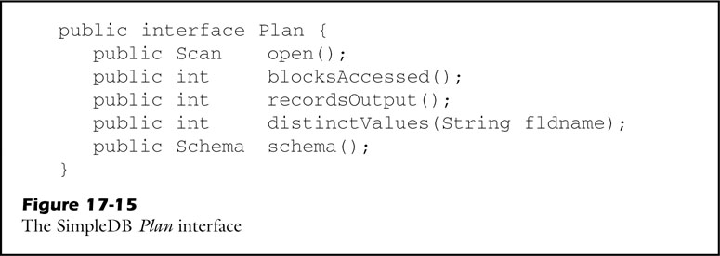
fig_17_15
fig_17_15

Slide 23
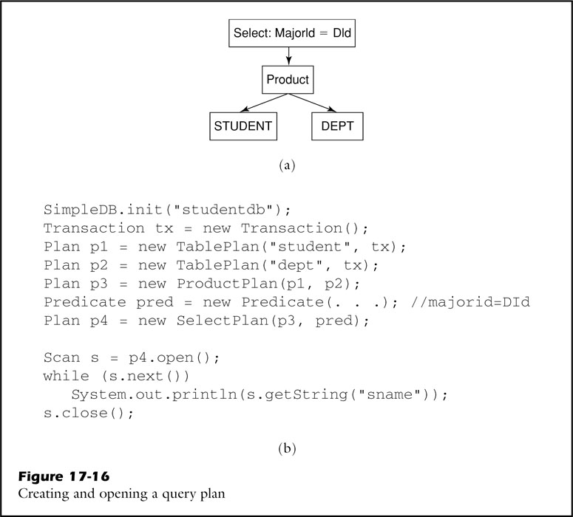
fig_17_16
fig_17_16

Slide 24
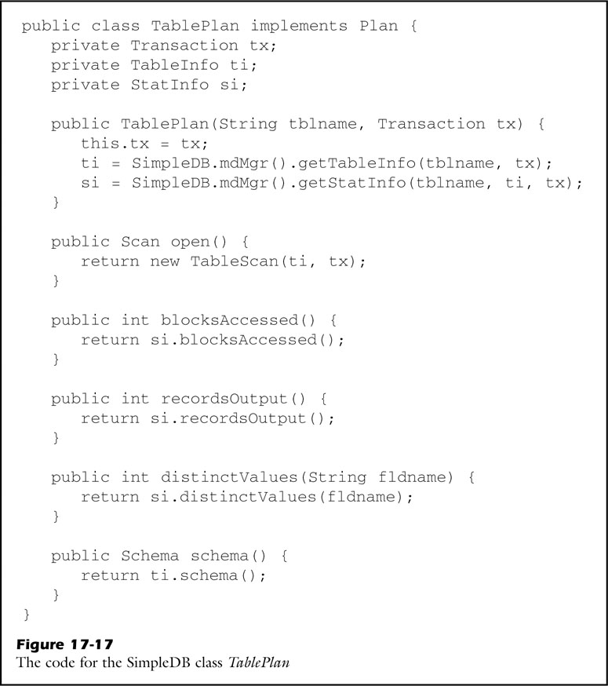
fig_17_17
fig_17_17

Slide 25
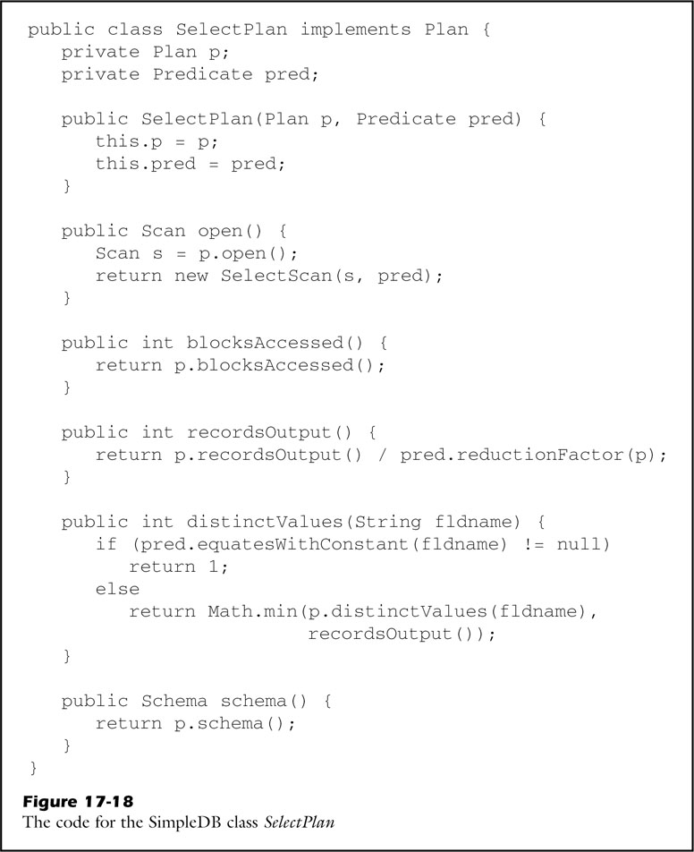
fig_17_18
fig_17_18

Slide 26
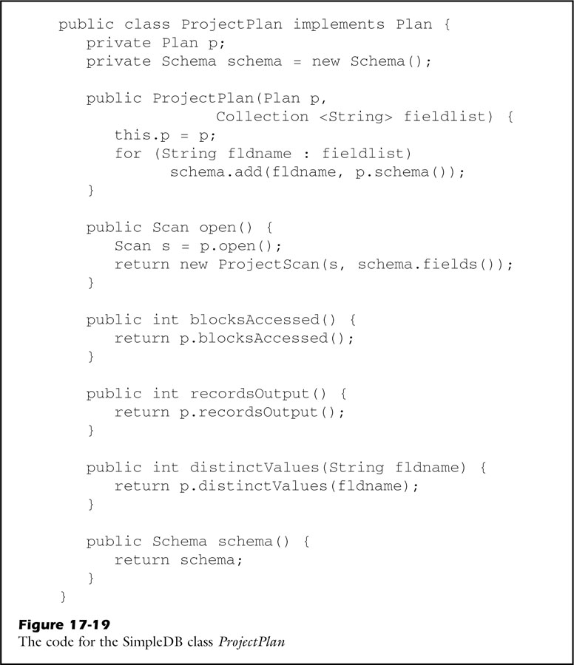
fig_17_19
fig_17_19

Slide 27
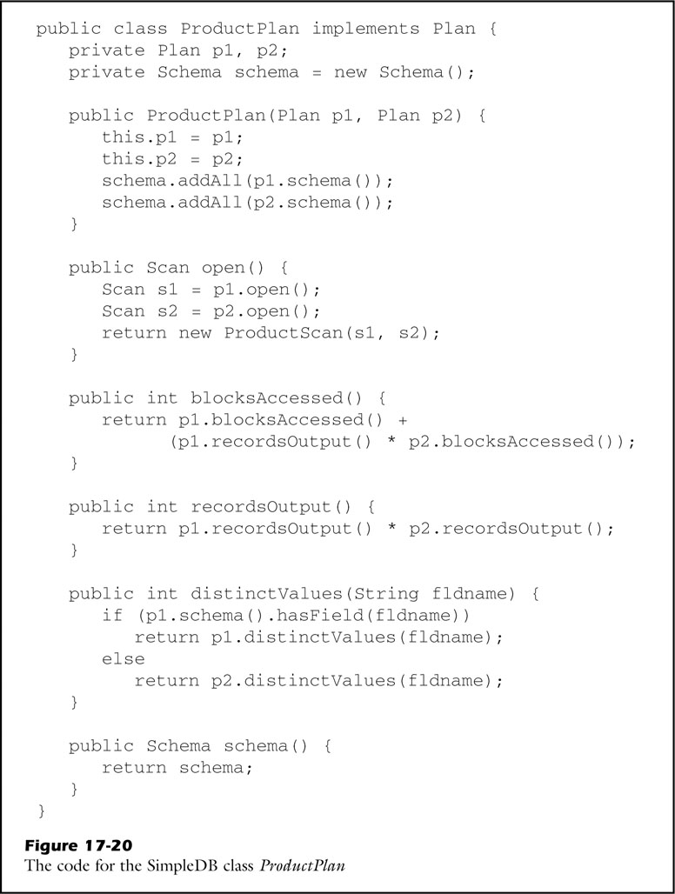
fig_17_20
fig_17_20

Slide 28
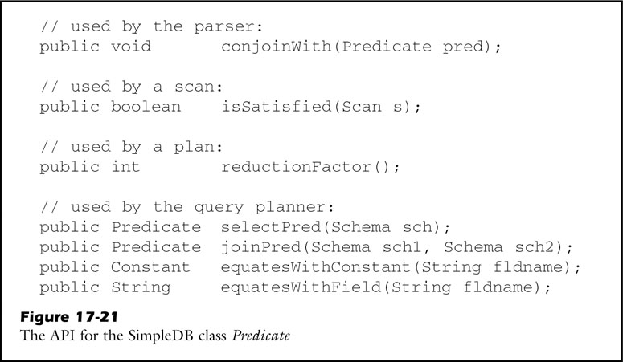
fig_17_21
fig_17_21

Slide 29
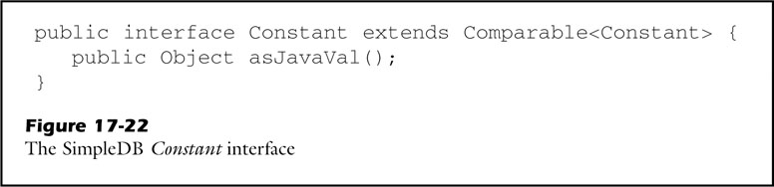
fig_17_22
fig_17_22

Slide 30
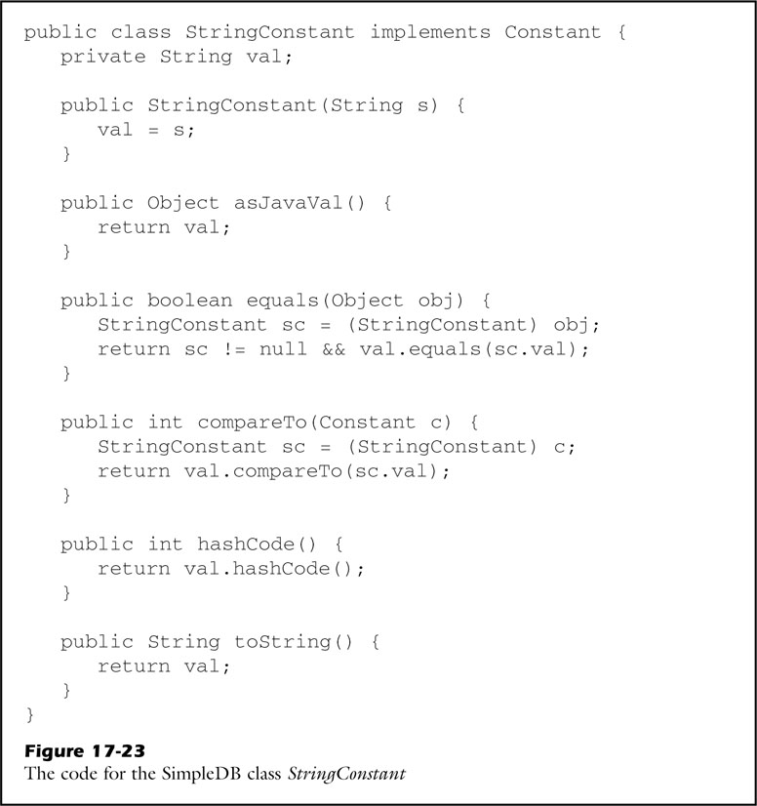
fig_17_23
fig_17_23

Slide 31
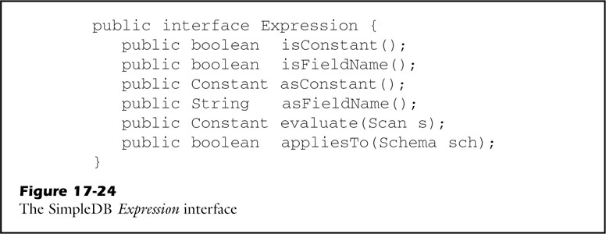
fig_17_24
fig_17_24

Slide 32
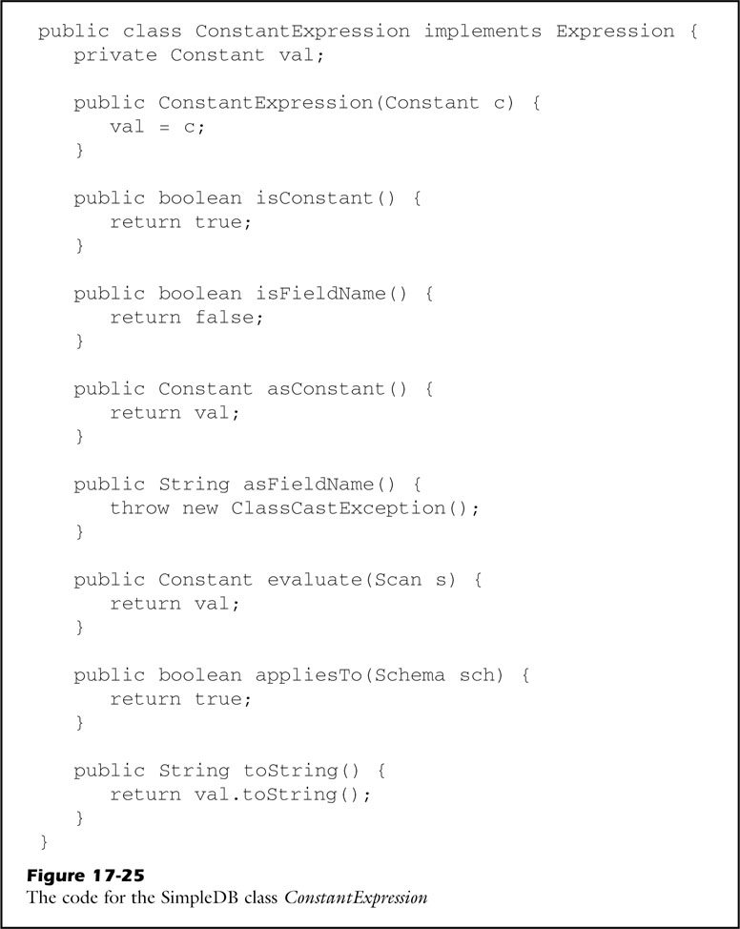
fig_17_25
fig_17_25

Slide 33
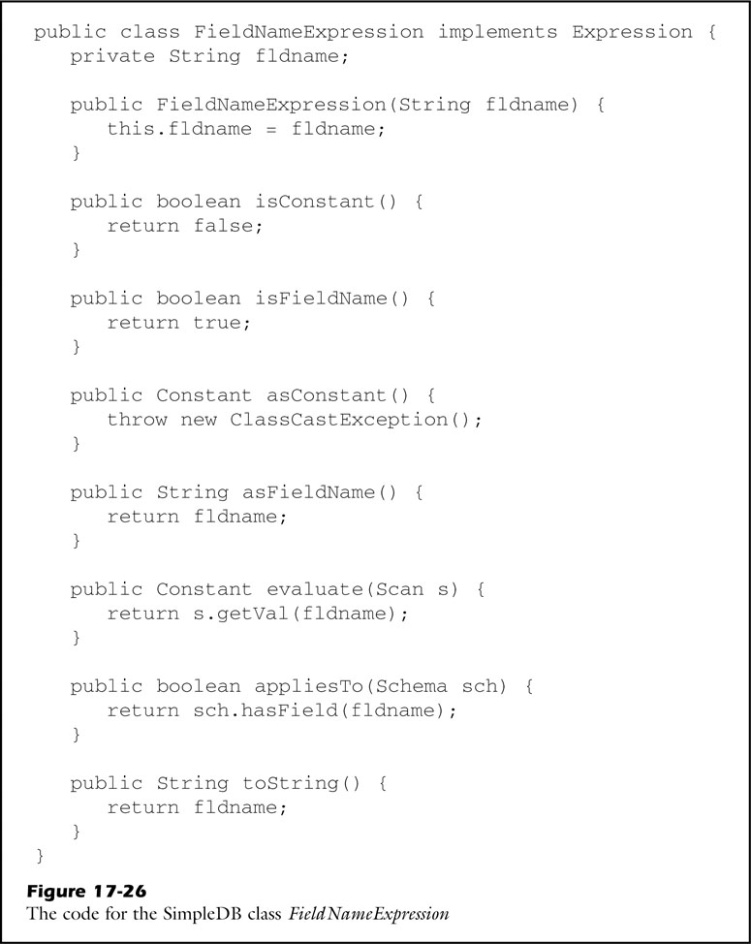
fig_17_26
fig_17_26

Slide 34
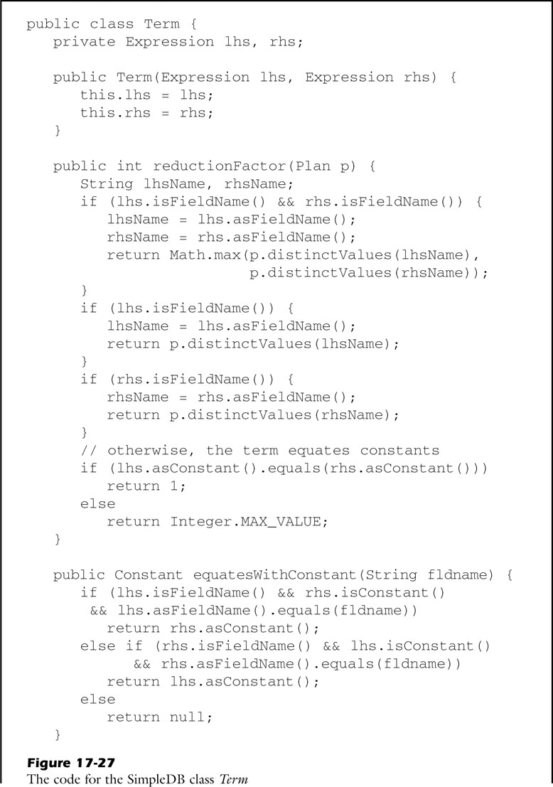
fig_17_27a
fig_17_27a

Slide 35
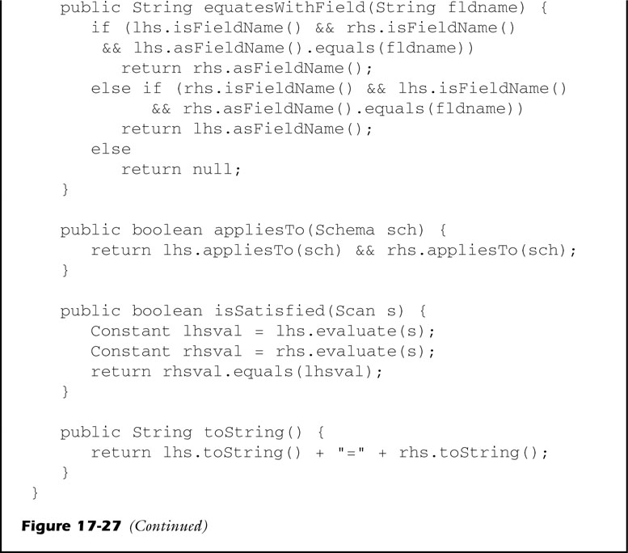
fig_17_27b
fig_17_27b

Slide 36
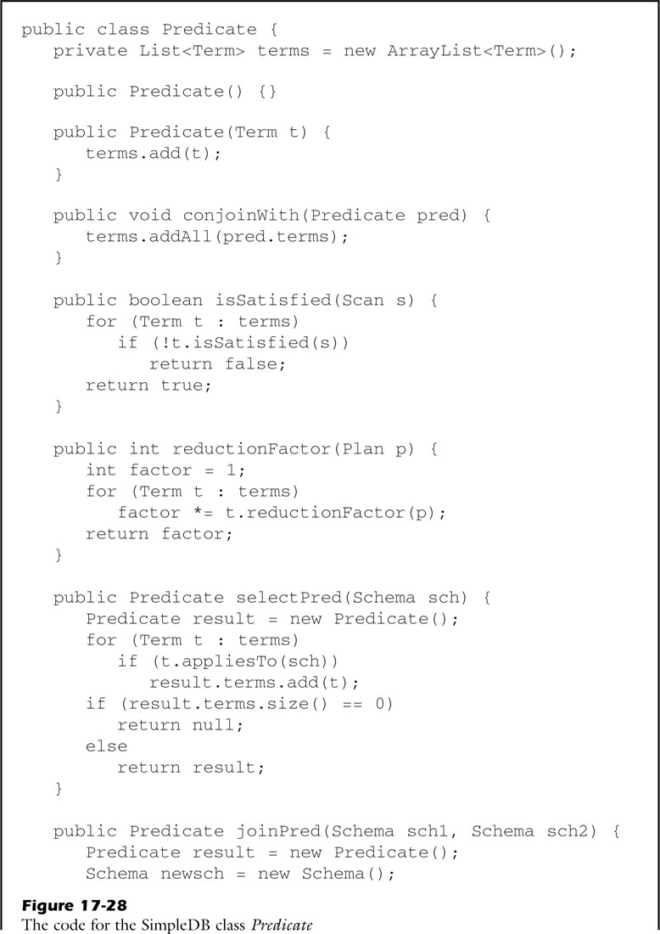
fig_17_28a
fig_17_28a

Slide 37
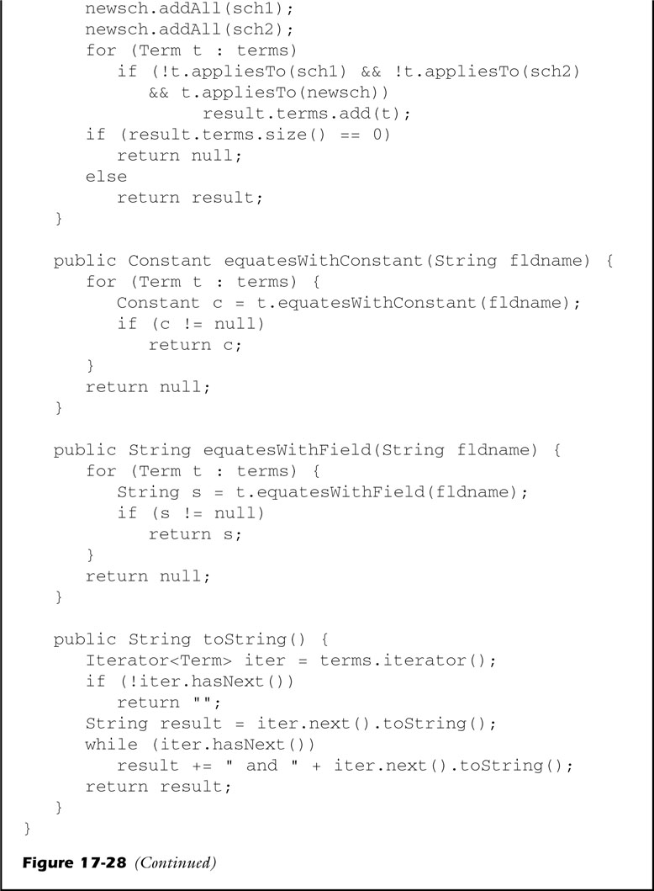
fig_17_28b
fig_17_28b

Slide 38
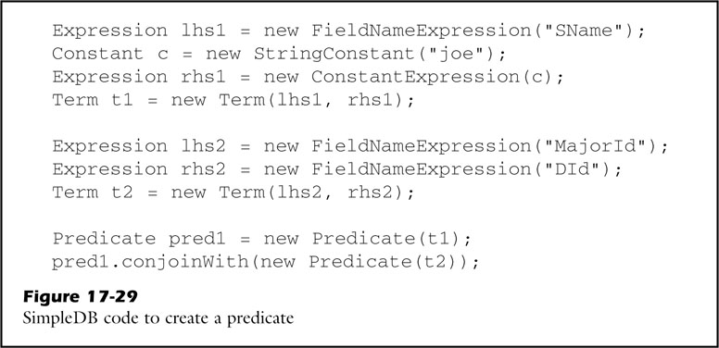
fig_17_29
fig_17_29

