Slide 1
Text Illustrations
To Accompany
Database Design and Implementation
Edward Sciore, Boston College
ISBN: 978-0-471-75716-0
Chapter 18. Parsing

Slide 2

co_18
co_18

Slide 3
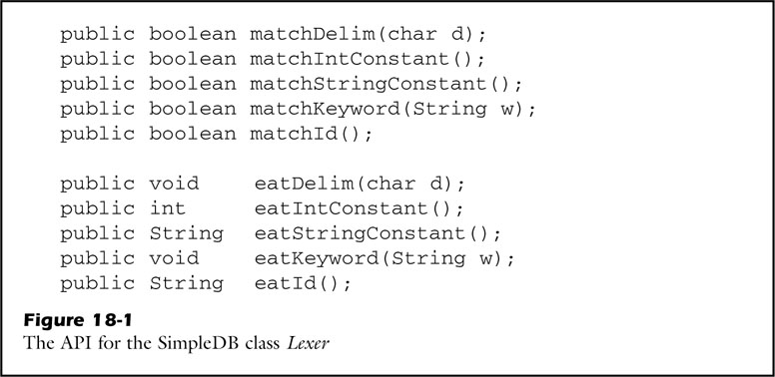
fig_18_01
fig_18_01

Slide 4
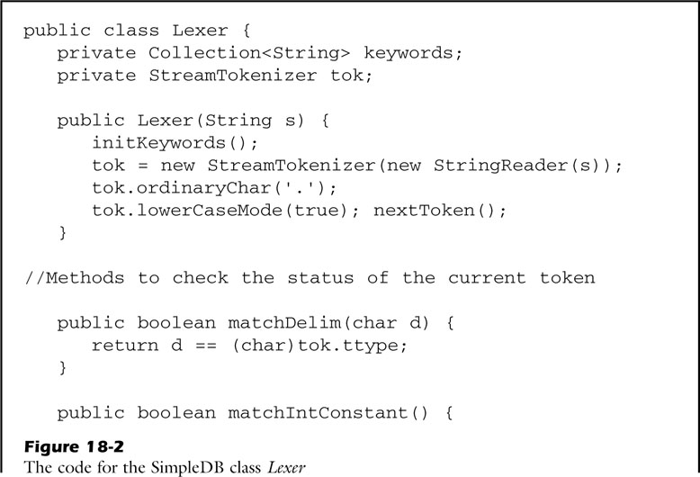
fig_18_02a
fig_18_02a

Slide 5
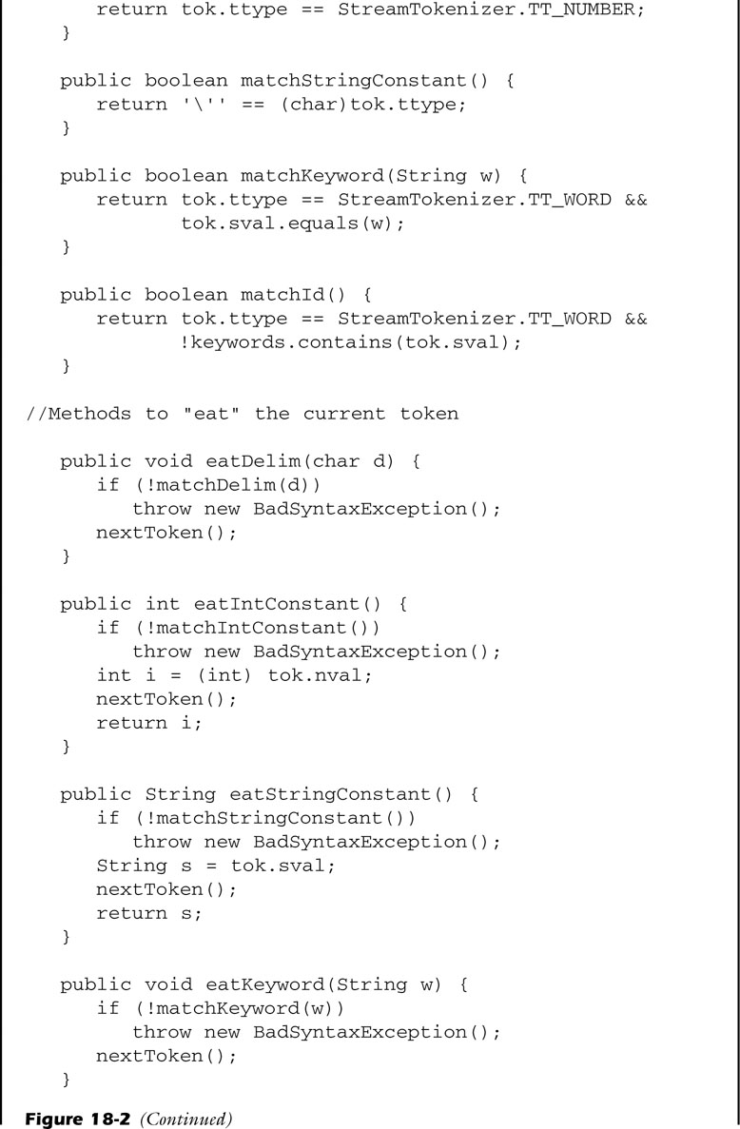
fig_18_02b
fig_18_02b

Slide 6
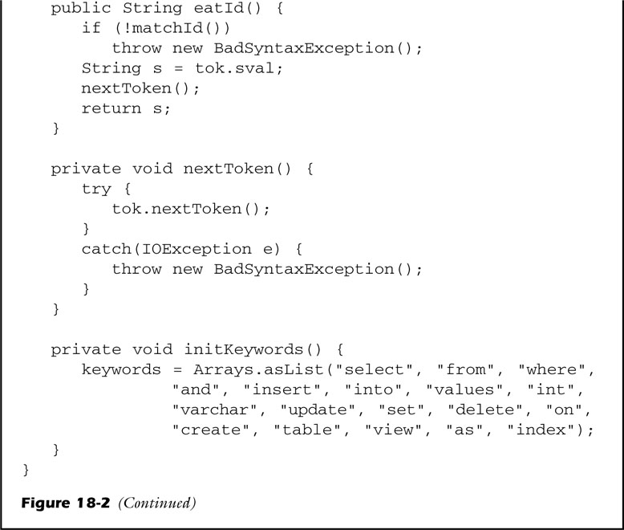
fig_18_02c
fig_18_02c

Slide 7
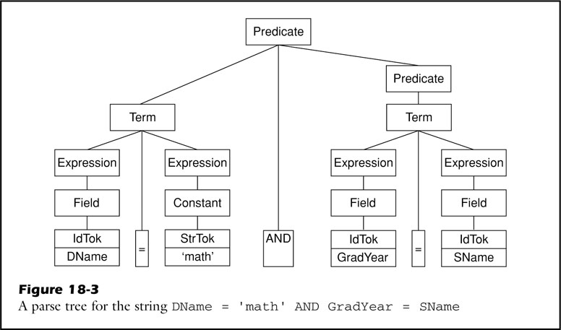
fig_18_03
fig_18_03

Slide 8
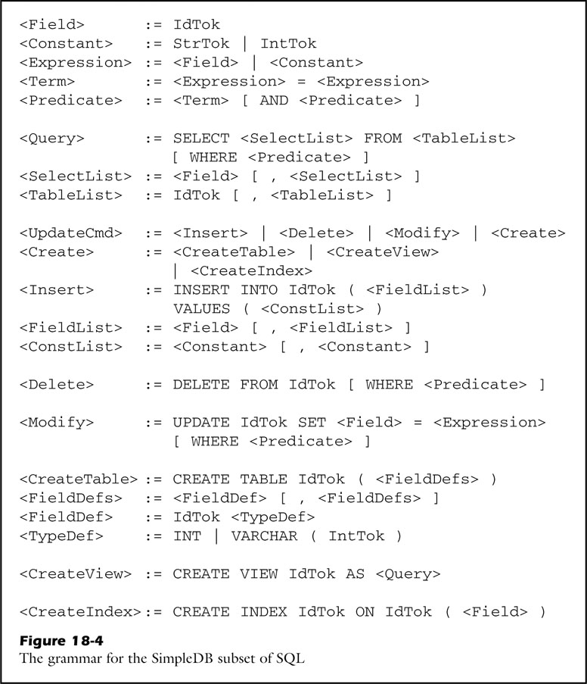
fig_18_04
fig_18_04

Slide 9
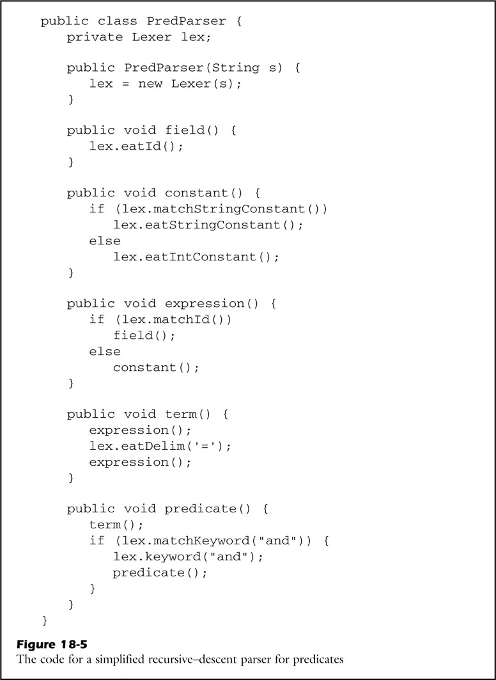
fig_18_05
fig_18_05

Slide 10
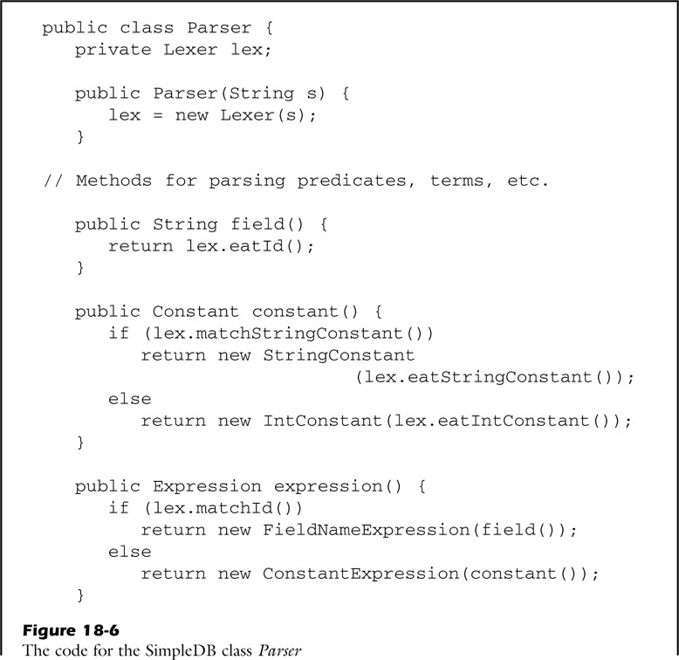
fig_18_06a
fig_18_06a

Slide 11
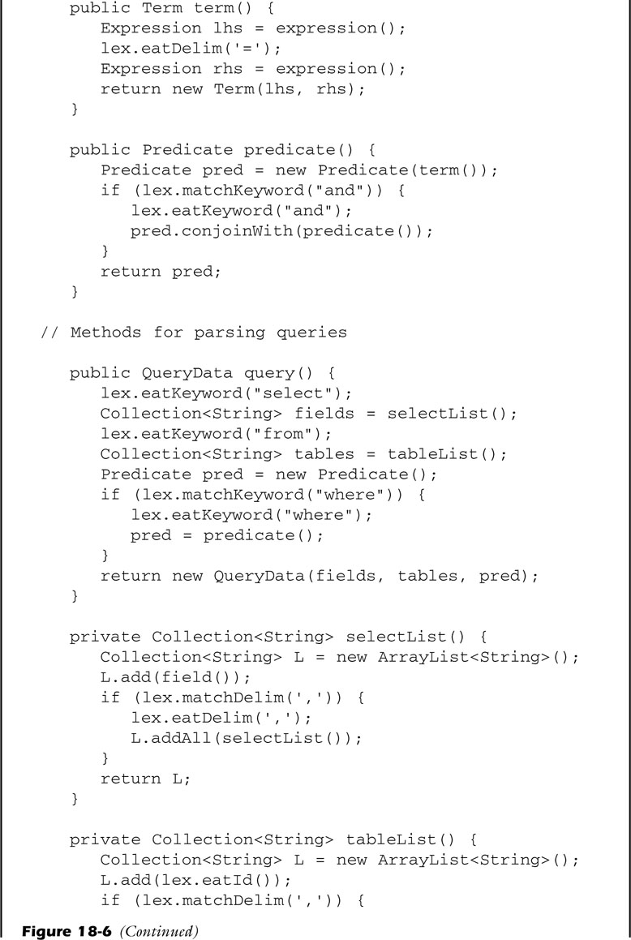
fig_18_06b
fig_18_06b

Slide 12
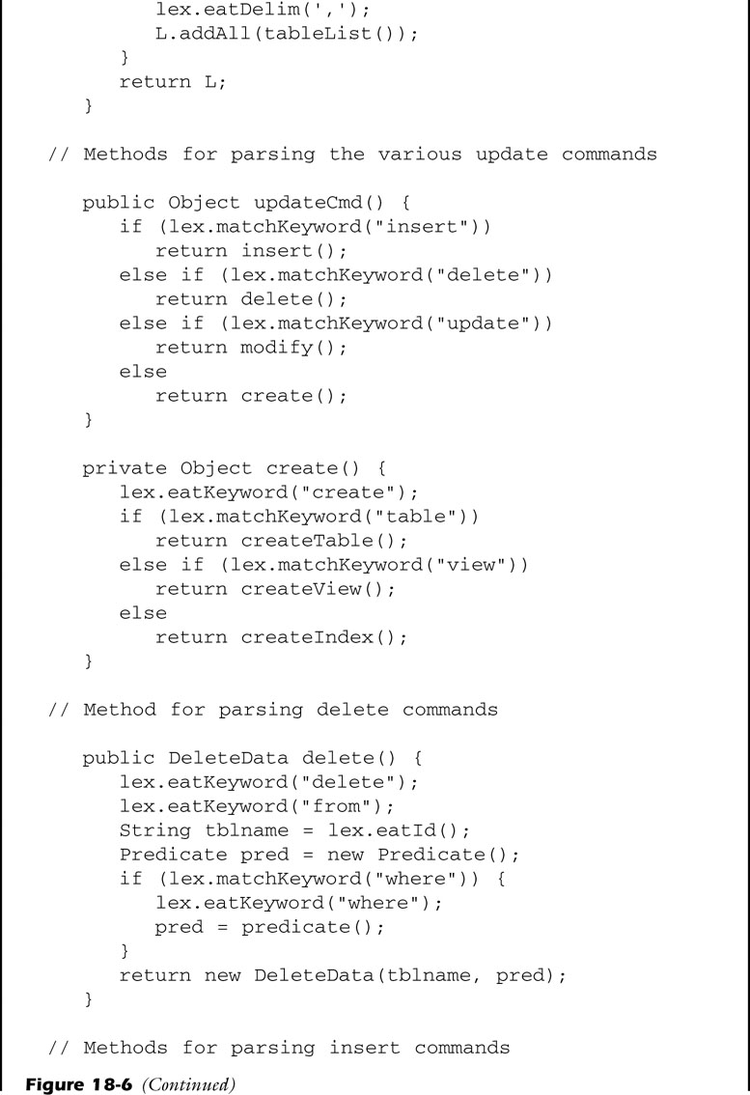
fig_18_06c
fig_18_06c

Slide 13
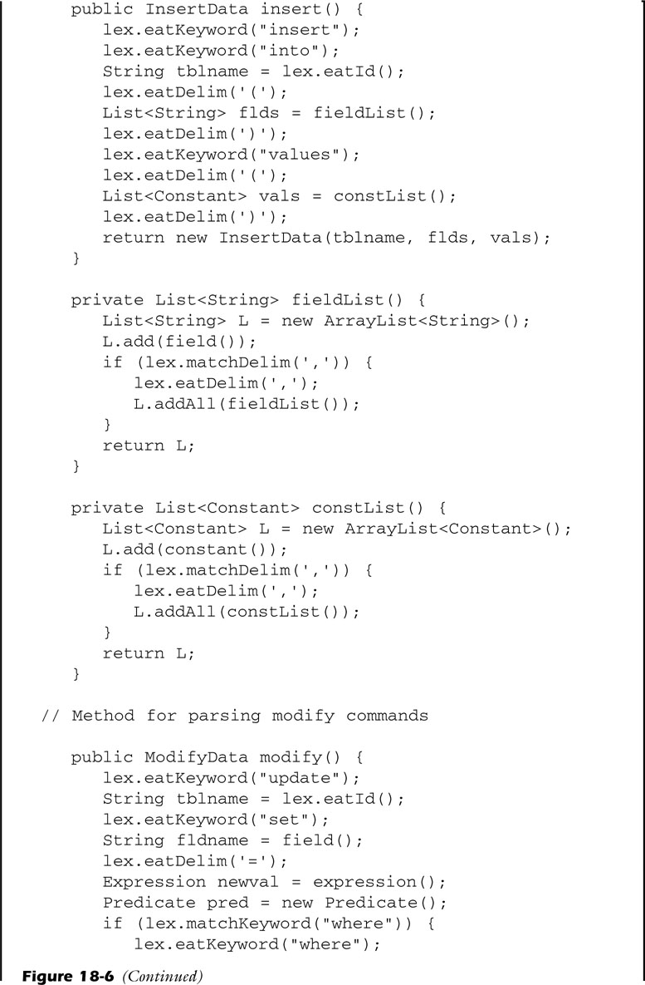
fig_18_06d
fig_18_06d

Slide 14
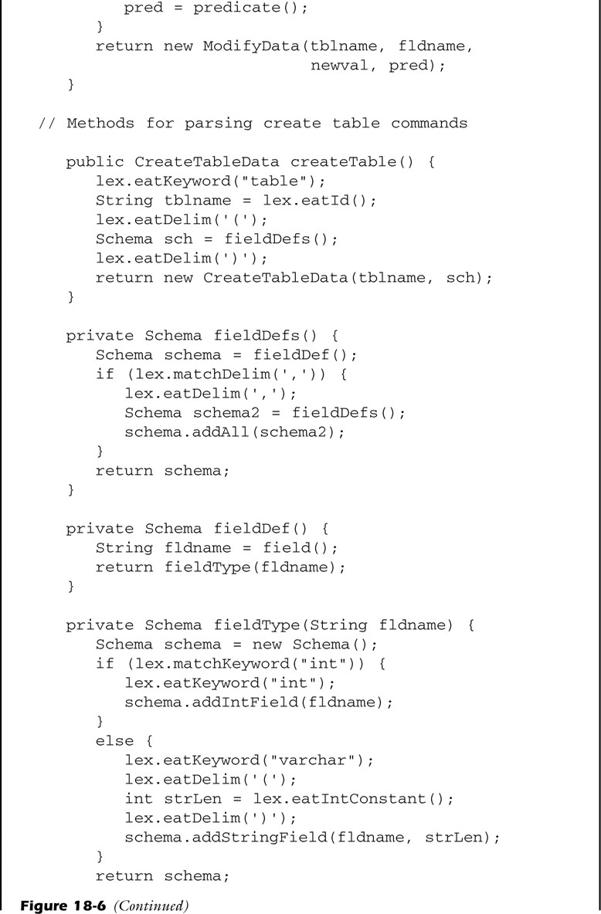
fig_18_06e
fig_18_06e

Slide 15
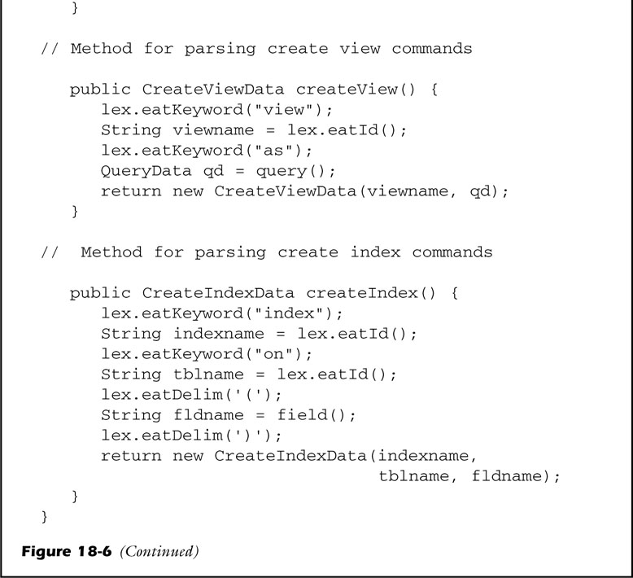
fig_18_06f
fig_18_06f

Slide 16
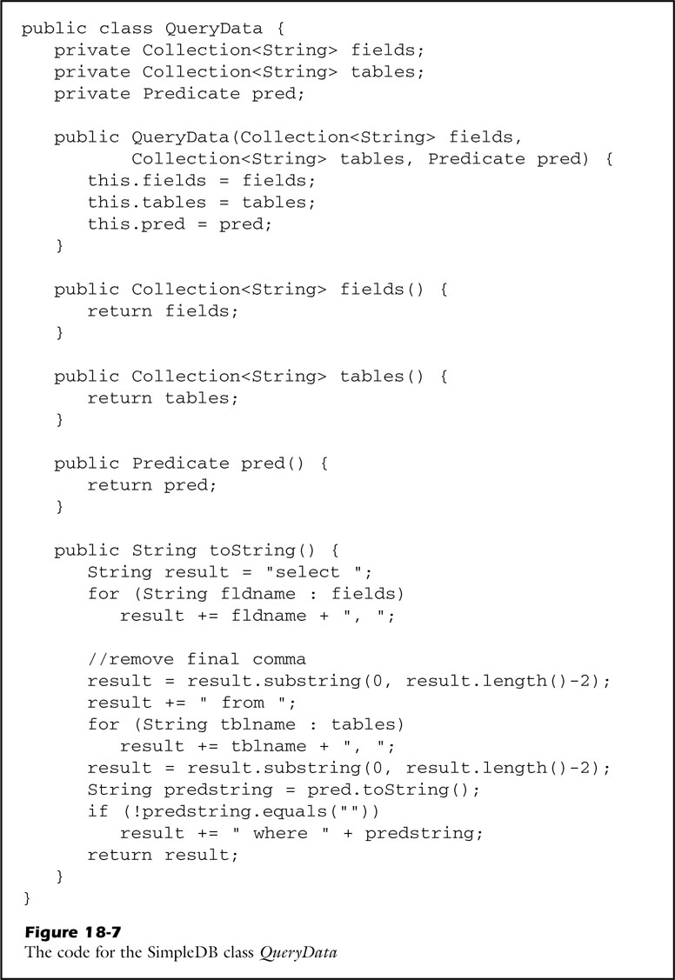
fig_18_07
fig_18_07

Slide 17
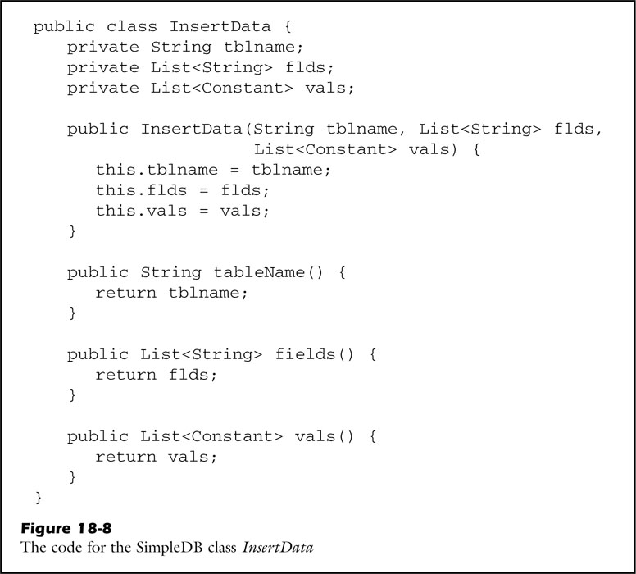
fig_18_08
fig_18_08

Slide 18
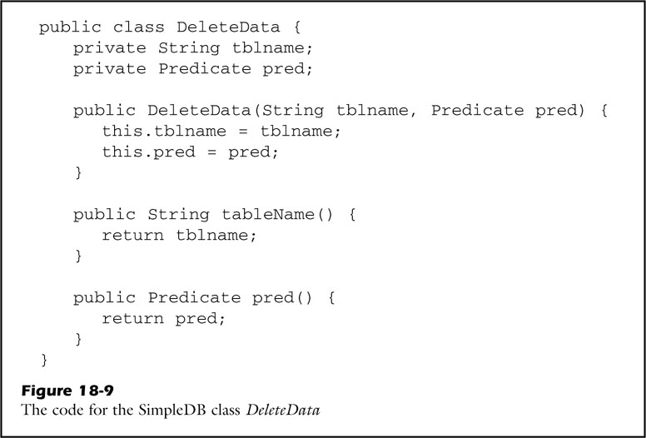
fig_18_09
fig_18_09

Slide 19
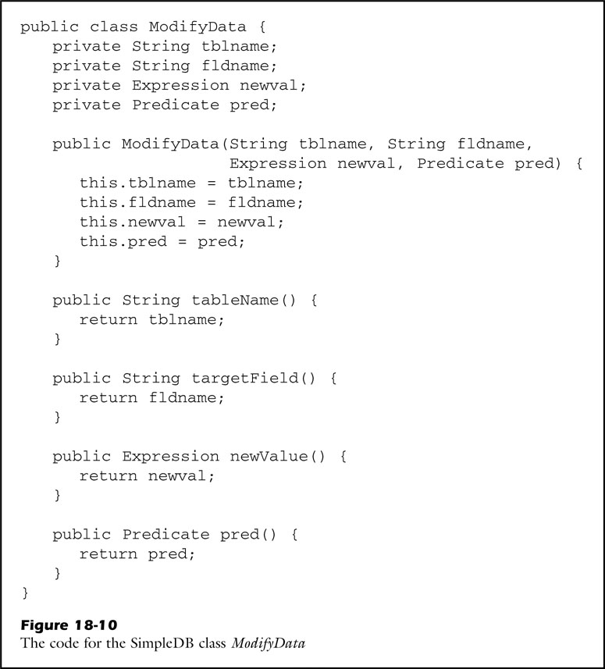
fig_18_10
fig_18_10

Slide 20
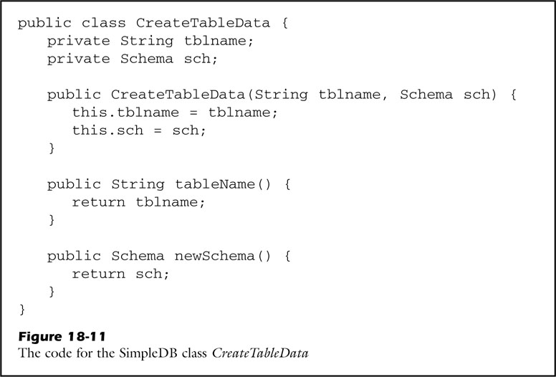
fig_18_11
fig_18_11

Slide 21
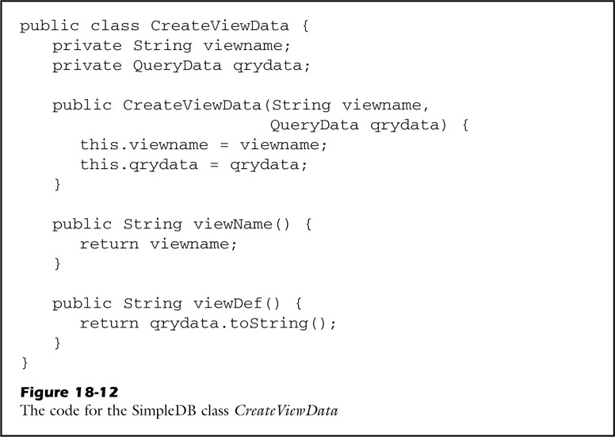
fig_18_12
fig_18_12

Slide 22
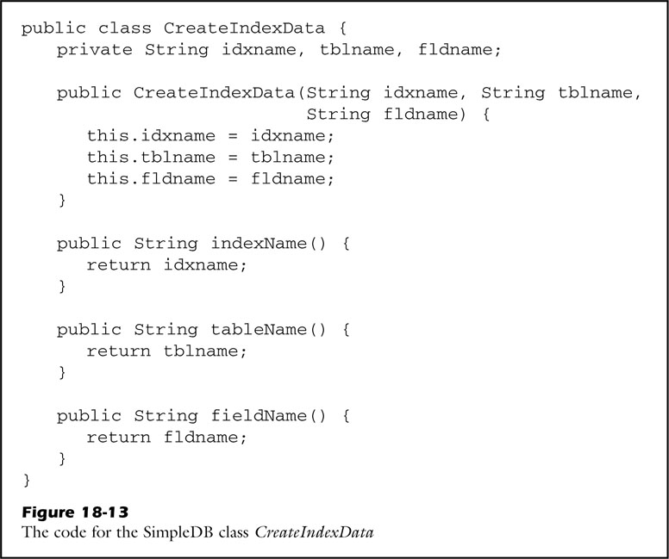
fig_18_13
fig_18_13

Slide 23
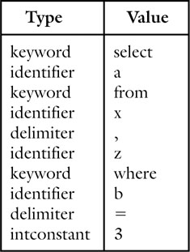
unfig_18_01
unfig_18_01

