Slide 1
Text Illustrations
To Accompany
Database Design and Implementation
Edward Sciore, Boston College
ISBN: 978-0-471-75716-0
Chapter 19. Planning

Slide 2

co_19
co_19

Slide 3

fig_19_01
fig_19_01

Slide 4
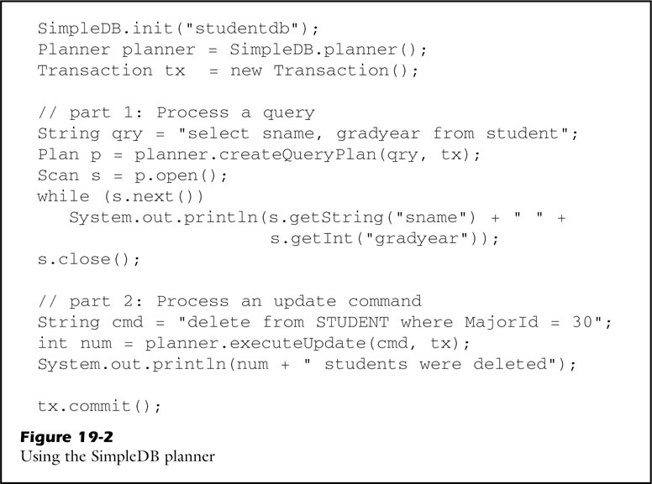
fig_19_02
fig_19_02

Slide 5
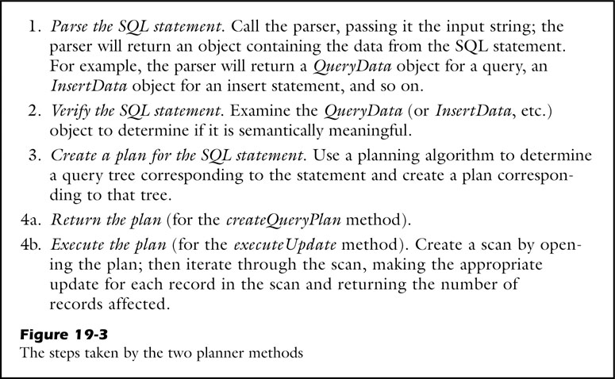
fig_19_03
fig_19_03

Slide 6
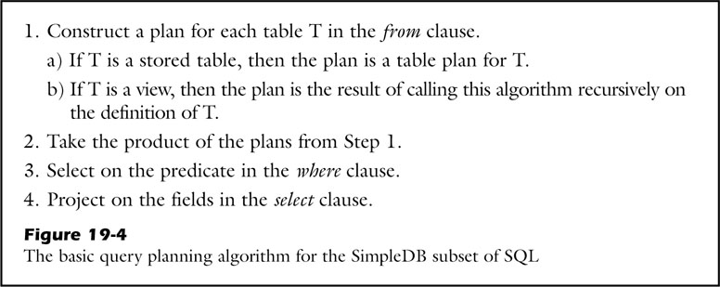
fig_19_04
fig_19_04

Slide 7
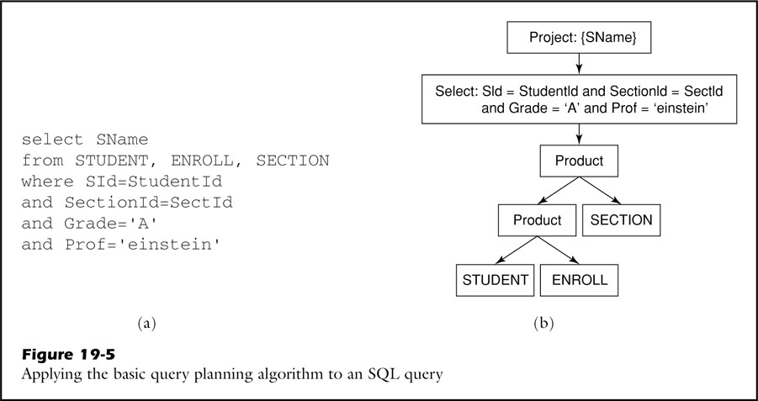
fig_19_05
fig_19_05

Slide 8
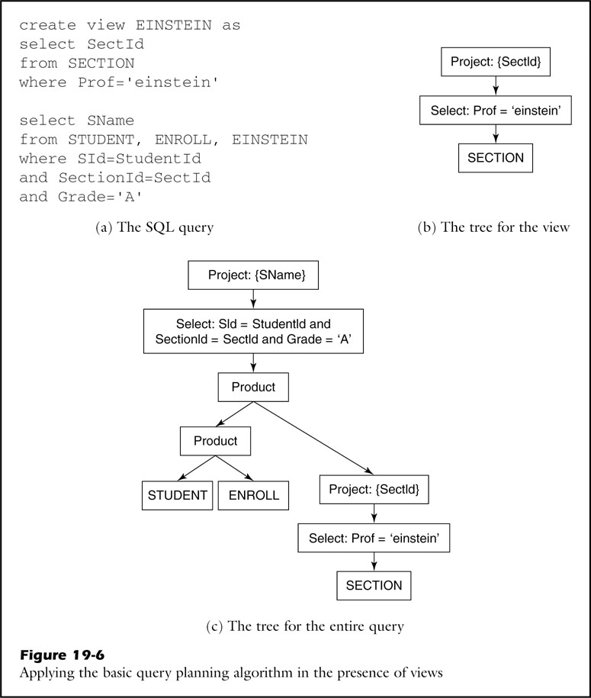
fig_19_06
fig_19_06

Slide 9
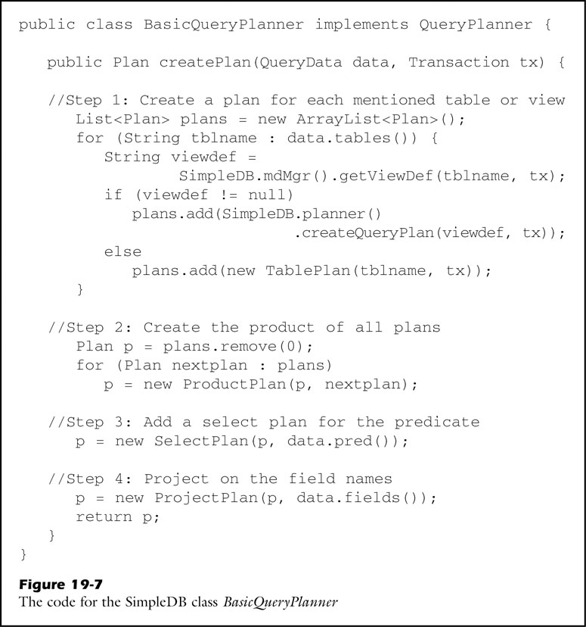
fig_19_07
fig_19_07

Slide 10
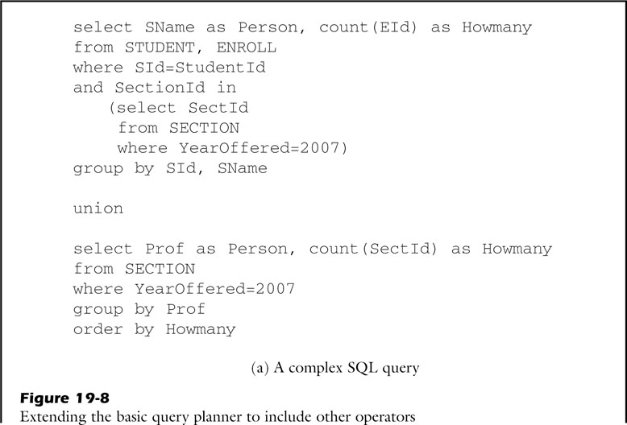
fig_19_08a
fig_19_08a

Slide 11
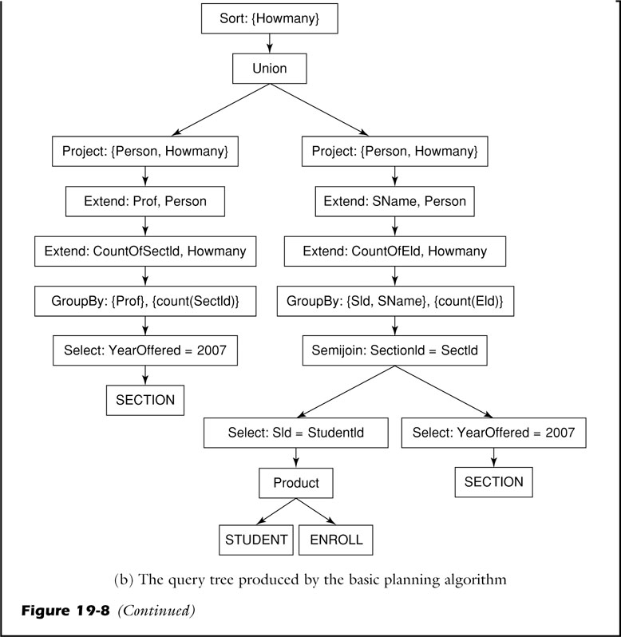
fig_19_08b
fig_19_08b

Slide 12
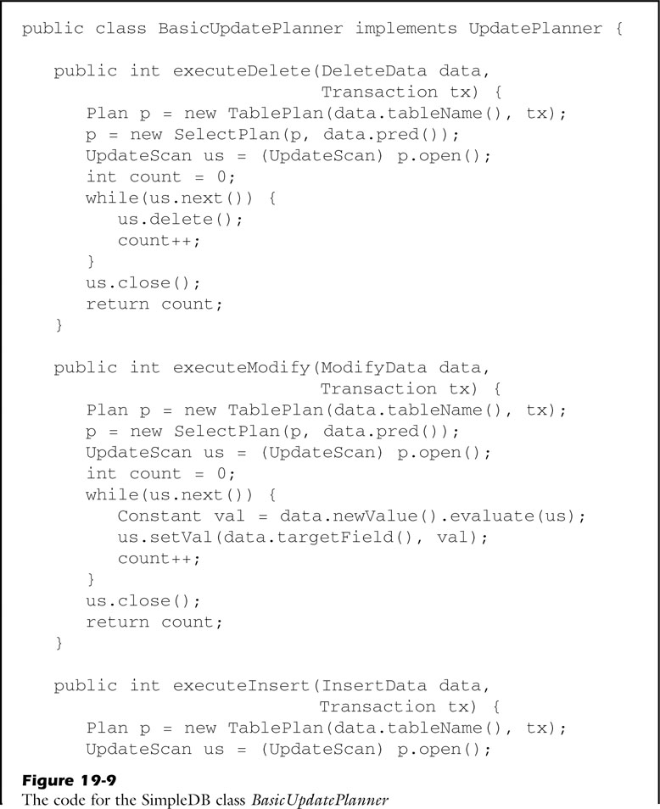
fig_19_09a
fig_19_09a

Slide 13
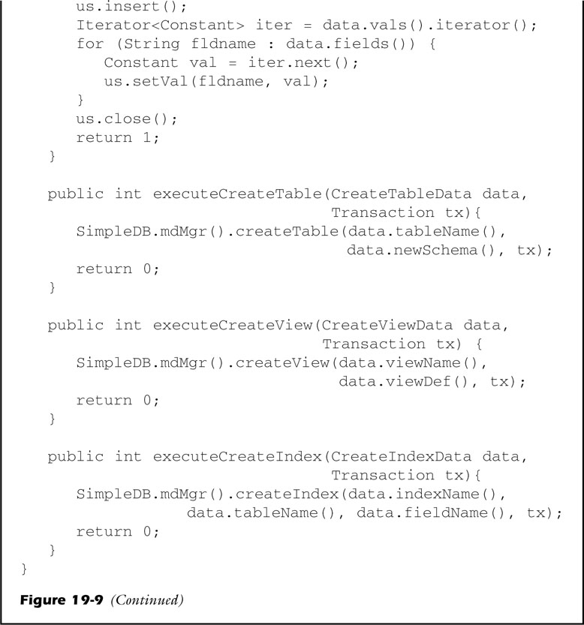
fig_19_09b
fig_19_09b

Slide 14
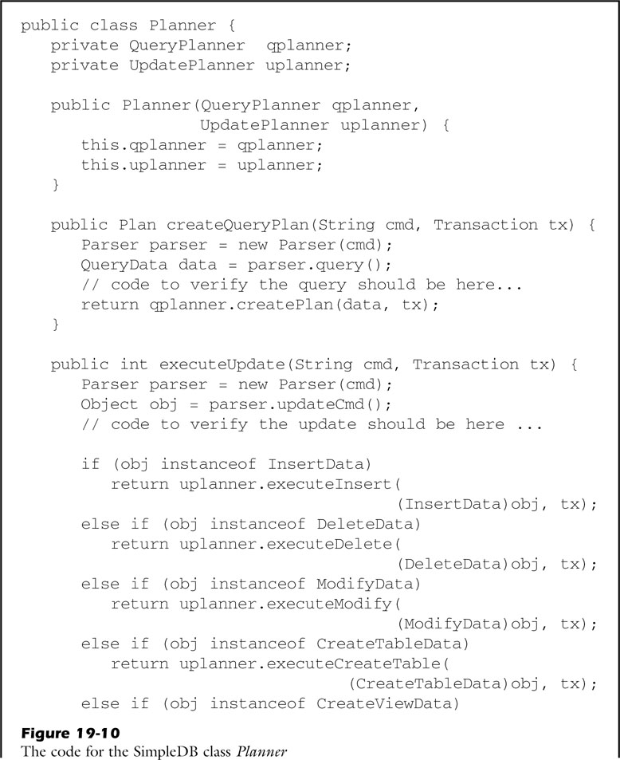
fig_19_10a
fig_19_10a

Slide 15
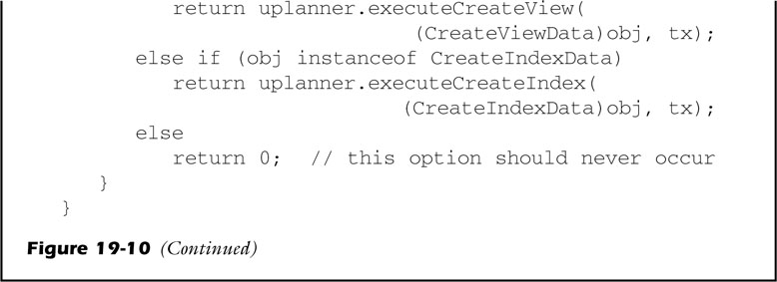
fig_19_10b
fig_19_10b

Slide 16
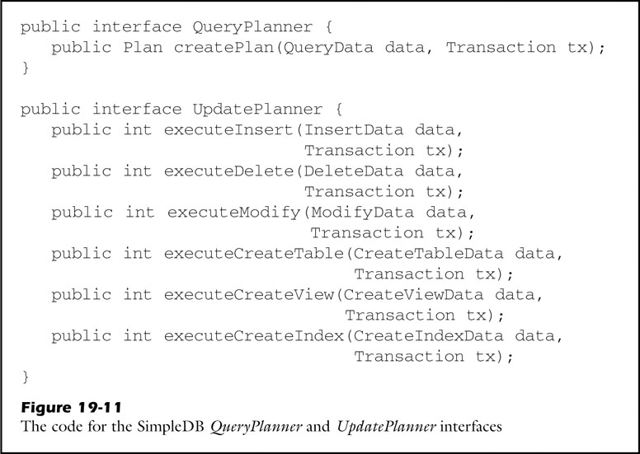
fig_19_11
fig_19_11

Slide 17
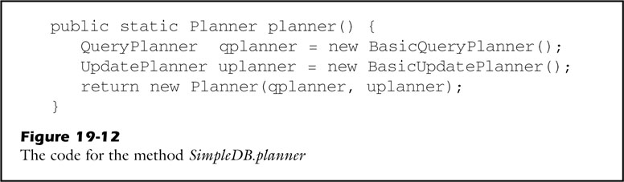
fig_19_12
fig_19_12

