Slide 1
Text Illustrations
To Accompany
Database Design and Implementation
Edward Sciore, Boston College
ISBN: 978-0-471-75716-0
Chapter 20. The Database Server

Slide 2

co_20
co_20

Slide 3
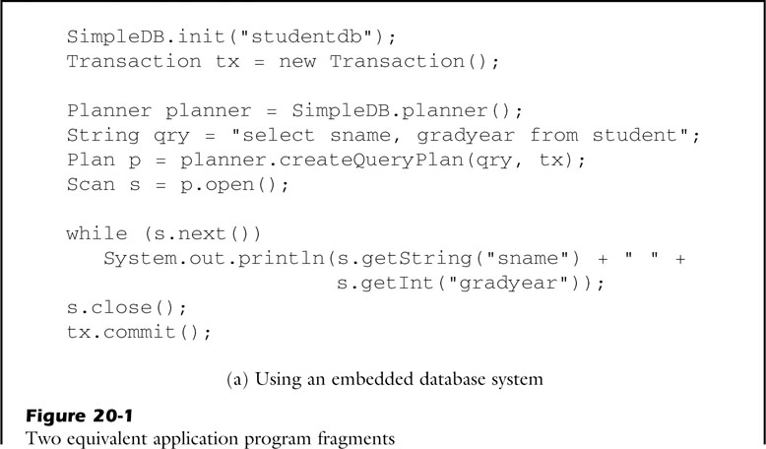
fig_20_01a
fig_20_01a

Slide 4
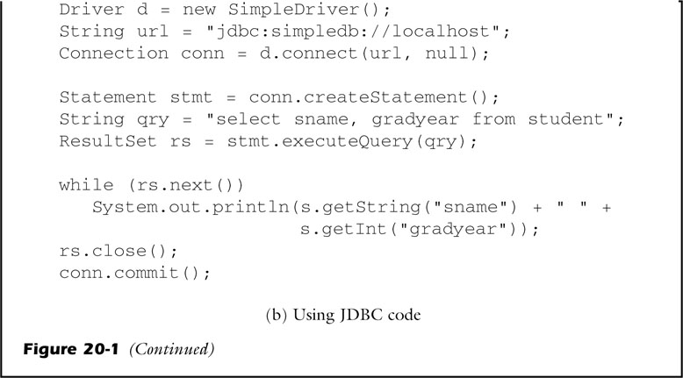
fig_20_01b
fig_20_01b

Slide 5
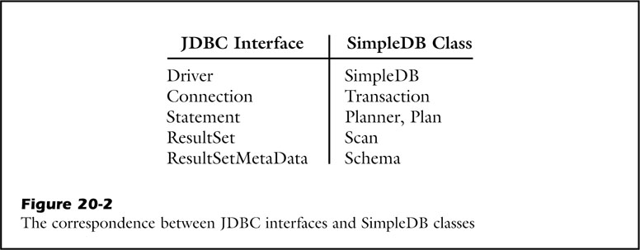
fig_20_02
fig_20_02

Slide 6
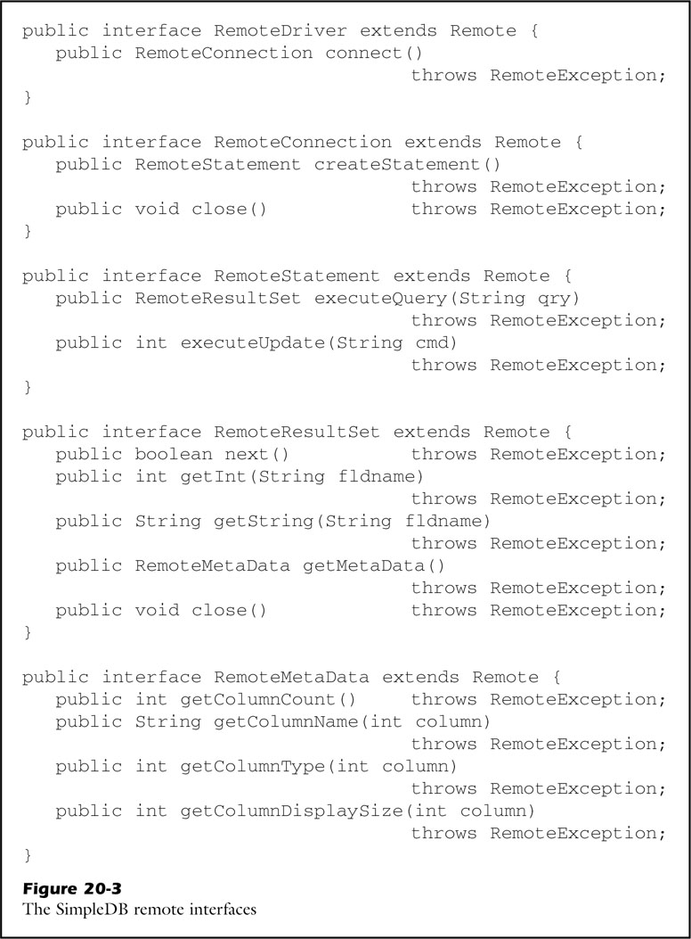
fig_20_03
fig_20_03

Slide 7

fig_20_04
fig_20_04

Slide 8
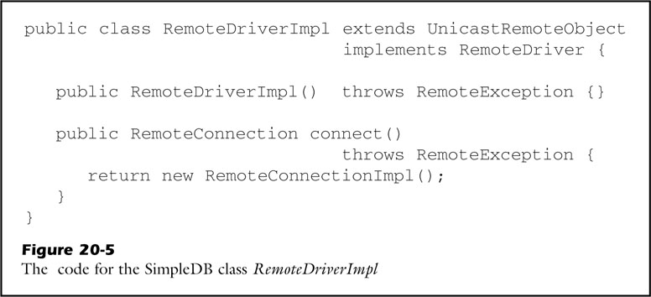
fig_20_05
fig_20_05

Slide 9
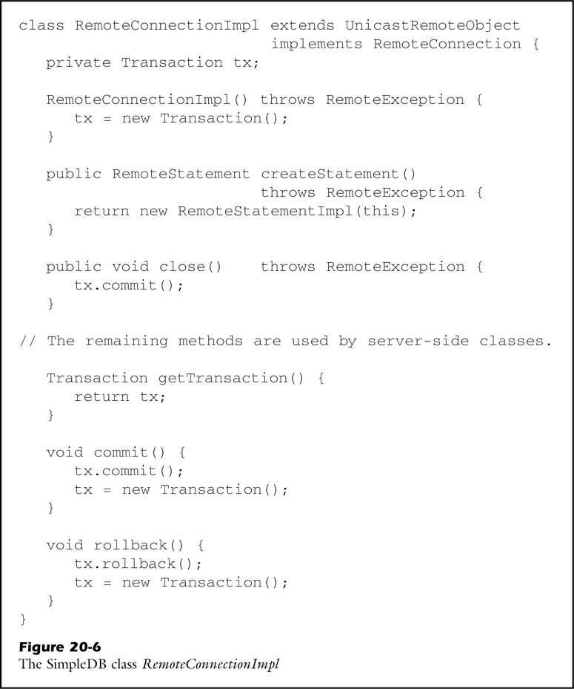
fig_20_06
fig_20_06

Slide 10
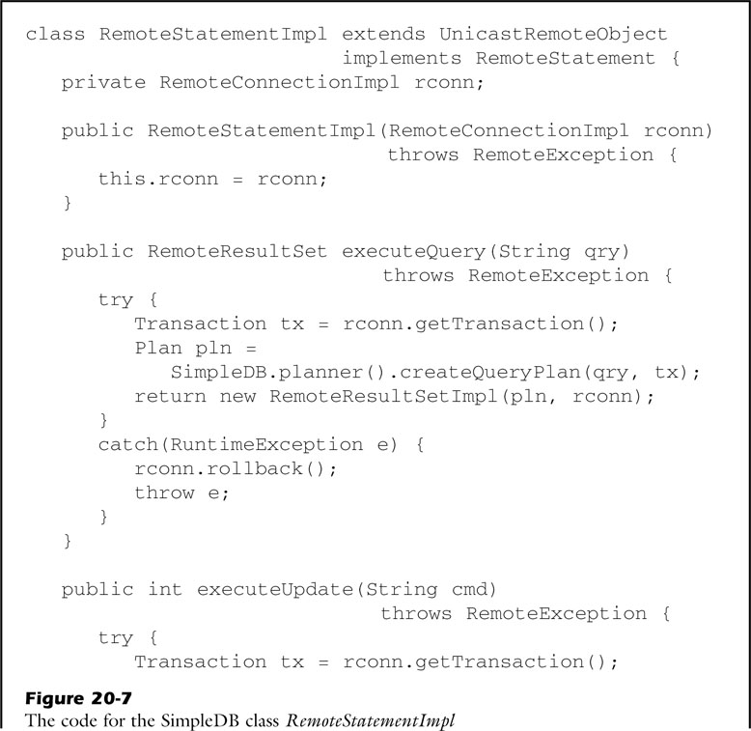
fig_20_07a
fig_20_07a

Slide 11
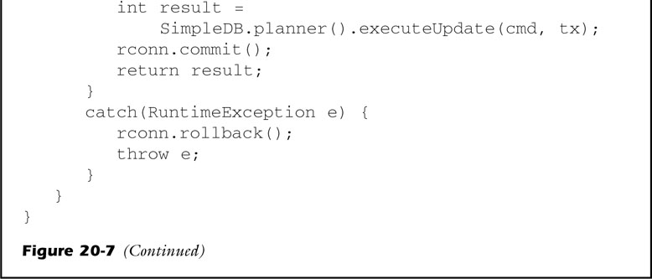
fig_20_07b
fig_20_07b

Slide 12

fig_20_08a
fig_20_08a

Slide 13
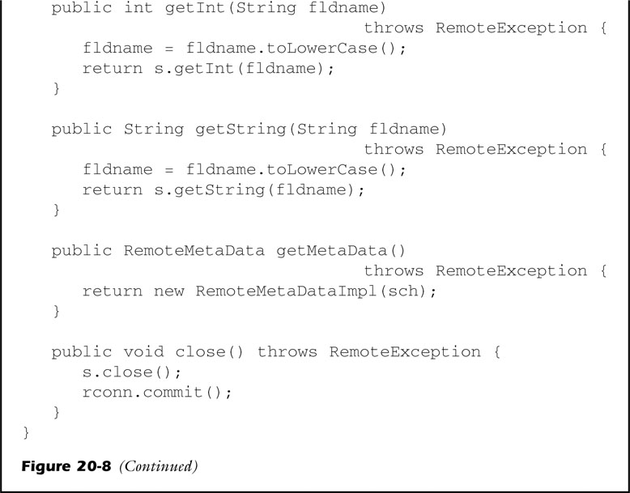
fig_20_08b
fig_20_08b

Slide 14
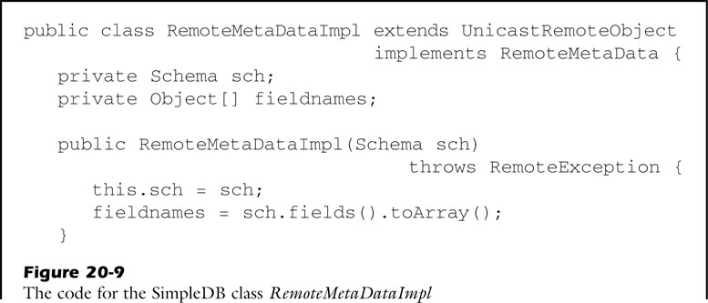
fig_20_09a
fig_20_09a

Slide 15
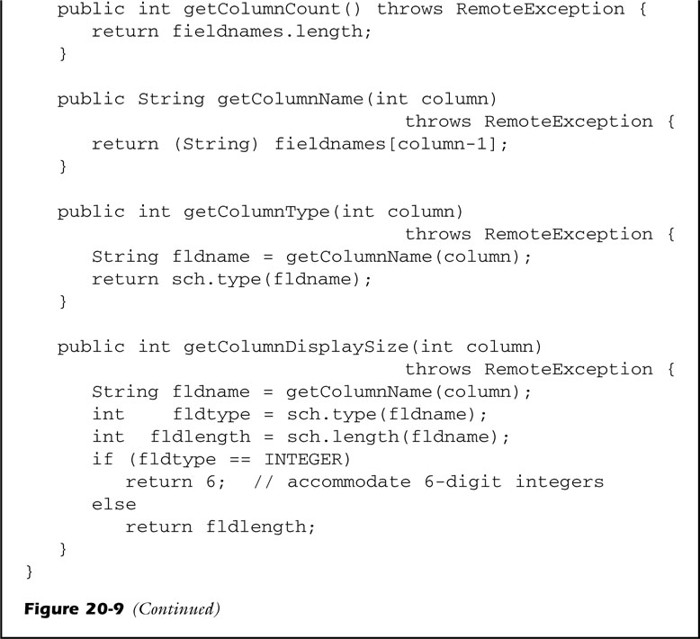
fig_20_09b
fig_20_09b

Slide 16
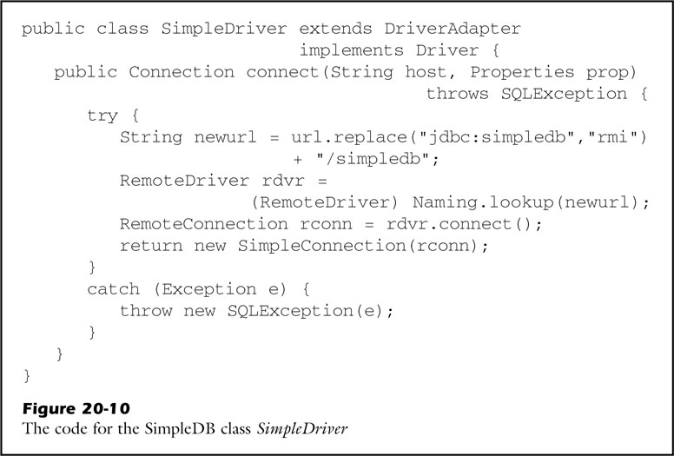
fig_20_10
fig_20_10

Slide 17
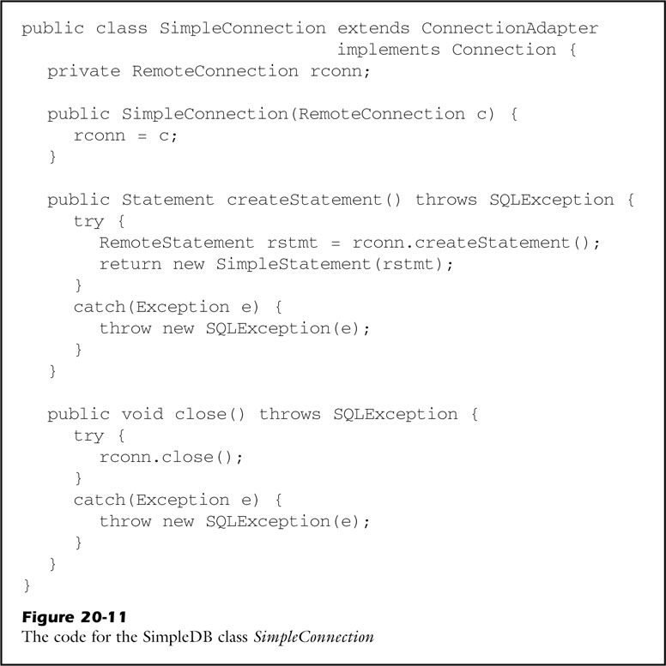
fig_20_11
fig_20_11

Slide 18
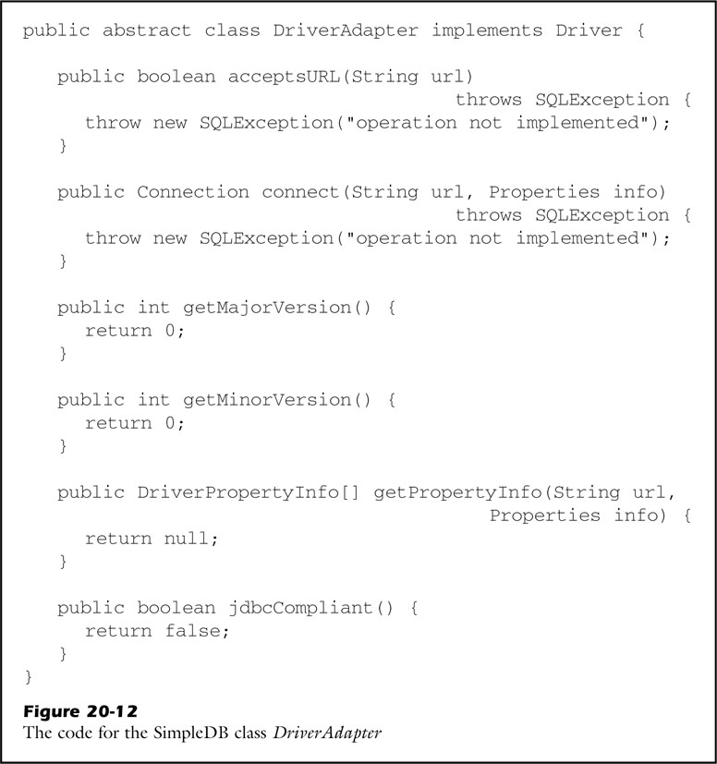
fig_20_12
fig_20_12

