Slide 1
Text Illustrations
To Accompany
Database Design and Implementation
Edward Sciore, Boston College
ISBN: 978-0-471-75716-0
Chapter 22. Materialization and Sorting

Slide 2
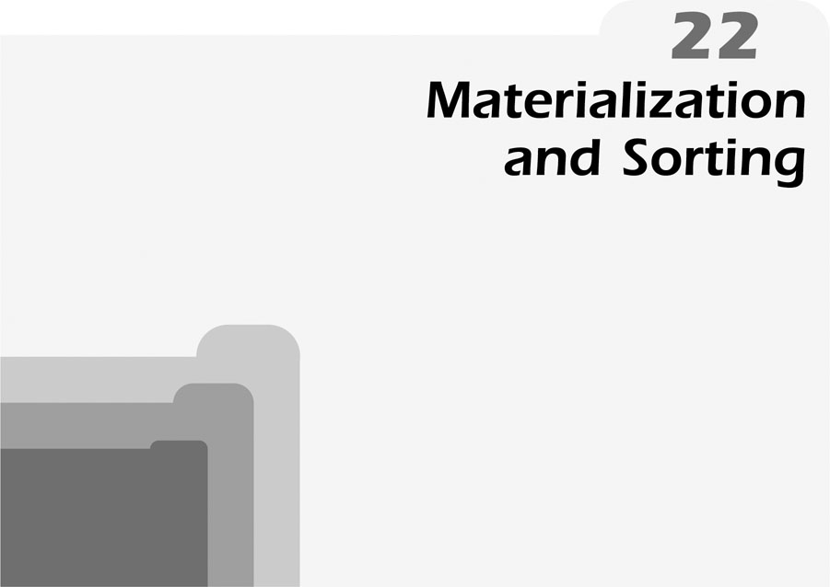
co_22
co_22

Slide 3
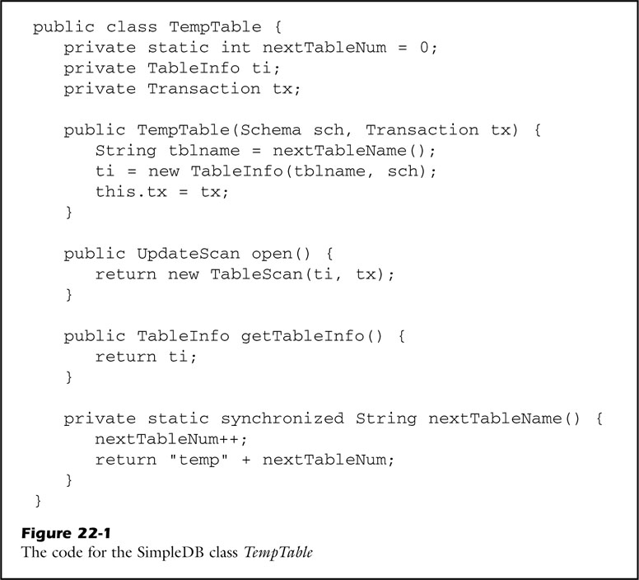
fig_22_01
fig_22_01

Slide 4
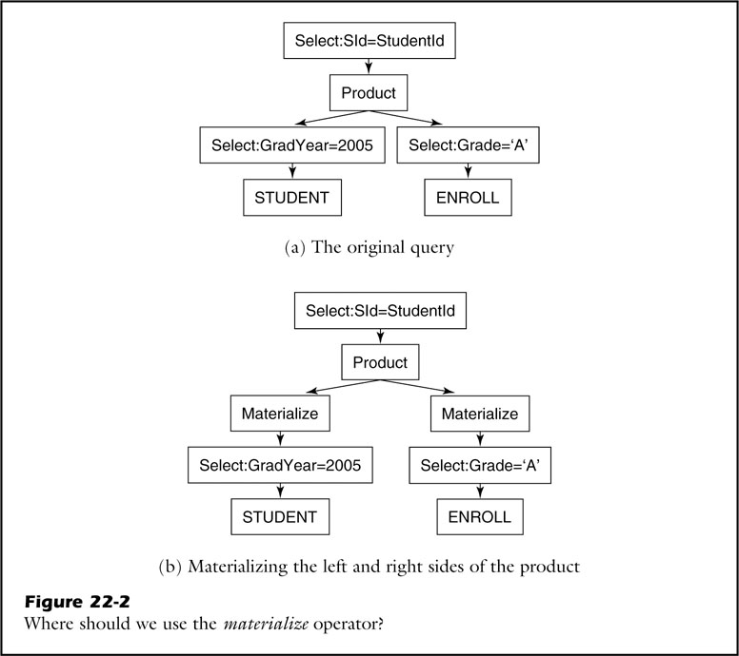
fig_22_02
fig_22_02

Slide 5
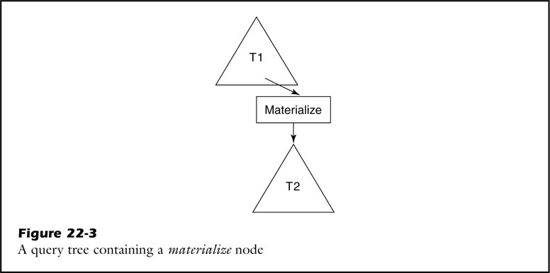
fig_22_03
fig_22_03

Slide 6
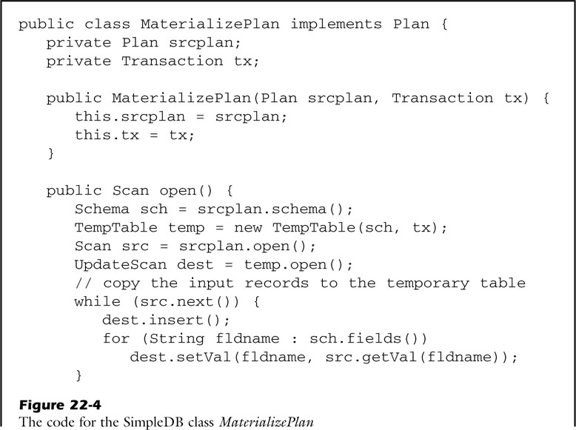
fig_22_04a
fig_22_04a

Slide 7
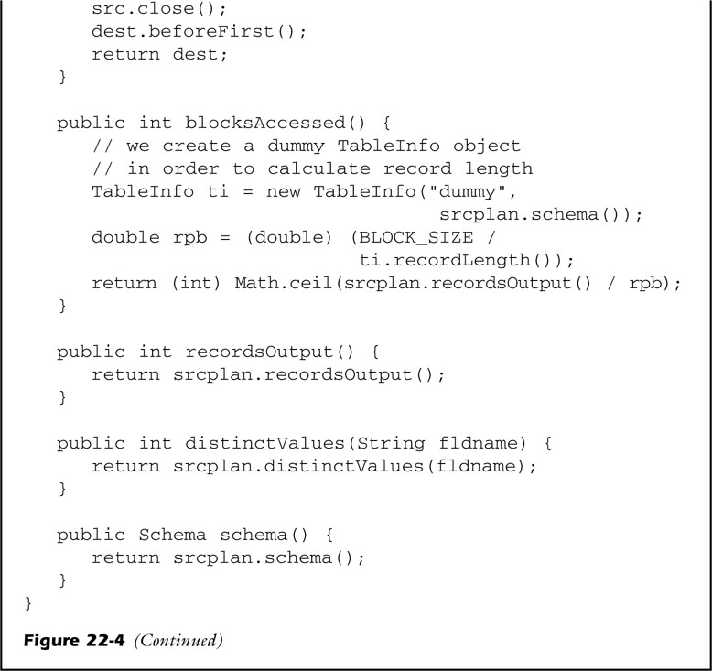
fig_22_04b
fig_22_04b

Slide 8
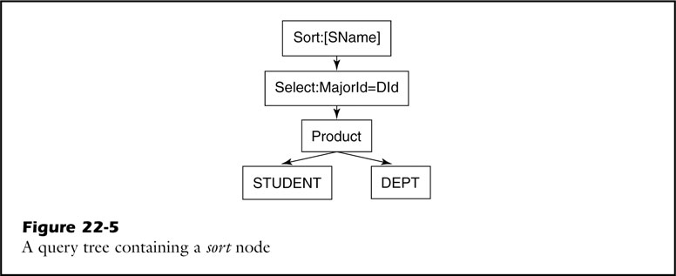
fig_22_05
fig_22_05

Slide 9
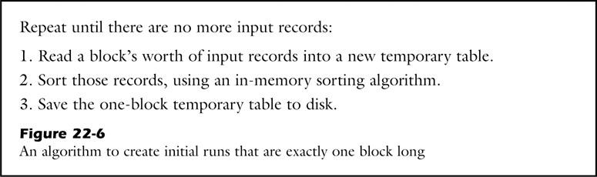
fig_22_06
fig_22_06

Slide 10
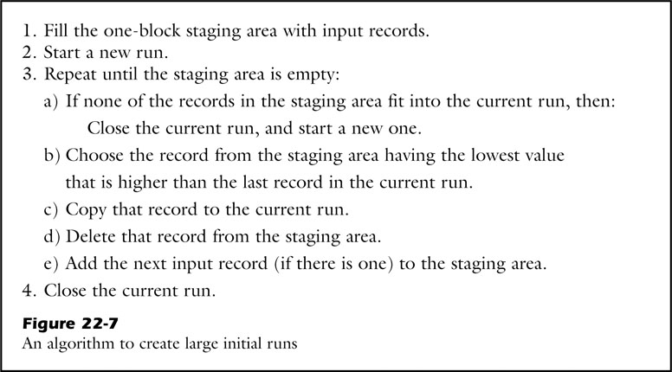
fig_22_07
fig_22_07

Slide 11
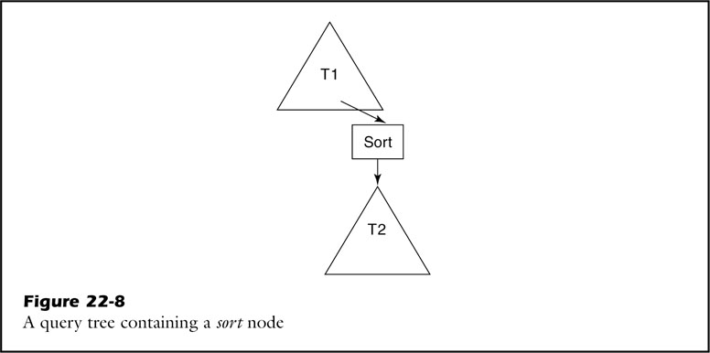
fig_22_08
fig_22_08

Slide 12
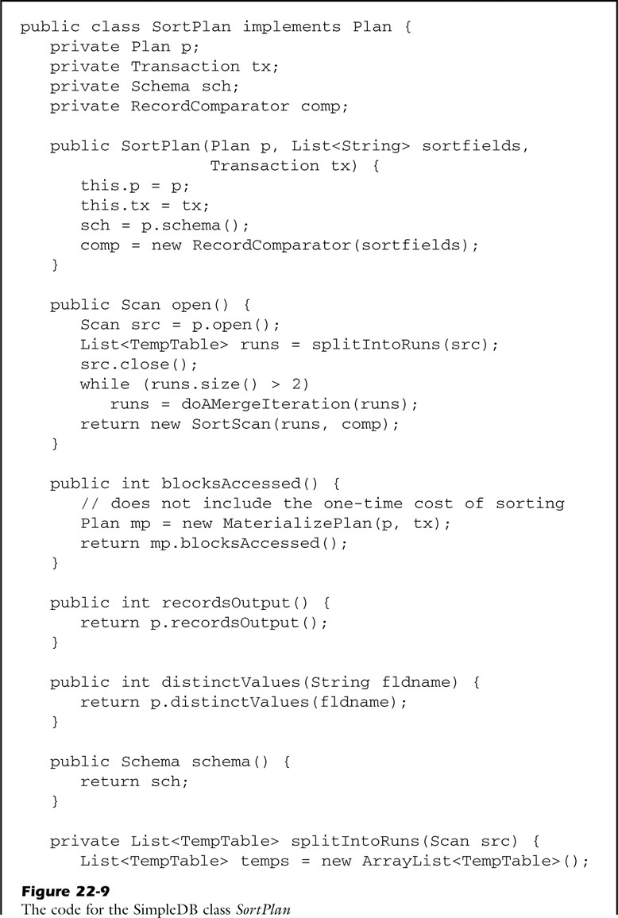
fig_22_09a
fig_22_09a

Slide 13
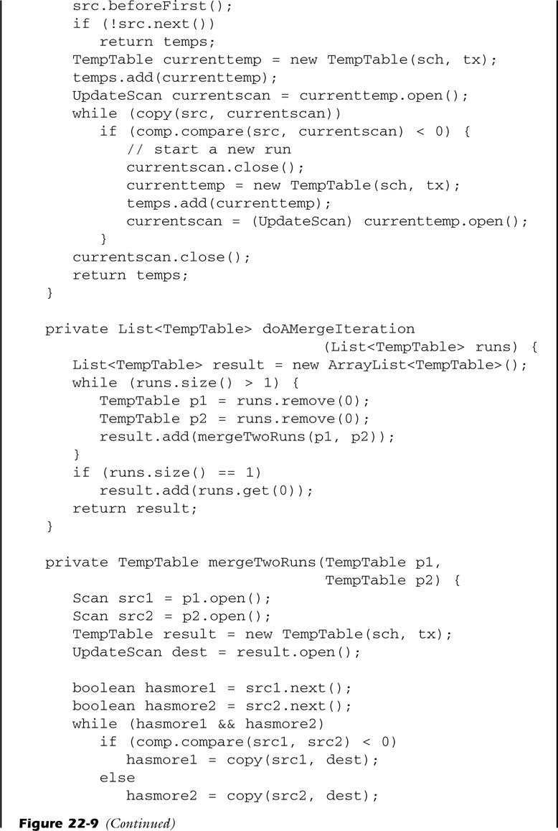
fig_22_09b
fig_22_09b

Slide 14
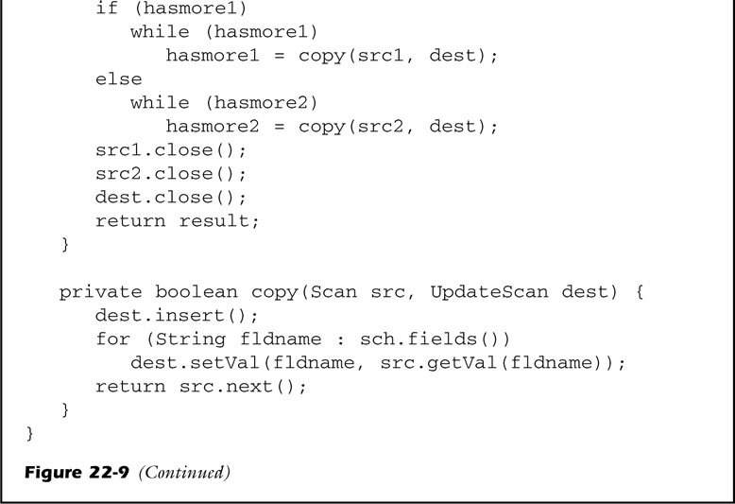
fig_22_09c
fig_22_09c

Slide 15
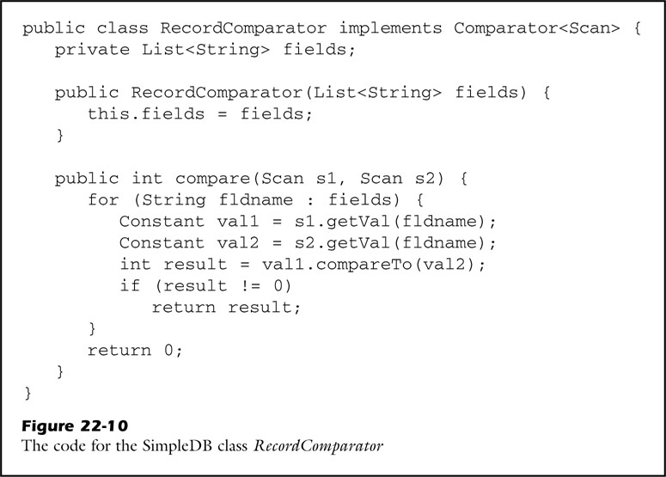
fig_22_10
fig_22_10

Slide 16
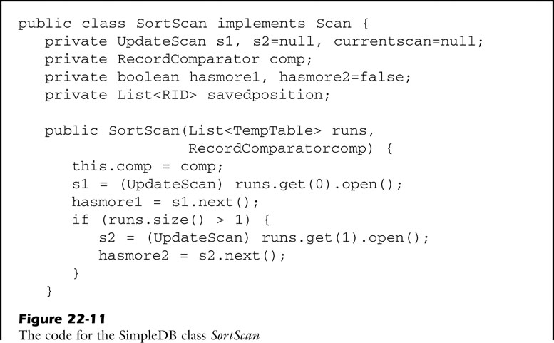
fig_22_11a
fig_22_11a

Slide 17
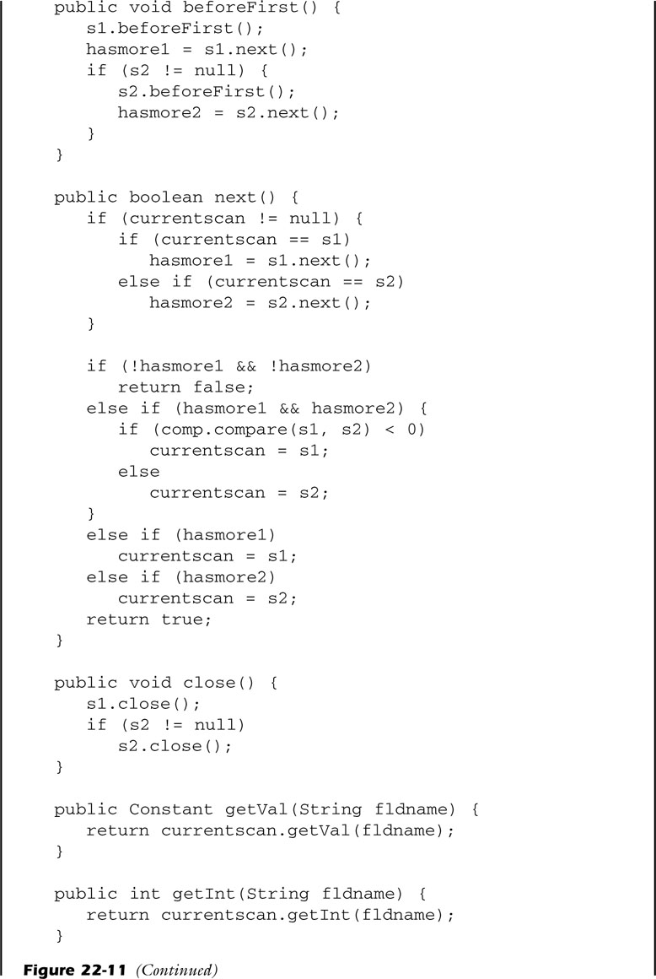
fig_22_11b
fig_22_11b

Slide 18
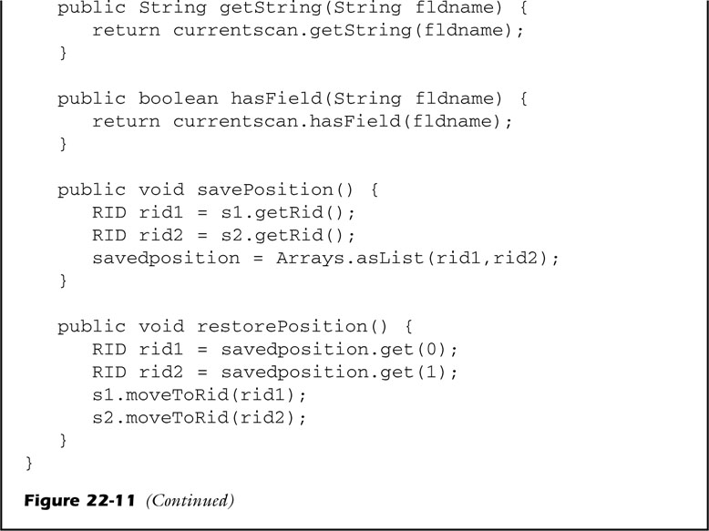
fig_22_11c
fig_22_11c

Slide 19
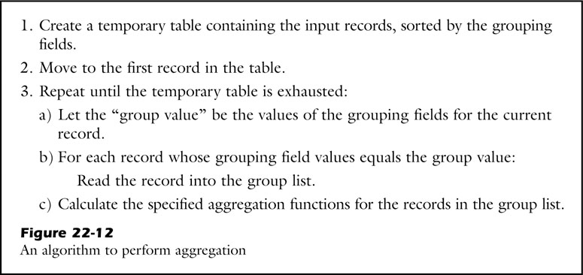
fig_22_12
fig_22_12

Slide 20
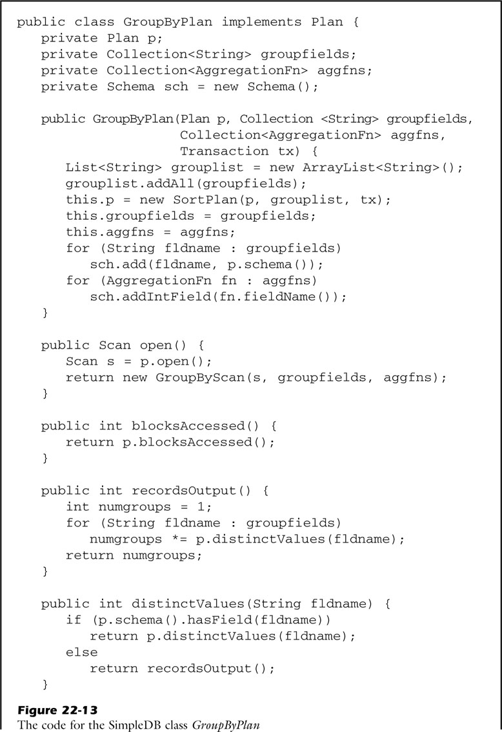
fig_22_13a
fig_22_13a

Slide 21

fig_22_13b
fig_22_13b

Slide 22
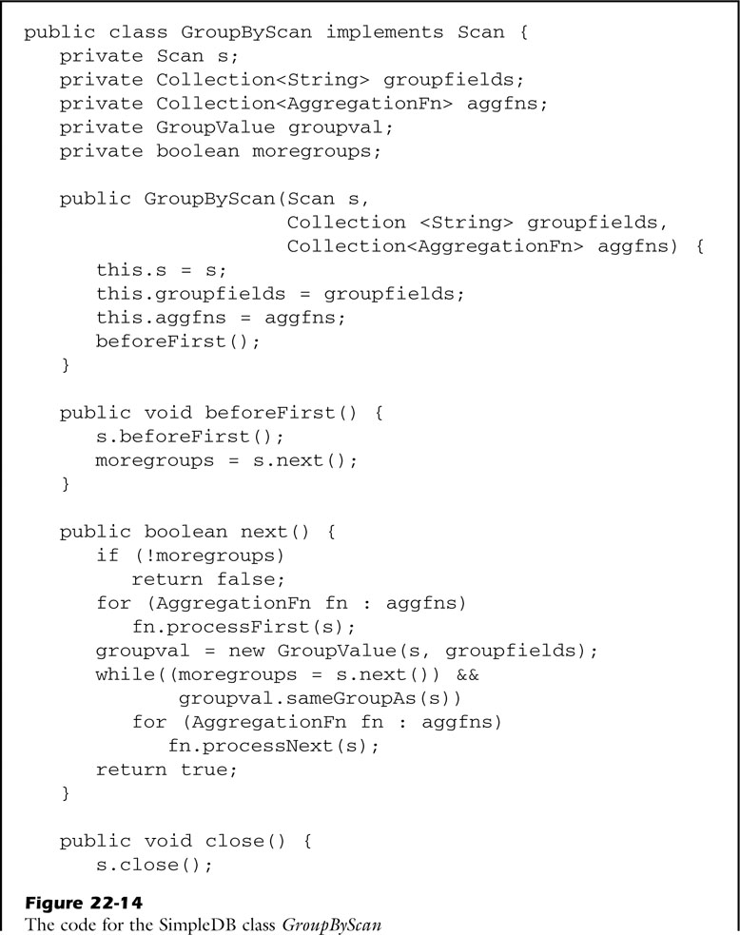
fig_22_14a
fig_22_14a

Slide 23
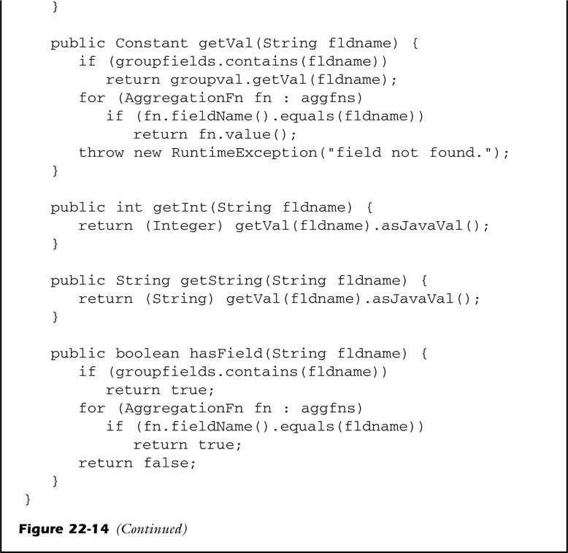
fig_22_14b
fig_22_14b

Slide 24
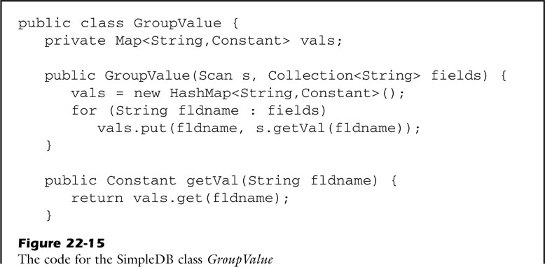
fig_22_15a
fig_22_15a

Slide 25
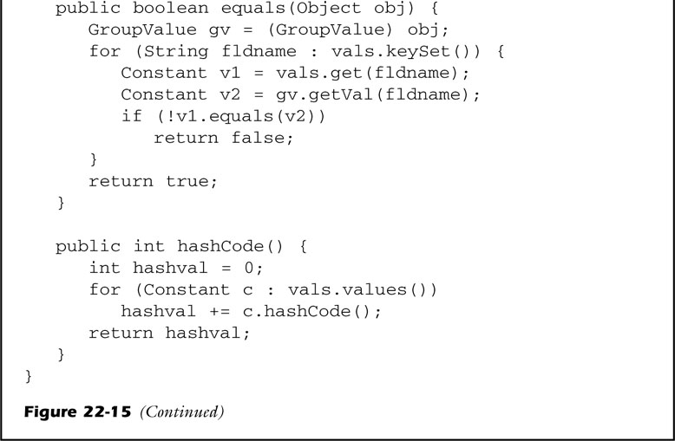
fig_22_15b
fig_22_15b

Slide 26
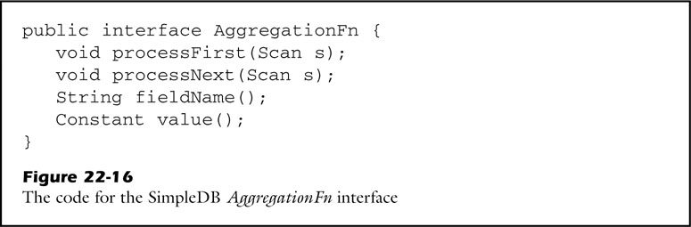
fig_22_16
fig_22_16

Slide 27
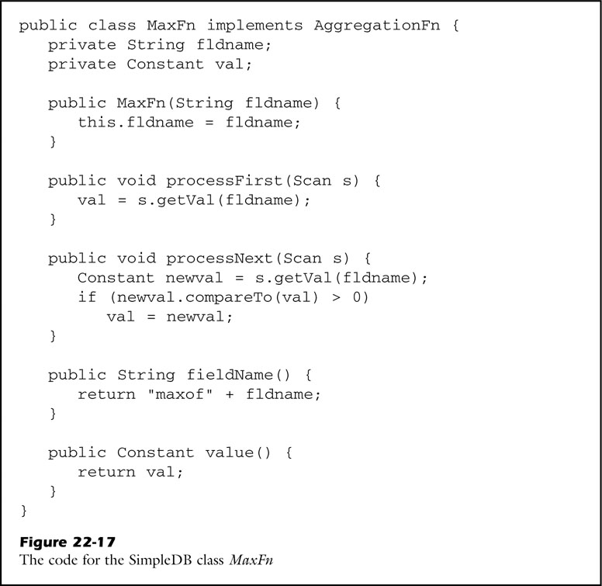
fig_22_17
fig_22_17

Slide 28
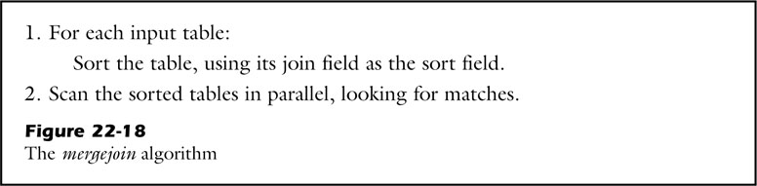
fig_22_18
fig_22_18

Slide 29
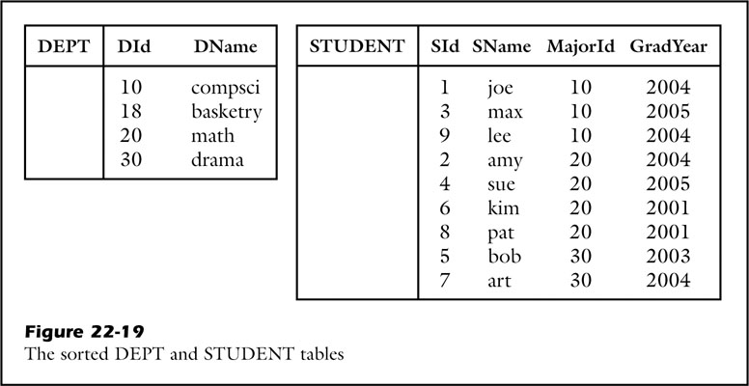
fig_22_19
fig_22_19

Slide 30
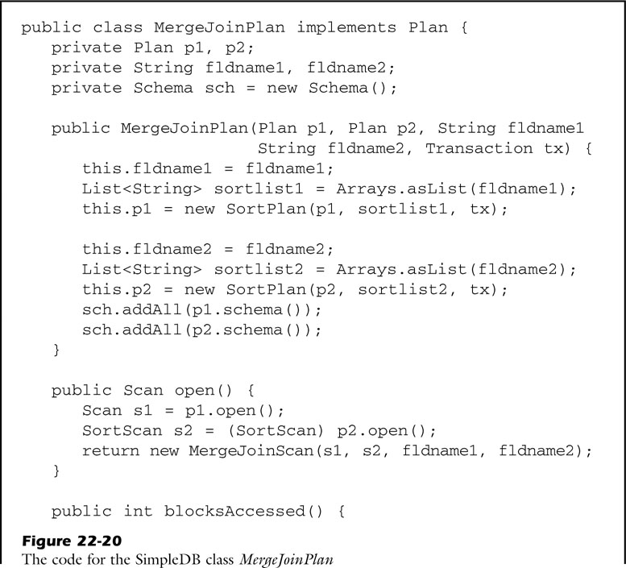
fig_22_20a
fig_22_20a

Slide 31
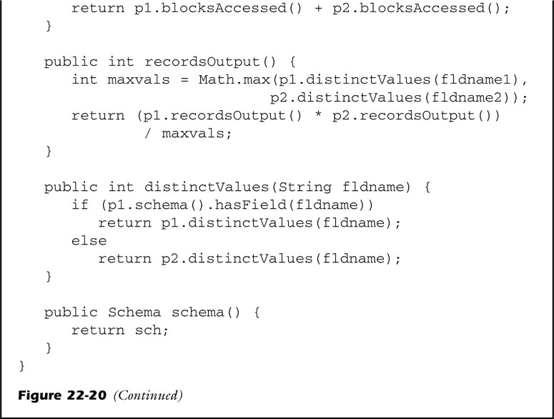
fig_22_20b
fig_22_20b

Slide 32
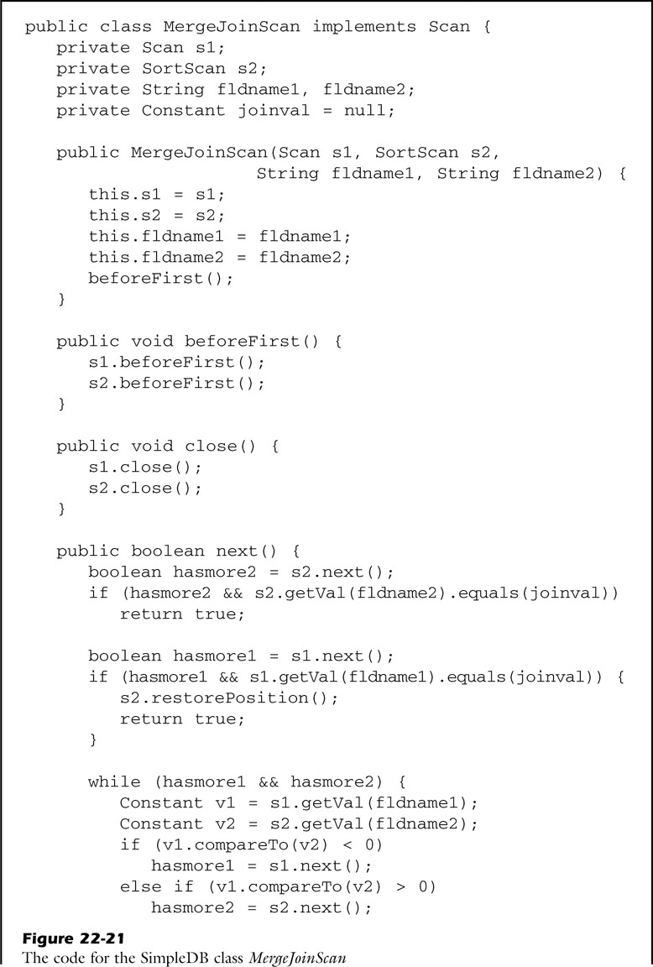
fig_22_21a
fig_22_21a

Slide 33
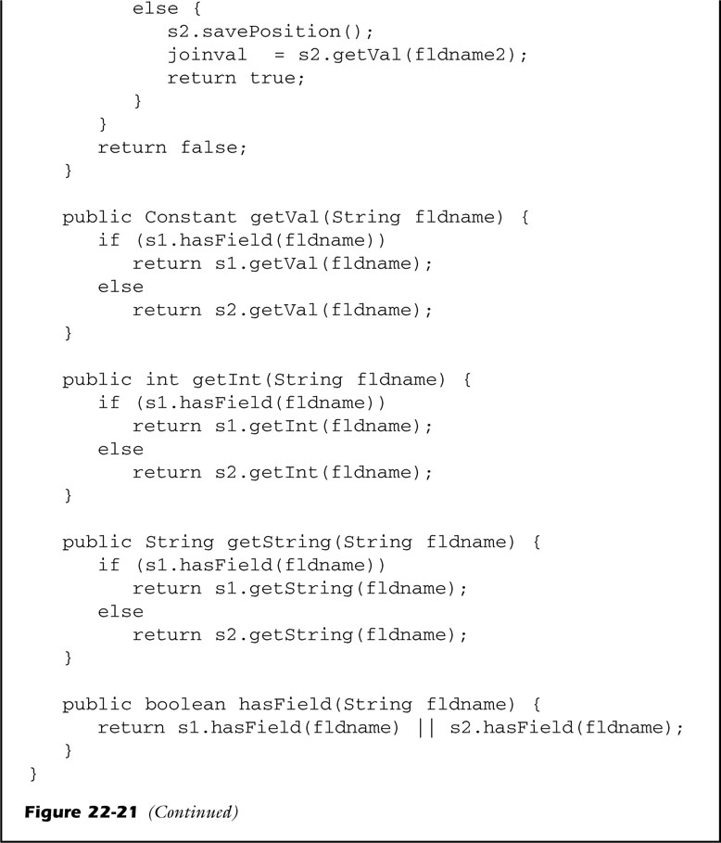
fig_22_21b
fig_22_21b

