Slide 1
Text Illustrations
To Accompany
Database Design and Implementation
Edward Sciore, Boston College
ISBN: 978-0-471-75716-0
Chapter 23. Effective Buffer Utilization

Slide 2

co_23
co_23

Slide 3
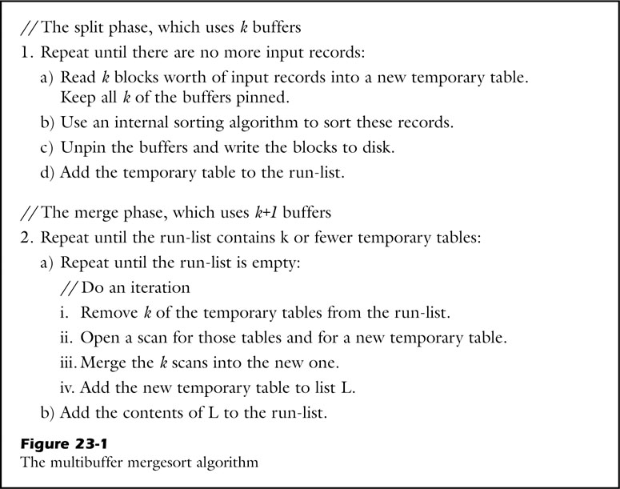
fig_23_01
fig_23_01

Slide 4
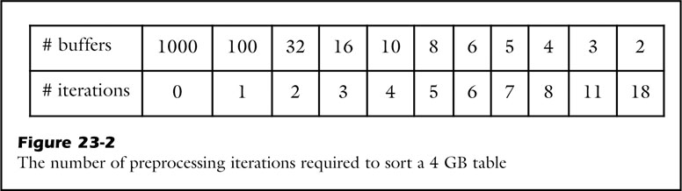
fig_23_02
fig_23_02

Slide 5
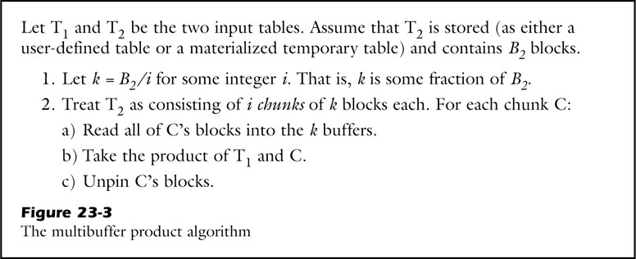
fig_23_03
fig_23_03

Slide 6
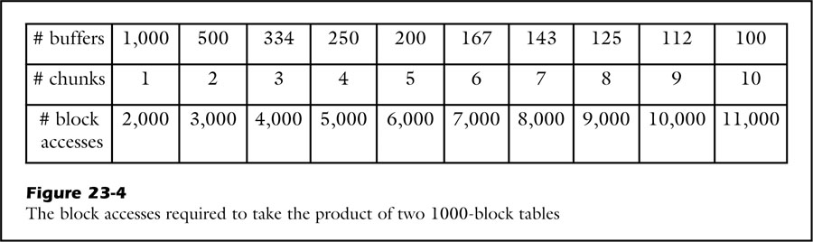
fig_23_04
fig_23_04

Slide 7
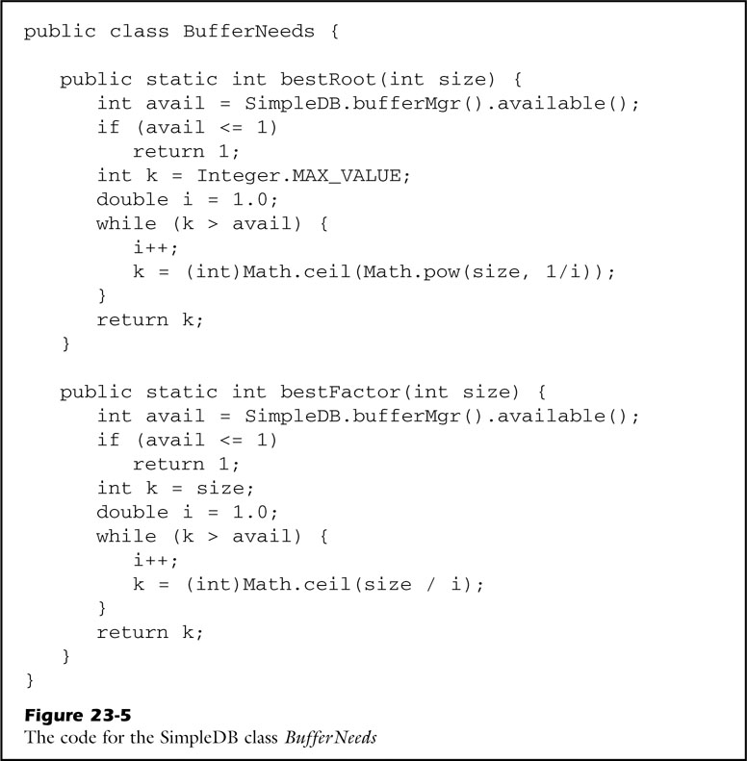
fig_23_05
fig_23_05

Slide 8
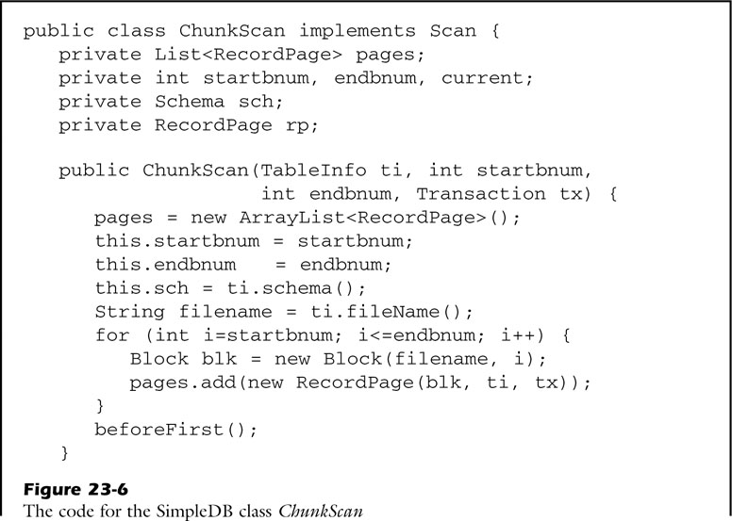
fig_23_06a
fig_23_06a

Slide 9
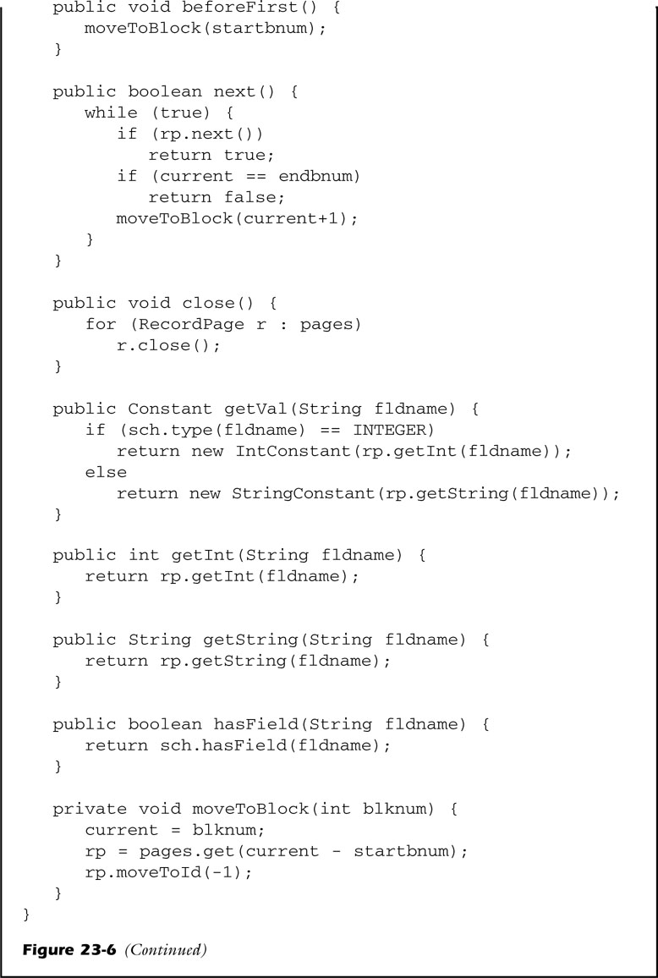
fig_23_06b
fig_23_06b

Slide 10
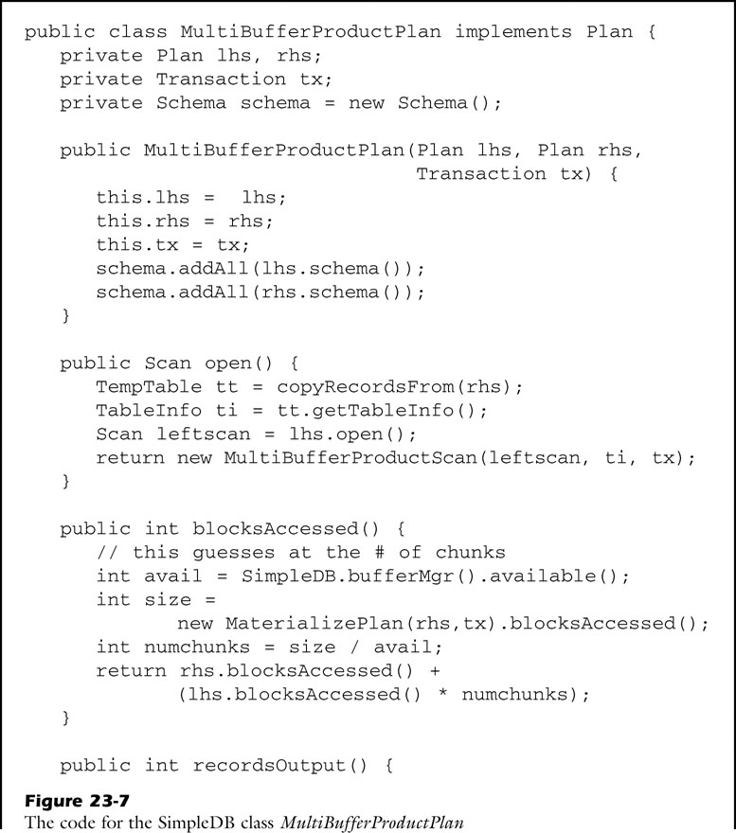
fig_23_07a
fig_23_07a

Slide 11
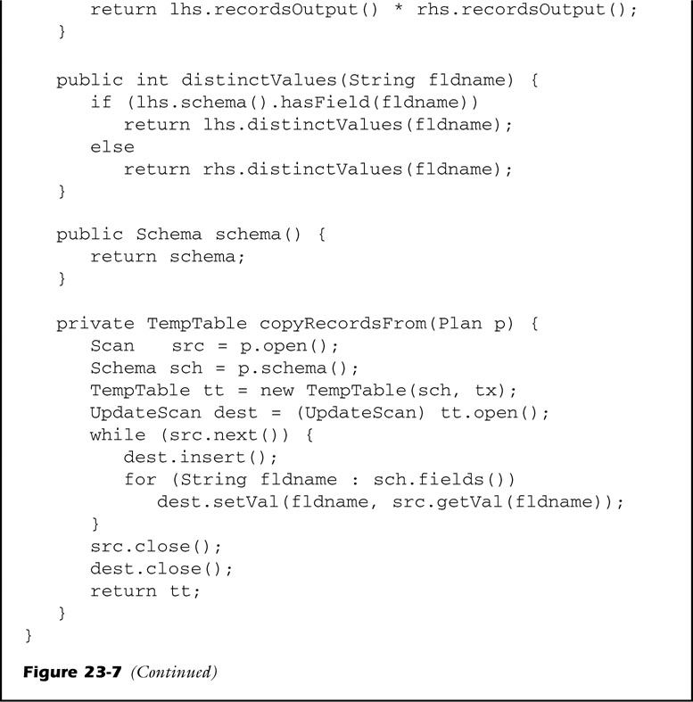
fig_23_07b
fig_23_07b

Slide 12
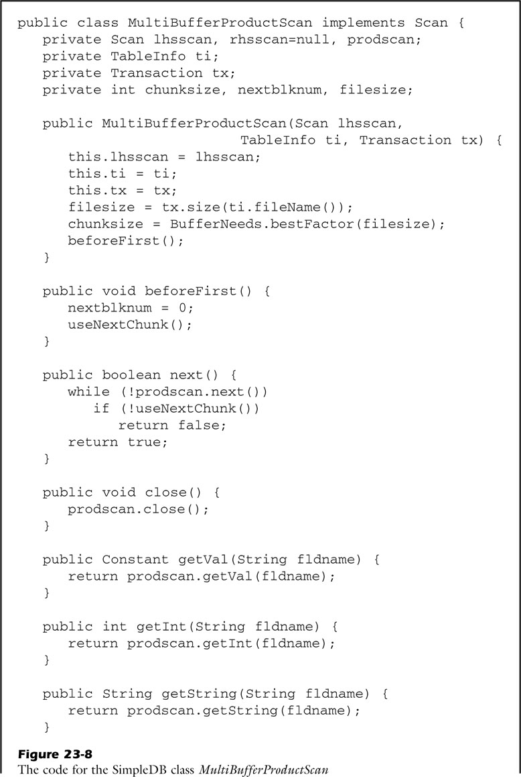
fig_23_08a
fig_23_08a

Slide 13
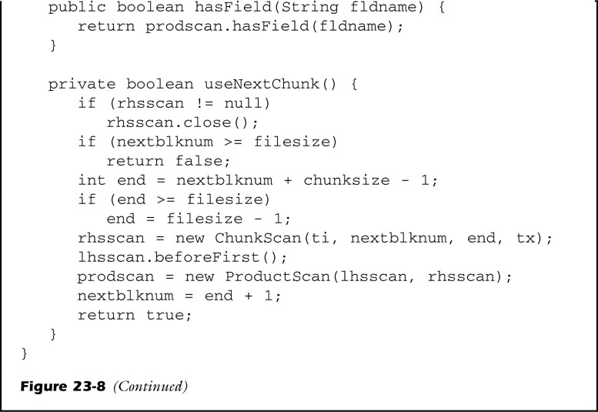
fig_23_08b
fig_23_08b

Slide 14
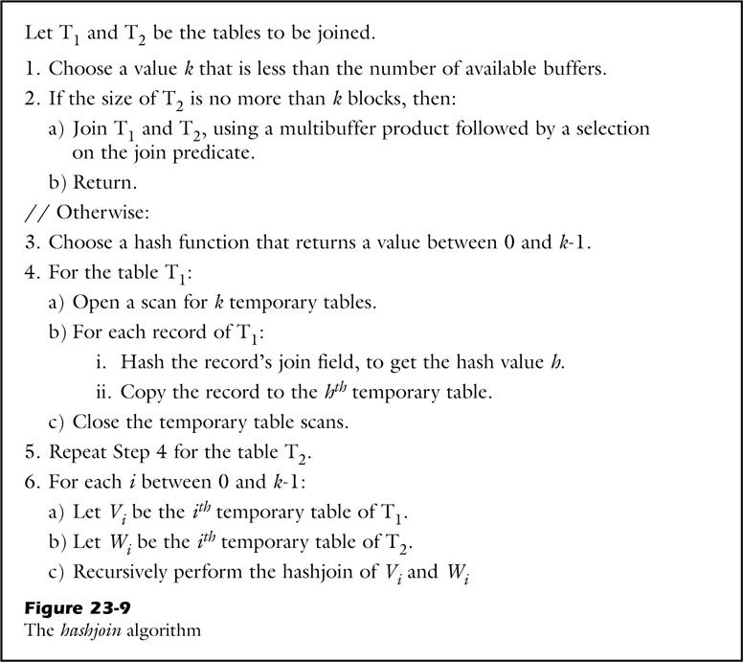
fig_23_09
fig_23_09

Slide 15
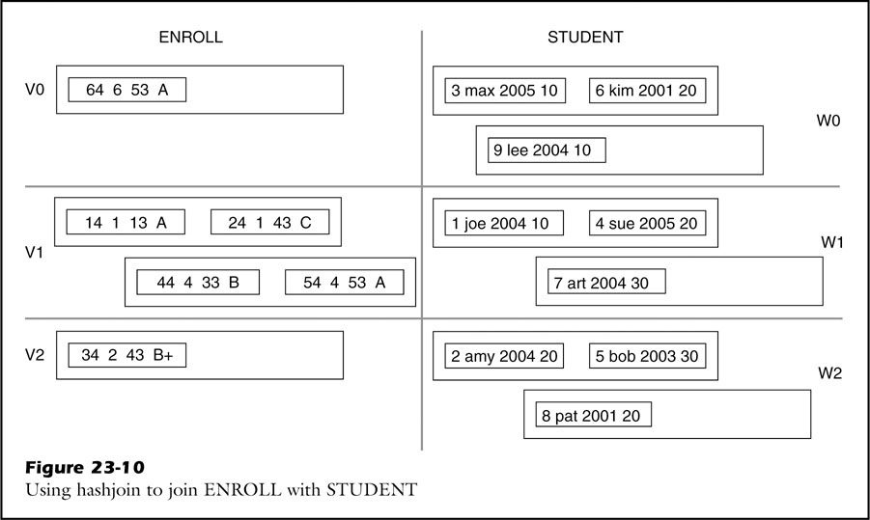
fig_23_10
fig_23_10

