Slide 1
Text Illustrations
To Accompany
Database Design and Implementation
Edward Sciore, Boston College
ISBN: 978-0-471-75716-0
Chapter 24. Query Optimization

Slide 2

co_24
co_24

Slide 3
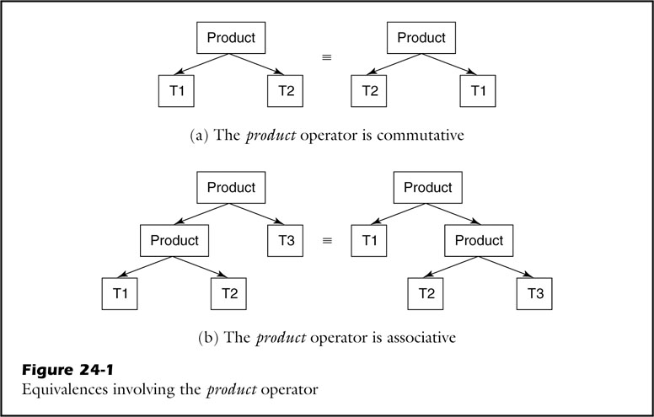
fig_24_01
fig_24_01

Slide 4
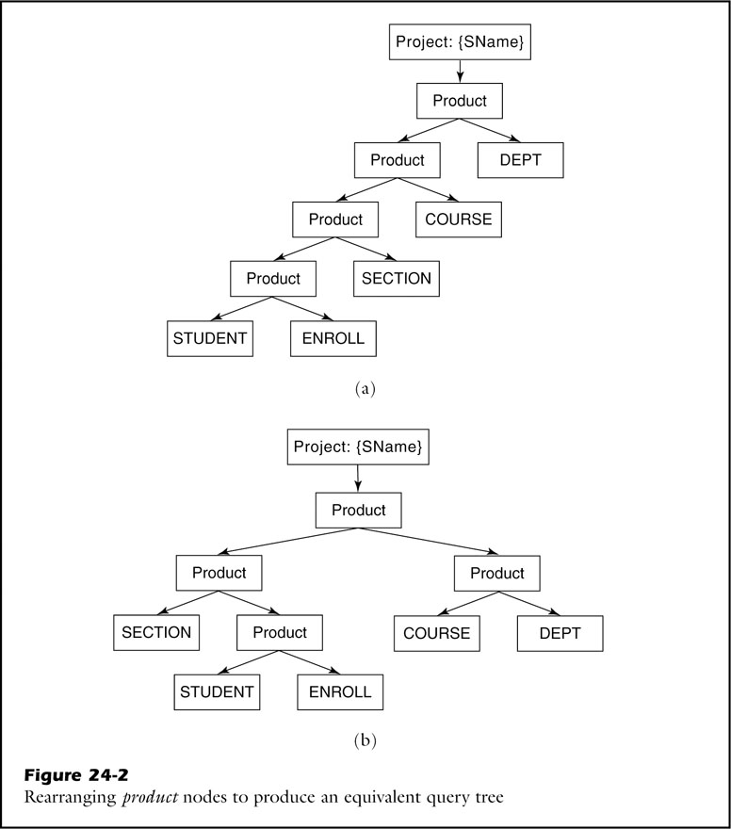
fig_24_02
fig_24_02

Slide 5
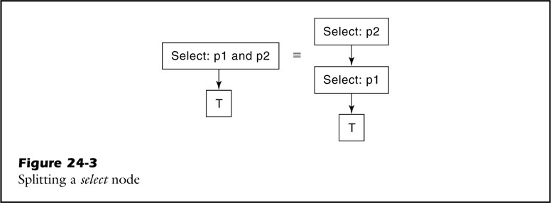
fig_24_03
fig_24_03

Slide 6
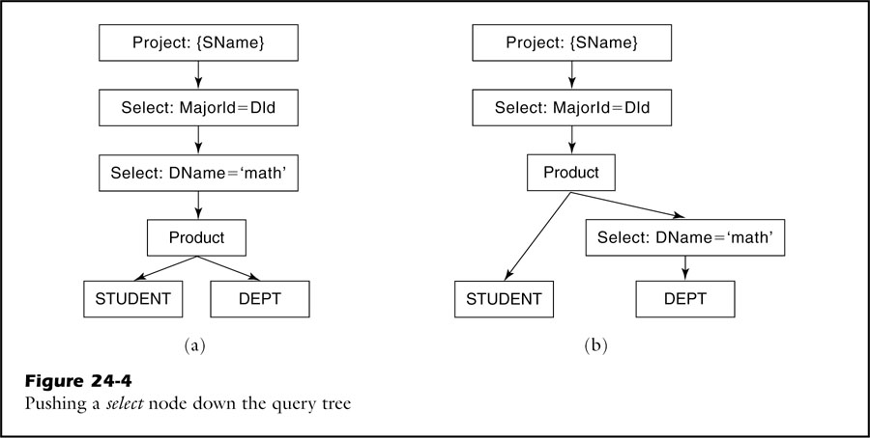
fig_24_04
fig_24_04

Slide 7
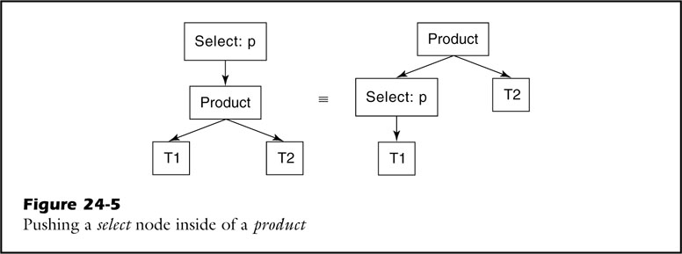
fig_24_05
fig_24_05

Slide 8
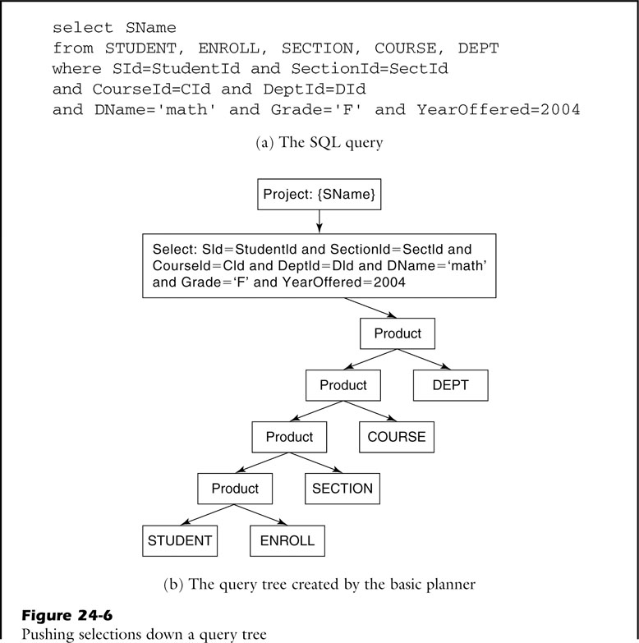
fig_24_06a
fig_24_06a

Slide 9
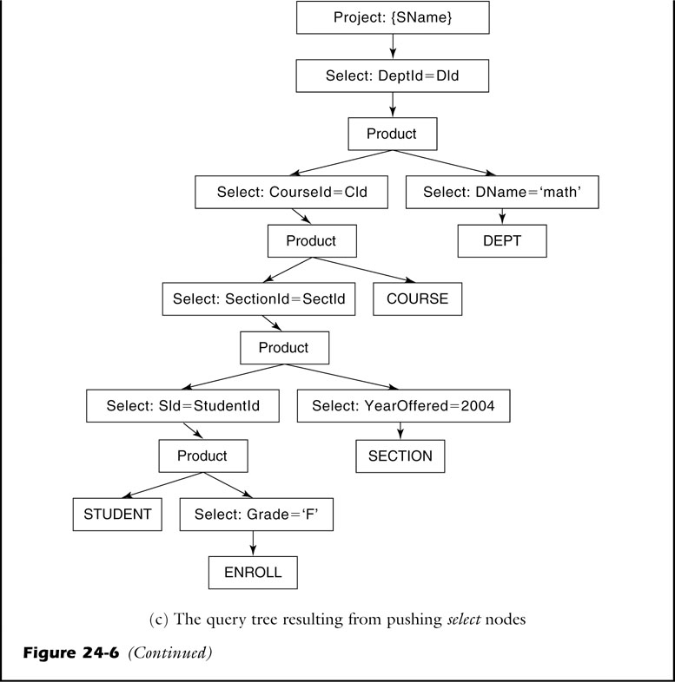
fig_24_06b
fig_24_06b

Slide 10
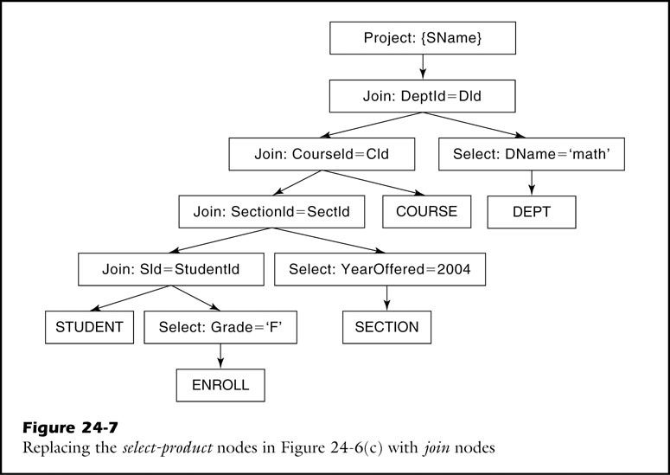
fig_24_07
fig_24_07

Slide 11
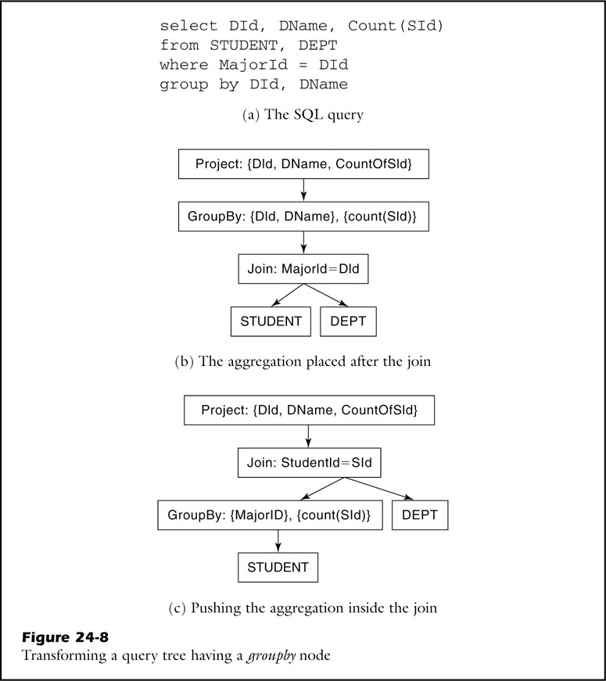
fig_24_08
fig_24_08

Slide 12
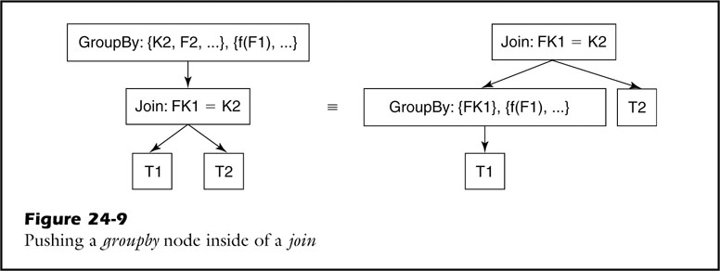
fig_24_09
fig_24_09

Slide 13
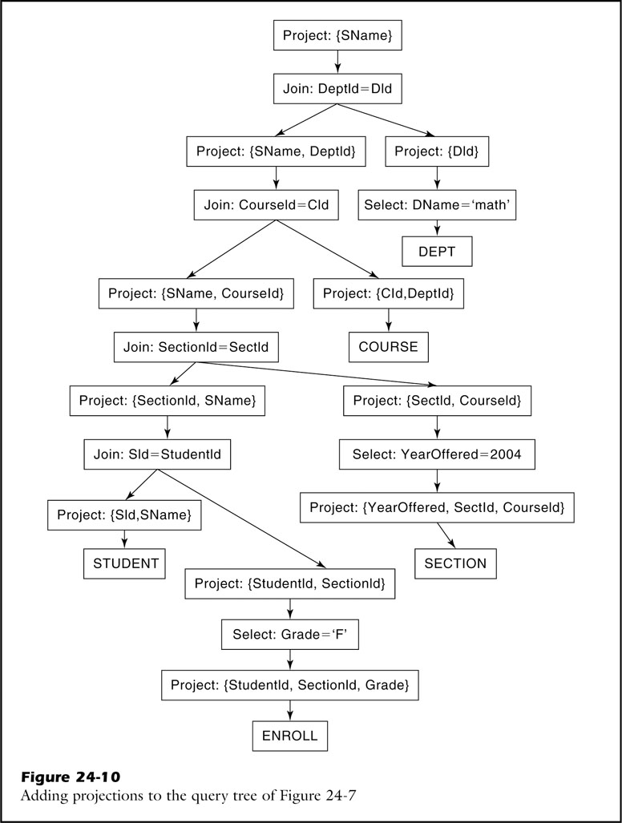
fig_24_10
fig_24_10

Slide 14
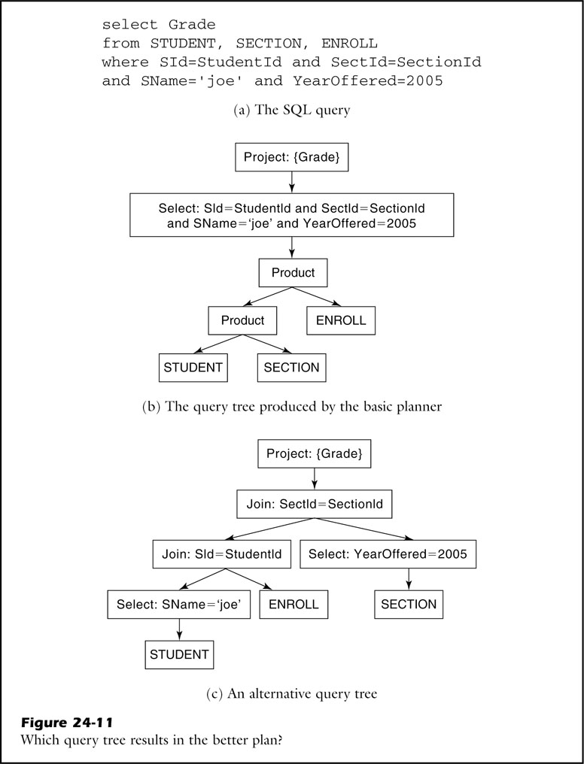
fig_24_11
fig_24_11

Slide 15
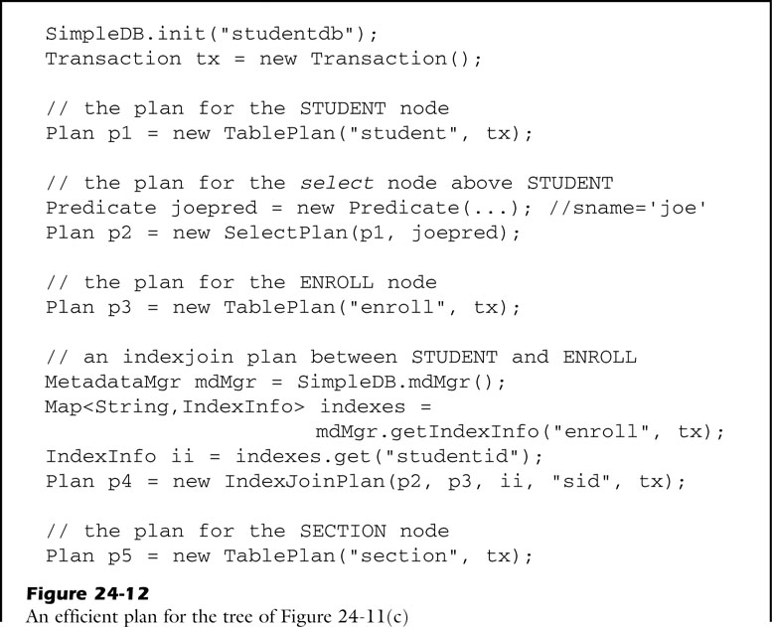
fig_24_12a
fig_24_12a

Slide 16
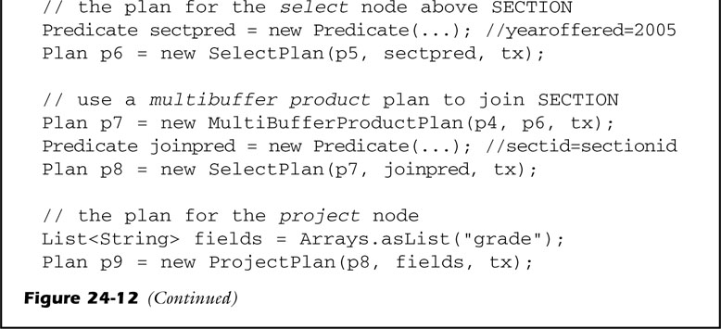
fig_24_12b
fig_24_12b

Slide 17
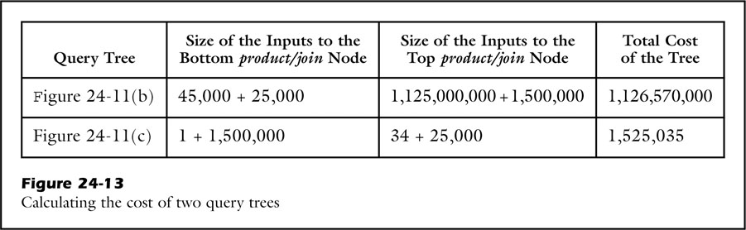
fig_24_13
fig_24_13

Slide 18
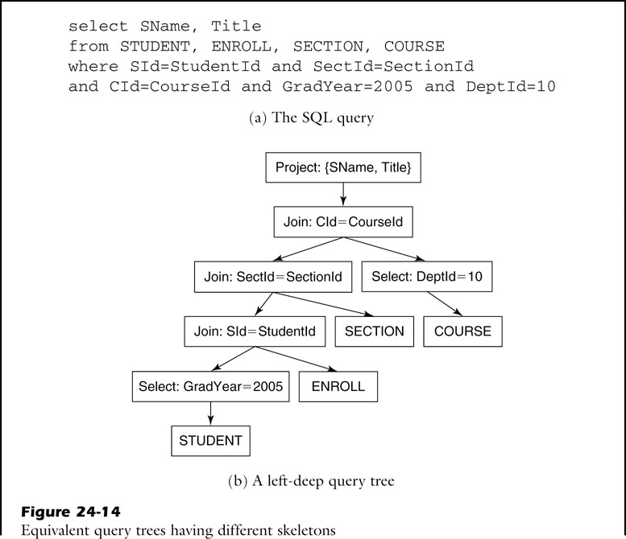
fig_24_14a
fig_24_14a

Slide 19
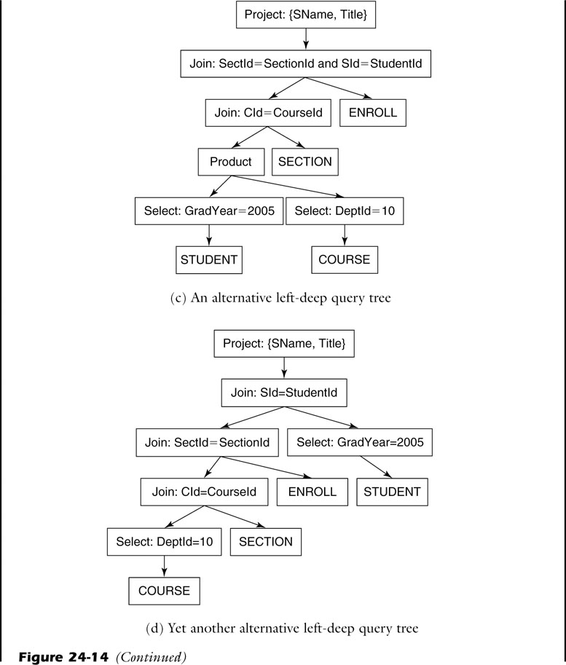
fig_24_14b
fig_24_14b

Slide 20
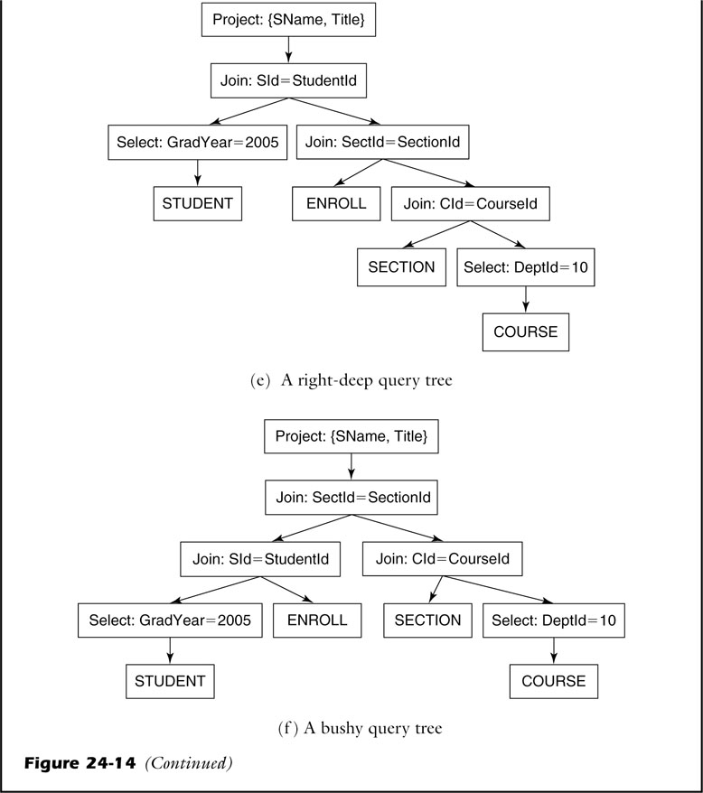
fig_24_14c
fig_24_14c

Slide 21
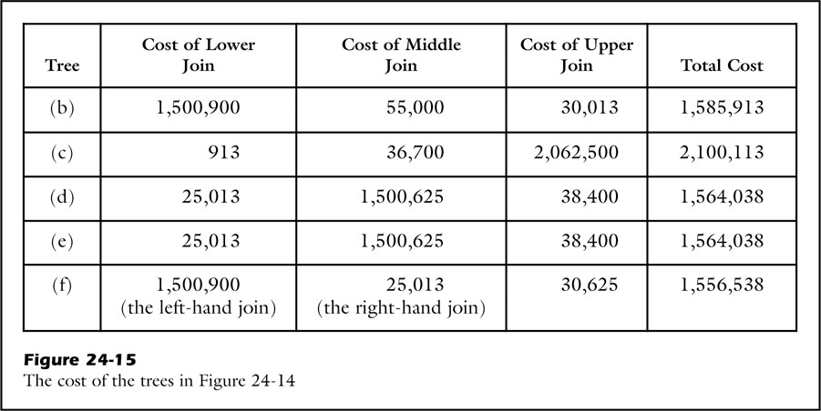
fig_24_15
fig_24_15

Slide 22
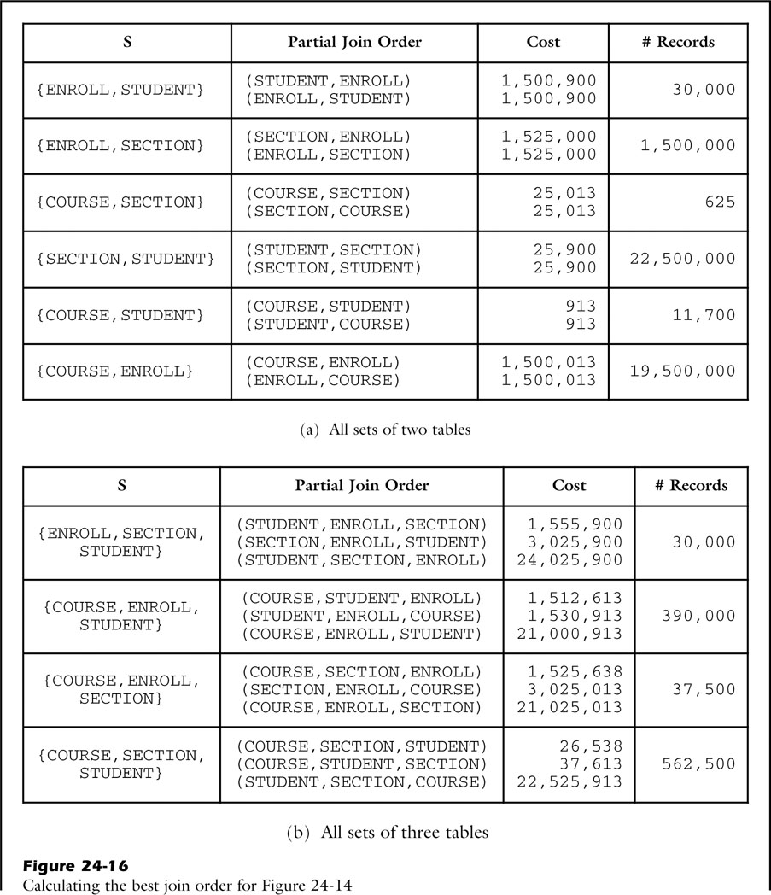
fig_24_16a
fig_24_16a

Slide 23
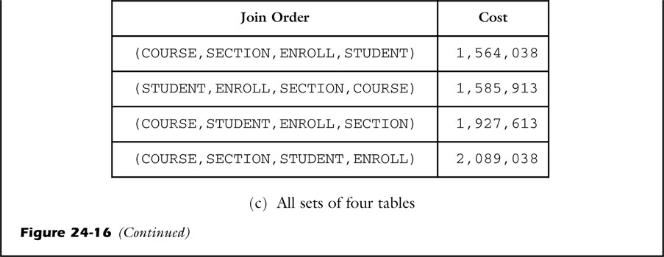
fig_24_16b
fig_24_16b

Slide 24
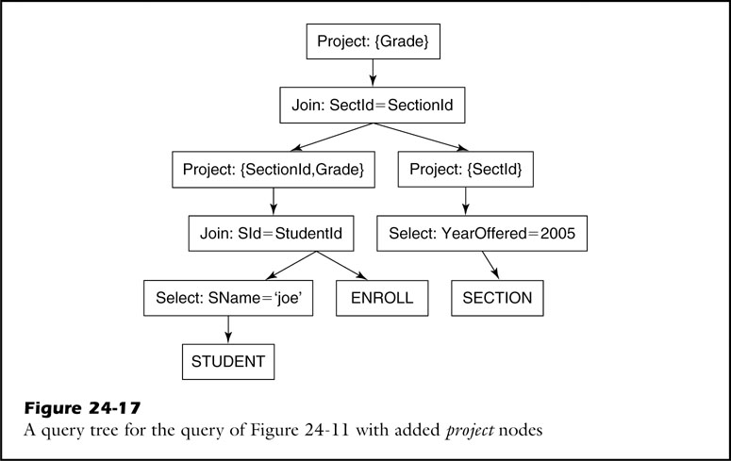
fig_24_17
fig_24_17

Slide 25
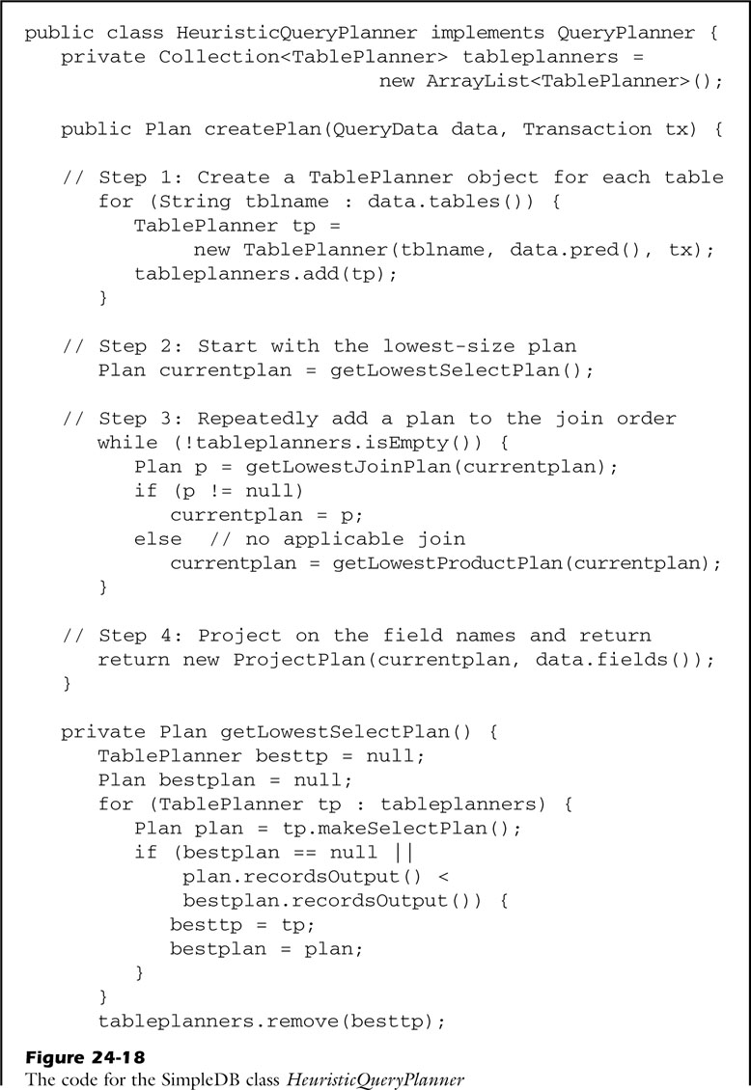
fig_24_18a
fig_24_18a

Slide 26
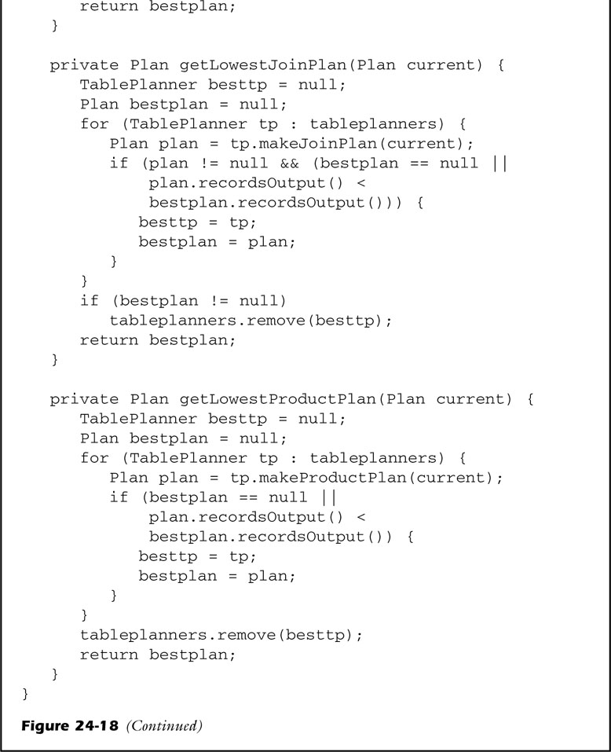
fig_24_18b
fig_24_18b

Slide 27
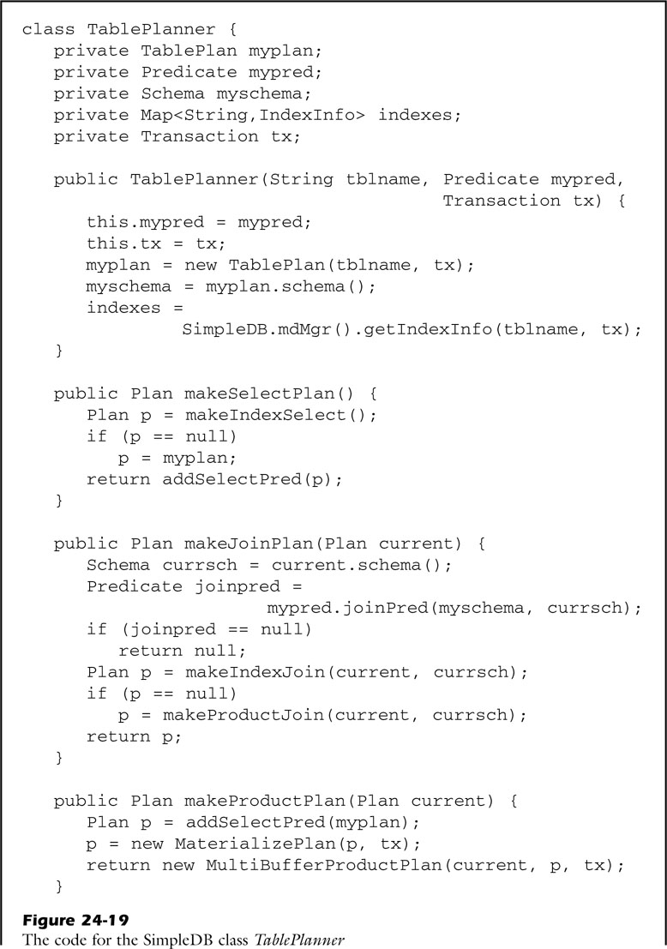
fig_24_19a
fig_24_19a

Slide 28
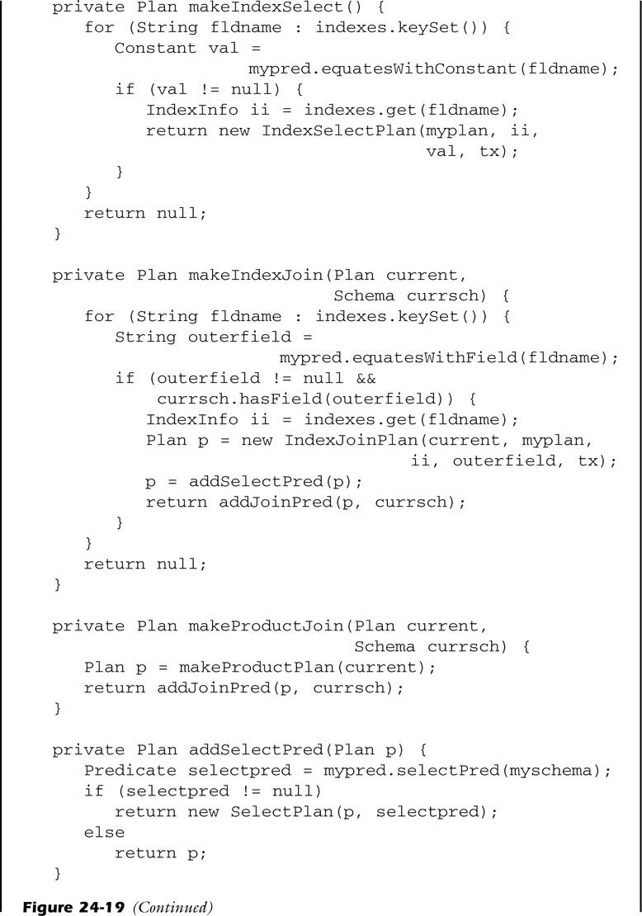
fig_24_19b
fig_24_19b

Slide 29
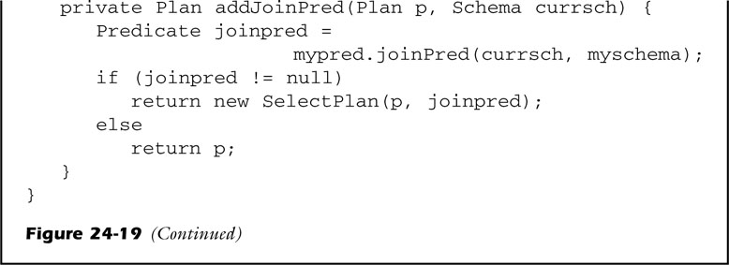
fig_24_19c
fig_24_19c

Slide 30
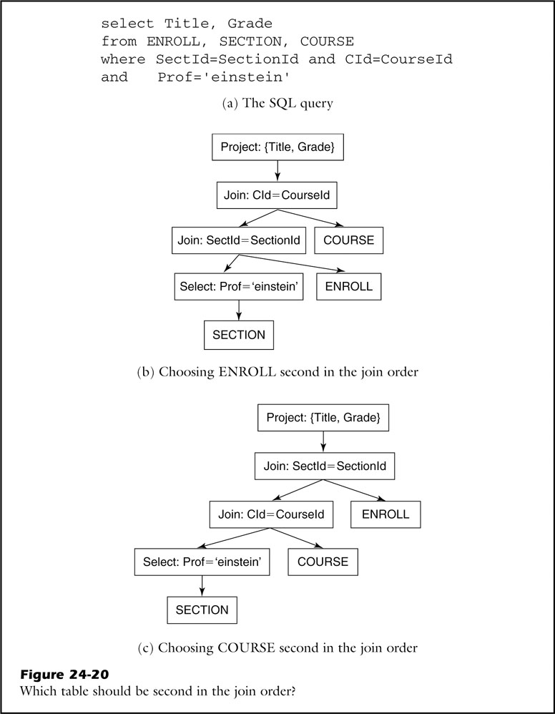
fig_24_20
fig_24_20

Slide 31
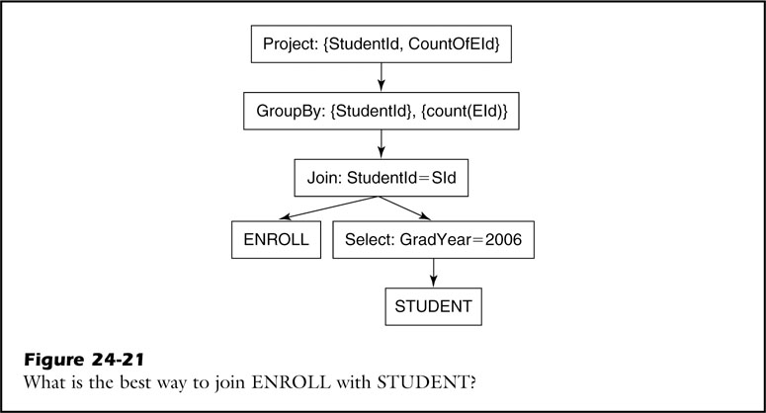
fig_24_21
fig_24_21

Slide 32
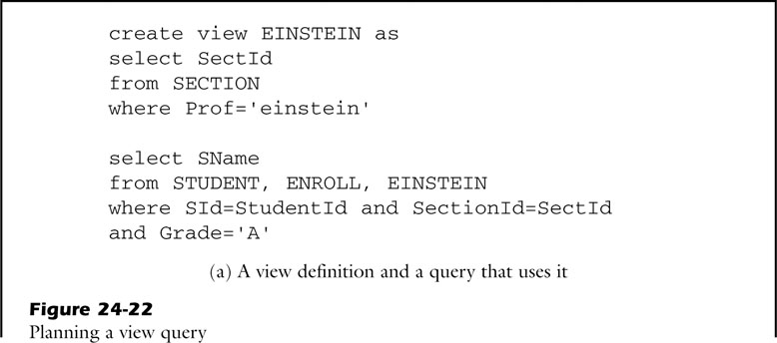
fig_24_22a
fig_24_22a

Slide 33
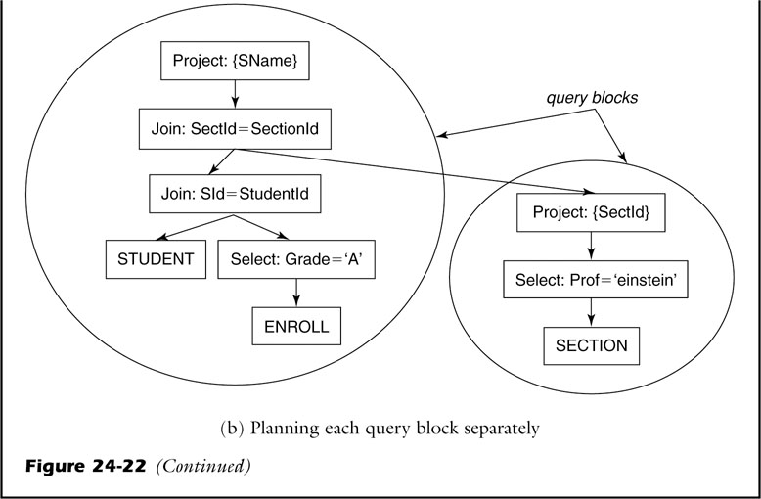
fig_24_22b
fig_24_22b

Slide 34
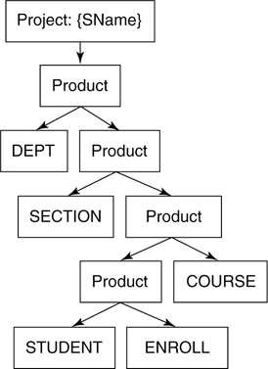
unfig_24_01
unfig_24_01

