Slide 1

Residential life
Group 11 :
Aishvwarya Iyer
Gayathree Iyer

Slide 2
database
‘Residents’ which includes all the details about the residents. These details include Student ID, Resident Name, Phone number, email address, gender, Hall, Room number and balance.
‘Guests’ which includes details like the ResidentID, Guest name, Date In and Date Out.
‘Equipment’ database includes the resident name, equipment name (pool supplies, cart, kitchen supplies, board games, etc.), the date on which the resident checks out the equipment and the date on which the resident checks in the equipment.
‘Package’ database includes the resident’s name, is perishable, the date on which the package arrives at the location, and the date on which the resident picks up the package.
‘Café’ in the dorms is for the residents. The database includes Item ID, Item name, Item price.
‘Stock’ table includes the item name, item count and item price.

Slide 3
Functionalities
A residential life desk manager can :
Add or remove a student from the roster.
Update a resident’s detail.
Get knowledge on which resident is checking in and checking out which guest and when
Get knowledge on which equipment a resident is checking out and checking in and when
Get knowledge of the package received by the resident.
Get knowledge of a resident’s café orders
Get knowledge of a resident’s current balance.

Slide 4
Tools and technology
Database: SQL Server Language: C# Windows Form Application
Microsoft .NET Framework

Slide 5
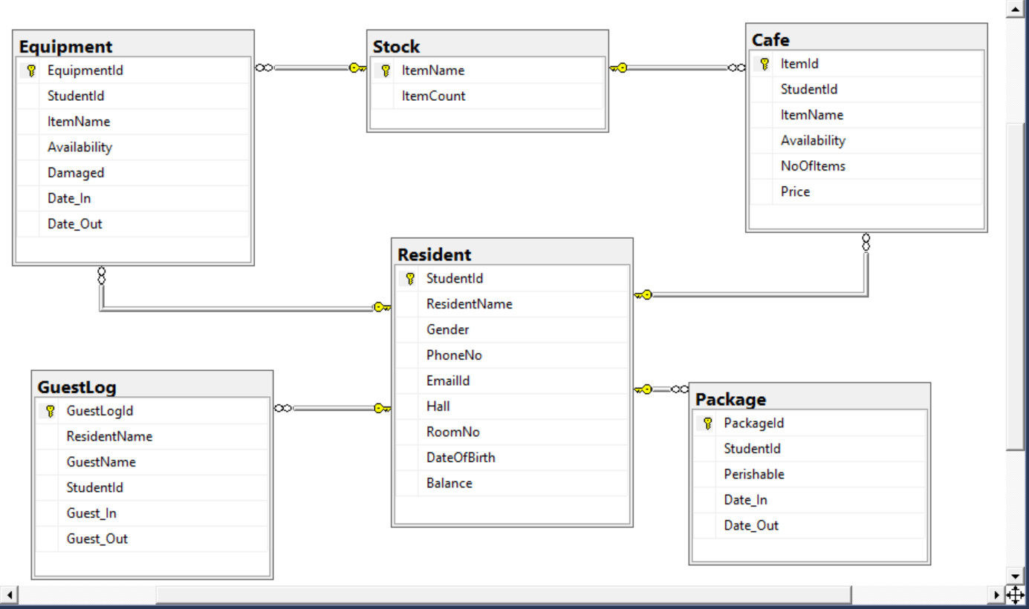
Schema Diagram

Slide 6
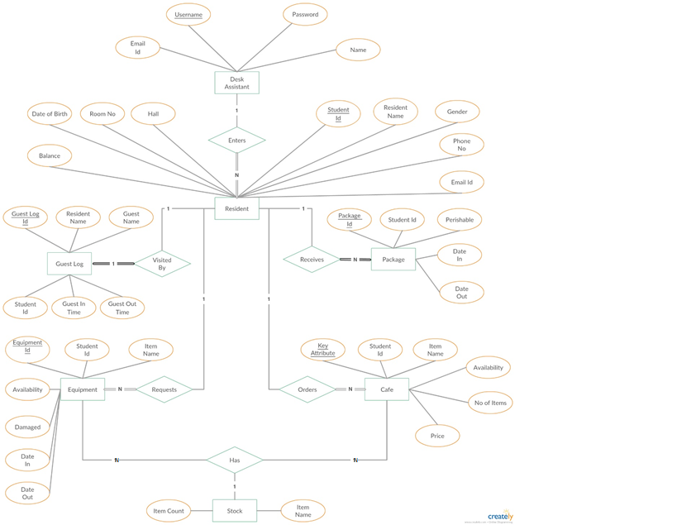
ER Diagram

Slide 7
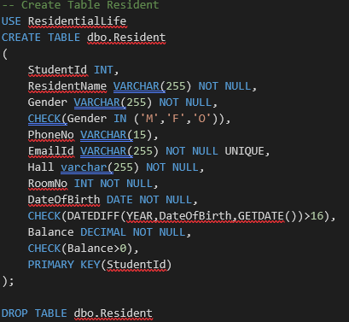
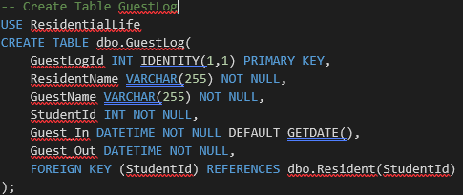
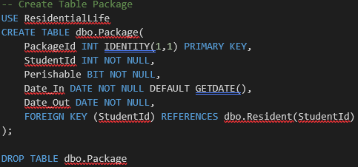
CORE QUERIES

Slide 8
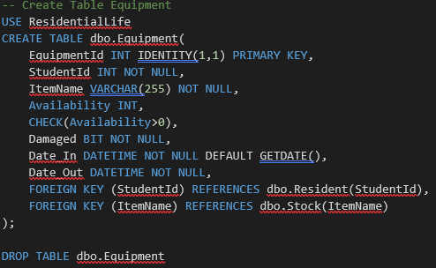
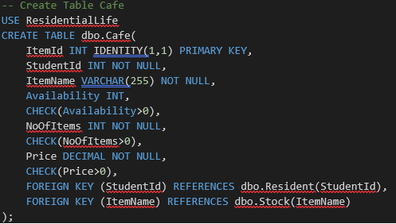
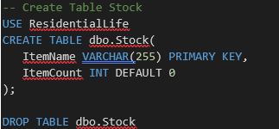
CORE QUERIES

Slide 9
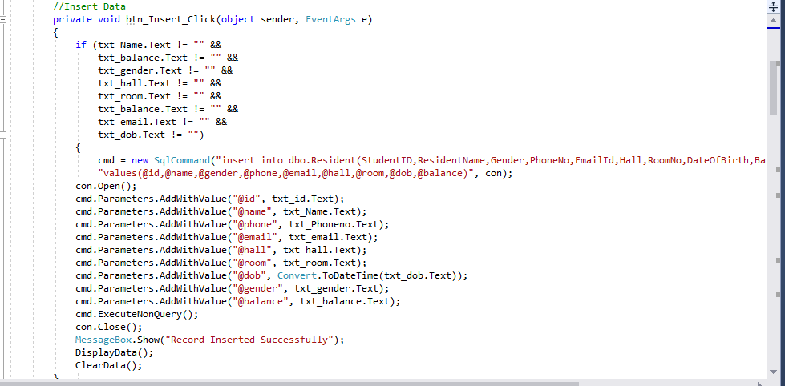
INSERT

Slide 10
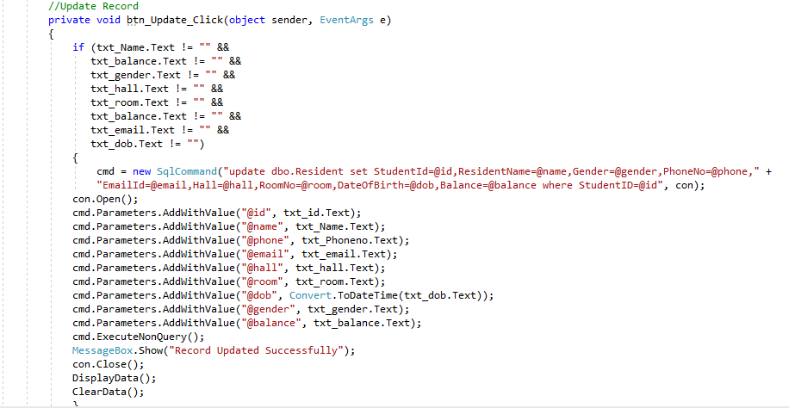
UPDATE

Slide 11
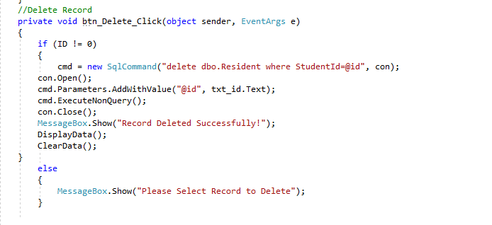
DELETE

Slide 12
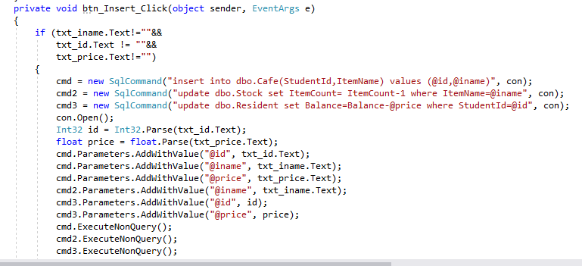
CORE QUERIES

Slide 13
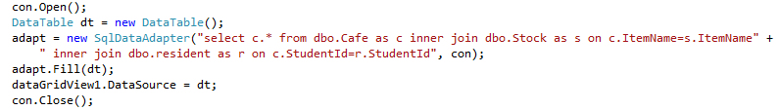
CORE QUERIES

Slide 14
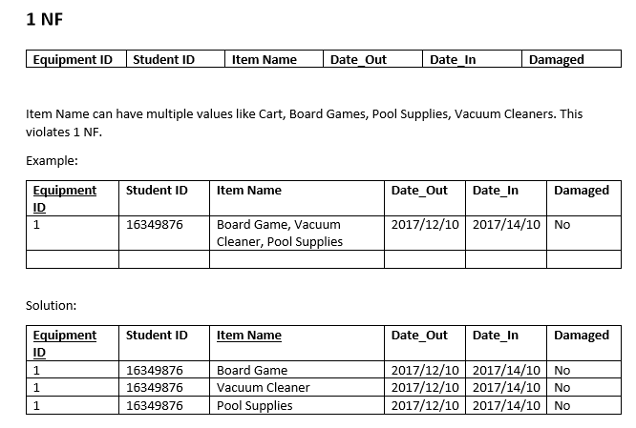
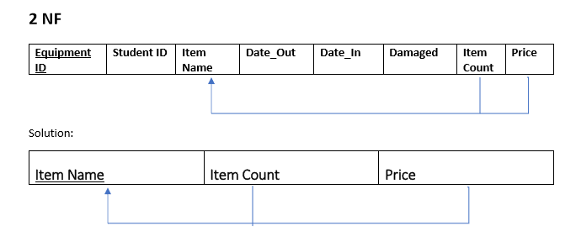
Normalization

Slide 15
When a resident checks out an equipment the date-in value will be the default value, i.e. current date-time.
When the resident checks-in the equipment back, the record must be updated to the actual date-in value.
Similarly, when a guest checks-in, the date-out value will be default value: current date-time. This must be updated when the guest checks-out of the residence hall.
This is because C# does not allow to insert null values in the date time picker in Windows Form Application.
DEFICIENCIES
FUTURE
SCOPE
Null value should be allowed in equipment date-in and guest check-out fields.

Slide 16
REFERENCEs
https://dev.mysql.com/doc/refman/5.7/en/tutorial.html
https://www.youtube.com/watch?v=yPu6qV5byu4
https://www.tutorialspoint.com/csharp/
https://www.youtube.com/watch?v=lisiwUZJXqQ

Slide 17
Thank you !!

