Slide 1
CAMPUS EATS Project Demonstration
Project Group 6

Slide 2
Project Overview
Modify the existing Campus_Eats_Script file
Create EERD Diagrams of the databse
Add a ratings system for restaurants and drivers
Develop tables and enter test data into the database
Create stored procedures and advanced views
Optional: Partial UI to connect database to app/web interface

Slide 3
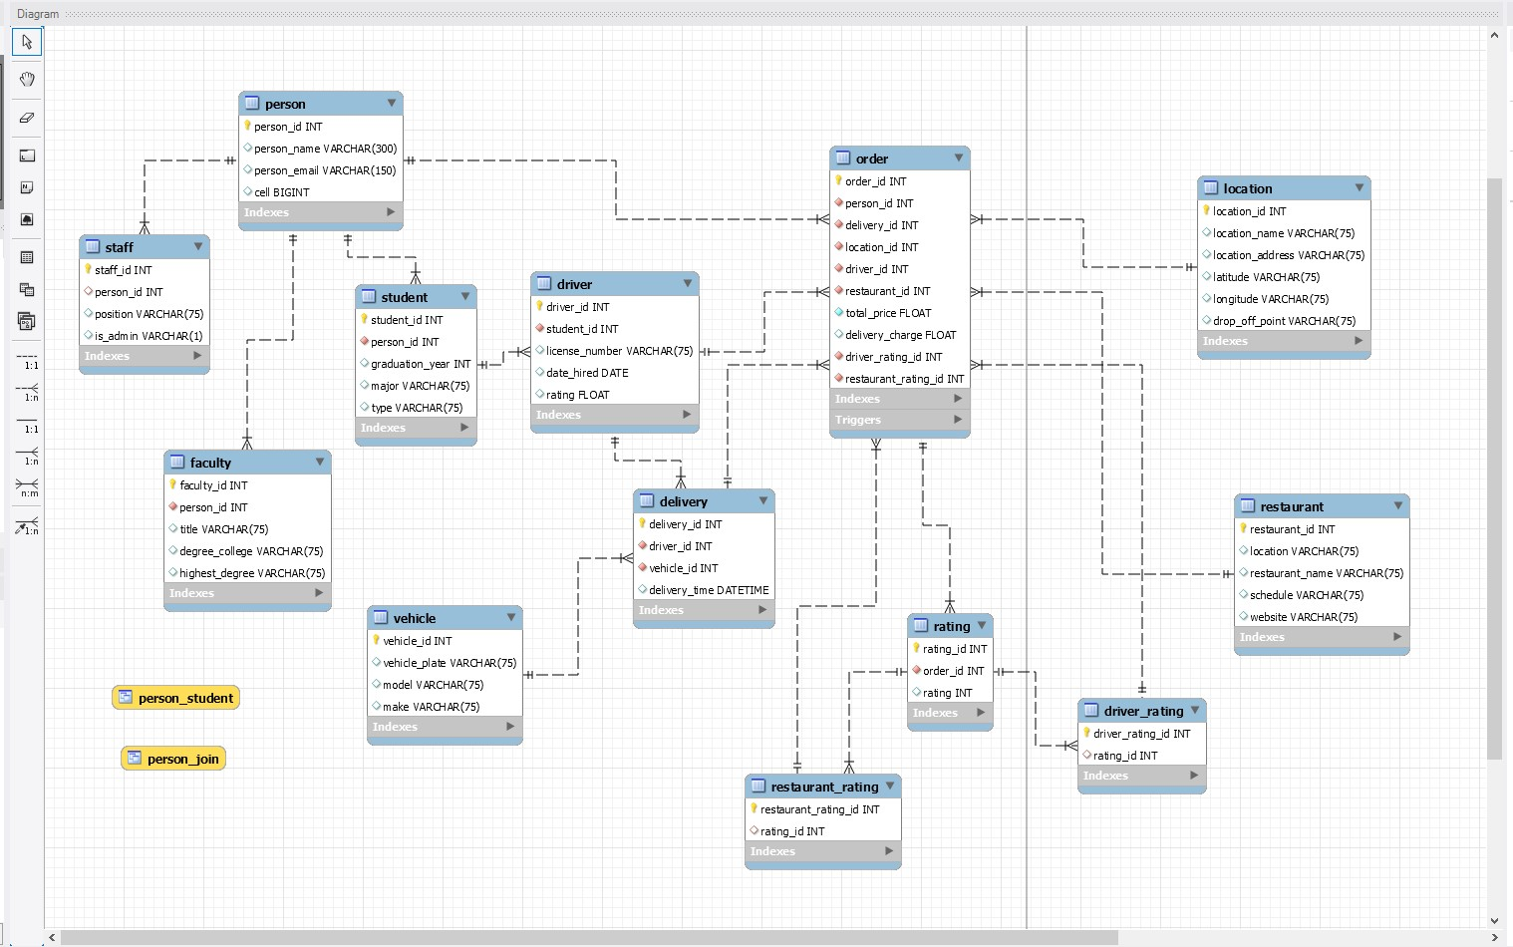
EERD Diagram

Slide 4
Database Overview
People Table
Staff, faculty and students
Drivers are subtype of students
Order Table
Restaurant Table
Location Table
Delivery table
Vehicle associated with delivery
Rating Table
Driver and Restaurant Ratings Table associated with Rating

Slide 5
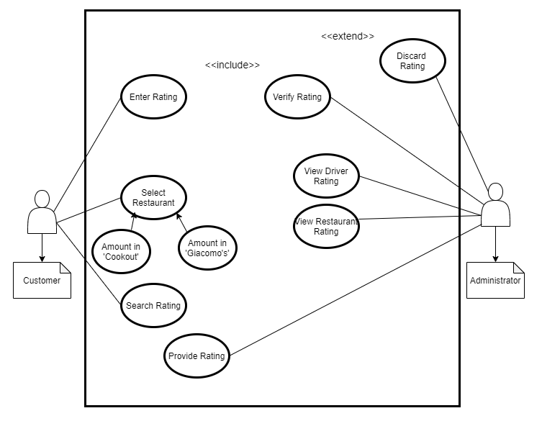
Use Case Diagram
Use Case Diagram with Customer and Administration of database Interactions

Slide 6
Deliverable 4
Stored Procedure
This procedure can be used to calculated the average rating of a restaurant or driver when passing in multiple ratings
Advanced View 1:
‘restaurants_with_lake’
This view shows all restaurants with ‘Lake’ in their name and sorts in Ascending Order
Advanced View 2:
‘drivers_with_high_ratings’
This view sorts all the ratings in the ratings table
It queries for driver ratings and then driver ratings higher than 3

Slide 7
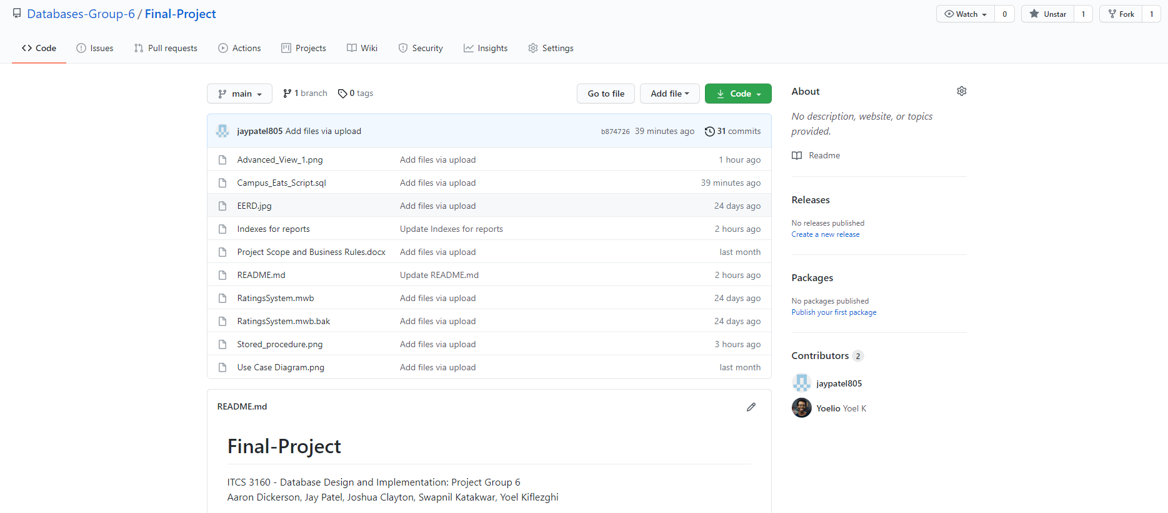
GitHub
https://github.com/Databases-Group-6/Final-Project

Slide 8
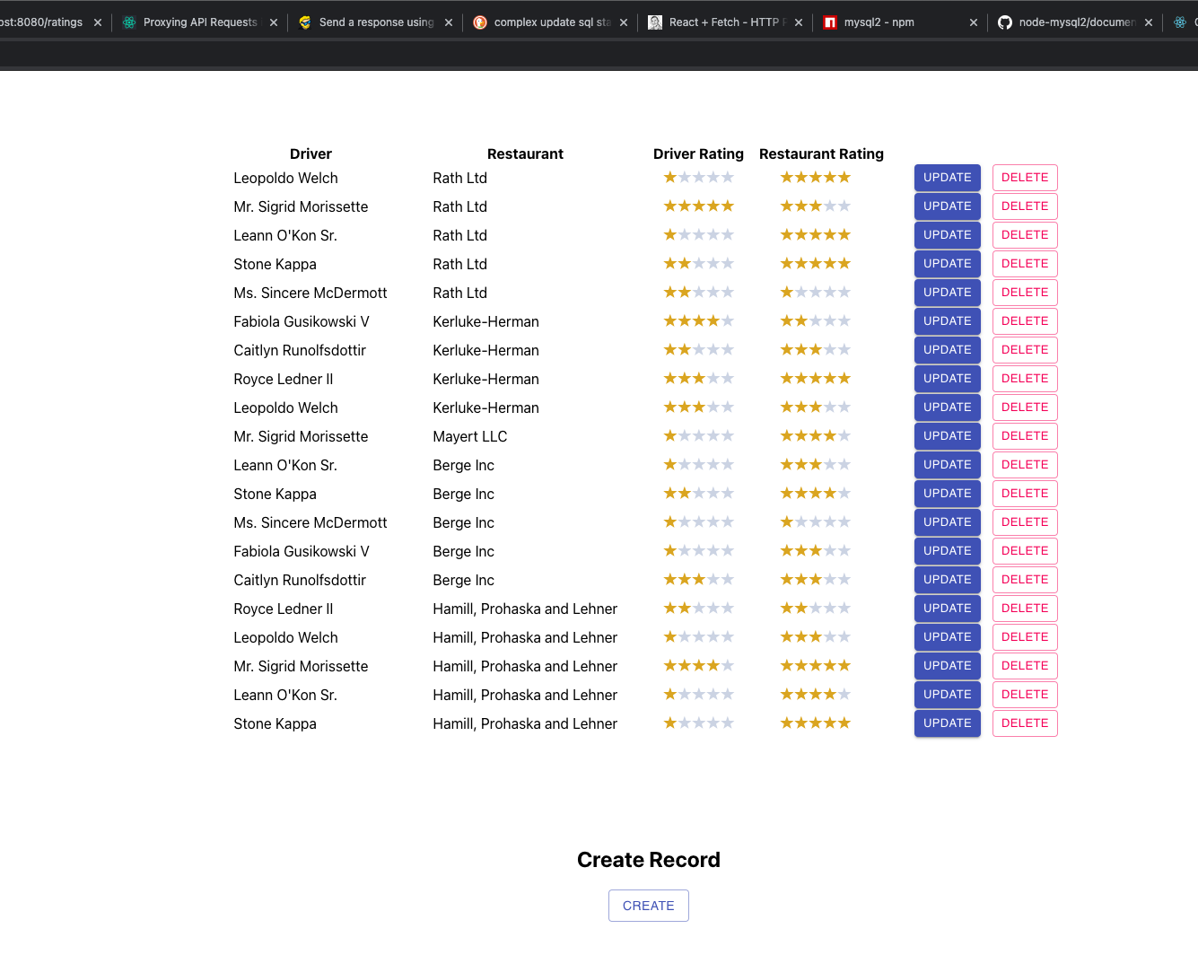
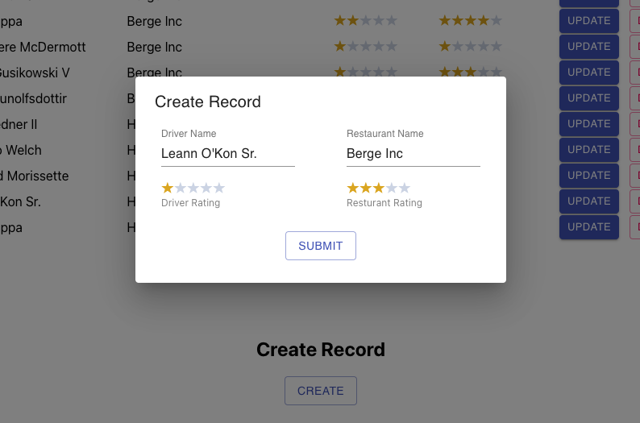
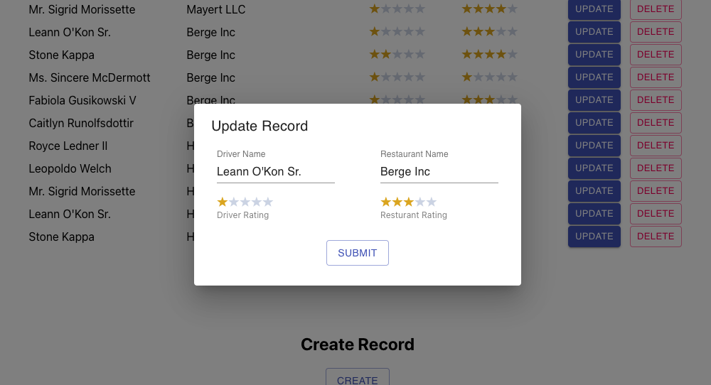
Web Interface UI

Slide 9

This Photo by Unknown Author is licensed under CC BY-SA

