Slide 1
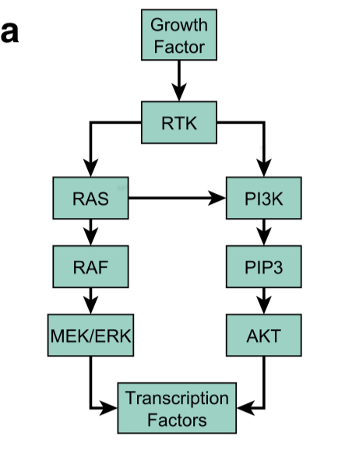


Slide 2
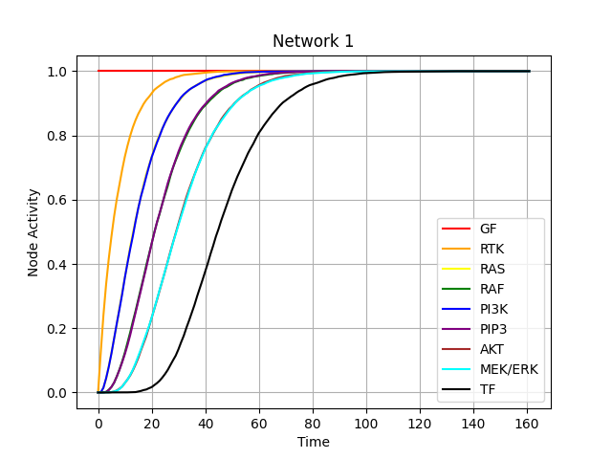
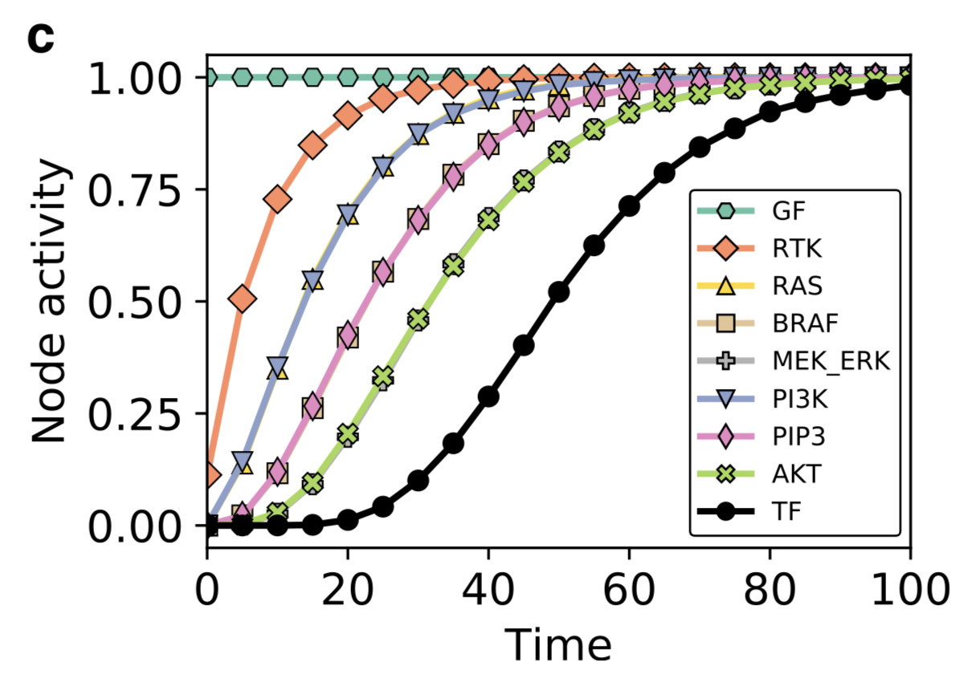

The results in the paper and those of my simulation are identical.

Slide 3
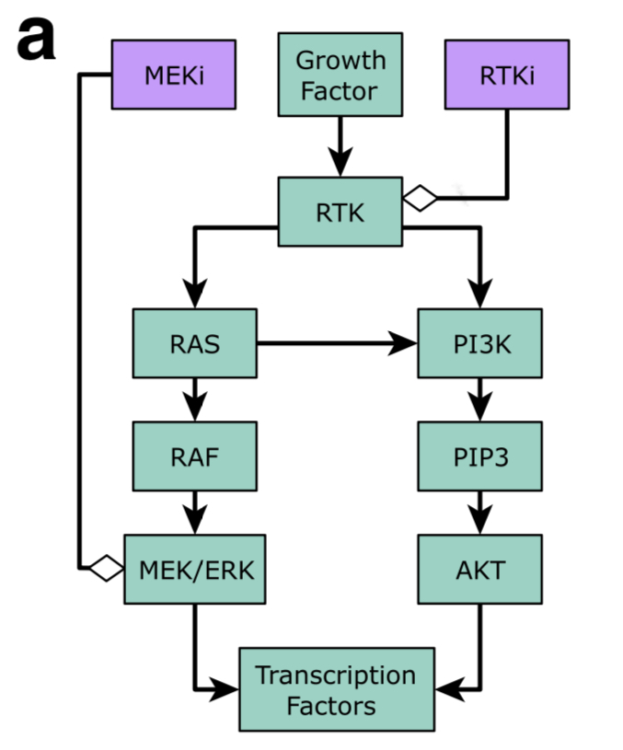


Slide 4
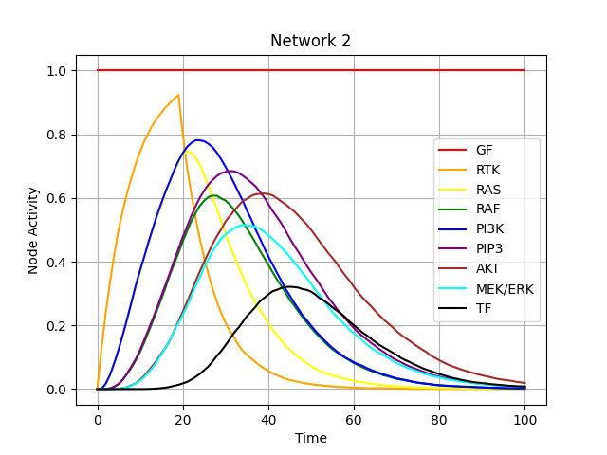
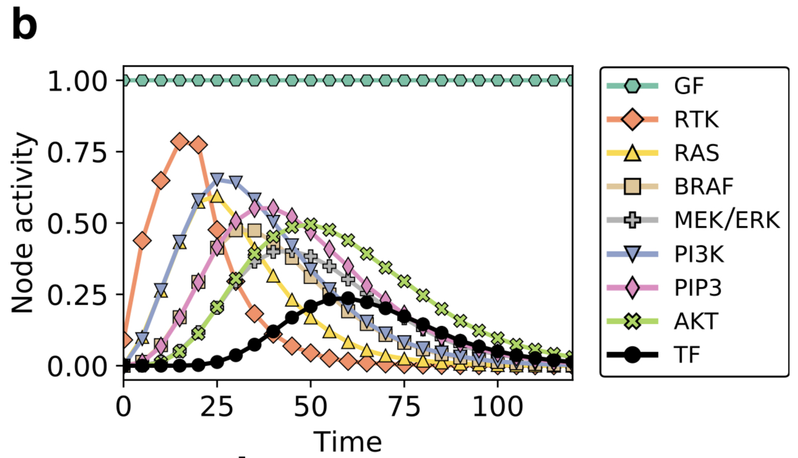

The results in the paper and those of my simulation are identical except that the peaks of the graphs indicate higher values of Node Activity.

Slide 5
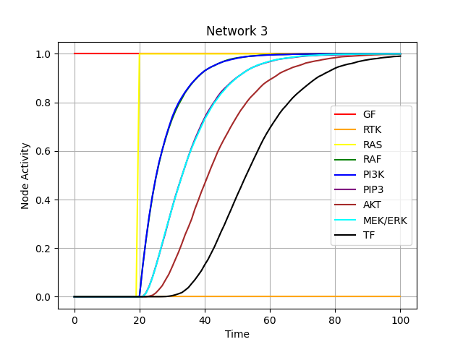
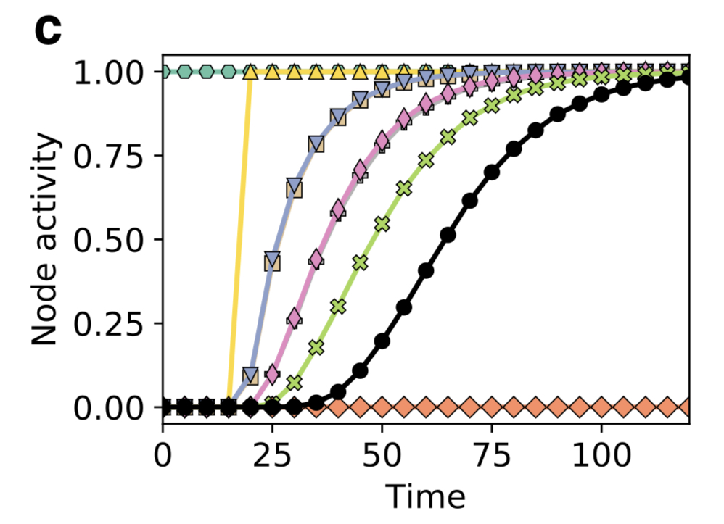

The results in the paper and those of my simulation are identical.

Slide 6
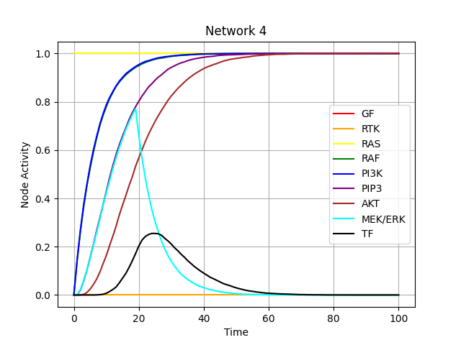
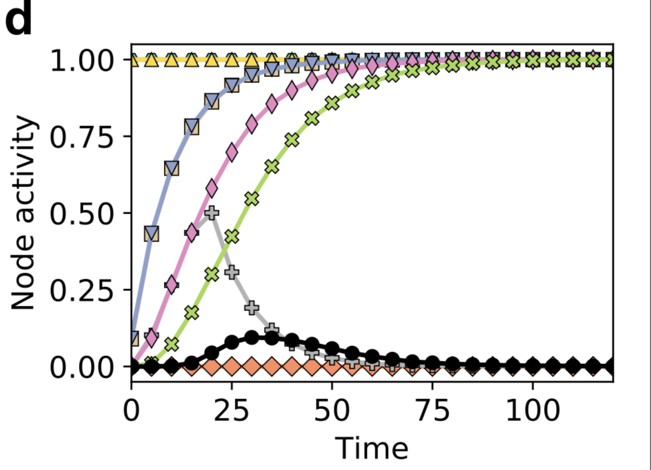

The results in the paper and those of my simulation are identical except that the peaks of the graphs indicate higher values of Node Activity.

