Slide 1
Contexts
Row Contexts
Every row have different value
Suchlike Age, Age bins
Filter Contexts
Single Output
What is max age from entire data

Slide 2
Time intelligence Function
YTD :- Year till date
MTD:- Month till date
QTD :- Quarter till date

Slide 3
Functions
SUM
MEAN
AVERAGE
MIN
MAX
COUNT
COUNT ROWS
CALCULATE
FILTER
DATEDIFF = difference of dates
DATEADD
Today’s Date = Today()
Format = to convert
Todys format = format(today(),”MMM”)
“DD/MM/YY”
First day – Last day

Slide 4
DAX: Data Analysis Expression
Difference
Measure → Filter Contexts
Calculated Columns → Calculated by row by row
Two Business Logics
1.Measures→ Sum, Mean
2.Calculated Columns →
Newly derived Column

Slide 5
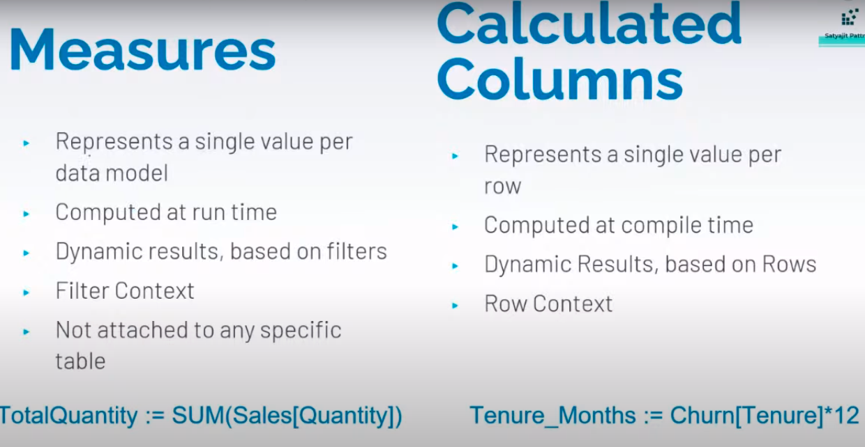
Difference

Slide 6
Implicit Measure
If we use a calculated columns as value/result , it creates am implicit measure.
Eg:- If we have columns such as:
- Tenure in year
- Monthly average usage
Goal:- to create oeverall average usage of for the costumer
Churn[Tenure_Months] = Churn[Tenure] * 12
c

Slide 7
DAX is great for two things
Aggregation
Filtering
Aggregation:- Combining group of values into one variable
Example:- Sum, Average, Min, Max, Distinct Countc

Slide 8
Jan
March
June
Aug
Sep
Jan
Feb
March
April
May
June
July
Aug
Sep
Calculated Function
Date = CALENDER(range)
Creates a dates table with a date per day between the specified range
Also creates a Date Hierarchy
Apply in new table | We can create specific dates with range by using calendar function
New_dates = CALENDER(DATE(2023,1,1),DATE(2024,1,1))

Slide 9
Calculate: Breaking Out of the filter context
If we want Sum of total charges → Sum()
Now sum of total charges for male
Male_sum = CALCULATE(SUM[Total_charges]),data[gender]==male))
CALCULATE(SUM[Balance]), filter(‘Data’[gender] == ‘Male’

Slide 10
If else and nested if blocks
Age_bins = IF(Data[Age]>45,”Greater than 30”,”Below 30”)
Nested if : IF (Age>40, ’40+’, IF(age>20,”21-49”,”0-20”))

Slide 11
Time Intelligence Function
Enable User to manipulate data using time periods such as years , quarters, months, and days
Creating calculations over those time periods
Most common time periods:
Year to date
Quarter to Date
Month to date
Last year
full year
rolling 12 months

Slide 12
Prev_month = calculate(sum(AirPass),PREVIOUSMONTH(airp[Month]))
2. Previous Month
=Format(PREVIOUSMONTH(AirPassengers[Month]),”MMMM”)
Next Month = calculate(sum(AirPass),NEXTMONTH(airp[Month]))
Pass YTD =TOTALYTD(Airpassengers[#Passengers]),Airpassengers[Month])

Slide 13
Total_Month_Till_date :
Total_MTD_Prev = CALCULATE([TotalMTD],SAMEPERIODLASTYEAR(Airpassengers[Month]))

Slide 14
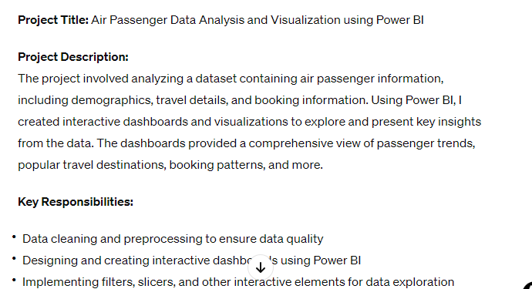
Total Month till Previous Quarter/Month/Year
Total_Previous_Quater :
Total_Prev_Q = CALCULATE([TotalMTD],SAMEPERIODLASTYEAR(Airpassengers[Month]))

Slide 15
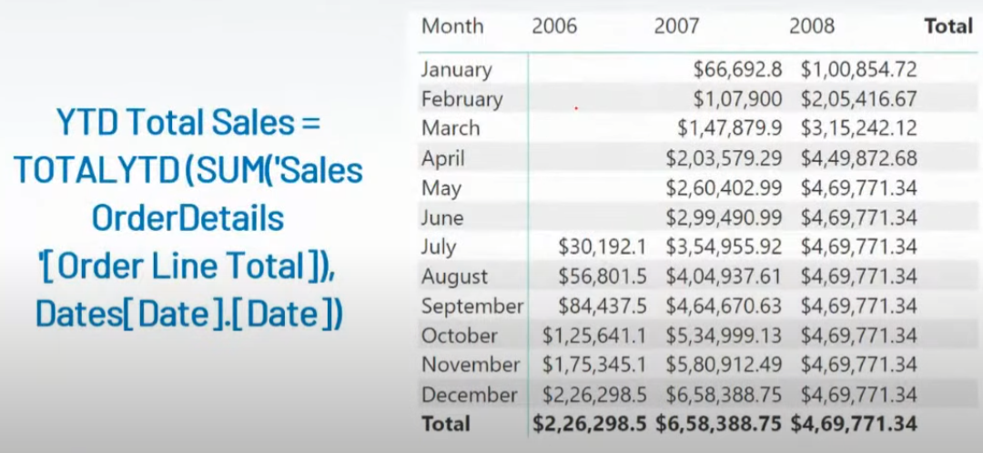

Slide 16
X vs NON X functions
(SUM vs SUMX)
X functions are the iterators functions
It works row by row.
It is measure
EG:
SUMX(Dataset,Column1 * Column2 + Column 3)

Slide 17
Sum
SUM is aggregator Function
It works like measure
Calculating based on the current filter context
Sum X
SUMX is Iterator Function
It works Row by row
Sumx has awareness of rows in a table, and can refrence the intersection of each row

Slide 18
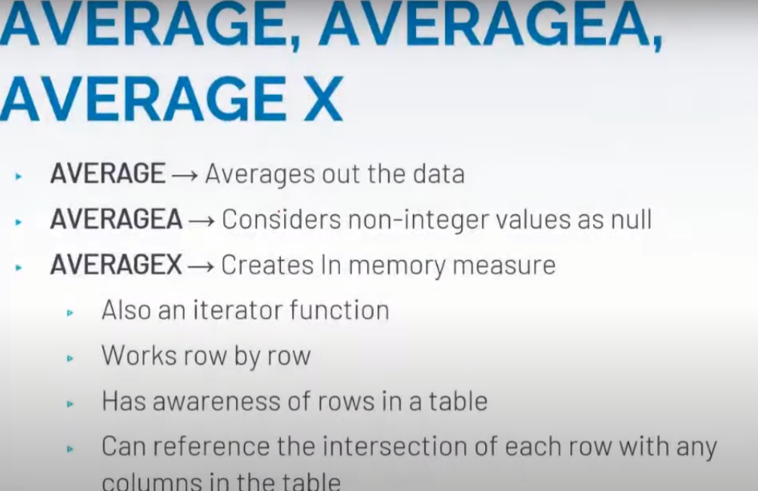
Average X

Slide 19
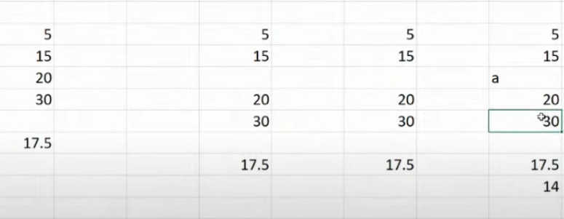
Diff b/w Avg , Avga

