Slide 1
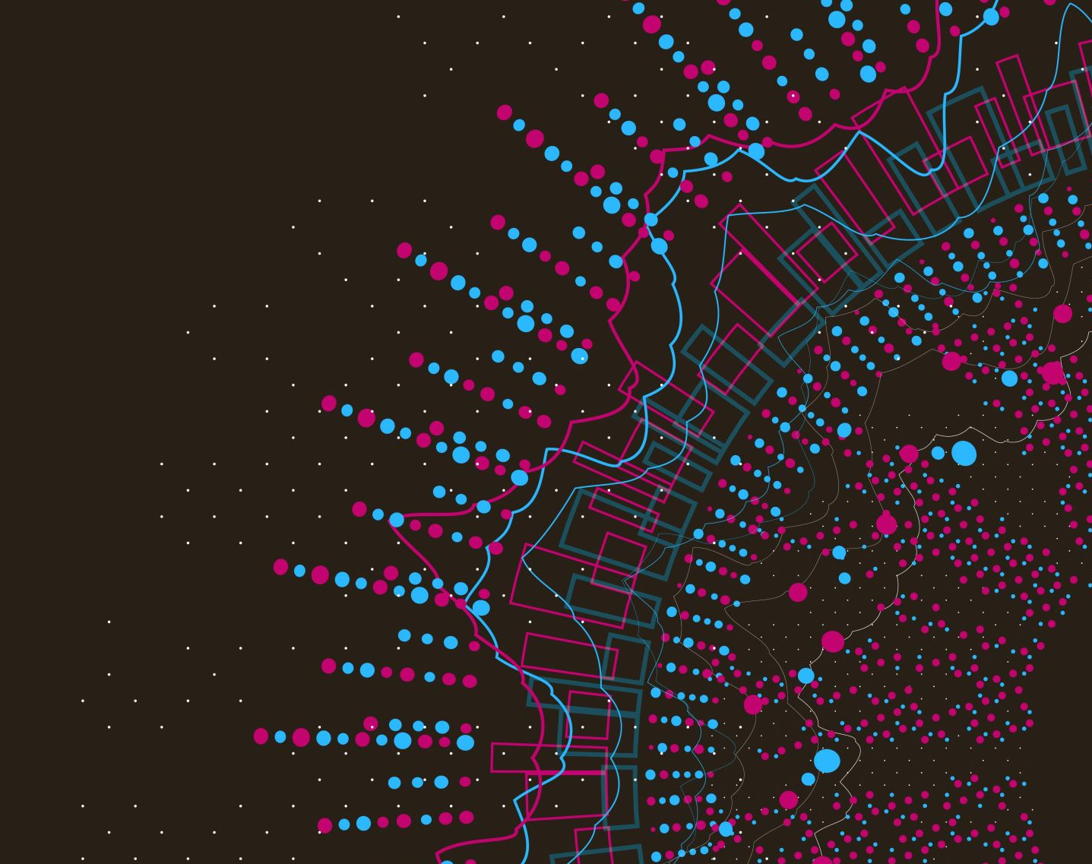
Red Cross Donor Prediction
Data Analysis and Machine Learning Insights
Prepared by: Amary Coulibaly

Slide 2
Project Overview
Objective: Predict donor behavior for the Red Cross.
Data Source: Donor dataset including demographics and donation history.
Tools Used: Python, Pandas, Matplotlib, PyCaret, etc.

Slide 3

Data Description
Total Records: 34,508 donors
Features: 23 columns including demographics, donation history, and engagement flags.

Slide 4

Data Cleaning Process
Missing Values: Handled missing values in columns like DonorPostalCode, MaritalStatus, GenderIdentity, WealthRating, etc.
Data Transformation: Converted monetary columns to numeric and binary columns to boolean.

Slide 5
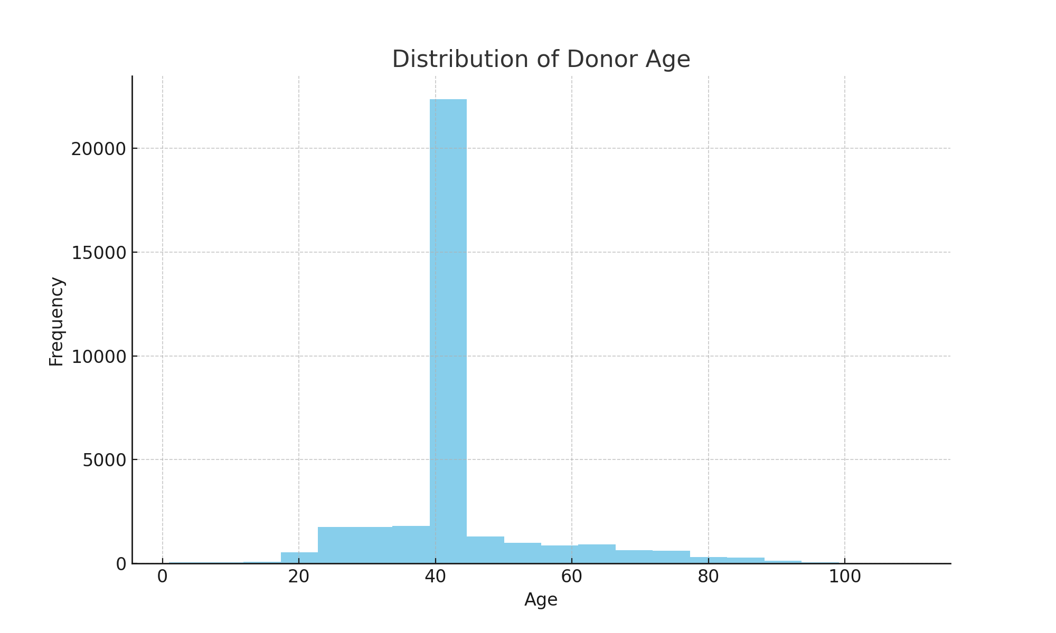
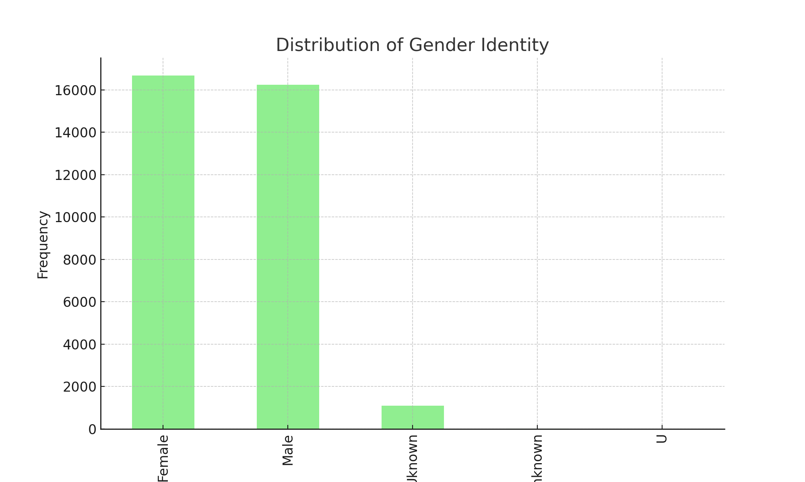
Demographics Analysis
Donor Age Distribution: Visualized the distribution of donor ages.
Gender Distribution: Analyzed the gender identity distribution among donors.

Slide 6
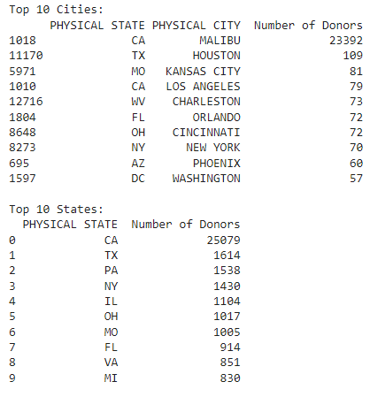

Slide 7
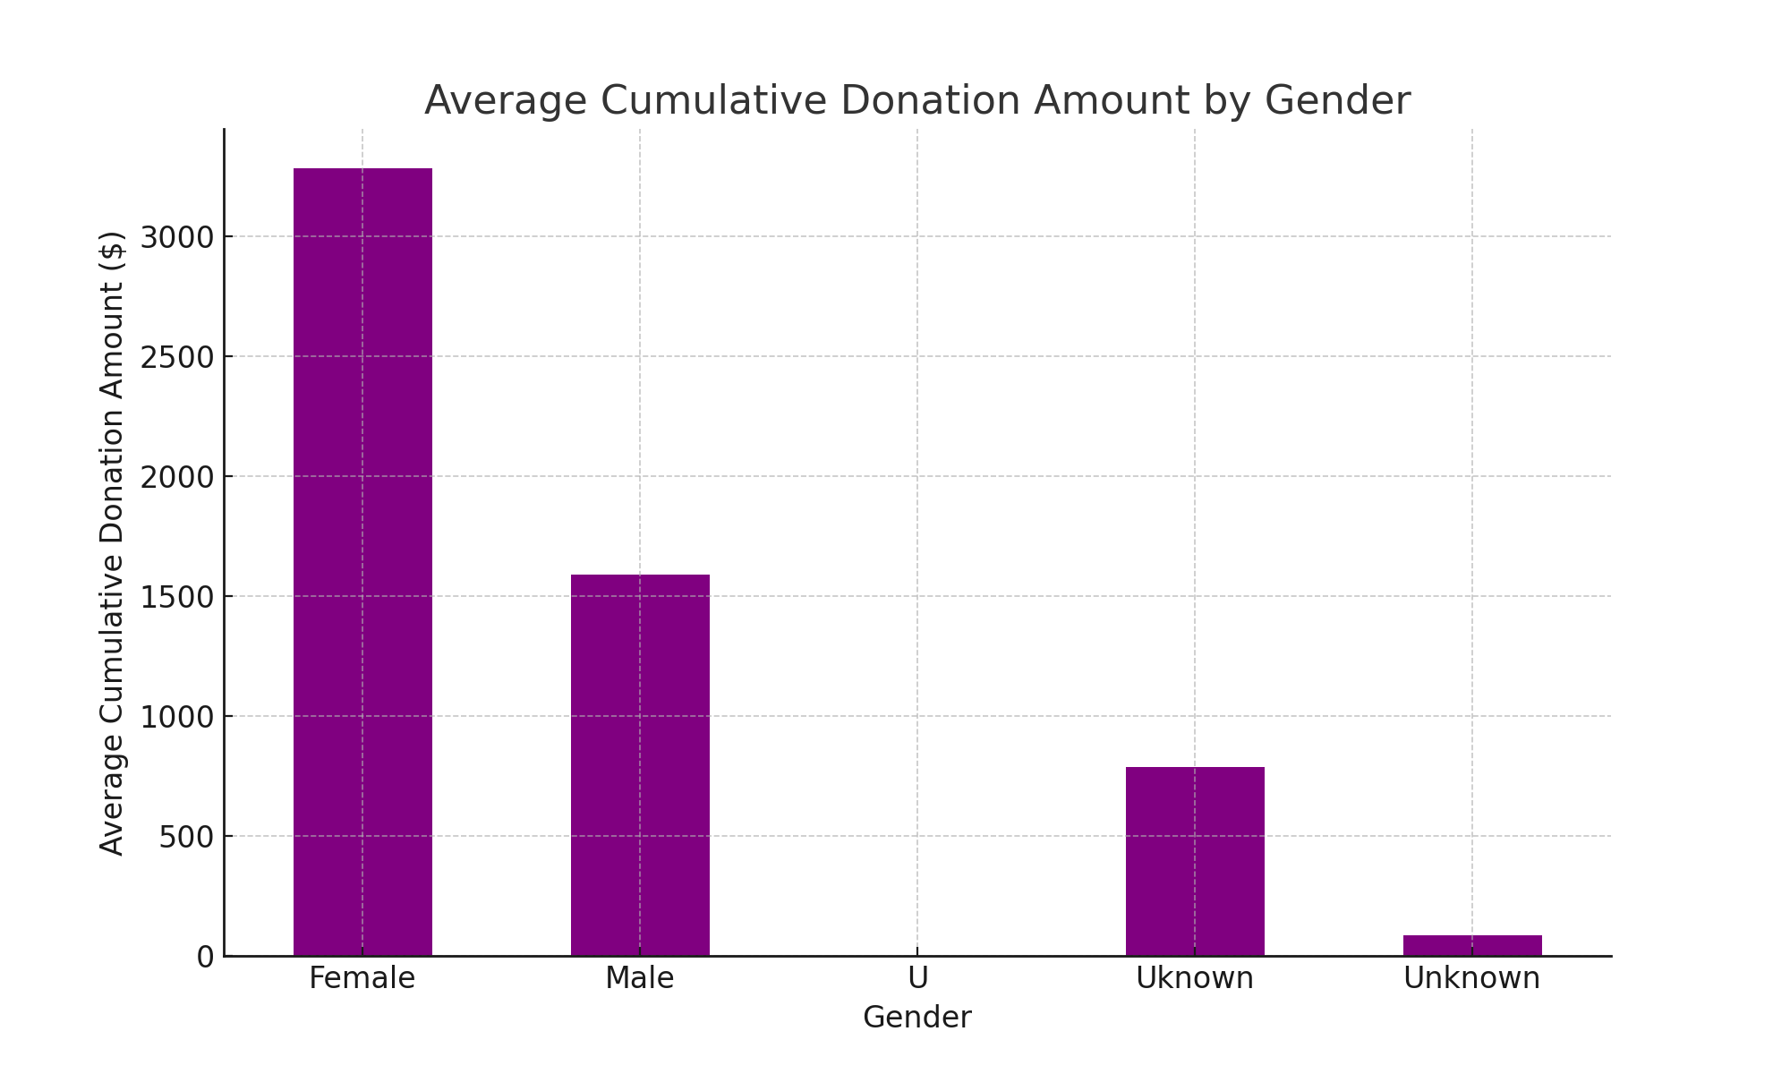
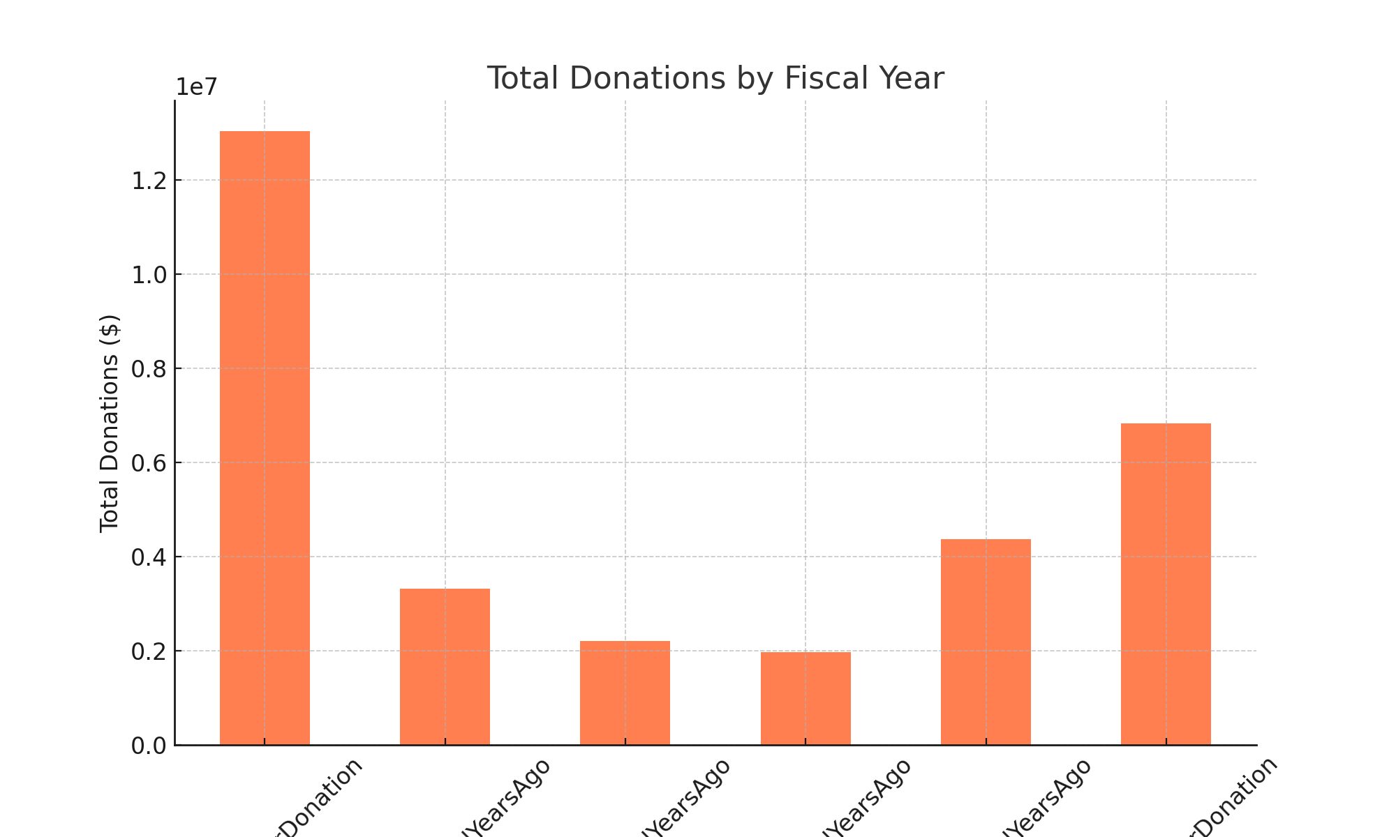
Donation Trends
Total Donations by Fiscal Year: Analyzed the total donations over different fiscal years.
Average Cumulative Donations by Gender: Compared average cumulative donation amounts by gender.

Slide 8
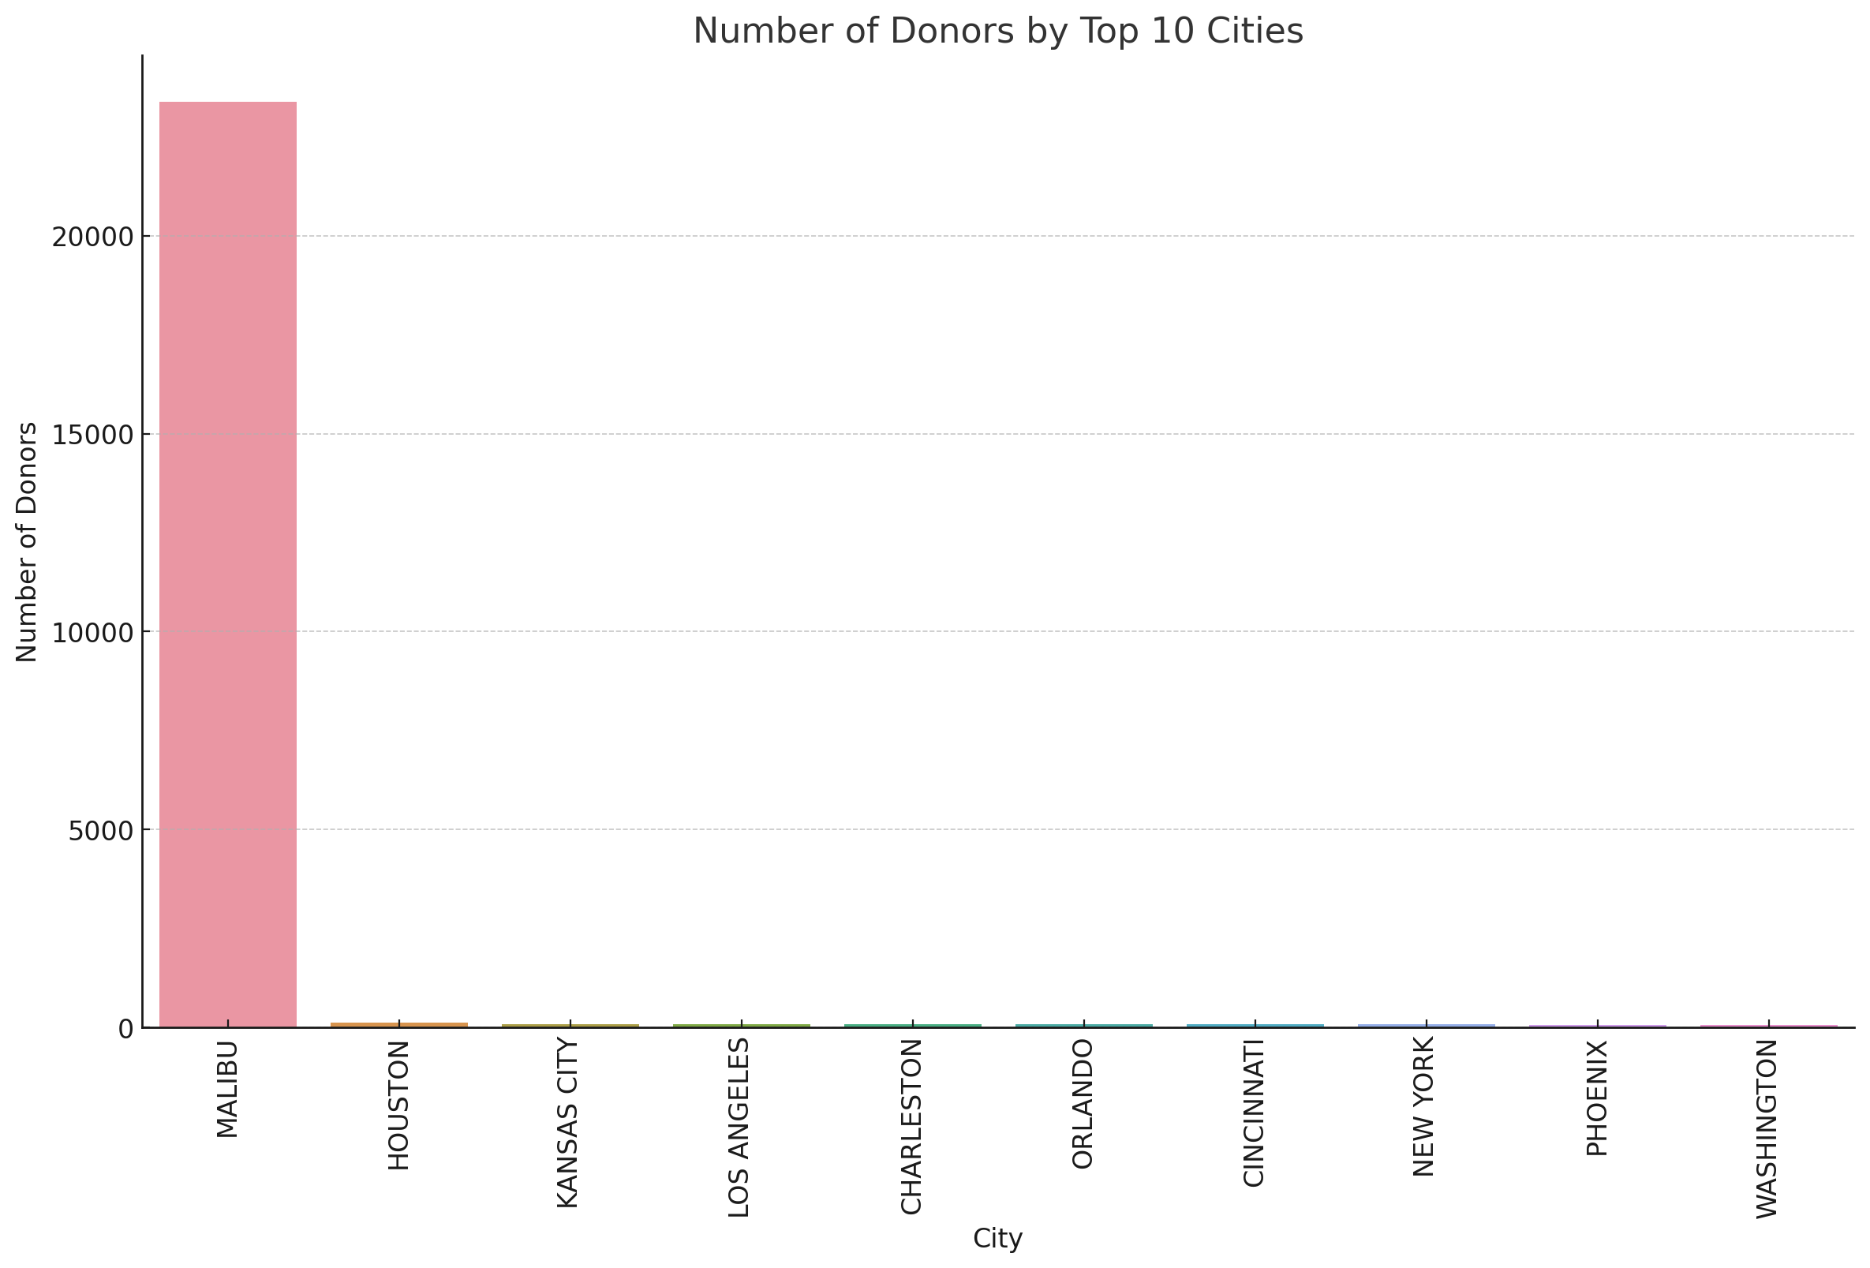

Slide 9
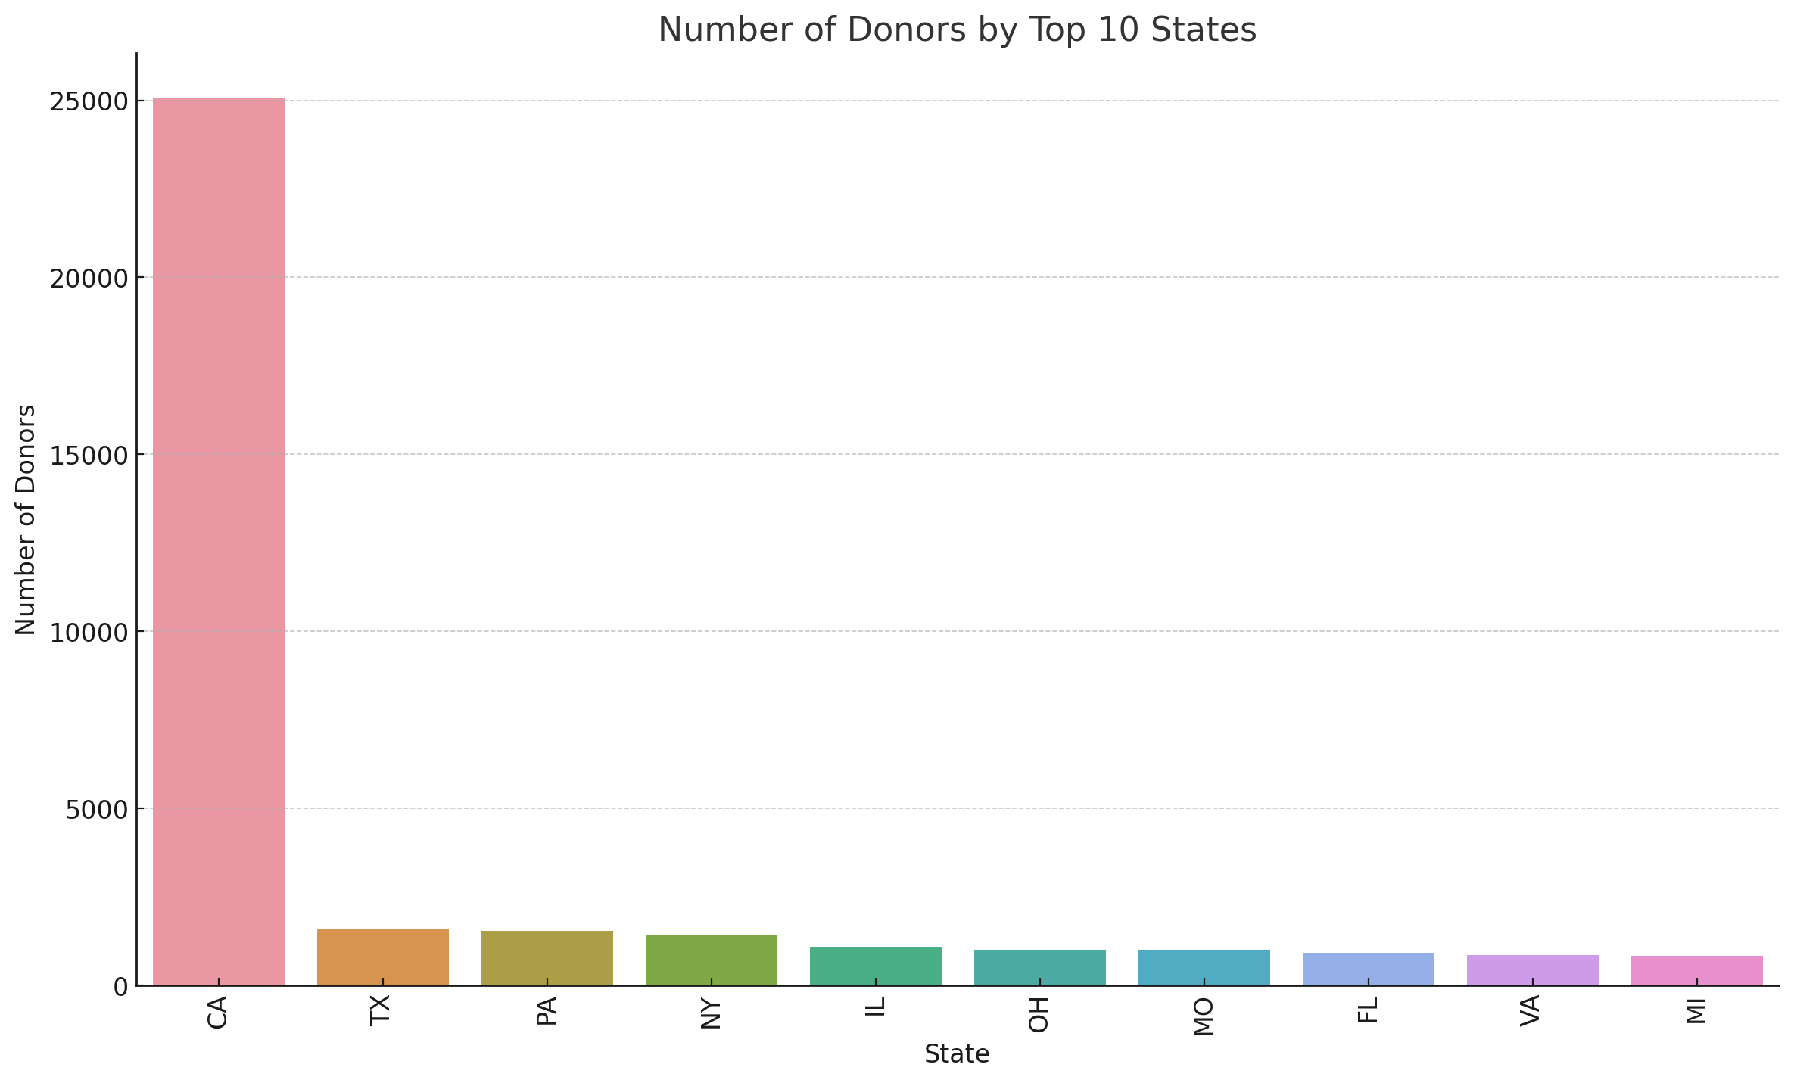

Slide 10
Data Profiling Report
EDA Tools: Used Dataprep and Sweetviz for comprehensive data profiling.
Key Findings: Highlighted important correlations and statistical summaries.

Slide 11
Feature Engineering
Selected Features: Chose features with at least 80% available data.
Ignored Columns: Dropped features with more than 20% missing data and noise variables.

Slide 12
Model Comparison
Algorithms Used: Gradient Boosting, AdaBoost, XGBoost, LightGBM, Logistic Regression, etc.
Best Model: Gradient Boosting Classifier with highest accuracy and AUC.

Slide 13
Gradient Boosting Classifier
Accuracy: 69.35%
AUC: 75.34%
Recall: 50.97%
Precision: 99.39%
F1 Score: 67.38%

Slide 14
Conclusion and Next Steps
Summary: Effective prediction of donor behavior using machine learning models.
Future Work: Further refinement of models and incorporation of additional data sources.

Slide 15
Q&A
Open floor for questions and discussion.

