Slide 1
Bangalore Metro Rail Corporation Limited
Date: March 2024

Slide 2
Table of Contents
03
04-06
07
08
09
14
Introduction
Routes
Mode of Travel & Discounts
10
Group Tickets
Metro Passes
Convenience
11-13
15
Technology
Advantages & disadvantages
FRT Challenges

Slide 3
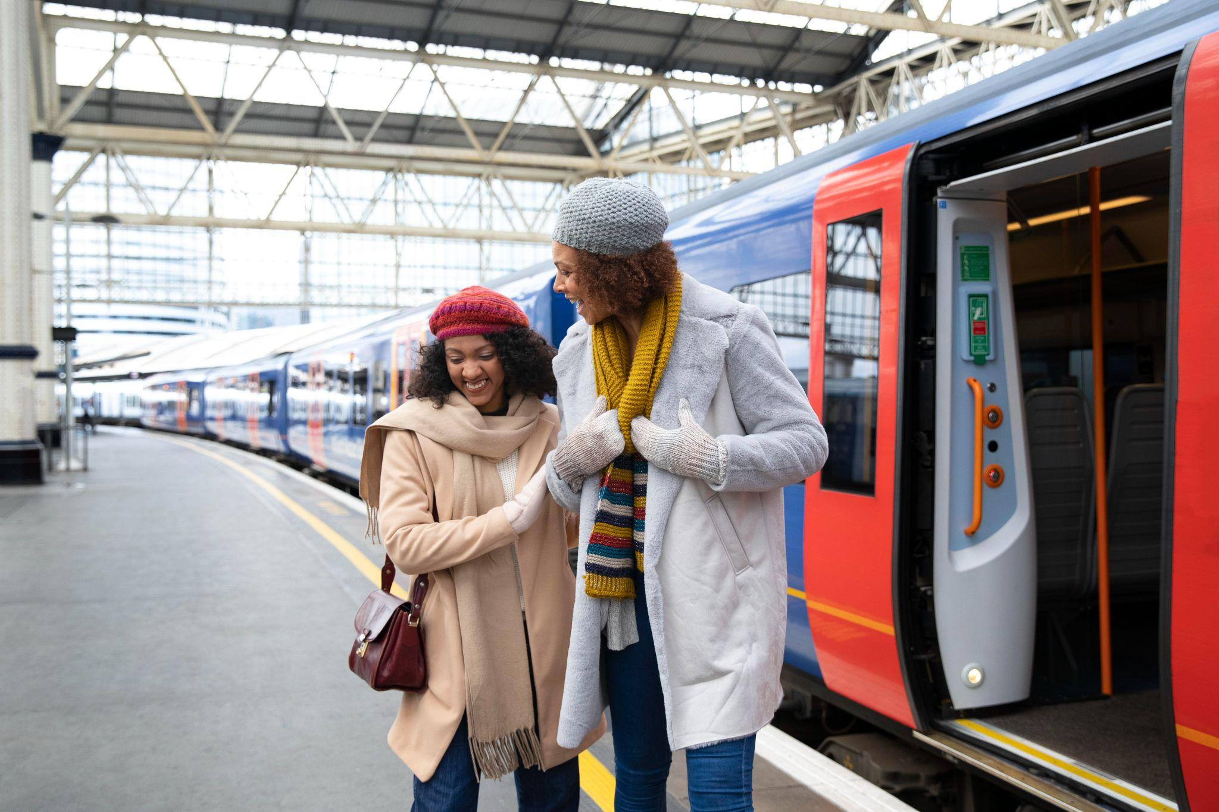
Introduction
Bengaluru Metro, is a rapid transit system serving the city of Bengaluru with an operational length of 73.75 kilometers
Services operates daily between 05:00 and 23:00 with a gap of 5 minutes.
Only Sunday the timings 07:00 to 23:00 with a gap of 10 minutes.
It became the first underground metro system in South India.

Slide 4
Routes
Section | Phase | Length in KM | Source | Destination | Opening Date
Reach 2 (west) | 1 | 6.5 | Mysuru Road | Magadi Road | 16 Nov 2015
Reach 2B (west) | 2 | 2.05 | Kengeri | Challaghatta | 9 October 2023
Reach 1B(east) | 2 | 2.10 | Baiyappanahalli | Krishnarajapura | 9 October 2023
Reach 3 (north) | 1 | 5.1 | Sampige Road | Yeshwanthpura | 1 March 2014
Reach 4B (south) | 2 | 6.3 | Yelachenahalli | Silk Institute | 15 January 2021

Slide 5
Other Metro Cities
Name | City | State | Length in KM | Source | Destination | Opening Date
Kolkata Metro Rail Corporation | Kolkata | West Bengal | 59.38 | Esplanade | Netaji Bhavan | 24 October 1984
Delhi Metro Rail Corporation | Delhi | Delhi | 350.42 | Shahdara | Tis Hazari | 24 December 2002
Gurugram Metro Rail Limited | Gurgaon | Haryana | 12.1 | Sikanderpur | DLF Cybercity business district | 14 November 2013
Maha Mumbai Metro Operation Corporation Limited | Mumbai | Maharashtra | 46.4 | Versova | Ghatkopar | 8 June 2014
Jaipur Metro Rail Corporation Limited | Jaipur | Rajasthan | 9.63 | Mansarovar | Badi Chaupar | 3 June 2015
Chennai Metro Rail Limited | Chennai | Tamil Nadu | 54 | Washermanpet | Chennai International Airport | 29 June 2015
Kochi Metro Rail Limited | Kochi | Kerala | 28 | Aluva | Palarivattom | 19 June 2017
Uttar Pradesh Metro Rail Corporation | Lucknow | Uttar Pradesh | 22.87 | Transport Nagar | Charbagh | 6 September 2017
Hyderabad Metro Rail Limited | Hyderabad | Telangana | 71.1 | Hussain Sagar | Miyapur | 29 November 2017

Slide 6
Lines under construction
Lines | Stations | Length in KM | Source | Destination | Estimated Opening
Green | 3 | 3.14 | Nagasandra | Madavara | July 2024
yellow | 16 | 19.15 | Rashtreeya Vidyalaya Road | Bommasandra | July 2024
Pink | 18 | 21.25 | Kalena Agrahara | Nagawara | December 2025
Blue | 32 | 58.19 | Central Silk Board | KIAL Terminals | June 2026

Slide 7
Mode of Travel Discounts
Payment mode
Type
Technology
Discounts
Cash
Token
RFID
No discount
Offline/onli ne(UPI)
Smart Card
RFID
5%
Online(Wha ts app,UPI)
QR Code
QR Code Reader
5%

Slide 8
Group Tickets
Introduced this feature allows up to six travelers to purchase tickets in a single transaction.
Mobile QR tickets come with a 5% discount on the regular token fare.
For groups of 25 or more people traveling between two stations, group tickets are available at a 10% discount off the single journey fare.
For groups of 100 to 1,000 people, a 15% discount off the token fare.
For more than 1000 people then it is 20% off.

Slide 9
Metro Passes
One-Day Pass
Price: ₹200 (including a refundable deposit of ₹50).
Validity: Valid only for the date of purchase.
Price: ₹400 (including the deposit).
Validity: Allows unlimited travel in Namma Metro for three days from the date of purchase.
Price: ₹600 (including a refundable deposit of ₹50).
Validity: Allows unlimited travel in Namma Metro for five days from the date of purchase.
Three-Day Pass
Five-Day Pass

Slide 10
Convenience
Senior citizens
Most metro stations are equipped with facilities such as elevators, escalators to reduce physical strain, priority seating areas reserved for senior citizens, women's, physically disabled persons.
Students
Students find the metro convenient for traveling to schools, colleges, and universities.
Professionals
Working professionals who need to travel to commercial hubs, IT parks, and business districts.
Travelers
When they need to travel between different parts of the city for meetings or conferences helping them manage their schedules more effectively.

Slide 11
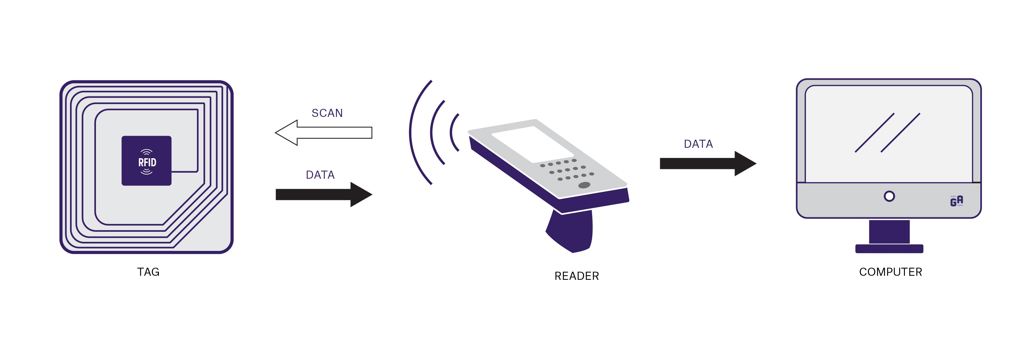
Technology
RFID (radio frequency identification)
Token Encoding
Each token used in the metro system is embedded with an RFID tag.
Fare Validation
When passengers enter the metro station, they need to present their tokens at the entry gates equipped with RFID readers.
Data Transmission
This information is sent to the metro system's central database for fare validation and access control.
If the token is valid and the token has not been used before, the entry gate opens allowing the passenger to the Automatic Fare Collection(AFC) gate .
Access Granted
Access Denied
If the token is invalid then the access will be denied.
Exit Process
The passenger will be validate at the destination station and both entry & exit will be verified.

Slide 12
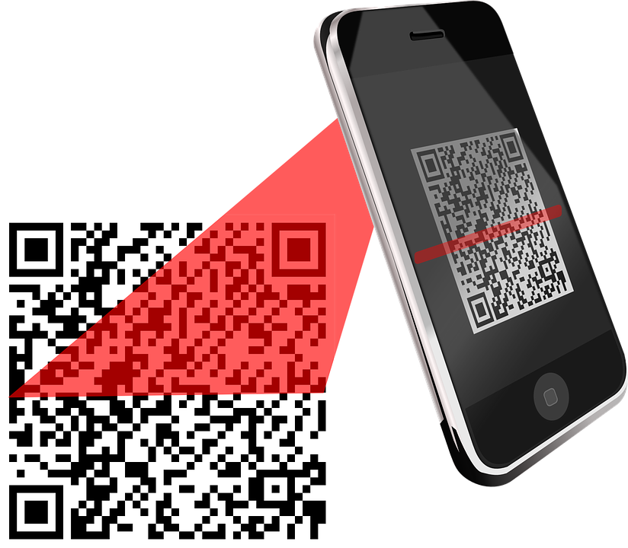
2. QR Code Reader:
1
Passengers can purchase tickets that generate QR codes representing the purchased fare.
2
The QR code contains encoded information such as ticket type, validity period, and fare details.
3
The QR code displayed on the screen to a QR code reader installed at entry gates.
4
The QR code reader scans the code and validate the ticket and grant access to the passenger if the QR code is valid.
5
Then the person will be allowed to Automatic Fare Collection(AFC) gate.
6
If the QR code is invalid then the access denied.
7
The passenger will be validate at the destination station and both entry & exit will be verified.

Slide 13
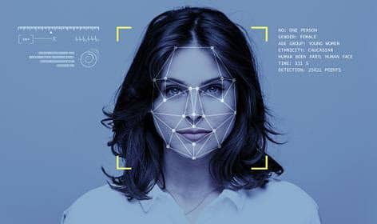
3. Facial Recognition Technology
Passengers would need to enroll voluntarily into Face recognition system.
Facial image of passenger would be stored into the metro data base as an object (ex:- QR code).
For verification the actual facial image will be stored in data base, if the facial image matches.
Then the person will be allowed to Automatic Fare Collection(AFC) gate.
If the facial images does not match then access denied to that person.
The passenger will be validate at the destination station and both entry & exit will be verified.

Slide 14
Advantages & Disadvantages (RFID,QR Code Reader)
Advantages
Disadvantages
1
Contactless operation
1
Range Limitations
Passengers can simply tap their cards or smartphones to access the metro.
The read range of RFID readers is limited.
2
Fast and efficient
2
Security Risk
RFID technology enables quick fare validation, allowing for smoother passenger flow.
RFID technology is designed to make access easier and more convenient but the RFID cards use unauthorized access.
3
Accessibility
3
Limited Accessibility
QR codes can be easily generated and scanned using smartphones.
QR codes may not be accessible to all passengers, particularly those with visual impairments.
4
Low cost
4
Scanning Issues
QR code implementation is relatively inexpensive compared to other technologies
QR code readability can be affected by factors such as poor lighting, low-resolution displays.

Slide 15
Challenges of Conventional Facial recognition technology
Privacy Concerns
Facial recognition raises significant privacy issues related to the collection, storage and use of biometric data.
1
Accuracy and Reliability
Factors such as variations in lighting conditions, facial expressions, or changes in appearance.
2
Technical Challenges
Metro environments presents technical challenges such as camera placement, lighting conditions, and image quality.
3
Cost and Resource
Technology involves significant costs and resource requirements, including investment in hardware, software, infrastructure, training, and maintenance.
4

