Slide 1
Transformer Feed Forward Networks Why is the inner width larger than the input/output?
Daniel Lam
2-15-23

Slide 2
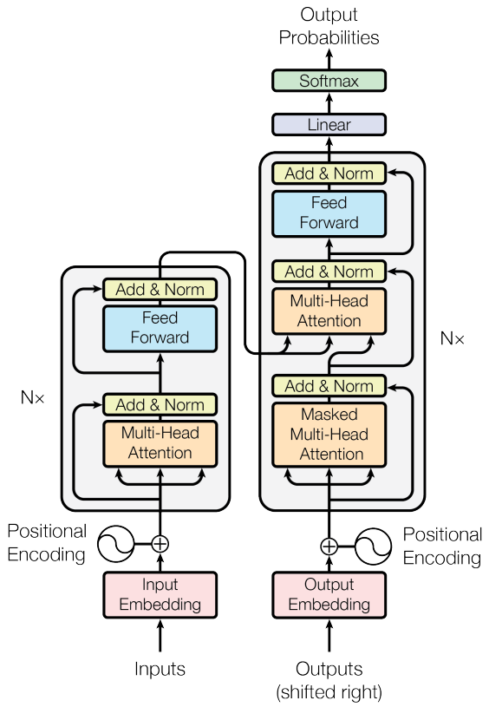
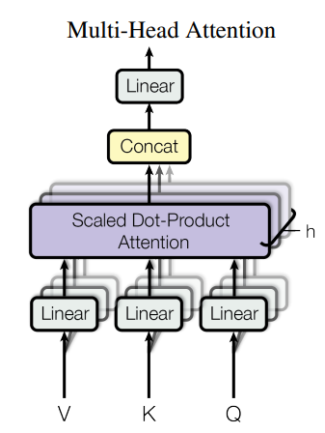
Transformer Background
Linear = Feed Forward Network
512
2048
512
1) Linear (512, 2048)
2) Relu
3) Linear(2048, 512)
Why?

Slide 3
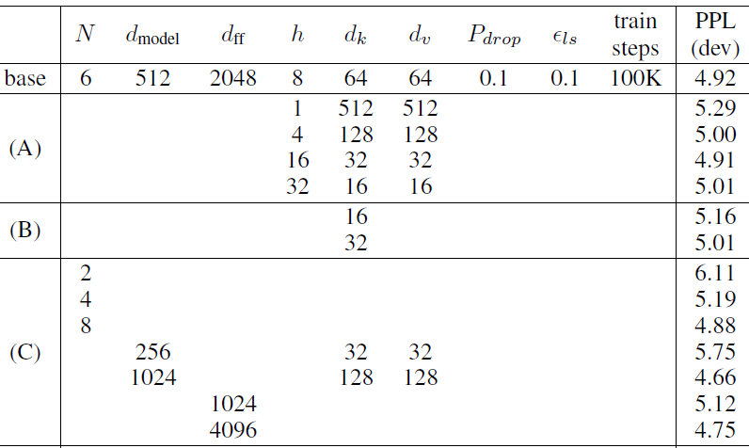
Preliminary White Paper Study
Attention 2017
GPT-NeoX-20B 2022
(Parallel FFN and Attention)
Output
Add
Feed Forward Network
Masked
M-H Attention
LayerNorm 1
Input

Slide 4
Proposed Experiment
nanoGPT Block (LayerNorm at input)
Output
Run architecture ablation study on FFN - Inner dim.: 0.5x, 1x, 2x, 4x - More layers: 1, 2, 3 - Parallel vs series FFN - TBD . . .
Use Karpathy’s nanoGPT GitHub repo - Simple code, might have bugs - PyTorch 2.0 - Measure perplexity (language gen.) - Data: tiny Shakespeare - Time frame: 2 months - Deliverable: Blog post
Add
Feed Forward Network
LayerNorm 2
Add
Masked
M-H Attention
LayerNorm 1
Input

Slide 5
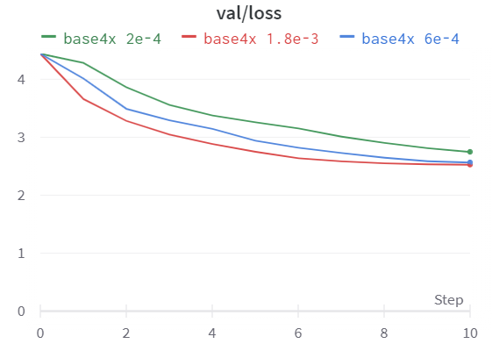
Results
Val. Loss for 3 Learning Rates
GitHub code just needs to be slightly modified to run the ablation studies
Test run: - LR: 2e-4, 6e-4, 1.8 e-3 - FFN inner factor: 4 (base) - Data: shakespeare_char - *Parameters in train.py
Val.
Loss
Eval. Step

Slide 6
References
Attention Is All You Need. Ashish Vaswani, Noam Shazeer, Niki Parmar, Jakob Uszkoreit, Llion Jones, Aidan N. Gomez, Lukasz Kaiser, Illia Polosukhin. https://arxiv.org/abs/1706.03762
GPT-NeoX-20B: An Open-Source Autoregressive Language Model. Sid Black, Stella Biderman, Eric Hallahan, Quentin Anthony, Leo Gao, Laurence Golding, Horace He, Connor Leahy, Kyle McDonell, Jason Phang, Michael Pieler, USVSN Sai Prashanth, Shivanshu Purohit, Laria Reynolds, Jonathan Tow, Ben Wang, Samuel Weinbach. http://arxiv.org/abs/2204.06745
Cramming: Training a Language Model on a Single GPU in One Day. Jonas Geiping, Tom Goldstein. https://arxiv.org/abs/2212.14034
Improving Transformer Models by Reordering their Sublayers. Ofir Press, Noah A. Smith, Omer Levy. https://arxiv.org/abs/1911.03864
Transformer Feed-Forward Layers Are Key-Value Memories. Mor Geva, Roei Schuster, Jonathan Berant, Omer Levy. https://arxiv.org/abs/2012.14913
GitHub repo: nanoGPT. Andrej Karpathy. https://github.com/karpathy/nanoGPT

