Slide 1
DataFed - A Scalable, Cross-Facility Scientific Data Management and Collaboration System
Dale Stansberry
Data Lifecycle and Scalable Workflows Group
Oak Ridge Leadership Computing Facility

Slide 2
Personal Background & Motivation
BSEE, software engineering
Prior nuclear, industrial, and commercial R&D
Past two decades in scientific application R&D
8 years at ORNL:
ADARA project at SNS (DAQ, streaming analytics)
High performance graph databases
Data publishing systems
Direct observations & personal experiences led to DataFed

Slide 3
Today: Inadequate Scientific Data Infrastructure
Scientific metadata not captured
Lab notebooks - not findable / accessible
File systems lack capabilities
Lacks metadata, tracking, provenance, and discovery
Must pose a priori knowledge of data location (path)
Ad hoc data sharing / transfer
scp, email, dropboxes, portable storage
Publishing data difficult and error prone
Misidentification and mishandling contribute to reproducibility crisis

Slide 4
Example of Common Metadata “Capture”
Nowhere to put context / metadata
Most often embedded in file names
Naming and structure varies by user and time (no schema)
Information is lost if file copied / moved
Instrument
User
Modality
Material
Date
Cypher_1\Senli\BE_KPFM\STO\2011_08_10_BE\
NC_STO_AC1V_73kHz_bw25kHz_5um_DC2V_offset_0V_Tap1302kHz_64BE_0009
Operation Mode
Data Acquisition
Scan size
Other Experiment
Parameters
(captured in parameters file)

Slide 5
Cross-Facility Research
More problems when crossing organizational boundaries
Different user accounts
Must understand structure of each file system
Sharing only by local permissions (admin)
Managing many security credentials (VOs)
Ad hoc approaches are non-interoperable and existing solutions do not scale
Need a holistic, uniform, and scalable solution

Slide 6
Is Globus the Answer? (partially)
✓ Fast, reliable, and secure data transfer
✓ Federated IDs, open authentication
✓ Provides coarse-grained sharing
✘ File system view of data
✘ No metadata and search (API)
✘ Difficult to script, endpoint activation
Most DOE facilities already support Globus

Slide 7

Toward a Scientific Data Federation
Observation
Simulation / Modeling
Federates facility storage
Simple, uniform data access from anywhere
FAIR principled
Powerful search and discovery
Web portal, CLI, API
DataFed
Globus
Publishing
Analytics

Slide 8
DataFed Introduction
Basics:
Federated Scientific Data Management System (SDMS)
Centralized tracking and control, federated raw data storage
Simple, uniform data access from “anywhere”
Logical view of data
Tracks data with unique, stable IDs
Searchable structured metadata & provenance
Administration:
Wraps Globus (federated ID, data transfer)
Scales-out without impact to facilities
Local repository control / policy enforcement
Notes:
unique IDs vs. a file in some arbitrary path as this is the main culprit in data handling errors (a collaborator using the wrong data)

Slide 9

DataFed Ecosystem - Integration
DataFed
Service
Observational
Facility
Experimental
Facility
Computational Facility
Workstation
R
R
Data Channel (Globus)
Control Channel

Slide 10
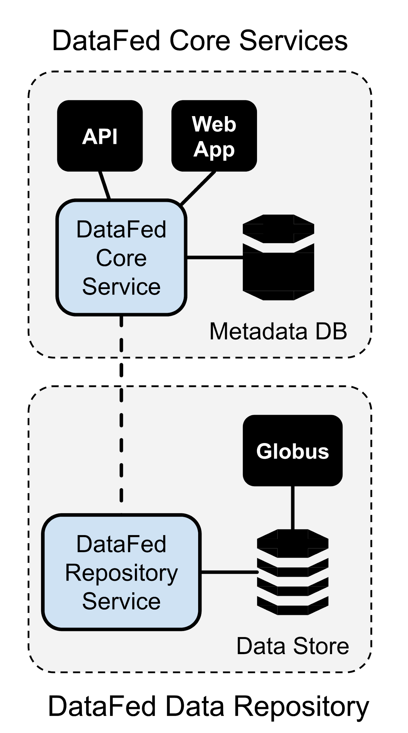
DataFed Core Services and Repositories
DataFed Core Services:
Control servers
Web servers
Metadata database
Sharing, discovery, concurrency
DataFed Data Repository:
Any data storage supported by Globus
Raw binary data, any size
Kept synchronized with metadata
No direct user access (managed by DataFed)

Slide 11
DataFed is not ...
a distributed file system
DataFed uses database semantics, logical view of data
a data catalog
DataFed is for dynamic / working data, fine-grained permissions
a publishing system
DataFed helps organize and prepare for publication
a workflow engine
DataFed can be used to stage data in/out within a workflow

Slide 12
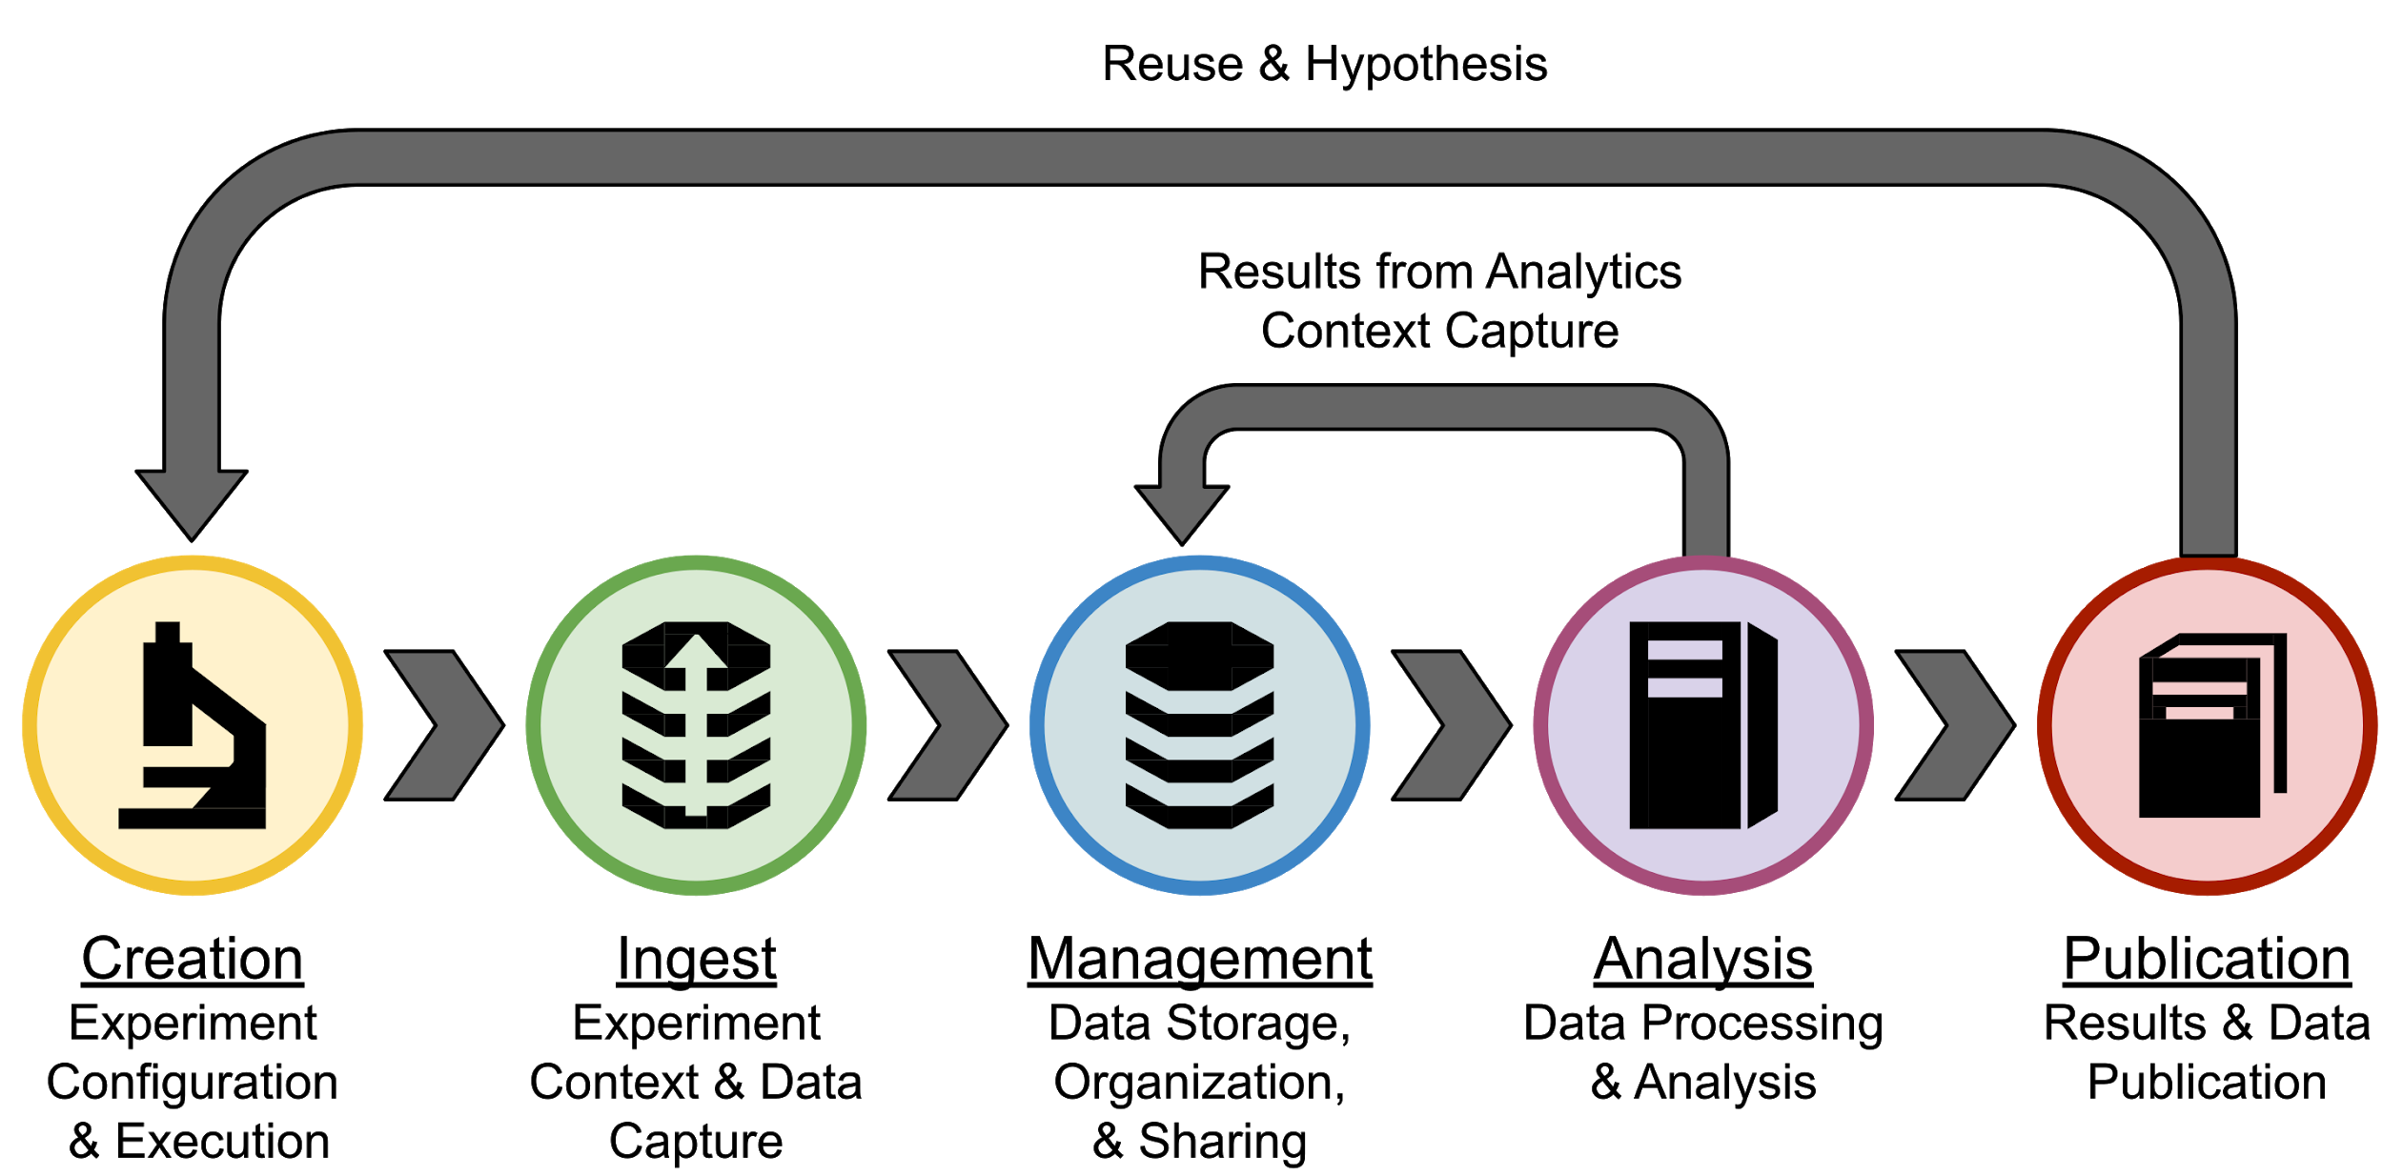
Lifecycle of Scientific Datasets
DataFed Support

Slide 13
Inside a DataFed Integrated Facility
DataFed
Control / DAQ
CLIENT
AUTHZ
API
Adapter
Instrument(s)
R
Endpoint
Endpoint
Local Repository
Local Filesystem
Globus

Slide 14
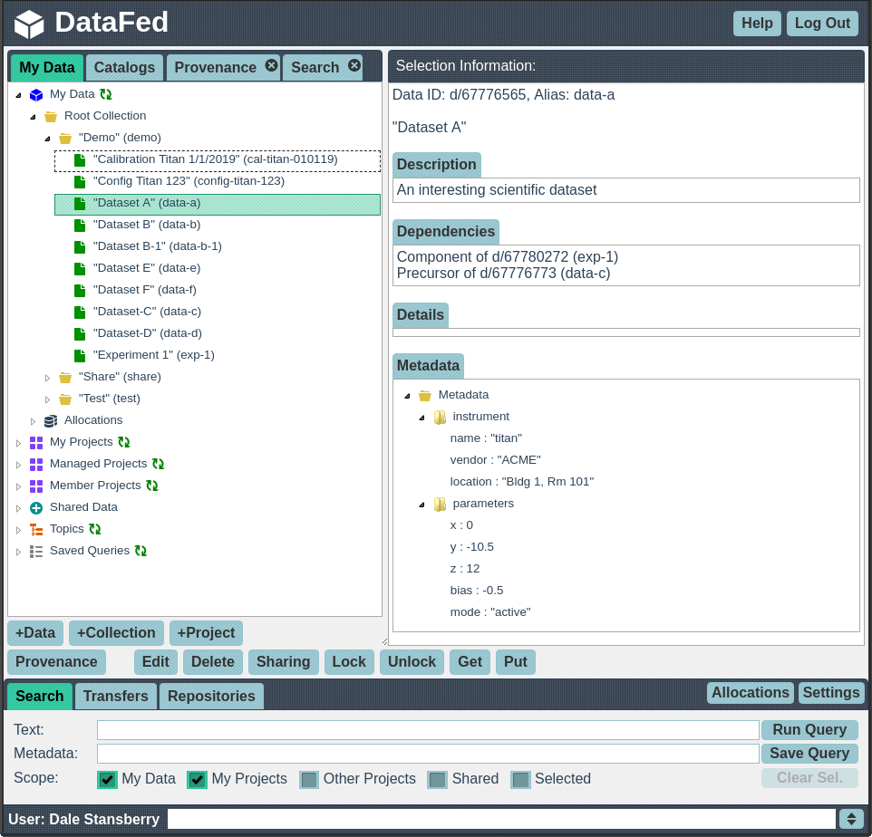
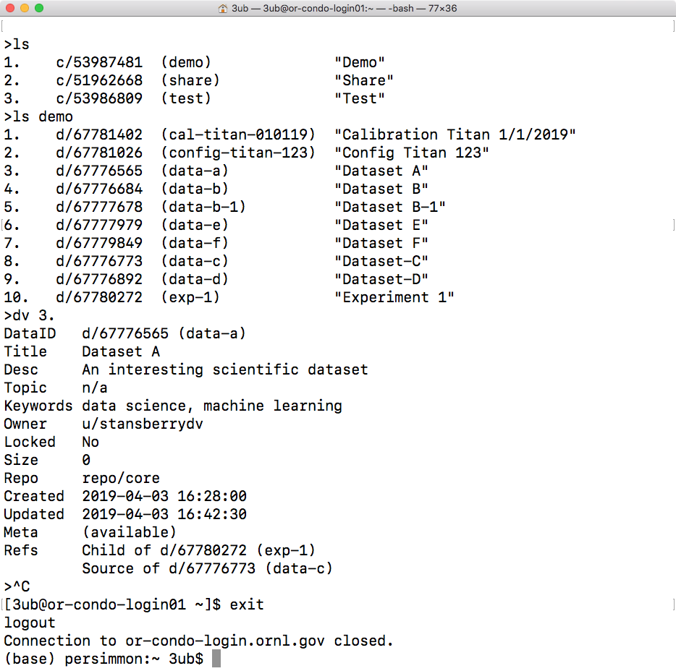
DataFed Interfaces - Web Portal, CLI, and API
Web application
Command-Line
(API in same client)

Slide 15
Additional DataFed Features
Collections of records
Dynamic views - saved queries
Allocations per user, project
Exploring related data via provenance graphs, tags
Provenance-driven annotation / impact assessment
Catalog view of pre-published data - discoverable, explorable
Scripting, batch processing and workflow support

Slide 16
DataFed Suitability
Individuals, collaborations, teams (multi-organization)
Max data size limited by allocation only
Not latency sensitive (shared resources)
Bandwidth limited by hardware
Latency from cloud services
Order of 1000’s of datasets per user/project
Better to archive many small files
Open / moderate security
Higher security being investigated

Slide 17
DataFed
Live Demonstration

Slide 18
Getting Started with DataFed as a User
Get a Globus account at https://globus.org
Register with DataFed at https://datafed.ornl.gov
Request an allocation on a DataFed data repository
On-line documentation available at https://ornl.github.io/DataFed
For CLI and/or scripting:
Install DataFed Python3 client from PyPi (pip install datafed)
Minimal client configuration need (see online docs)
Optionally set-up auto-logon
Currently in pre-production state - only test accounts available

Slide 19
DataFed - Development Roadmap
Production Deployment
Solicit / respond to user feedback
Metadata schema support
Data subscription & notifications
Workflow notification hooks
Data publishing integration (maybe)

Slide 20
Questions?
DataFed URL: https://datafed.ornl.gov
Contact:
Dale Stansberry (tech) stansberrydv@ornl.gov
Suhas Somnath (science) somnaths@ornl.gov

