Slide 1
Chapter One
Introduction to Statistics

Slide 2
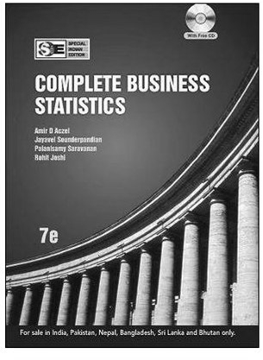
Course Summary Descriptive Statistics: Getting a better sense of data Mean, Standard Deviation, Median, Quartiles, Distribution Inferential Statistics: Drawing conclusions about the population based on sample data Properties of a single variable
5
Book for the Course Textbook is much more exhaustive than what we will cover in five weeks The best use of the book is as a reference, go to specific sections of chapter where you need more clarity First solve the exercises from the textbook before thinking of more practice problems
6

Slide 3
Definitions:
¬It is a science which helps us to collect, analyze and
present data systematically.
¬It is the process of collecting, processing, summarizing, presenting, analysing and interpreting of data in order to study and describe a given problem.
¬Statistics is the art of learning from data.
¬Statistics may be regarded as (i)the study of populations,
(ii) the study of variation, and (iii) the study of methods of the reduction of data.

Slide 4
Importance of Statistics:
It simplifies mass of data (condensation);
Helps to get concrete information about any problem;
Helps for reliable and objective decision making;
It presents facts in a precise & definite form;
It facilitates comparison(Measures of central tendency and measures of dispersion);
It facilitates Predictions (Time series and regression analysis are the most commonly used methods towards prediction.);
It helps in formulation of suitable policies;

Slide 5
Limitation of statistics:
¬
¬
Statistics does not deal with individual items;
Statistics deals only with quantitatively expressed items, it does not study qualitative phenomena;
Statistical results are not universally true;
Statistics is liable/responsible/ to be misused.
¬
¬

Slide 6
Application areas of statistics
¬Engineering:
Improving product
design,
testing
product
performance, determining reliability and maintainability, working out safer systems of flight control for airports, etc.
¬Business:
Estimating the volume of retail sales, designing optimum inventory control system, producing auditing and accounting procedures, improving working conditions in industrial plants, assessing the market for new products.

Slide 7
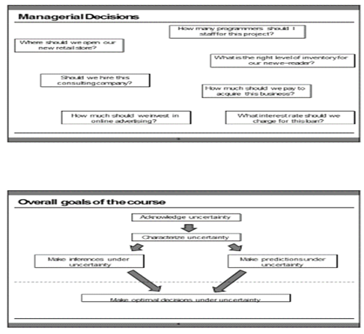

Slide 8
¬Quality Control:
Determining techniques for
evaluation
of quality
through adequate sampling, in process control, consumer survey and experimental design in product development etc.
Realizing its importance, large organizations are maintaining their own Statistical Quality Control Department *.
¬Economics:
Measuring indicators such as volume of trade, size of labor force, and standard of living, analyzing consumer behavior, computation of national income accounts, formulation of economic laws, etc.
Particularly, Regression analysis extensively uses in the field of Economics*.

Slide 9
¬ Health and Medicine:
Developing and testing new drugs, delivering improved medical care, preventing diagnosing, and treating disease, etc. Specifically, inferential Statistics has a tremendous application in the fields of health and medicine.
Biology:
Exploring the interactions of species with their environment, creating theoretical models of the nervous system, studying genetically evolution, etc.
Psychology:
Measuring characteristics, behavior, etc.
¬ Sociology:
learning ability, intelligence, and personality creating psychological scales and abnormal
Testing theories about social systems, designing and conducting sample surveys to study social attitudes, exploring cross-cultural differences, studying the growth of human population, etc.

Slide 10
Software for Class (R, RStudio) Open source, free, becoming increasingly popular Used sporadically in lectures, needed for working through assignments Important to “get hands dirty” to learn Stats You will not be required to analyze data using the software in exams However, you should know how to interpret results of analysis presented by the software You do need to use software to do assignments (20% of grade)
7
Materials/ Resources Class handouts Lecture slides, Kelly material Learning Management System (Mrinal’s GitHub) Assignments Datasets Practice Problem sets with solutions
8

Slide 11
There are two main branches of statistics:
Descriptive statistics
Inferential statistics
1. Descriptive statistics:
¬
¬
It is the first phase of Statistics;
involve any kind of data processing designed to the collection, organization, presentation, and analyzing
the important features of the data with out
attempting to infer/conclude any thing that goes beyond the known data.
In short, descriptive Statistics describes the nature
¬
or characteristics of the observed data (usually a sample) without making conclusion or generalization.

Slide 12
The following are some examples of descriptive Statistics:
The daily average temperature range of AA was 25 0c last week .
The maximum amount of coffee export of Eth. (as observed from the last 20 years) was in the year 2004.
The average age of athletes participated in London Marathon was 25 years.
75% of the instructors in AAU are male.
The scores of 50 students in a Mathematics exam are found to range from 20 to 90.

Slide 13
2. Inferential statistics (Inductive Statistics):
¬
It is a second phase of Statistics which deals with techniques of making a generalization that lie outside the scope of Descriptive Statistics;
¬
It is concerned with the process of drawing
conclusions (inferences) about specific characteristics of a population based on information
obtained from samples;
It is a process of performing hypothesis testing, determining relationships among variables, and making predictions.
The area of inferential statistics entirely needs the whole aims to give reasonable estimates of unknown population parameters.
¬
¬

Slide 14
The following
are some examples of inferential
Statistics:
⎫The result obtained from the analysis of the income of 1000 randomly selected citizens in Ethiopia suggests that the average monthly income of a citizen is estimated to be 600 Birr.
⎫Here in the above example we are trying to represent the income of about entire population of Ethiopia by a sample of 1000 citizens, hence we are making inference or generalization.
⎫Based on the trend analysis on the past observations/data, the average exchange rate for a dollar is expected to be 18 birr in the coming month.
⎫The national statistical Bereau of Ethiopia declares the out come of its survey as “The population of Eth. in the year 2020 will
likely to be 120,000,000.”
⎫From the survey obtained on 15 randomly selected towns of Eth. it is estimated that 0.1% of the whole urban dwellers are victims of AIDS virus.

Slide 15
Exercise: Descriptive Statistics or Inferential Statistics
The manager of quality control declares the out come of its survey as “the average life span of the imported light bulbs is 3000 hrs.
Of all the patients taking the drug at a local health center 80% of them suffer from side effect developed.
The average score of all the students taking the exam is found to be 72.
The national statistical bureau of Eth. declares the out come of its survey for the last 30 years as “the average annual growth of the people of Ethiopia is 2.8%.
The national statistical bureau of Eth. declares the out come of its survey for the last 30 years as “the population of Ethiopia in the year 2015 will likely to be 100,000,000.
Based on the survey made for the last 10 years 30,000 tourists are expected to visit Ethiopia.
Based on the survey made for the last 20 years the maximum number of tourists visited Eth. were in the year 1993.
The Ethiopian tourism commission has announced that (as observed for the last 20 years) the average number of tourists arrived Ethiopia per year is 3000.
The maximum difference of the salaries of the workers of the company until the end of last year was birr 5000.

Slide 16
Main terms in statistics:
Data: Certainly known facts from which conclusions may be drawn.
Statistical data: Raw material for a statistical investigation which are obtained when ever measurements or observations are made.
Quantitative data: data of a certain group of individuals which is expressed numerically.
Example: Heights, Weights, Ages and, etc of a certain group of individuals.
Qualitative data: data of a certain group of individuals that is not expressed numerically.
Example: Colors, Languages, Nationalities, Religions, health, poverty etc of a certain group of individuals.
Primary data and Secondary data
13

Slide 17
Variable: A variable is a factor or characteristic that can take on different possible values or outcomes.
A variable can be qualitative or quantitative (numeric).
Example: Income, height, weight, sex, age, etc of a certain group of individuals are examples of variables.
Population: A complete set of observation (data) of the entire group of individuals under consideration .
A population can be finite or infinite.
Example: The number of students in this class, the population in Addis Ababa etc.
Sample: A set of data drawn from population containing a part which can reasonably serve as a basis for valid generalization about the population.
A sample is a portion of a population selected for further analysis.

Slide 18
Sample size: The number of items under investigation in a sample.
Survey (experiment): it is a process of obtaining the desired data. Two types of survey:
Census Survey: A way of obtaining data referring the entire population including a total coverage of the population.
Sample Survey: A way of obtaining data referring a portion of the entire population consisting only a partial coverage of the population.

Slide 19
STEPS/STAGES IN STATISTICAL INVESTIGATION
Collection of Data:
Data collection is the process of gathering information or data about the variable of interest. Data are inputs for Statistical investigation. Data may be obtained either from primary source or secondary source.
Organization of Data
Organization of data includes three major steps.
Editing: checking and omitting inconsistencies, irrelevancies.
Classification : task of grouping the collected and edited data .
Tabulation: put the classified data in the form of table.

Slide 20
3. Presentation of Data
The purpose of presentation in the statistical analysis is to display what is contained in the data in the form of Charts, Pictures, Diagrams and Graphs for an easy and better understanding of the data.
Analyzing of Data
In a statistical investigation, the process of analyzing data includes finding the various statistical constants from the collected mass of data such as measures of central tendencies (averages) , measures of dispersions and soon.
It merely involves mathematical operations: different measures of central tendencies (averages), measures of variations, regression analysis etc. In its extreme case, analysis requires the knowledge of advanced mathematics.

Slide 21
5. Interpretation of Data
⎫ involve interpreting the statistical constants computed in analyzing data for the formation of valid conclusions and inferences.
⎫ It is the most difficult and skill requiring stage.
⎫ It is at this stage that Statistics seems to be very much viable to be misused.
⎫ Correct interpretation of results will lead to a valid conclusion of the study and hence can aid in taking correct decisions.
⎫ Improper (incorrect) interpretation may lead to wrong conclusions and makes the whole objective of the study useless.

Slide 22
THE ENGINEERING METHOD AND STATISTICAL THINKING
An engineer is someone who solves problems of interest to society by the efficient application of scientific principles.
Engineers accomplish this by either refining an existing product or process or by designing a new product or process that meets customers’ expectations and needs.

Slide 23
The steps in the engineering method are as follows:
Develop a clear and concise description of the problem.
Identify, the important factors that affect this problem or that may play a role in its solution.
Propose a model for the problem, using scientific or engineering knowledge of the phenomenon being studied. State any limitations or assumptions of the model.
Conduct appropriate experiments and collect data to test or validate the tentative model or conclusions made in steps 2 and 3.

Slide 24
Refine the model on the basis of the observed data.
Manipulate the model to assist in developing a solution to the problem.
Conduct an appropriate experiment to confirm that the proposed solution to the problem is both effective and efficient.
Draw conclusions or make recommendations based on the problem solution.

Slide 25
Cont’d
The engineering method features a strong interplay between the problem, the factors that may influence its solution, a model of the phenomenon, and experimentation to verify the adequacy of the model and the proposed solution to the problem.
Specifically, statistical techniques can be a powerful aid in designing new products and systems, improving existing designs, and designing, developing, and improving production processes.

Slide 26
Cont’d
⎫Therefore, Engineers must know how to efficiently plan experiments, collect data, analyze and interpret the data, and understand how the observed data are related to the model that have been proposed for the problem under study.

Slide 27
1.2. Data collection and graphical representation of data
Classification of Data based on source:
Primary: data collected for the purpose of specific study. It can be obtained by:
¬Direct personal observation
¬Direct or indirect oral interviews
¬Administrating questionnaires
Secondary: refers to data collected earlier for some purpose other than the analysis currently being undertaken.
It can be obtained from:
External Secondary data Sources( for eg. gov’t and non gov’t publications)
Internal Secondary data Sources: the data generated within the organization in the process of routine business activities
Qualitative data are nonnumeric. Quantitative data are numeric.

Slide 28
Method of data presentation
¬The purpose of organizing data is to see quickly some of the characteristics of the data that have been collected.
¬Raw data is collected numerical data which has not been arranged in order of magnitude.
¬An array is an arranged numerical data in order of magnitude.
25

Slide 29
Method of data presentation
¬ Mechanism for reducing and summarizing data are:
Tabular method.
Graphical method
Diagrammatic method

Slide 30
1. Tabular presentation of data:
¬The collected raw data should be put into an ordered array in either ascending or descending order so that it can be organized in to a Frequency Distribution (FD)
¬Numerical data arranged in order of magnitude along with the corresponding frequency is called frequency distribution (FD).
¬FD is of two kinds namely ungrouped /and grouped frequency distribution.
27

Slide 31
A. Ungrouped (Discrete) Frequency Distribution
⎫
It is a tabular arrangement of numerical data in order of magnitude showing the distinct values with the corresponding frequencies.

Slide 32
Example:
Suppose the following are test score of 16 students in a class, write un grouped frequency distribution.
“14, 17, 10, 19, 14, 10, 14, 8, 10, 17, 19, 8, 10, 14, 17, 14”
Sol: the ungrouped frequency distribution:
Array: 8,8,10,10,10,10,14,14,14,14,14, 17,17,17,19,19.
Then the ungrouped frequency distribution is then grouped:-
Test score | 8 | 10 | 14 | 17 | 19
Frequency | 2 | 4 | 5 | 3 | 2
¬ The difference between the highest and the lowest value in a given set of observation is called the range (R)
R= L- S, R= 19-8 = 11

Slide 33
B. Grouped (continuous) Frequency Distribution (GFD)
It is a tabular arrangement of data in order of magnitude by classes together with the corresponding class frequencies.
In order to estimate the number of classes, the ff formula is used:
Number of classes=1+3.322(log N) where N is the Number of observation.
The Class size = (class width)
Range 1+3.322(log N)
(round up)

Slide 34
Example:
Grouped/Continuous frequency distribution where several numbers are grouped into one class.
e.g.
Student age
18-25
26-32
33-39
Frequency
5
15
10
31

Slide 35
Components of grouped frequency distribution
1. Lower class limit:
is the smallest number that can actually belong to the respective classes.
1. Upper class limit:
is the largest number that can actually belong to the respective classes.
1. Class boundaries:
are numbers used to separate adjoining classes
which should not coincide observations.
1. Class mark:
is the midpoint of the class.
with the actual

Slide 36
Class width/ Class intervals
is the difference between two consecutive lower class limits or the two consecutive upper class limits. (OR)
can be obtained by taking the difference of two adjoining class marks or two adjoining lower class boundaries.
Class width = Range/Number of class desired.
Where: Number of classes=1+3.322(log N) where N is the Number of observation.
Unit of measure
is the smallest possible positive difference between any two measurements in the given data set that shows the degree of precision.

Slide 37
⎫
Class boundaries:
can be obtained by taking the averages of the upper class limit of one class and the lower class limit of the next class.
Lower class boundaries:
can be obtained by subtracting half a unit of measure from the lower class limits.
Upper class boundaries:
can be obtained by adding half the unit of measure to the upper class limits.
⎫
⎫

Slide 38
Example1 :
Suppose the table below is the frequency distribution of test score of 50 students.
Then the frequency table has 6 classes (class intervals).
Test score Frequency
11-15 | 7
16-20 | 8
21-25 | 10
26-30 | 12
31-35 | 9
36-40 | 4
What is the Unit of Measure, LCLs, UCLs, LCBs, UCBs, CW, and CM

Slide 39
Rules to construct Grouped Frequency Distribution (GFD):
Find the unit of measure of the given data;
Find the range;
Determine the number of classes required;
Find class width (size);
Determine a lowest class limit and then find the successive lower and upper class limits forming non over lapping intervals such that each observation falls into exactly one of the class intervals;
Find the number of observations falling into each class intervals that is taken as the frequency of the class (class interval) which is best done using a tally.

Slide 40
Exercise:
Construct a GFD of the following aptitude test scores of 40 applicants for accountancy positions in a company with
a. 6 classes b. 8 classes
96 | 89 | 58 | 61 | 46 | 59 | 75 | 54
41 | 56 | 77 | 49 | 58 | 60 | 63 | 82
66 | 64 | 69 | 67 | 62 | 55 | 67 | 70
78 | 65 | 52 | 76 | 69 | 86 | 44 | 76
57 | 68 | 64 | 52 | 53 | 74 | 68 | 39

Slide 41
Types of Grouped Frequency Distribution
Relative frequency distribution (RFD)
Cumulative Frequency Distribution (CFD)
Relative Cumulative Frequency Distribution (RCFD)

Slide 42
Types of Grouped Frequency Distribution
1. Relative frequency distribution (RFD):
¬ A
table presenting the ratio of the
frequency of each class to the total frequency of all the classes.
Relative frequency generally expressed
¬
as a percentage, percent of the
used to show the total number of
observation in each class.

Slide 43
For example
Test score | F | RFD | PFD
37.5-47.5 | 4 | 4/40=0.1 | 10%
47.5-57.5 | 8 | 8/40=0.2 | 20%
57.5-67.5 | 13 | 13/40=0.325 | 32.5%
67.5-77.5 | 10 | 10/40=0.25 | 25%
77.5-87.5 | 3 | 3/40=0.075 | 7.5%
87.5-97.5 | 2 | 2/40=0.05 | 5%

Slide 44
2. Cumulative Frequency Distribution (CFD):
¬It is applicable when we want to know how many observations lie below or above a certain value/class boundary.
¬CFD is of two types, LCFD and MCFD:
Less than Cumulative Frequency Distribution (LCFD): shows the collection of cases lying below the upper class boundaries of each class.
More than Cumulative Frequency Distribution (MCFD): shows the collection of cases lying above the lower class boundaries of each class.

Slide 45
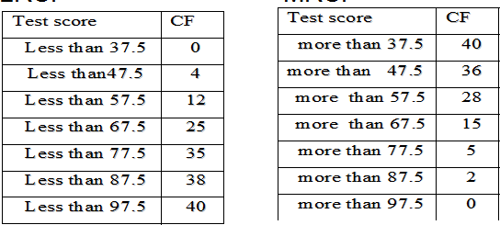

Slide 46
3. Relative Cumulative Frequency Distribution (RCFD)
It is used to determine the ratio or the percentage of observations that lie below or above a certain value/class boundary, to the total frequency of all the classes. These are of two types: The LRCFD and MRCFD.
Less than Relative Cumulative Frequency Distribution (LRCFD): A table presenting the ratio of the cumulative frequency less than upper class boundary of each class to the total frequency of all the classes
More than Relative Cumulative Frequency Distribution (MRCFD): A table presenting the ratio of the cumulative frequency more than lower class boundary of each class to the total frequency of all the classes.

Slide 47
LRCFD
Test score | LCF | LRCF | LPCF
Less than 37.5 | 0 | 0/40=0 | 0%
Less than 47.5 | 4 | 4/40=0.1 | 10%
Less than 57.5 | 12 | 12/40=0.3 | 30%
Less than 67.5 | 25 | 25/40=0.625 | 62.5%
Less than 77.5 | 35 | 35/40=0.875 | 87.5%
Less than 87.5 | 38 | 38/40=0.95 | 95%
Less than 97.5 | 40 | 40/40=1 | 100%

Slide 48
MRCFD
Test score | MCF | MRCF | MPCF
More than 37.5 | 40 | 40/40=1 | 100%
More than 47.5 | 36 | 36/40=0.9 | 90%
More than 57.5 | 28 | 28/40=0.7 | 70%
More than 67.5 | 15 | 15/40=0.375 | 37.5%
More than 77.5 | 5 | 5/40=0.125 | 12.5%
More than 87.5 | 2 | 2/40=0.05 | 5%
More than 97.5 | 0 | 0/40=0 | 0%

Slide 49
Graphic Methods of Data presentation
Histogram
Frequency Polygon (Line graph)
Cumulative frequency curve (o-give)
47

Slide 50
1. Histogram:
⎫
A graphical presentation of grouped frequency distribution consisting of a series of adjacent rectangles whose bases are the class intervals specified in terms of class boundaries (equal to the class width of the corresponding classes) shown on the x-axis and whose heights are
proportional to the corresponding class frequencies shown on the y-axis.

Slide 51
Histogram: E.g.
Freq.
20
15
10
3-D Colum n 1
5
0
20 - 3030 - 4040 - 5050 - 6060 - 70 70 -80
49

Slide 52
Steps to draw Histogram
Mark the class boundaries on the horizontal axis (x- axis) and the class frequencies along the vertical axis ( y- axis) according to a suitable scale.
With each interval as a base draw a rectangle whose height equals the frequency of the corresponding class interval. It describes the shape of the data.

Slide 53
2. Frequency Polygon:
It is a line graph of grouped frequency distribution in which the class frequency is plotted against class mark that are subsequently connected by a series of line segments to form line graph including classes with zero frequencies at both ends of the distribution to form a polygon.

Slide 54
Frequency Polygon:
20
15
10
Line 1
5
0
20 - 30
30 - 40
40 - 50
50 - 60
60 - 70
70 -80 80

Slide 55
Steps to draw Frequency polygon
Mark the class mid points on the x-axis and the frequency on the y-axis.
Mark dots which correspond to the frequency of the marked class mid points.
Join each successive dot by a series of line segments to form line graph, including classes with zero frequencies at both ends of the distribution to form a polygon.

Slide 56
3. O-GIVE curve (Cumulative Frequency Curve / percentage Cumulative Frequency Curve)
It is a line graph presenting the cumulative frequency distribution.
O-gives are of two types: The Less than O-give and The
More than O-give.
The Less than O-give shows the cumulative frequency less than the upper class boundary of each class; and
The More than O-give shows the cumulative frequency more than the lower class boundary of each class.

Slide 57
Ogive: E.g.
45
40
35
30
25
20
15
10
5
0
Line 1
20 30 40 50 60 70 80

Slide 58
Steps to draw O-gives
Mark class boundaries on the x-axis and mark non overlapping intervals of equal length on the y-axis to represent the cumulative frequencies.
For each class boundaries marked on the x-axis, plot a point with height equal to the corresponding cumulative frequencies.
Connect the marked points by a series of line segments where the less than O-give is done by plotting the less than cumulative frequency against the upper class boundaries

Slide 59
Diagrammatic Presentation Of Data
Bar charts
Pie chart
Pictograph and
Pareto diagram

Slide 60
Outline
Measures of Central Tendency
Measures of Dispersion
Measure of skewness and kurtosis

Slide 61
1.3 Measures of Central Tendency
Central value refers to the location of the centre of the distribution of data.
Measure of central value:
¬The mean
¬The mode
¬The median
¬Percentile/Quantiles and
¬Midrange

Slide 62
The Mean:
⎫
It is the most commonly used measures of central value.
Types of Mean:
⎫
Arithmetic Mean
Geometric Mean
Harmonic Mean
Quadratic Mean
Trimmed Mean
Weighted Mean
Combination mean

Slide 63
1. Arithmetic Mean (simply Mean)
⎫The mean is defined as the arithmetic average of all the values.
⎫ It is represented by x read as x-bar for a sample and by µ for a population
fc
N
∑mi
_{x =} i=1
fc
∑^{x}i
_{µ =} i =1
N

Slide 64
Advantages
It is the most commonly used measure of location or central tendency for continuous variables.
The arithmetic mean uses all observations in the data set.
All observations are given equal weight.
•
•
Disadvantage
•
The mean is affected by extreme values that may not be representative of the sample.

Slide 65

2. Geometric mean
It is the nth root of the product of the data elements.
It is used in business to find average rates of growth.
Geometric mean = all n >=2.
, for

Slide 66
•
Example: suppose you have an IRA
(Individual
Retirement Account) which earned annual interest
rates
Solution:
of 5%,
The proper
10%,
average
and 25%. would be the
geometric mean or the cube root of (1.05 • 1.10 • 1.25) or about 1.13 meaning 13%.
Note that the data elements must be positive. Negative growth is represented by positive values less than 1. Thus, if one of the accounts lost 5%, the proper multiplier would be 0.95.
•

Slide 67

3. Harmonic mean
⎫It is used to calculate average rates.
⎫It is found by dividing the number of data elements by the sum of the reciprocals of each data element.
Harmonic mean =

Slide 68
Example: Suppose a boy rode a bicycle three miles. Due to the topography, for the first mile he rode 2 mph; for the second mile 3 mph; for the final mile the average speed was 4 mph. What was the average speed for the three miles? Solution: The arithmetic mean of (2+3+4)/3 = 3.0 is incorrect. This would imply it took 1 hour. Breaking it down into the separate components, it takes 30 minutes (1st) + 20 minutes (2nd) + 15 minutes (3rd) to walk (each mile) or 65 minutes total. His actual speed was thus 3/1.083 or 2.77 mph.
Another way to show our work would be:
•
3 miles = 3 . = 1/2+1/3+1/4 13/12
36 = 2.77mph
13

Slide 69

4. Quadratic mean
It is another name for Root Mean Square or RMS.
RMS is typically used for data whose arithmetic mean is zero.

Slide 70
Example
Suppose measurements of 120, -150, and 75 volts were obtained.
Solution: The corresponding quadratic mean is
√((120² + (-150)² + 75²)/3) or 119 volts RMS.
The quadratic mean gives a physical measure of the average distance from zero.

Slide 71
5. Trimmed mean
⎫It is usually refers to the arithmetic mean without the top 10% and bottom 10% of the ordered scores;
⎫Removes extreme scores on both the high and low ends of the data.
A truncated mean or trimmed mean

Slide 72

6. Weighted mean
⎫It is the average of differently weighted scores;
⎫It takes into account some measure of weight attached to different scores.

Slide 73
The Mode
The mode is the most frequent or most typical value.
The mode will not always be the central value; in fact it may sometimes be an extreme value. Also, a sample may have more than one mode.
Bimodal or Multimodal

Slide 74
Example
‘23, 22, 12, 14, 22, 18, 20, 22, 18, 18’
The mode is 18 and 22 - bimodal

Slide 75
Advantages
•
•
Requires no calculations.
Represents the value that occurs most often.
Disadvantage
The mode for continuous measurements is dependent on the grouping of the intervals.
We may not have mode

Slide 76
The Median
⎫The median is the middle value of a group of an odd number of observations when the data is arranged in increasing or decreasing order magnitude.
⎫If the number of values is even, the median is the average of the two middle values.

Slide 77
Example
‘23, 22, 12, 14, 22, 18, 20, 22, 18, 18’
Array: 12, 14, 18, 18, 18, 20, 22, 22,22,23
The median (18+20)/2 = 19

Slide 78
Advantages
•
•
The median always exists and is unique.
The median is not affected by extreme values.
Disadvantages
•
•
The values must be sorted in order of magnitude. The median uses only one (or two) observations.

Slide 79
Percentiles / Quartiles
Percentiles are values that divide a distribution into two groups where the Pth percentile is larger than P% of the values.
Some specific percentiles have special names: First Quartile : Q₁ = the 25 percentile
Median : Q₂ = the 50 percentile

Slide 80
Interpretation
Q₁ = a. This means that 25% of the data values are smaller than a
Q₂ = b. This means that 50 % of the data has values smaller than b.
Q₃ = c. This means that 75 % of the data has values smaller than c.
•
•

Slide 81
Midrange
The midrange is the average of largest and smallest observation.
Midrange = (Largest +Smallest)/2
The percentile estimate (P25 + P75)/2 is sometimes used when there are a large number of observations.

Slide 82
1.4. Measure of Dispersion (of Variability)
⎫A measure of dispersion indicates how the observations are spread about the central value.
⎫Measures of dispersion are:
¬The range
¬The variance
¬The standard deviation and
¬The coefficient of variation

Slide 83
The range
⎫The range is the difference between the largest and the smallest value in the sample.
⎫The range is the easiest of all measures of dispersion to calculate.
R = Maximum Value - Minimum Value

Slide 84
Advantage
The range is easily understood and gives a quick estimate of dispersion.
The range is easy to calculate
Disadvantage
The range is inefficient because it only uses the extreme value and ignores all other available data. The larger the sample size, the more inefficient the range becomes.

Slide 85
The Variance
⎫The variance is the mean square deviation of the observations from the mean. To calculate the variance, the following equation is used:
∑
fi *(m_{i} − x)
2
s² = σ 2 =
n − 1

Slide 86
Advantages
•
•
The variance is an efficient estimator Variances can be added and averaged
Disadvantage
The calculation of the variance can be without the aid of a calculator or computer
tedious

Slide 87
The Standard Deviation
⎫The square root of the variance is known as the standard deviation. The symbol for the standard deviation is s.
_{s} 2
s =

Slide 88
Advantages
The standard deviation is in the same dimension as the observed values.
The standard deviation is an efficient estimator.
Disadvantages
The calculations can be tedious without the aid of a good calculator

Slide 89
The coefficient of variation
⎫The coefficient of variation is a measure of relative dispersion, that is, a measure which expresses the magnitude of the variation to the size of the quantity that is being measured and is expressed as a percent.
CV = (s / x) *100

Slide 90
Advantages
The coefficient of variation can be used for comparing the variation in different populations of data that are measured in two different units. (because the CV is unitless)
Disadvantages
The coefficient of variation fails to be useful when x is close to zero.
The coefficient of variation is often misunderstood and misused.

Slide 91
The Interquartile range
It is the difference between the 25th and the 75th quartiles.
Interquartile range = Q3 – Q1

Slide 92
Measure of skewness and kurtosis Skewness (mean deviation)
Skewness is a measure of the tendency of the deviations to be larger in one direction than in the other.
Skewness is the degree of asymmetry or departure from symmetry of a distribution.
If the frequency curve of a distribution has a longer tail to the right of the central value than to the left, the distribution is said to be skewed to the right or to have positive skewness.
If the reverse is true, it is said that the distribution is skewed to the left or has negative skewness.
⎫
⎫

Slide 93
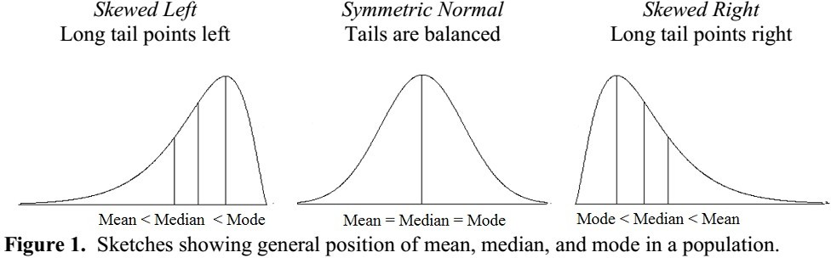
Chapter 1- Introduction to statistics
91

Slide 94
⎫Population skewness is defined as
E( x −μ)³
_{σ}3
where E stands for expected value
A bell-shaped distribution which has no skewness, i.e., mean
= median = mode is called a normal distribution.
f mean > Median > mode, the distribution is positively skewed distribution or it is said to be skewed to the right.
If mean < Median < mode, the distribution is negatively skewed distribution or it is said to be skewed to the left.

Slide 95
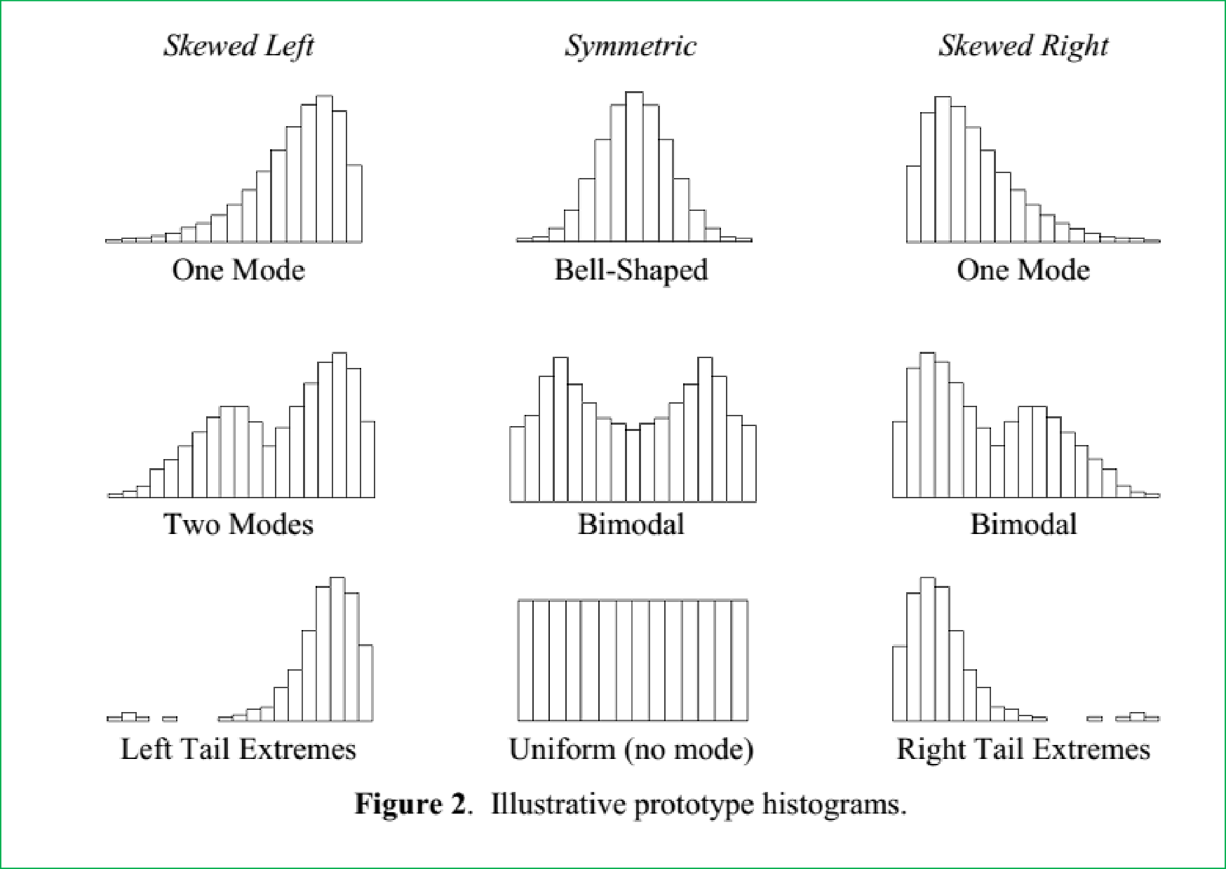

Slide 96
Measure of kurtosis
Kurtosis characterises the relative peakedness or flatness of a distribution compared with the normal distribution.
Positive kurtosis indicates a relatively peaked
distribution.
Negative
distribution.
⎫
kurtosis indicates a relatively flat
⎫ The population kurtosis is usually defined as:
E(x − μ )⁴
− 3
Nσ ⁴

Slide 97
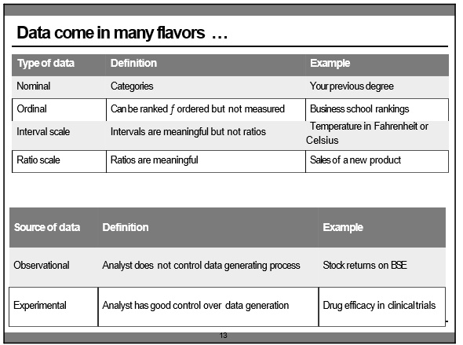

Slide 98
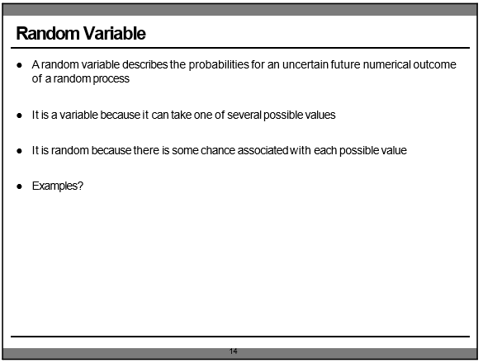

Slide 99
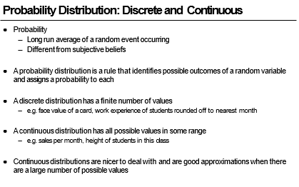

Slide 100
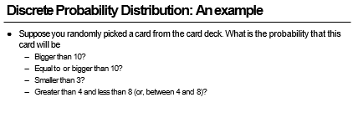

Slide 101
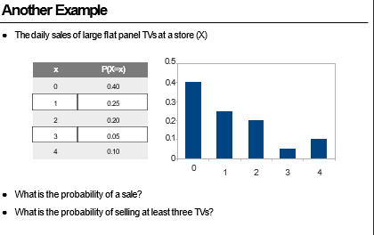

Slide 102
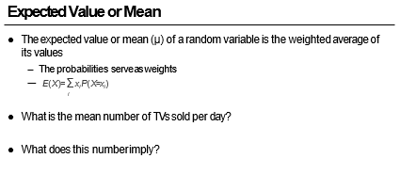

Slide 103
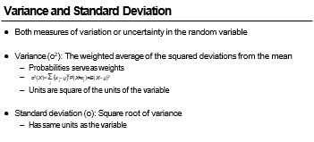

Slide 104
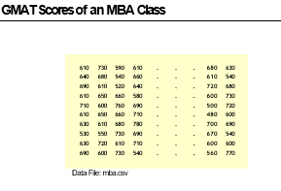

Slide 105
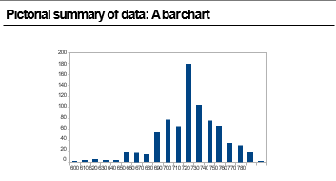

Slide 106
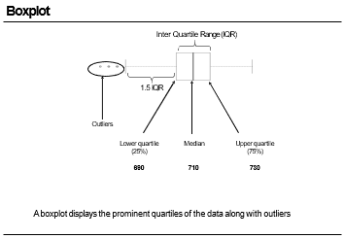

Slide 107
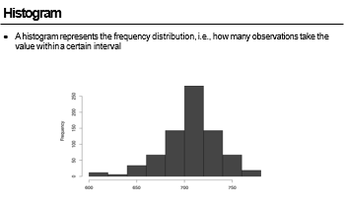

Slide 108
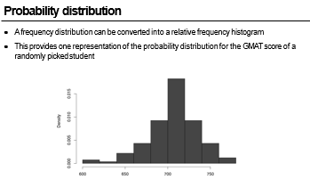

Slide 109
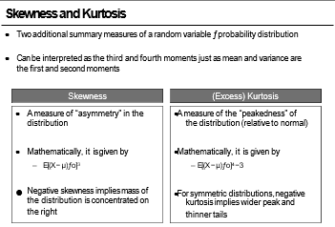

Slide 110
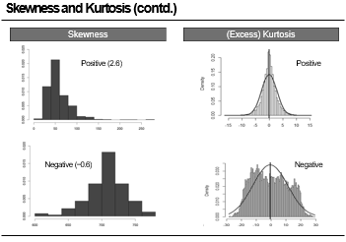

Slide 111
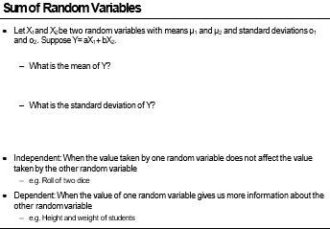

Slide 112
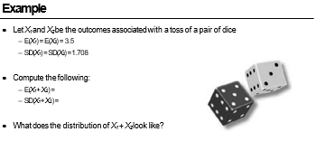

Slide 113
