Slide 1
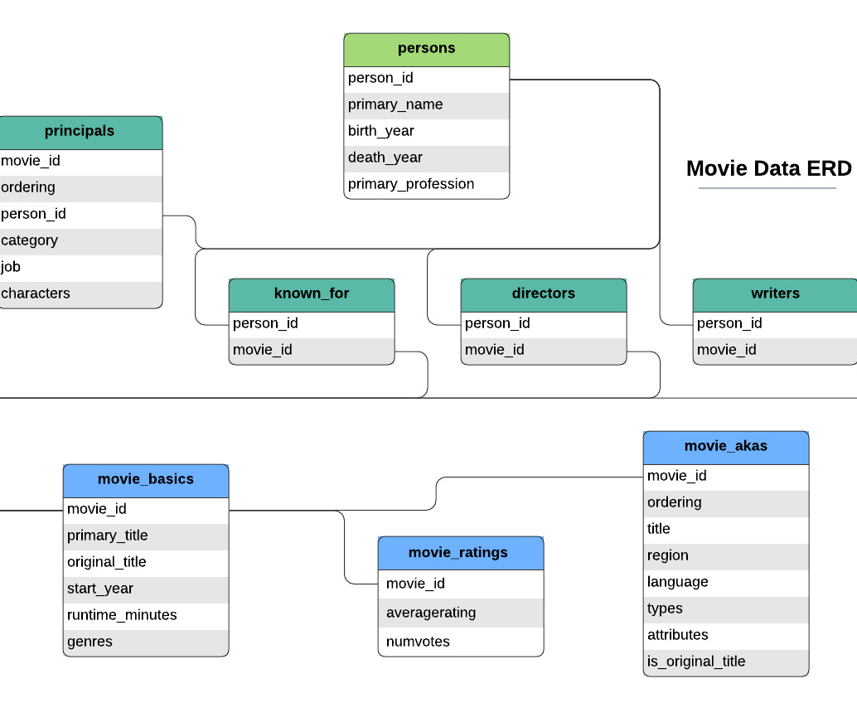
SQL Summative Lab
Part 2: IMDb Exploratory Analysis
Focus
Identify high-value content patterns using movies released from 2010–2019, ratings, votes, genres, and runtimes.
Deliverables
Exploration findings
Business question
Cleaning assessment
Entity relationships guided joins across movie, ratings, genre, and person tables.
SQL Summative Lab · Part 2 IMDb Analysis · 1

Slide 2
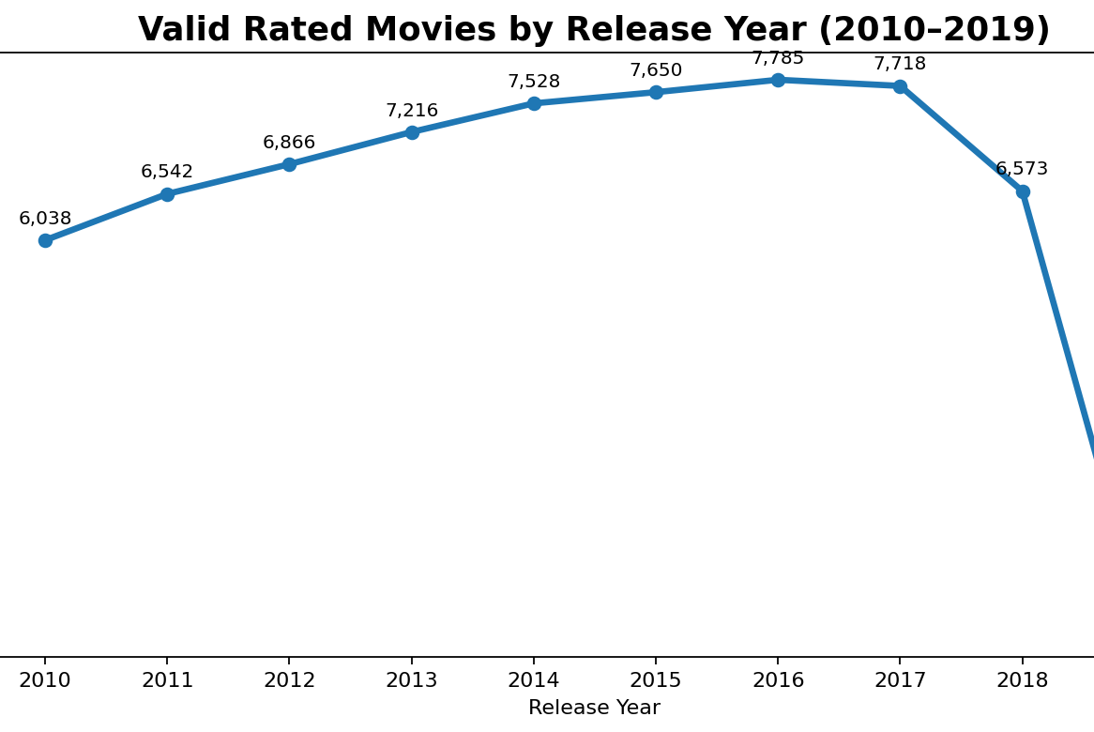
Initial exploration: clean scope first
Filtered to valid rated movies from 2010–2019 and excluded null analytical fields.
65,720
valid rated movies after excluding nulls and post-2019 records
259.9M
total audience votes across the cleaned rated-movie dataset
Key finding
Ratings stay relatively stable by year, so genre and runtime are better candidates for deeper business analysis.
SQL Summative Lab · Part 2 IMDb Analysis · 2

Slide 3
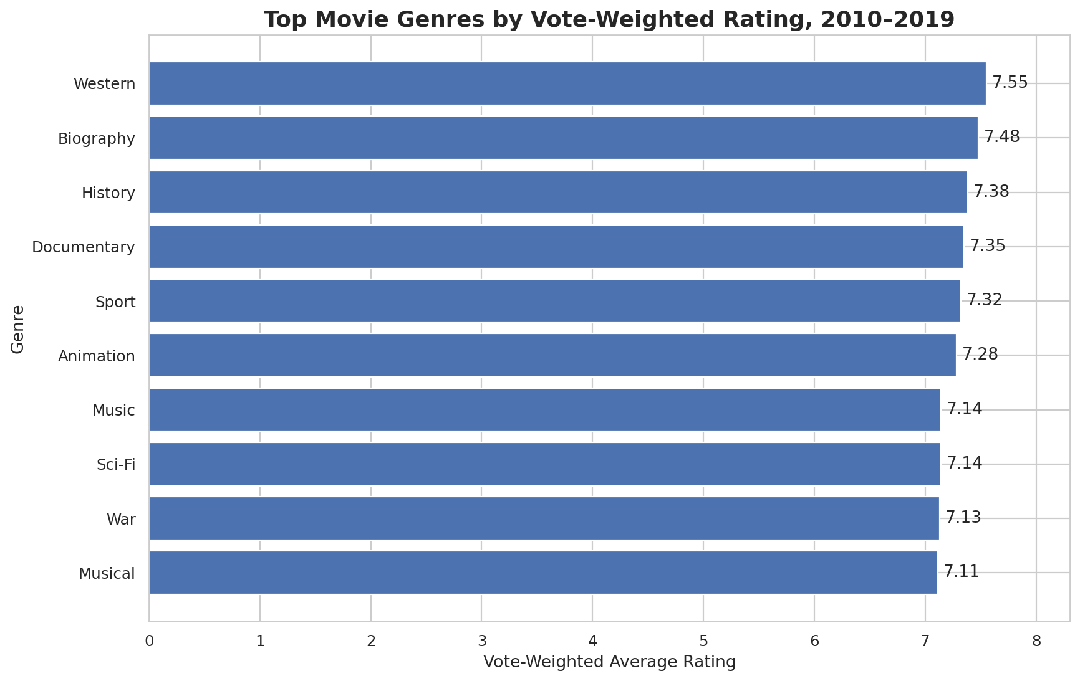
Business question: where is audience engagement strongest?
Metric used: vote-weighted rating so highly-voted movies influence the result more than lightly-voted titles.
Question
Which genres and runtime ranges provide the strongest audience engagement for movies released from 2010 to 2019?
Why it matters
Genre strength combines audience reach with quality. This can inform content acquisition, production strategy, and recommendation priorities.
SQL Summative Lab · Part 2 IMDb Analysis · 3

Slide 4
Cleaning assessment and next steps
Reliable insights require reducing nulls, duplicate-driven joins, and multi-valued fields before deeper modeling.
Cleaning tasks identified
Recommendation
• Exclude movies after 2019 and null analytical fields
• Normalize comma-separated genres into a movie-to-genre table
• Prevent duplicate counts when joining multi-row tables
• Standardize text fields such as region, language, roles, and genre labels
• Investigate unrealistic runtime outliers before recommendations
Prioritize deeper investigation into high weighted-rating genres, then validate demand using total votes, runtime bands, and title-level examples. This balances quality with audience scale.
Next SQL pass
Add title-level drilldowns for top genres, compare directors/writers where data is complete, and build genre-normalized tables before final reporting.
SQL Summative Lab · Part 2 IMDb Analysis · 4

