Slide 1
Predictive analysis
Targeted marketing campaign

Slide 2
Client: Portuguese Banking Institution
Marketing:
To ensure marketing efforts are directed at customers most likely to subscribe to product
Financial Planning:
Effective sales and cost planning
Target Audience All organizations
Strategy
In-depth of understanding of customers segmentation and demographics and resource planning
Demand Planning:
Effective demand forecast and inventory planning

Slide 3

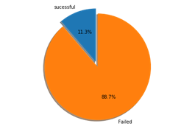
Problem Statement
Bank marketers seek to maximize marketing campaigns by predicting which customers are most likely to subscribe to bank product(term deposit)
An 11% product adoption rate by customers is very poor and is very costly to the bank

Slide 4




Benefits of Predictive analysis
Streamline marketing effort and processes
Optimize marketing costs
Optimize marketing headcount
Maximize bottom line profitability

Slide 5
Data
Dependent Variable: ‘y’ (has client subscribed a term deposit? (binary: ‘yes’,’no)
Independent Variable
Age | Numeric | Job | Categorical
Duration | Numeric | Marital Status | Categorical
Campaign | Numeric | Education | Categorical
pdays | Numeric | Default | Categorical (Binary)
previous | Numeric | Housing | Categorical (Binary)
emp.var.rate: | Numeric | Loan | Categorical (Binary)
cons.price.idx | Numeric | Contact | Categorical (Binary)
cons.conf.idx | Numeric | Month | Categorical
euribor3m | Numeric | Day_of_week | Categorical
nr.employed | Numeric | poutcome | Categorical (Binary)
Dropped data
Duration has high impact on the target response and skews results of the analysis.
Poutcome has 86% missing values
Pdays has 90% missing values
12 duplicate rows dropped

Slide 6
Exploratory Data Analysis
Age:
Impact is not significant
Average age of 37 for all customers
Job:
Impact is significant
Retirees and students more likely to subscribe
Blue collar, is least likely to subscribe
Contact
customers contacted by telephone most likely to subscribe
cons.price.idx', emp.var.rate', euribor3m, nr.employed
All correlated with one another

Slide 7
Machine Learning:
Logistic Regression vs. Random Forest
Clean Data
Standardize data
Balance Data
Apply Classifier
Predict probability for features
Generate confusion matrix
Generate classification Report
Generate ROC
Interprete Data
Explore Data
Create Training and Test set
Clean Data
Use Hyper-Parameter
Apply Random Forest
Predict probability for features
Generate confusion matrix
Generate classification Report
Generate ROC
Interpret Data
Explore Data
Create Training and Test set

Slide 8
Results
 | Logistic Regression |  |  |  | Random Forest
 | precision | recall | f1-score | support | precision | recall | f1-score | support
Subscribed: No | 0.95 | 0.77 | 0.85 | 7265 | 0.91 | 0.98 | 0.94 | 7265
Subscribed: Yes | 0.28 | 0.68 | 0.40 | 971 | 0.61 | 0.23 | 0.34 | 971
accuracy |  |  | 0.76 | 8236 |  |  | 0.89 | 8236
macro avg | 0.62 | 0.72 | 0.62 | 8236 | 0.76 | 0.61 | 0.64 | 8236
weighted avg | 0.87 | 0.76 | 0.80 | 8236 | 0.87 | 0.89 | 0.87 | 8236

Slide 9
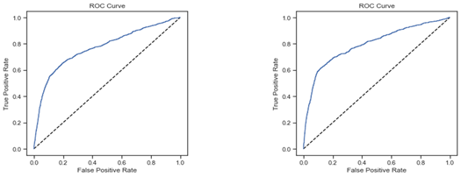
ROC
Logistic Regression Random Forest
The roc_auc_score of random forest is 79% which is higher than the 77% reported for logistic regression.

Slide 10
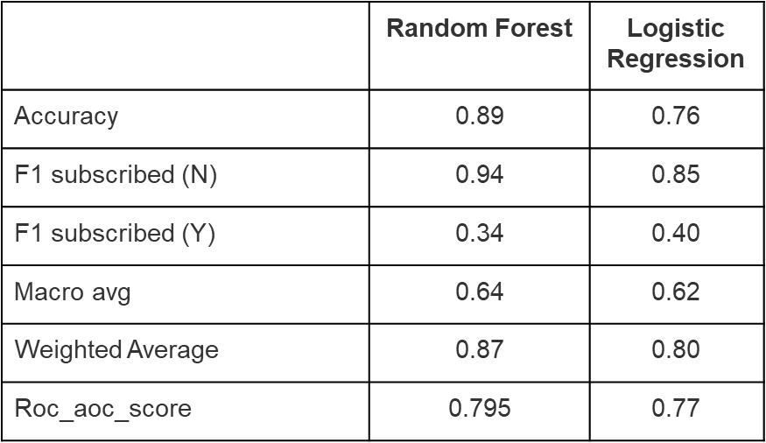
Random forest is a better predictor of variable ‘y’ than logistic regression on all measures with the exclusion of the F1 scores for customers who subscribed This analysis would be further improved with availability of more data

Slide 11
 | Random Forest | Logistic Regression
Accuracy | 0.89 | 0.76
F1 subscribed (N) | 0.94 | 0.85
F1 subscribed (Y) | 0.34 | 0.40
Macro avg | 0.64 | 0.62
Weighted Average | 0.87 | 0.80
Roc_aoc_score | 0.795 | 0.77

