Slide 1
Timeseries Analysis
EURUSD Foreign EXCHANGE RATE

Slide 2
Client:
Financial Institutions
Professional currency Traders
Target Audience is all individuals and institutions exposed to foreign currency exchange risk
All businesses with multi-currency transactions
Independent currency traders

Slide 3

Problem Statement
Predicting foreign exchange rate has been a challenging task for traders and practitioners in financial markets
This project attempts to examine and compare the effectiveness and performance of ARIMA and Neural Networks in predicting Foreign Exchange rate.

Slide 4
Methodology and Data
Use foreign exchange rates from 2000 to 2019 to predict EUR/USD exchange rate: ARIMA and LSTM models.
ARIMA consists of three parts:
Autoregressive ‘p’ : (ACF)
Integrated ‘d’ : stationary test of time-series using Dickey-fuller test.
Moving average ‘q’: (PACF)
LSTM: predict values for time series using the multi-layered LSTM recurrent neural network
Dataset
Consists of daily closing exchange rate of eurusd from barchart.com

Slide 5
Exploratory Data Analysis
Hypothesis 1:
p-value > 0.05: Accept the null hypothesis (H0), the data has a unit root and is non-stationary.¶
p-value <= 0.05: Reject the null hypothesis (H0), the data does not have a unit root and is stationary.
Result of hypothesis:
Standard deviation is stationary, while the mean is not. We will reject the null hypothesis H0, the data does not have a unit root and is stationary.

Slide 6

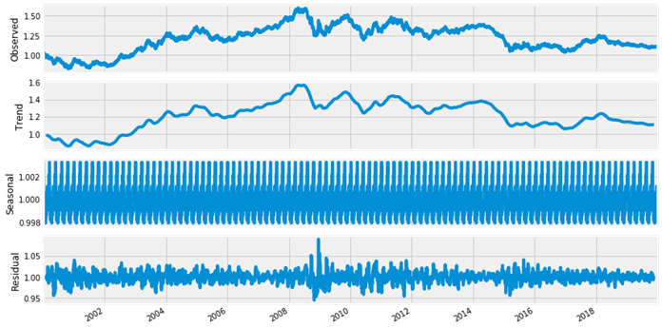


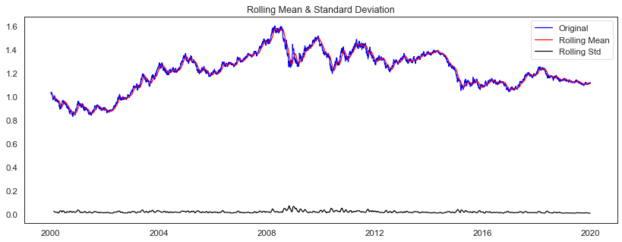

Exploratory Data Analysis

Slide 7
Exploratory Data Analysis
Statistical Normality Test
Statistical normality test quantifies whether data was drawn from a Gaussian distribution
Hypothesis 2:
p <= alpha: reject H0, not normal.¶
p > alpha: fail to reject H0, normal
Result of hypothesis:
Data does not look Gaussian, we will reject the null hypothesis H0.

Slide 8
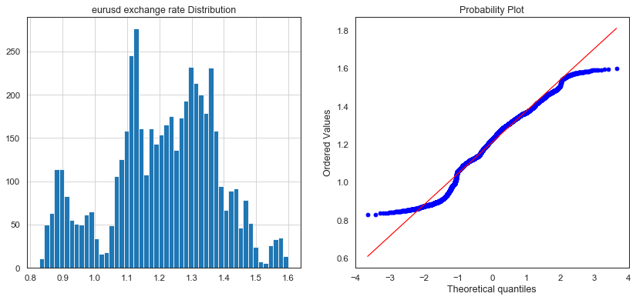
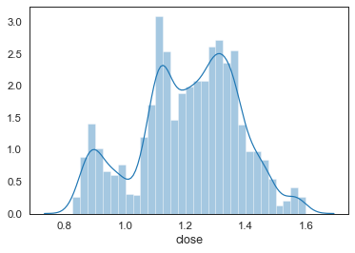
Exploratory Data Analysis
The kurtosis of the distribution is less than zero and is light tailed. The distribution is fairly symmetrical
Statistics=137.136, p=0.000
Kurtosis of normal distribution: -0.43668157335097213
Skewness of normal distribution: -0.28722463936355497

