Slide 1
NETWORK ELEVATE
TECHNOTHON 2023

Slide 2
Problem Statement
To Create a Wikipedia Connected People Analysis

Slide 3
OBJECTIVE
Informetric study of unstructured Wikipedia data.
To recommend relative targets bored on given data.

Slide 4
Features
Search someone on Wikipedia.
Data Extraction
Database Creation
Relation Graph Creation

Slide 5
Tools and Technologies used:
Language | Python Version 3.10
Libraries | NumPy, Pandas, re, Spacy, BeautifulSoup, Neo4j Driver
Techniques | Web Scraping, Text Pre Processing, NLP, Knowledge Graph, NER
Tool | VS Code, Jupyter Notebook, Neo4j

Slide 6
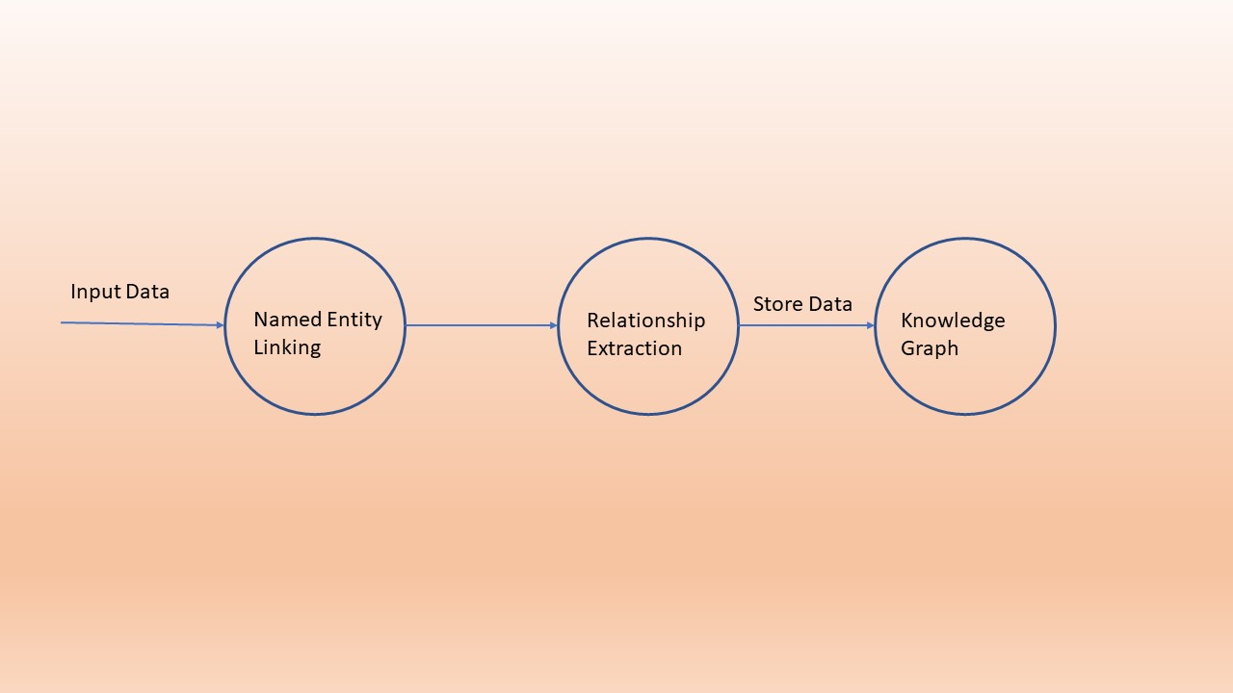
DATA FLOW DIAGRAM Level 0
DFD level 0

Slide 7
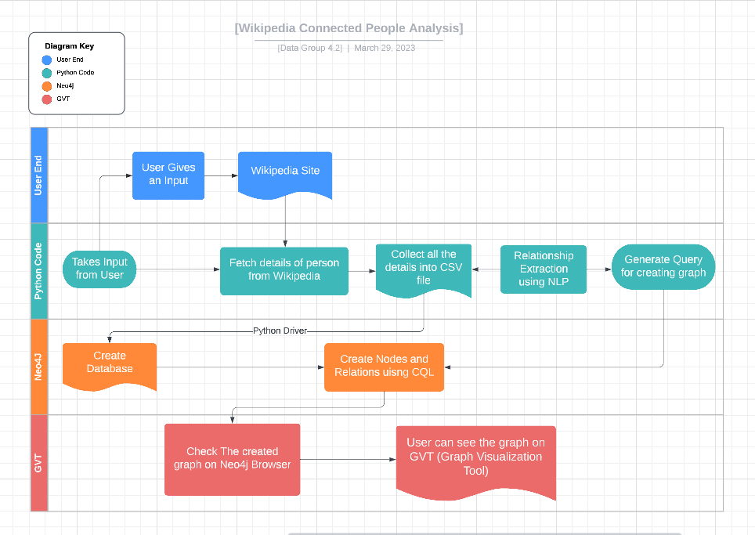
DATA FLOW DIAGRAM Level-1

Slide 8
DEMO

Slide 9



Business Value
Sales
Social Network
Recommendation Engine

Slide 10
THANK YOU

