Slide 1
From Stored Data to Data Stories: Building Data Narratives with Open-Source Tools
Paul J Kowalczyk, PhD
Senior Data Scientist
Solvay / Bristol Research & Innovation Centre
paul.kowalczyk@solvay.com
www.linkedin.com/in/PaulJKowalczyk
https://github.com/pjkowalczyk/StoredDataStories

Slide 2
Workshop Outline

Slide 3

An Advanced Materials and Specialty Chemicals Company
Solvay is a global leader in advanced materials and specialty chemicals. Our materials and innovation help to design everyday solutions in clean mobility and resource efficiency.
Advanced Materials - Providing solutions for sustainable mobility, lightweight, CO2, and energy efficiency.
Advanced Formulations - Customized specialty formulations for surface chemistry and liquid behavior, maximizing yield and efficiency, and minimizing eco-impact.
Performance Chemicals - Solvay specialty chemicals lead in chemical intermediates through scale and technology to develop applications and industrial innovation for optimized costs.

Slide 4
Why data narratives?

Slide 5
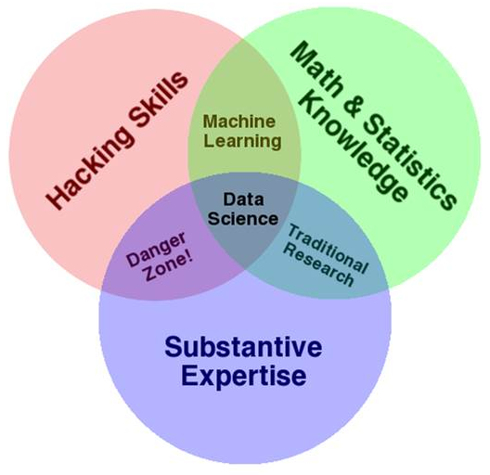
Data Science Venn Diagram
http://drewconway.com/zia/2013/3/26/the-data-science-venn-diagram

Slide 6
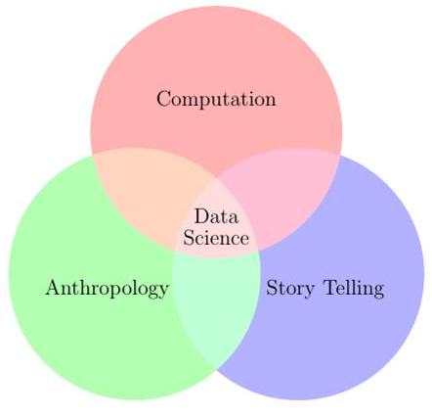
A Complementary (!?) View …

Slide 7
Stories: Formats
opening – challenge – action – resolution
lead – development – resolution
lead – development
action – background – development – denouement - ending

Slide 8
Stories: Formats
opening – challenge – action – resolution
lead – development – resolution
lead – development
action – background – development – denouement - ending

Slide 9
Stories: Formats
opening – challenge – action – resolution
lead – development – resolution
lead – development
action – background – development – denouement - ending
ABSTRACT

Slide 10
Stories: Formats
opening – challenge – action – resolution
lead – development – resolution
lead – development
action – background – development – denouement - ending
ABSTRACT
INTRODUCTION (& PRIOR ART)

Slide 11
Stories: Formats
opening – challenge – action – resolution
lead – development – resolution
lead – development
action – background – development – denouement - ending
MATERIALS
&
METHODS
ABSTRACT
INTRODUCTION (& PRIOR ART)

Slide 12
Stories: Formats
opening – challenge – action – resolution
lead – development – resolution
lead – development
action – background – development – denouement - ending
MATERIALS
&
METHODS
ABSTRACT
CONCLUSION(S)
INTRODUCTION (& PRIOR ART)

Slide 13
Stories: Formats
opening – challenge – action – resolution
lead – development – resolution
lead – development
action – background – development – denouement - ending
e.g., SUPPL. MATL.,
CODE,
BIBLIOGRAPHY,
…
MATERIALS
&
METHODS
ABSTRACT
CONCLUSION(S)
INTRODUCTION (& PRIOR ART)

Slide 14
The Power of Three
“ingredients”:
data science
anthropology
storytelling

Slide 15
The Power of Three
“ingredients”:
data science
anthropology
storytelling
audiences:
creator
curator
consumer

Slide 16
The Power of Three
“ingredients”:
data science
anthropology
storytelling
audiences:
creator
curator
consumer
compendia:
re-run
run, with new / different data
expand

Slide 17
The Power of Three
“ingredients”:
data science
anthropology
storytelling
audiences:
creator
curator
consumer
compendia:
re-run
run, with new / different data
expand
“media”:
*.R, *.py
*.Rmd, *.ipynb
*.html, *.doc, *.pdf

Slide 18
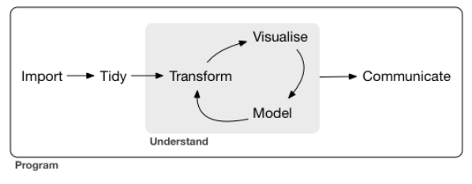
… a typical data science project.
R for Data Science
Hadley Wickham & Garret Grolemund
ISBN-13: 978-1491910399

Slide 19
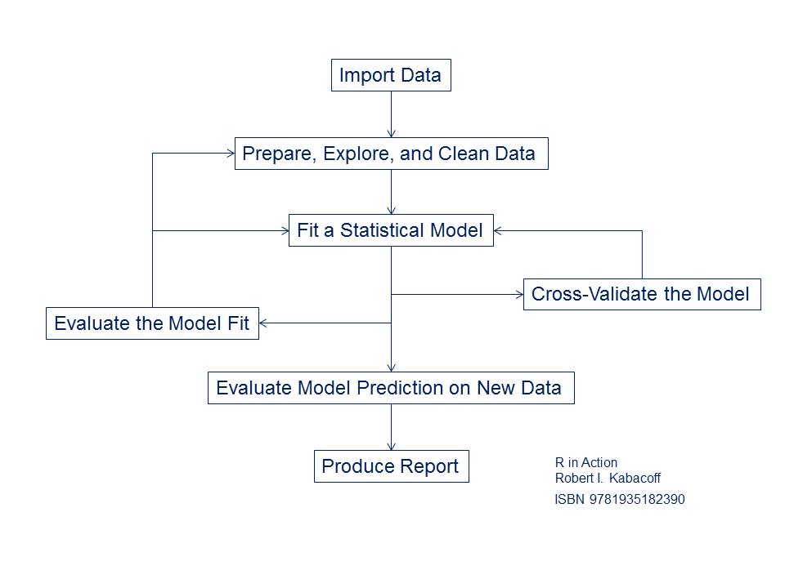

Slide 20
Case studies:
Build predictive models for
water solubility (regression)
OECD Test No. 105
biodegradability (classification)
OECD Test No. 301
The OECD Guidelines for the Testing of Chemicals is a collection of about 150 of the most relevant internationally agreed testing methods used by government, industry and independent laboratories to identify and characterize potential hazards of chemicals. They are a set of tools for professionals, used primarily in regulatory safety testing and subsequent chemical and chemical product notification, chemical registration and in chemical evaluation. They can also be used for the selection and ranking of candidate chemicals during the development of new chemicals and products and in toxicology research. This group of tests covers physical-chemical properties.
OECD = Organisation for Economic Cooperation and Development

Slide 21
Ground Truth
Expected input data format:
ID | EndPoint | Variable₁ | Variable₂ | Variable₃ | …
Obs01 | endpt01 | var_{1,1} | var_{1, 2} | var_{1,3} | …
Obs02 | endpt02 | var_{2,1} | var_{2,2} | var_{2,3} | …
Obs03 | endpt03 | var_{3,1} | var_{3,2} | var_{3,3} | …
… | … | … | … | …

Slide 22
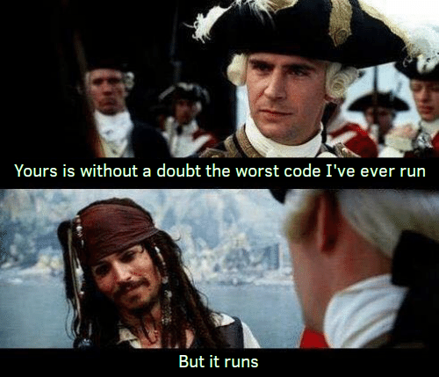
A word about my code …

Slide 23
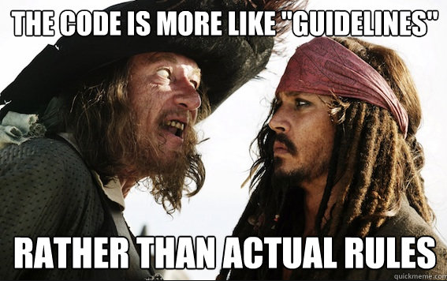
Many paths to the same destination …

Slide 24
Ground Truth
https://github.com/pjkowalczyk/StoredDataStories
WS_ground_truth.R (regression)
ReadyBiodeg_ground_truth.R (classification)

Slide 25
Practicum I
Using one of
WS_ground_truth.R (regression)
ReadyBiodeg_ground_truth.R (classification)
as a template, build a ‘ground truth’ predictive model for some other dataset.

Slide 26
Notebooks
An R notebook is
an R Markdown document
that can be executed independently and interactively,
with output that is immediately visible.
R notebooks are implementations of literate programming.
A good choice when iterating on code.

Slide 27
Notebooks
a lightweight markup language
An R notebook is
an R Markdown document
that can be executed independently and interactively,
with output that is immediately visible.
R notebooks are implementations of literate programming.
A good choice when iterating on code.

Slide 28
Notebooks
a lightweight markup language
An R notebook is
an R Markdown document
that can be executed independently and interactively,
with output that is immediately visible.
R notebooks are implementations of literate programming.
A good choice when iterating on code.
combine code, text, tables, & graphics in a executable document

Slide 29
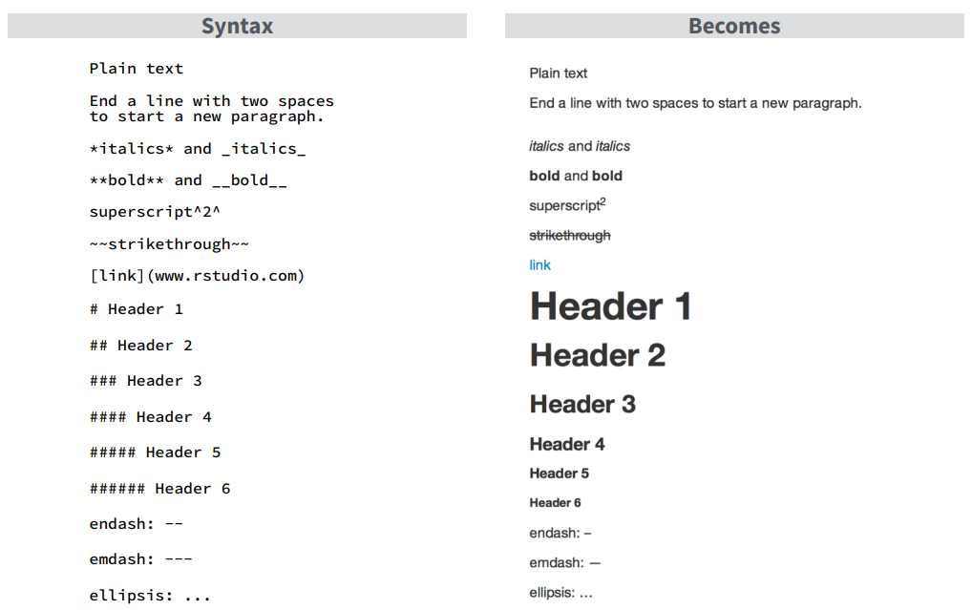
Notebooks
YAML:
---
title: “ODSC Notebook”
output: html_notebook
---
R code:
```{r}
code goes here
```

Slide 30
Practicum II
Build a notebook around
WS_ground_truth.R (regression)
ReadyBiodeg_ground_truth.R (classification)
your dataset

Slide 31
Presentations
ioslides_presentation
slidy_presentation
beamer_presentation
powerpoint_presentation

Slide 32
Practicum III
add water solubility modeling results to slides
build slide deck for your data

Slide 33
Documents
---
title: "Water Solubility"
subtitle: "ODSC West 2019 Workshop"
author: "Paul J. Kowalczyk"
date: "`r Sys.Date()`"
output: tint::tintPdf
bibliography: skeleton.bib
link-citations: yes
---

Slide 34
Practicum IV
add water solubility modeling results to document
build document for your data

Slide 35
Wrap-Up
paul.kowalczyk@solvay.com
www.linkedin.com/in/PaulJKowalczyk
https://github.com/pjkowalczyk/StoredDataStories

Slide 36
BIF*
*because I forget!

Slide 37
Wrap-Up
Thank You!
Merci!
Dziękuję
paul.kowalczyk@solvay.com
www.linkedin.com/in/PaulJKowalczyk
https://github.com/pjkowalczyk/StoredDataStories

