Slide 1
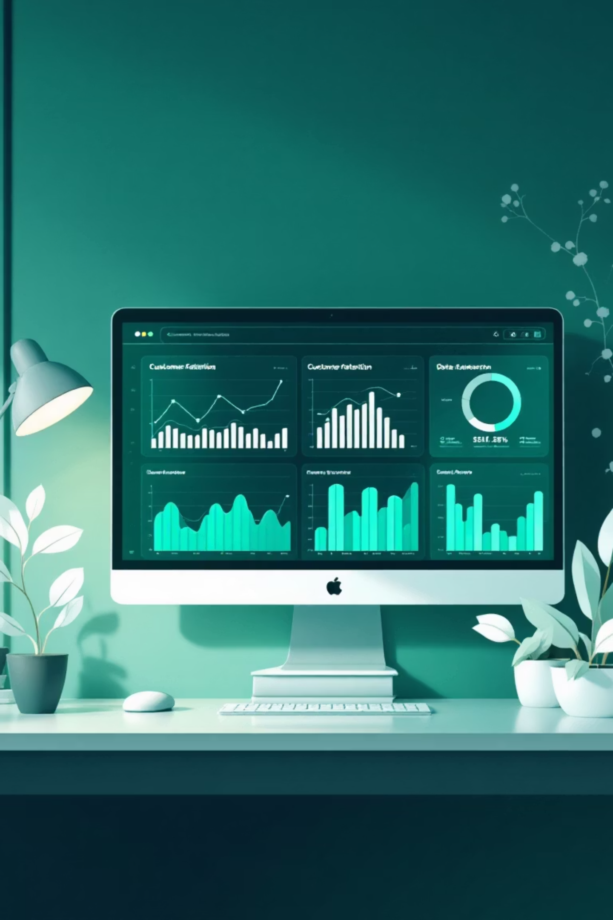
Customer Churn Analysis Using Machine Learning
Leveraging advanced ML models to identify high-risk customers and deliver actionable insights for improving retention strategies.

Slide 2

The Challenge of Customer Churn
What is Customer Churn?
Why It Matters
Acquiring new customers costs 5-25x more than retaining existing ones
Customer churn occurs when clients discontinue their relationship with a business. In banking, this represents lost revenue, reduced market share, and increased acquisition costs.
Early identification enables proactive intervention
Data-driven insights improve retention strategies
Understanding churn patterns is critical for sustainable growth and profitability.
Reduces revenue loss and strengthens customer relationships

Slide 3
Project Overview
01
02
Data Collection
Preprocessing & EDA
Bank customer dataset with comprehensive behavioral and demographic features
Data cleaning, feature engineering, and exploratory analysis to uncover patterns
03
04
Model Development
Model Comparison
Training multiple ML algorithms to predict churn probability
Evaluating performance using ROC-AUC and other key metrics
05
06
Feature Analysis
Actionable Insights
Identifying the most influential factors driving customer churn
Delivering recommendations for targeted retention strategies

Slide 4

Data Preprocessing & Exploration
Data Quality
Feature Engineering
Handled missing values, outliers, and inconsistencies to ensure clean, reliable data for modeling.
Created new variables and transformed existing features to capture meaningful patterns in customer behavior.
Exploratory Analysis
Uncovered key trends, correlations, and distributions that inform model development and business strategy.

Slide 5

Machine Learning Models Deployed
Logistic Regression
Random Forest
Gradient Boosting
Baseline model providing interpretable probability estimates for churn prediction.
Ensemble method capturing complex non-linear relationships in customer data.
Advanced algorithm optimizing prediction accuracy through iterative learning.
Each model was trained, validated, and fine-tuned using cross-validation to ensure robust performance across different customer segments.

Slide 6
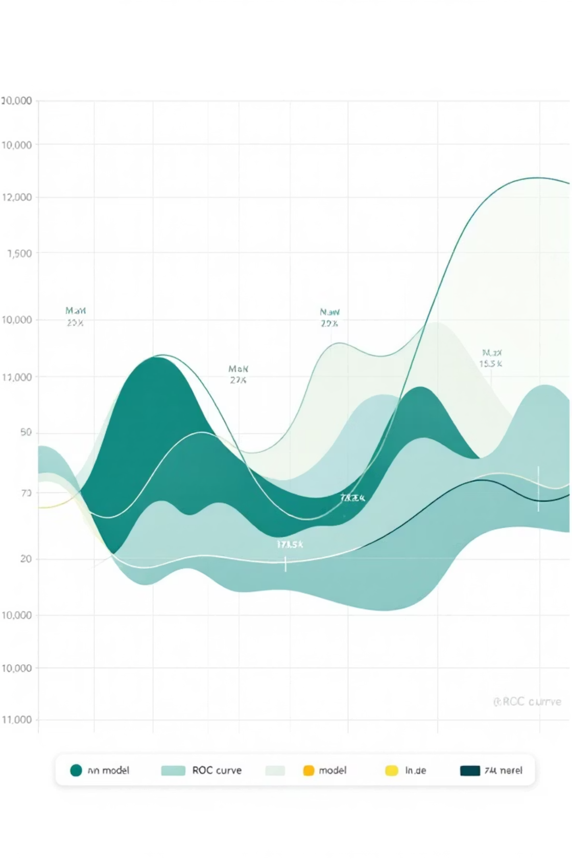
Model Performance Comparison
1
2
ROC-AUC Analysis
Precision & Recall
Models evaluated using Receiver Operating Characteristic curves and Area Under Curve metrics to measure classification performance.
Balanced evaluation of true positive rates and false positive rates to optimize business outcomes.
3
Best Model Selection
Gradient Boosting emerged as the top performer, achieving superior accuracy and generalization capability.

Slide 7
Key Features Driving Churn
Customer Age
Account Balance
Product Usage
Geography
Age significantly impacts churn likelihood, with certain demographics showing higher retention rates.
Lower balances correlate with increased churn risk, indicating financial engagement levels.
Number of products held and transaction frequency are strong predictors of customer loyalty.
Regional differences reveal varying churn patterns across different markets and locations.

Slide 8
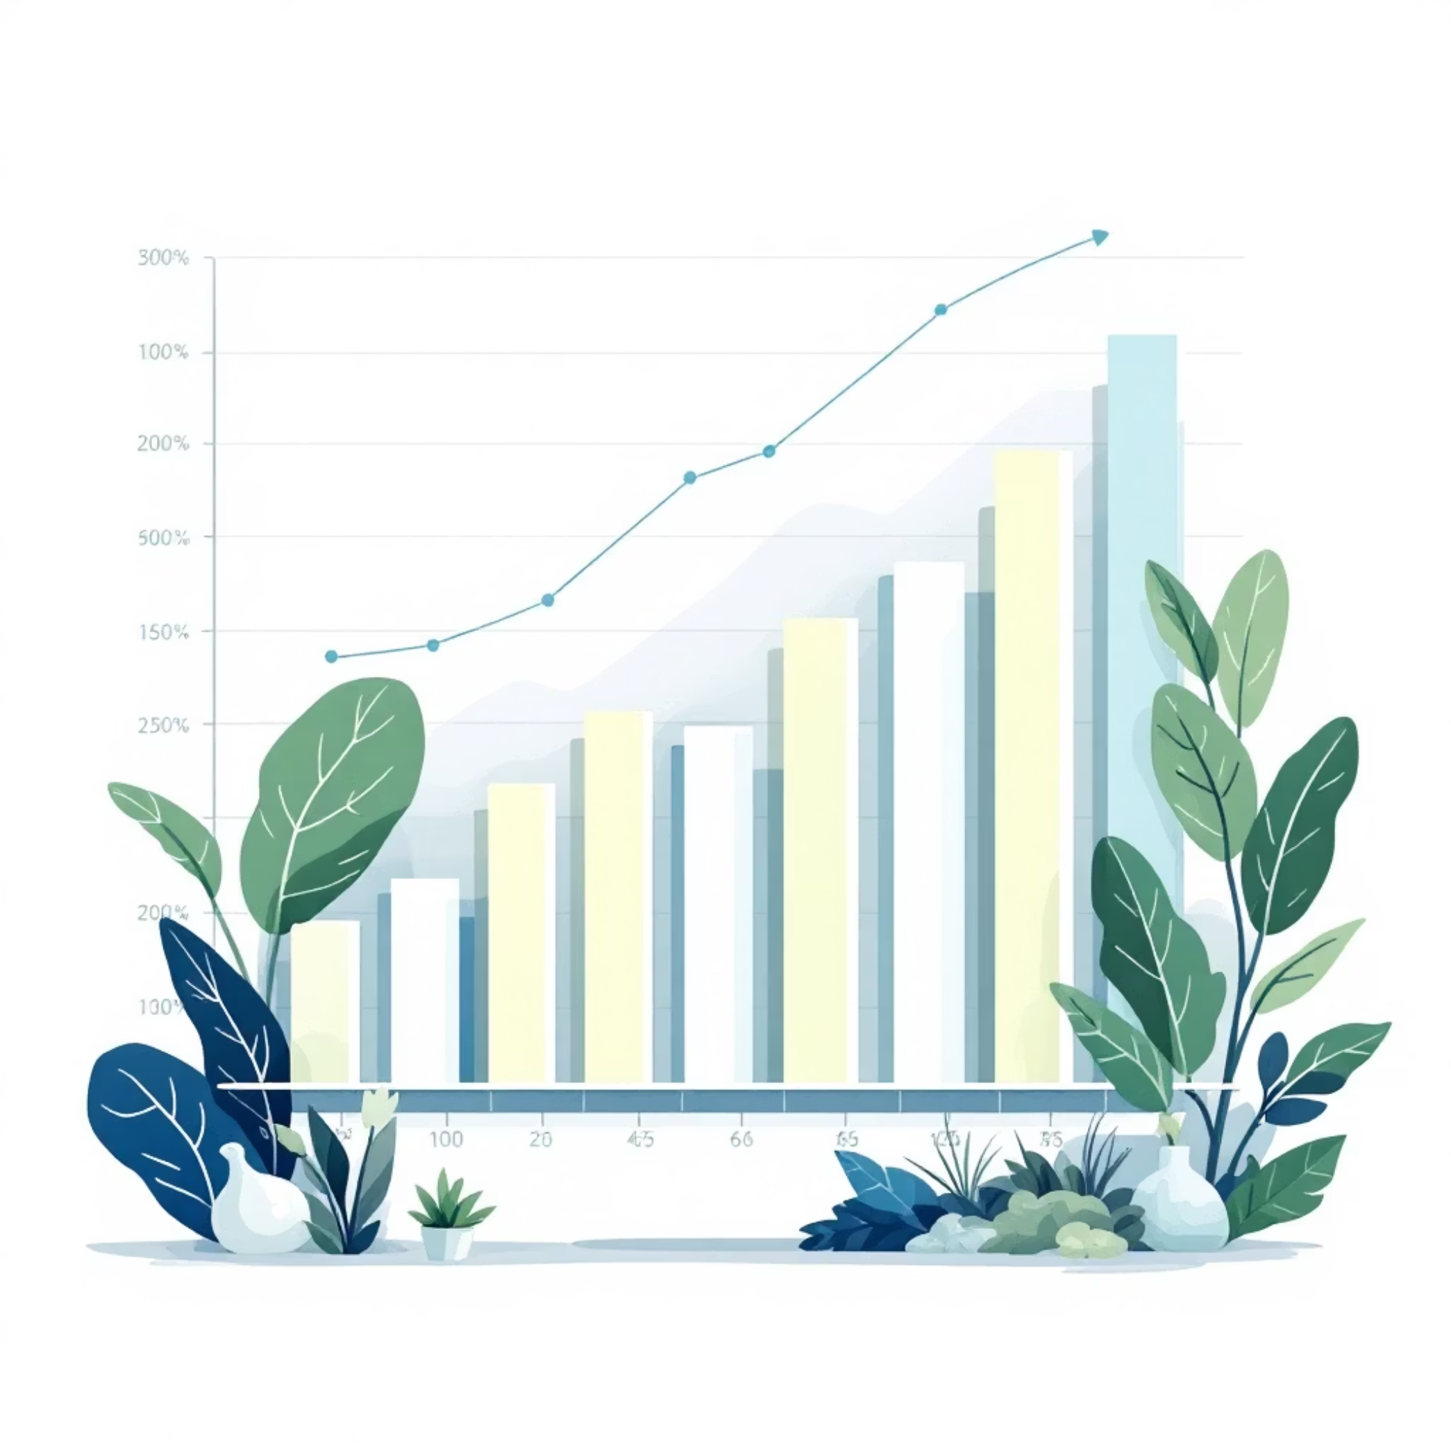
Feature Importance Analysis
Top Predictors
Our analysis identified the most influential factors:
Account tenure - Length of customer relationship
Transaction frequency - Engagement level
Customer complaints - Service satisfaction
Credit score - Financial health indicator

Slide 9




Actionable Insights & Recommendations
Targeted Interventions
Personalized Engagement
Early Warning System
Focus retention efforts on high-risk customer segments identified by the model.
Tailor communication and offers based on individual churn probability scores.
Implement real-time monitoring to detect churn signals before customers leave.
These insights enable proactive retention strategies that reduce churn rates and maximize customer lifetime value.

Slide 10


Project Deliverables & Impact
Trained ML Pipeline
Production-ready model saved as best_churn_pipeline.pkl for deployment and real-time predictions.
Comprehensive Documentation
Detailed project documentation covering methodology, findings, and implementation guidelines.
Jupyter Notebook
Complete analysis workflow with code, visualizations, and reproducible results.
Business Value
Reduced churn rates, improved retention ROI, and data-driven decision-making capabilities.

