Slide 1
Part I
Factor Models, Fama-French, and Pipeline

Slide 2
Oversimplification
Linear Regression:
Height = Nutrition + Sleep + Genetics (+ Error)

Slide 3
Linear Factor Models in Finance

Slide 4
Linear Factor Models in Finance
Ffasdasdasd
For an equity i:
Ri = returns on equity i ai = some constant bix = change in return per unit change in Fx Fx = value of factor x ei = random error

Slide 5
Fama-French Three-Factor Model
Linear Regression Model
Purpose: to describe returns of an equity over some time period

Slide 6
Fama-French Three-Factor Model
Returns: (Rm-Rf), SMB, HML

Slide 7
Fama-French
Rm - Rf = Returns of market - risk free returns
Risk free rate of return = 0
Rm - Rf = Rm = S&P500 (SPY)

Slide 8
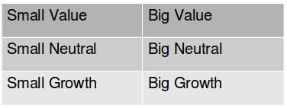
Fama-French
Partitioning our Universe
Book Value Market Cap
Market Cap
50th Percentile
70th Percentile
30th Percentile

Slide 9
Fama-French
SMB: Small Minus Big
SMB = ⅓ (Small value returns + Small neutral returns + Small growth returns) - ⅓ (Big value returns + Big neutral returns + Big growth returns)

Slide 10
Fama-French
HML: High Minus Low
HML = ½ (Small value returns + Big value returns) - ½ (Small growth returns + Big growth returns)

Slide 11
Fama-French
Partitioning our Universe
Book Value Market Cap
Market Cap
50th Percentile
70th Percentile
30th Percentile

Slide 12
Pipeline
Effectively: map-reduce on securities data
Before: algorithms limited to 500 securities
Now: unlimited
Compute on large universes
Filter universes down to desired sets

Slide 13
Pipeline
Pipeline allows us to swiftly work with literally every security in our database.
This enables us to use large-scale strategies. This Fama-French implementation is a “Hello World” for a new class of strategies that users can deploy on Quantopian.

Slide 14
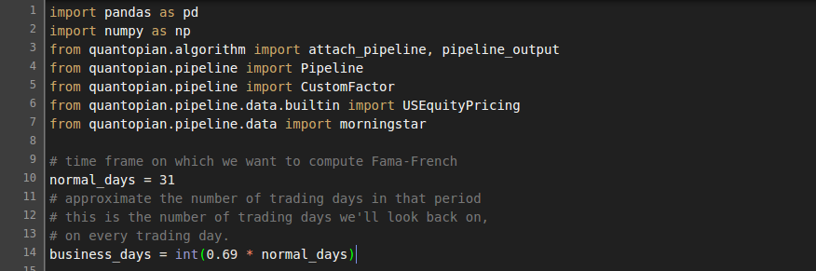
Fama-French & Pipeline

Slide 15
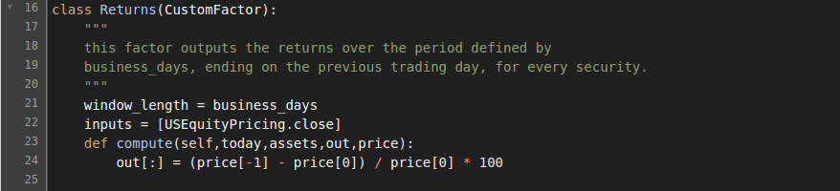
Fama-French & Pipeline

Slide 16
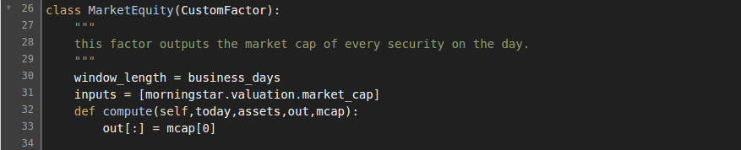
Fama-French & Pipeline

Slide 17
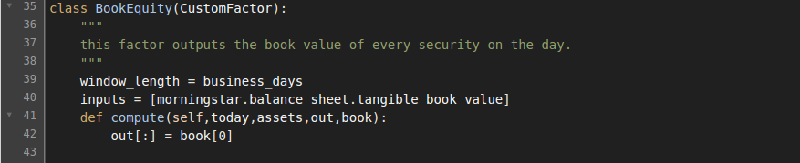
Fama-French & Pipeline

Slide 18
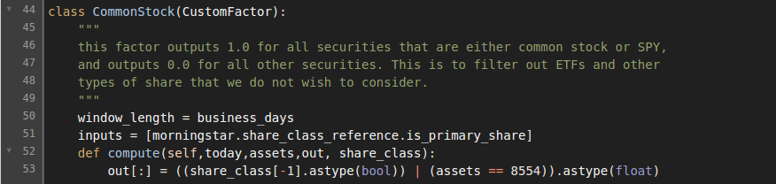
Fama-French & Pipeline

Slide 19
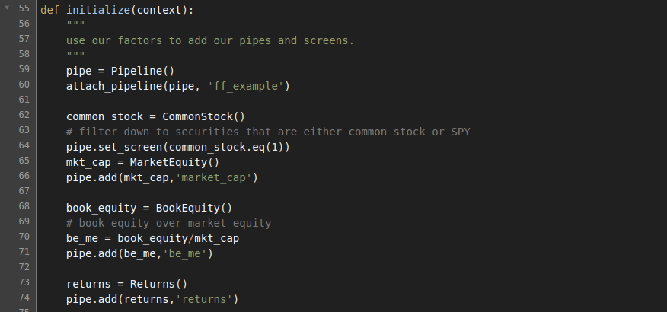
Fama-French & Pipeline

Slide 20
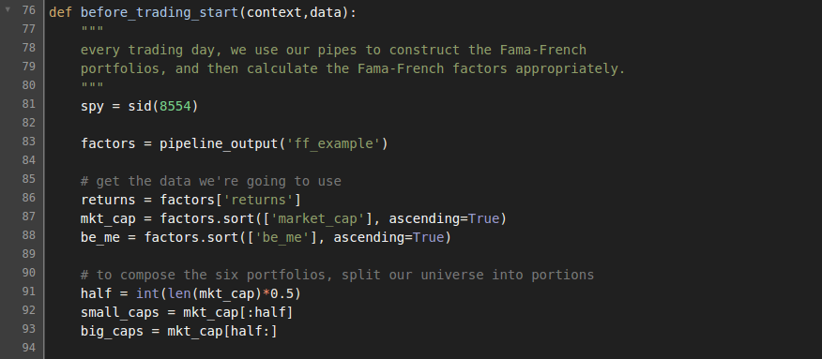
Fama-French & Pipeline

Slide 21
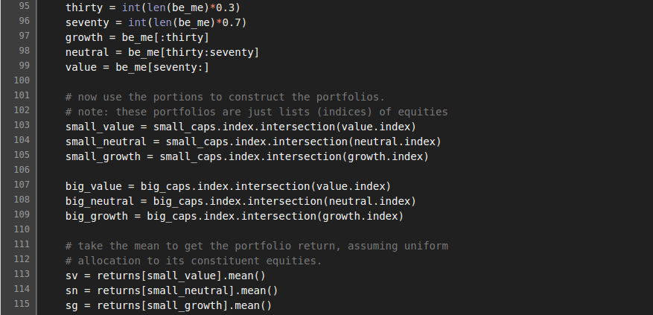
Fama-French & Pipeline

Slide 22
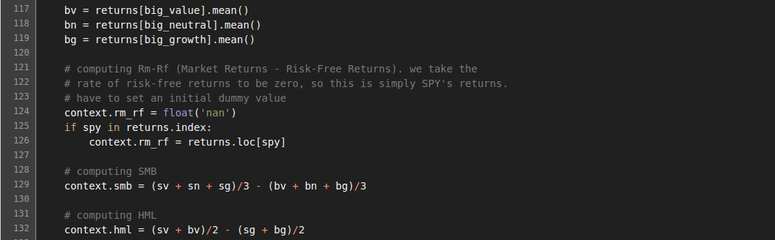
Fama-French & Pipeline

Slide 23
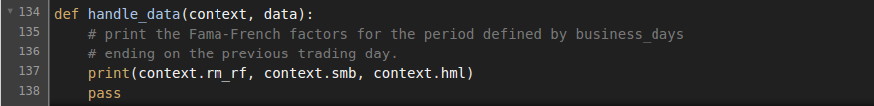
Fama-French & Pipeline

Slide 24
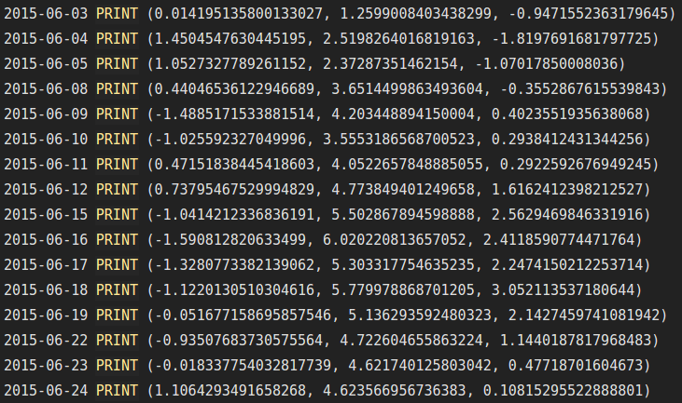
Fama-French & Pipeline

Slide 25
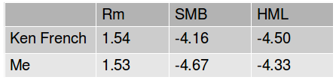
Implementation
Ken French’s data library: to double-check
July 2015:

Slide 26
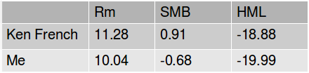
Implementation
Ken French’s data library: to double-check
August 2014 - August 2015:

Slide 27
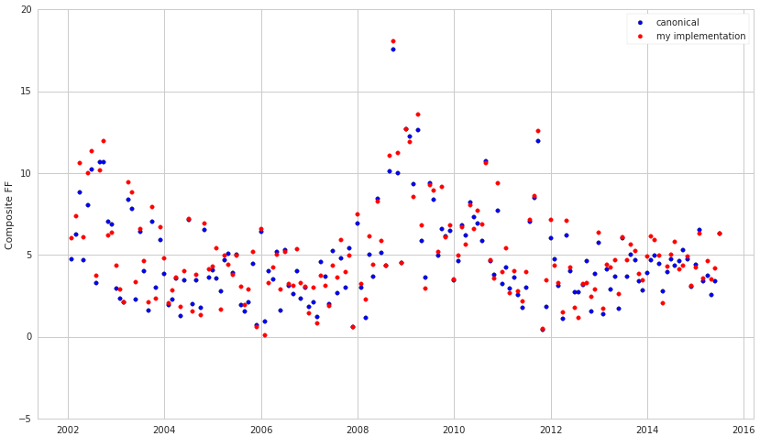
Monthly Fama-French Comparison

Slide 28
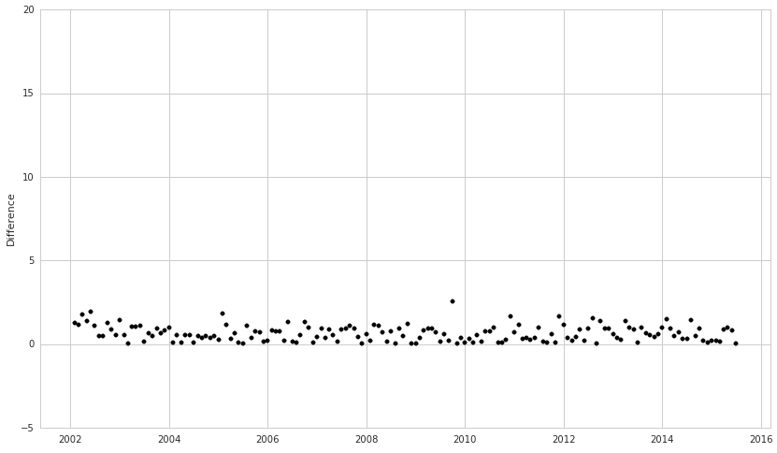
Monthly Fama-French Comparison

Slide 29
Is Our Implementation Better?
Ken French’s implementation uses only NYSE, NASDAQ, and AMEX.
We use data from over 12 exchanges.

Slide 30
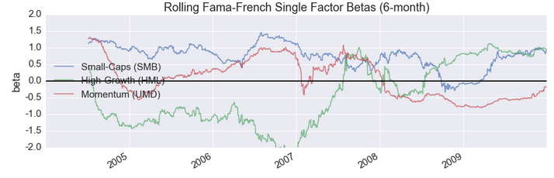
Applications
Evaluate strategies with FF factor correlation
Coming: Pipeline in research
Pyfolio: regression against FF factors

Slide 31
Part II
Parameter Optimization in Research

Slide 32
Quantopian Research
iPython platform
run algorithms
import datasets
use Python’s data-analytic libraries

Slide 33
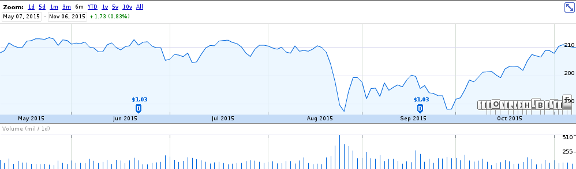
Motivation

Slide 34
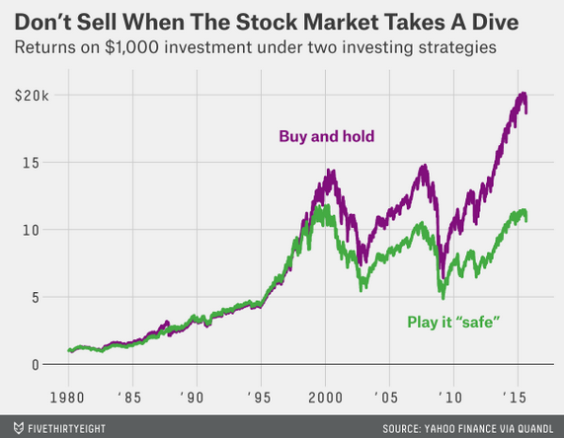

Slide 35
That’s just one strategy.
It’s not sufficiently rigorous.
We want more general results.

Slide 36
Does there exist a simple, profitable strategy
for lay investors that sells on market downturns
and buys back on rebounds?

Slide 37
Parameter Optimization
Goal: optimize the percentage downturns and rebounds to sell and buy on
Space: [0, 25%] Downturns
[0, 25%] Rebounds
Increments of 0.5%
Benchmark: SPY returned ~85% between January 2002 and February 2015

Slide 38
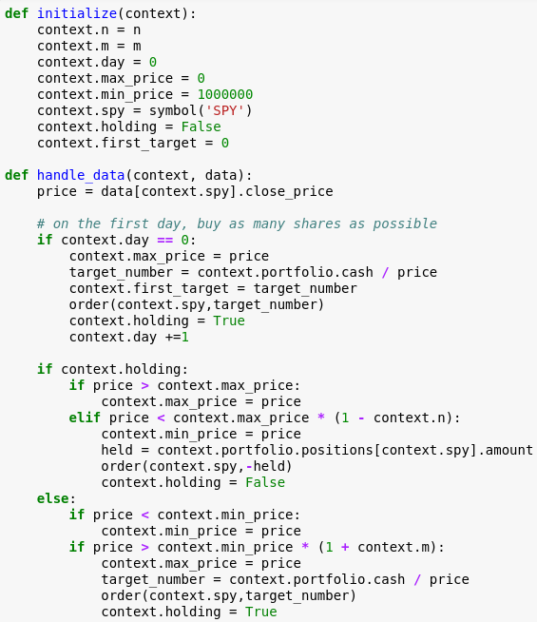
Algorithm

Slide 39
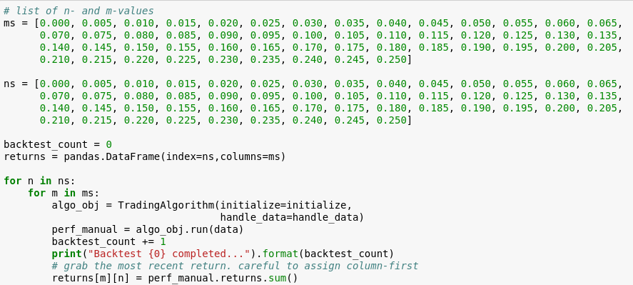
Iteration: 2500 backtests

Slide 40
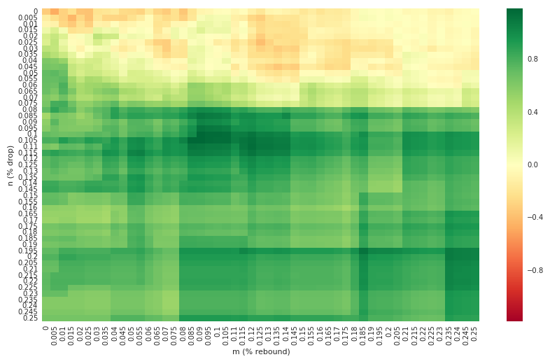
Heatmap: 2500 backtests

Slide 41
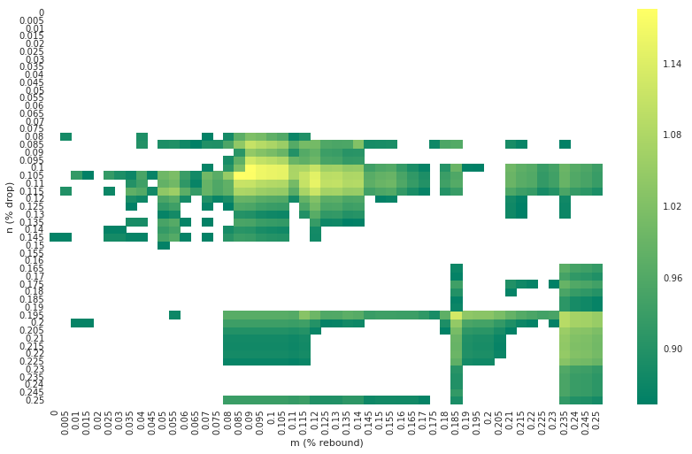
Threshold: Benchmark-Beating

Slide 42
While we’re liquidated, why not pick up some risk-free returns?
Let’s return 2% annually on any cash we hold (to simulate buying treasury bills, etc.)

Slide 43
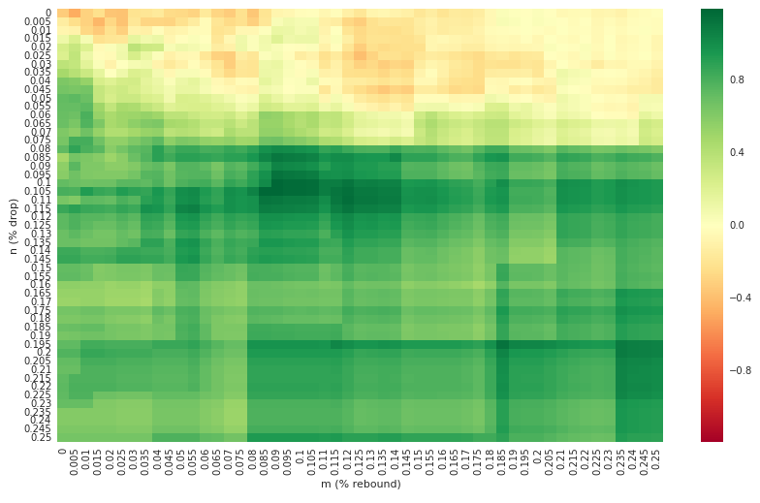
Another 2500 backtests

Slide 44
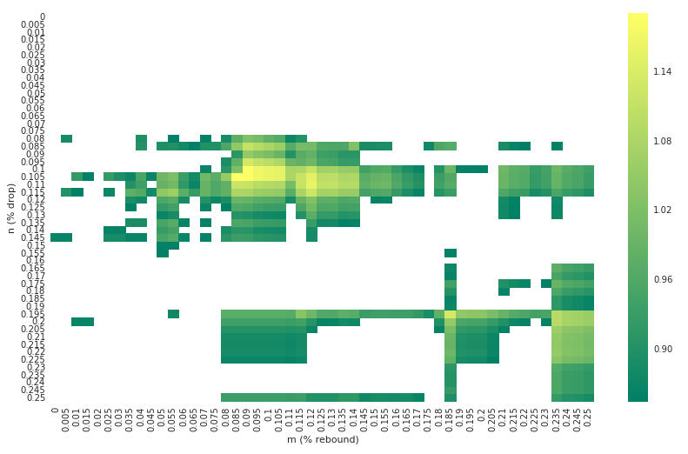
Threshold: Benchmark-Beating

Slide 45
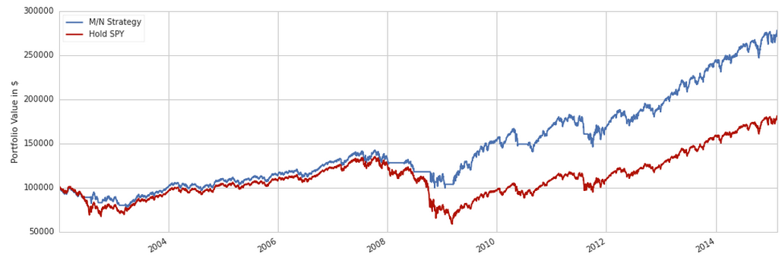
Overfit to the Recession

Slide 46
Giveaway: best returns next to mediocre ones

Slide 47
Conclusions
Parameter optimization is powerful, but dangerous!
Next economic downturn: will it be structurally similar enough to the previous one for this model to be reliable? Probably not.
Does there exist a simple strategy for lay investors to ensure market-beating returns over times of economic downturn? Maybe, but not this one.
If a lay investor is holding SPY during an economic downturn, they may as well hold on.

Slide 48
Questions?
contact@johnloeber.com

