Slide 1

Prediction of Diabetes Using Machine Learning Models
Presentation by Group 1:
Ratnaprabha Keshwar and Manohar Babu Bunga
Wichita state University, Wichita, USA.

Slide 2
Introduction
Diabetes is a chronic disease where the body cannot properly process blood sugar (glucose).
Early prediction and diagnosis of diabetes are very important because they can help patients manage the disease effectively and avoid severe health complications.
In this project, we used machine learning models to predict whether a patient has diabetes based on certain health measurements. We implemented the following models:
• Logistic Regression
• K-Nearest Neighbors (KNN)

Slide 3
Objectives
The objective of this project is to develop a machine learning model that can accurately predict whether a person is diabetic based on health-related features such as glucose level, BMI, age, and more.
By using classification algorithms like K-Nearest Neighbors (KNN) & Logistic Regression, the project aims to:
Understand the key factors influencing diabetes.
Evaluate and compare the performance of different models.

Slide 4
Dataset Overview
Main Source: National Institute of Diabetes and Digestive and Kidney Diseases (NIDDK)
Title: Pima Indians Diabetes Dataset
Samples: 768 female patients
Features: 8 diagnostic measurements (e.g., Glucose, BMI, Age)
Target: Outcome (1 = diabetic, 0 = non-diabetic)

Slide 5
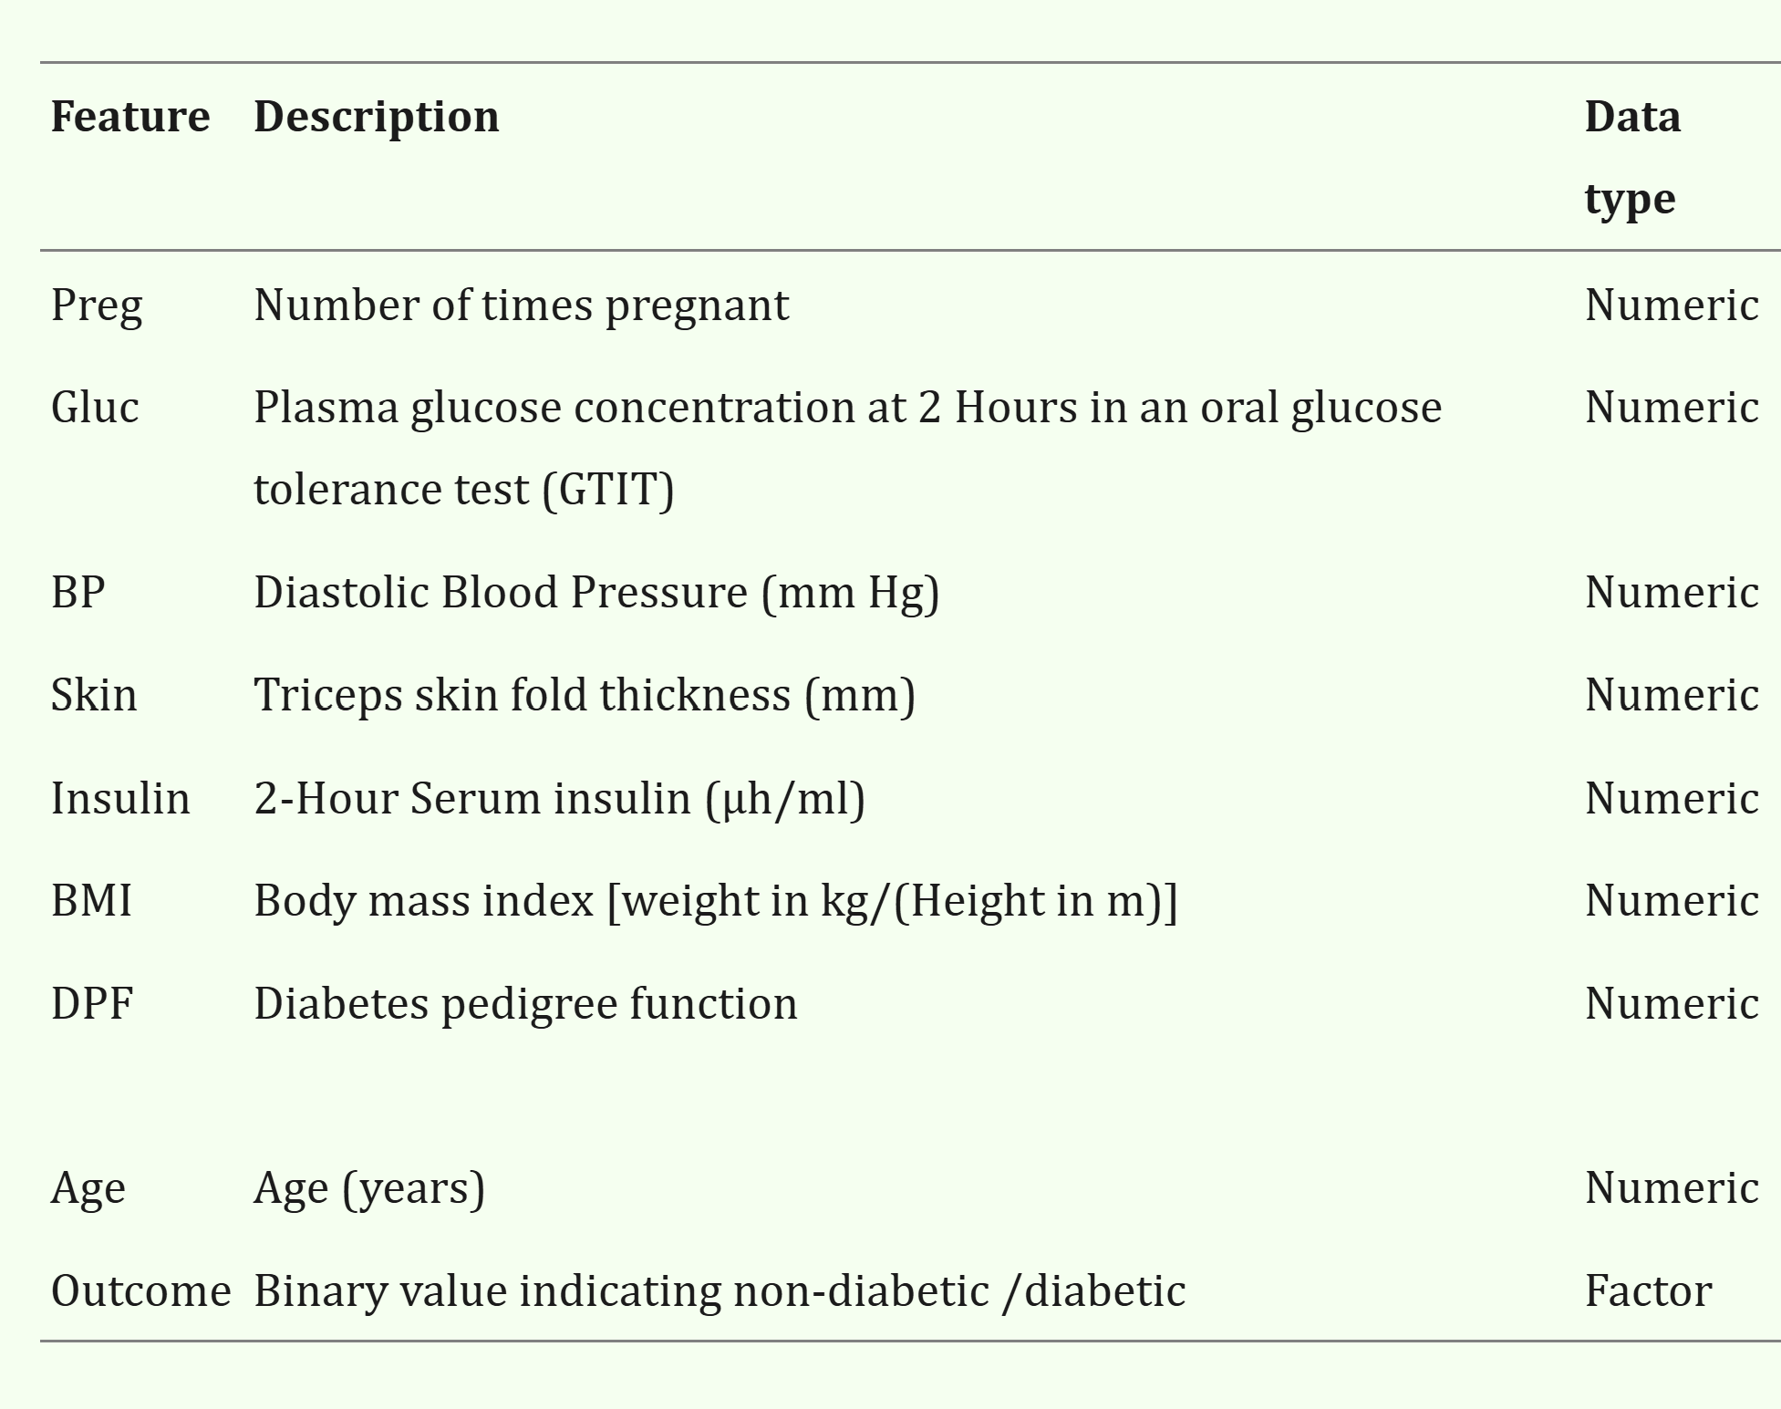

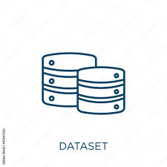
Dataset Overview

Slide 6
Project Workflow
Exploratory Data Analysis : Univariate Analysis & Bivariate Analysis.
Data Preprocessing: Replaced 0s with NaN, handled missing values.
Feature Scaling: Standard Scaling method used to scale the features.
Data Modeling: Logistic Regression,& KNN
Data Evaluation: Accuracy, Precision, Recall, & F1-score
Model Comparison: Performance across all models.

Slide 7
Exploratory Data Analysis
Missing Values:
Pregnancies, Glucose, BloodPressure, SkinThickness, Insulin, BMI & Outcome had 0s
Univariate Analysis & Bivariate Analysis

Slide 8
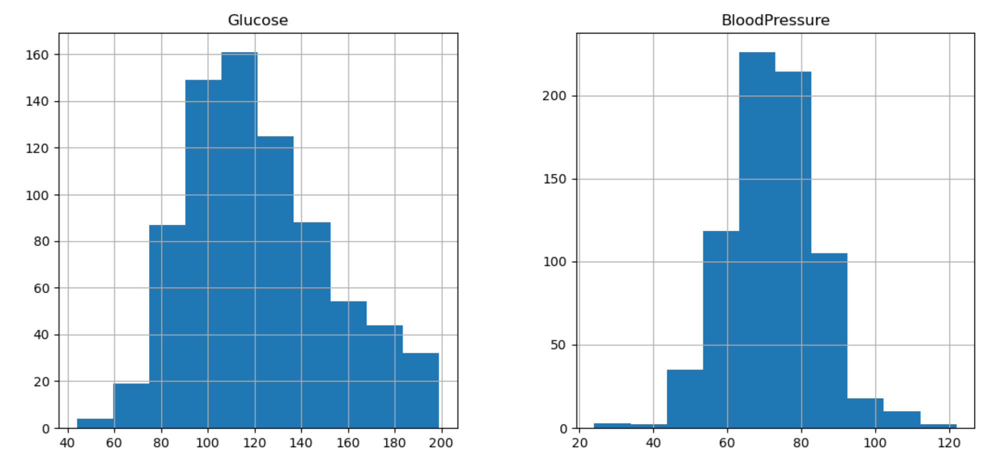
Exploratory Data Analysis
Glucose & BloodPressure are approximately symmetric, closer to a normal distribution.

Slide 9
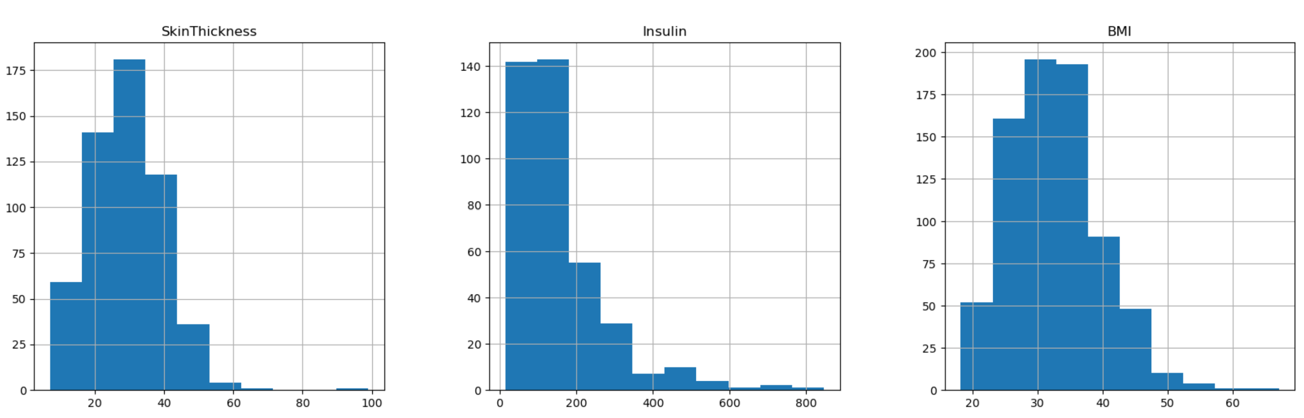
Exploratory Data Analysis
Skin Thickness, Insulin & BMI show right-skewed distributions with outliers (especially Insulin)

Slide 10
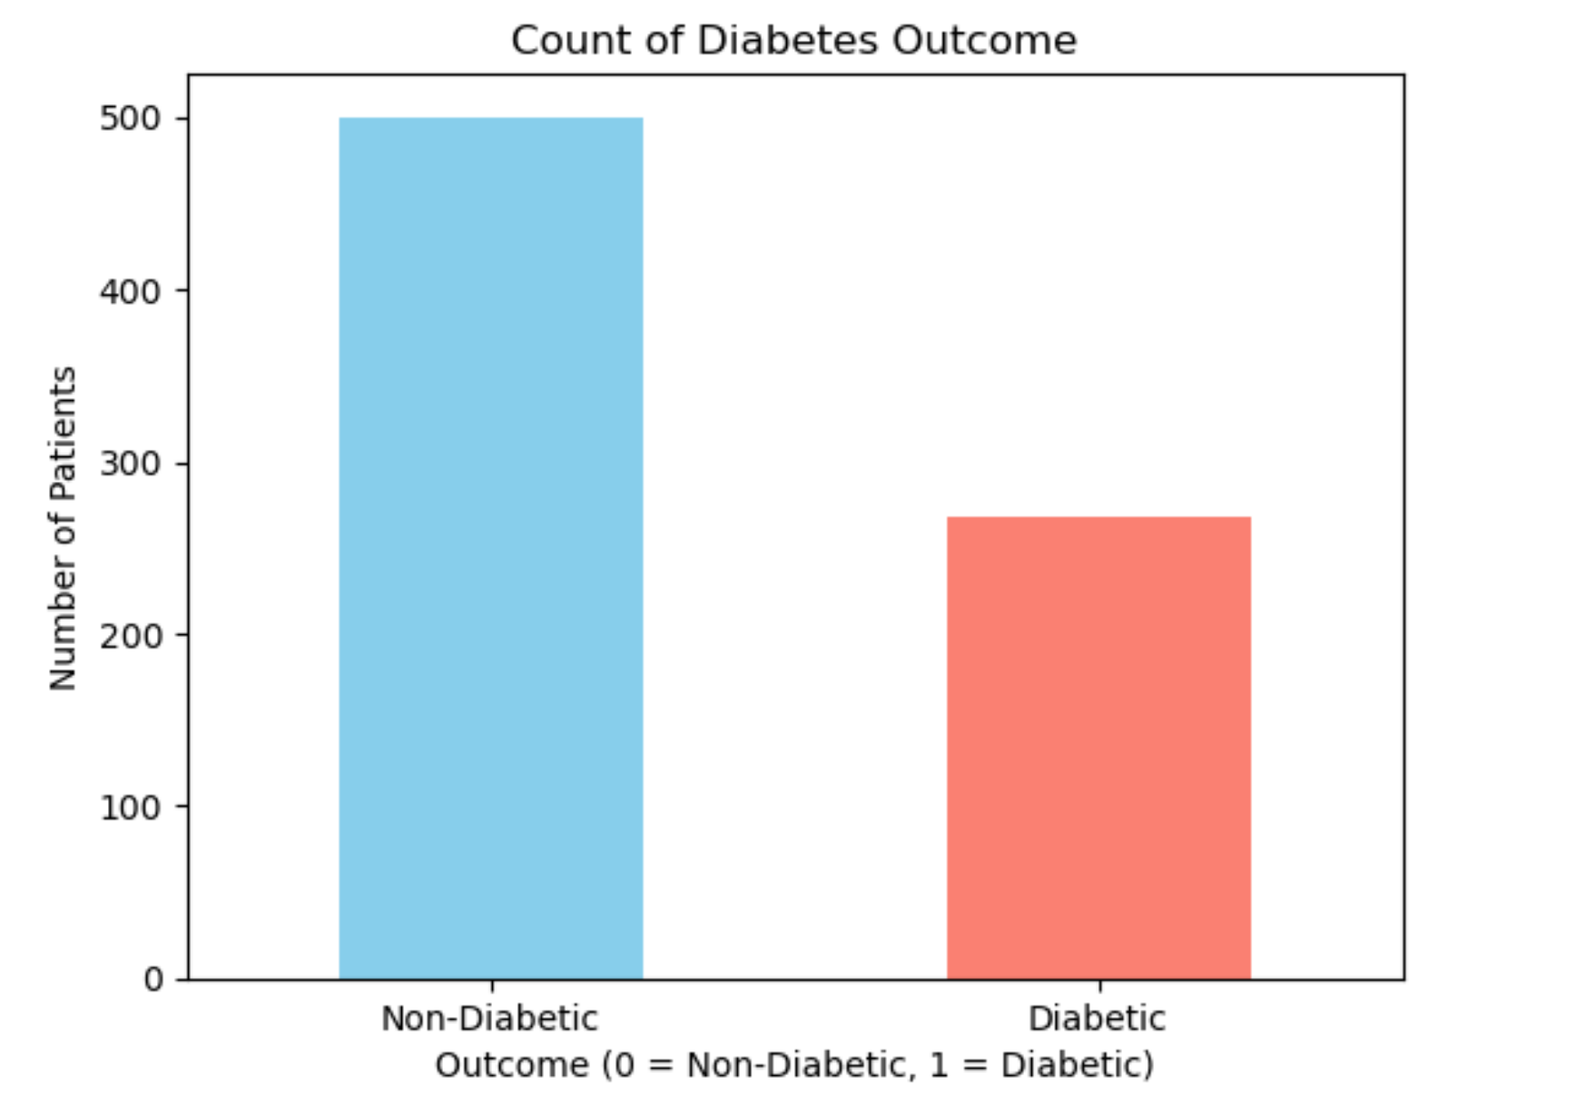
Exploratory Data Analysis
Non-Diabetic= 500
Diabetic= 268
The number of Non-Diabetic patients are almost twice the number of Diabetic patients.

Slide 11
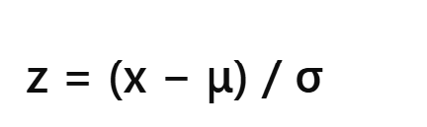
Data Preprocessing
Replaced 0s with NaN for invalid measurements.
Filled missing values:
Mean for: Glucose, BloodPressure (normally distributed)
Median for: SkinThickness, Insulin, BMI (Right-skewed)
Standard Scaling method is used to normalize all features for model compatibility.
x = original value of the feature
μ = mean of the feature
σ = standard deviation of the feature
z = standardized value

Slide 12
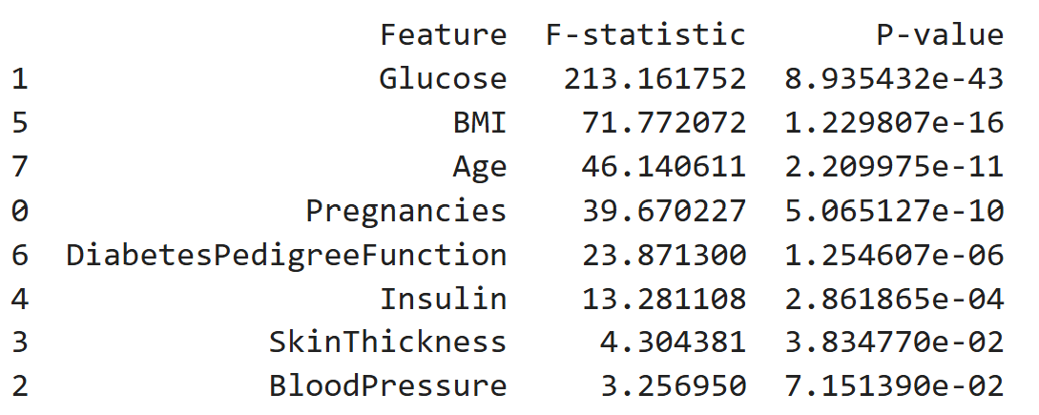
Feature Selection (ANOVA F-test)
Glucose, BMI,Age, Pregnancies, & DiabetesPedigreeFunction features had very low p-values, indicating a strong statistical relationship with diabetes occurrence.

Slide 13
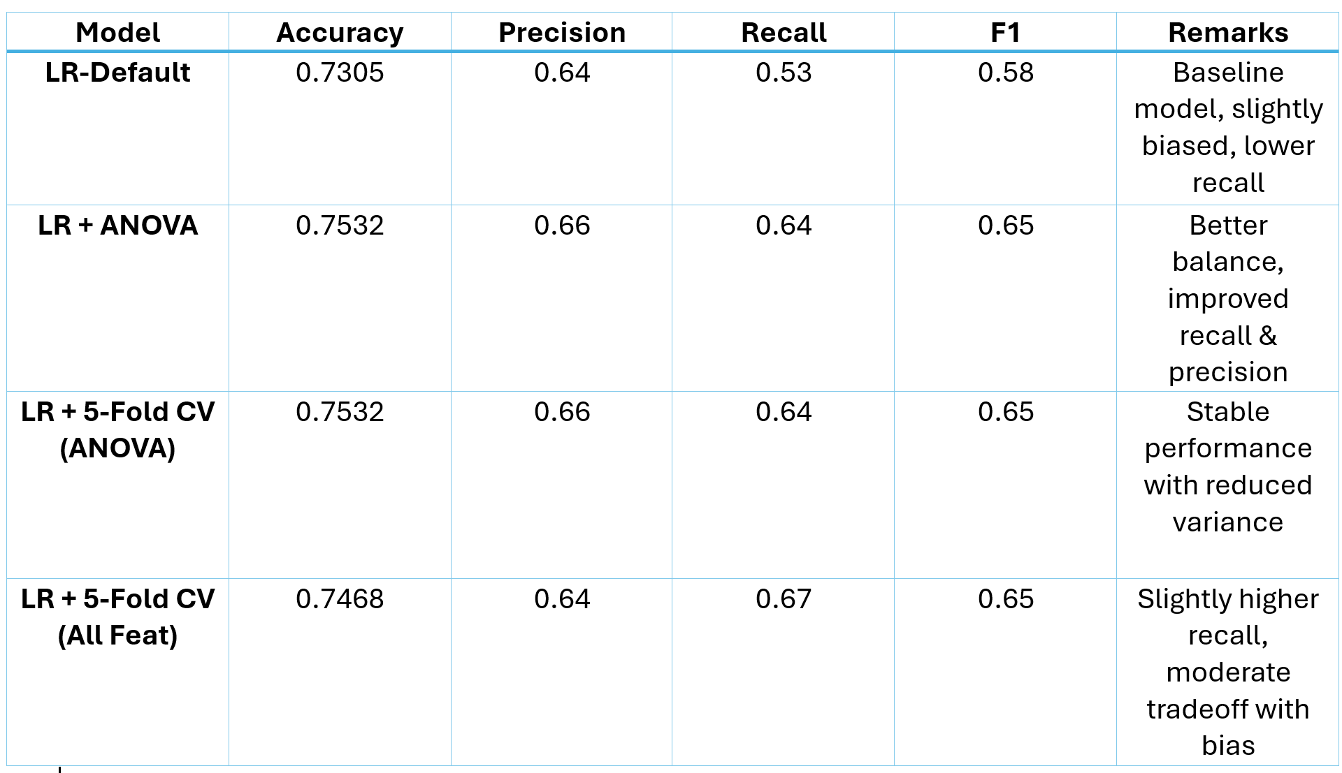
Logistic Regression Model
ANOVA feature selection helped reduce complexity and improved results.
Cross-validation provided a more reliable performance estimate.

Slide 14
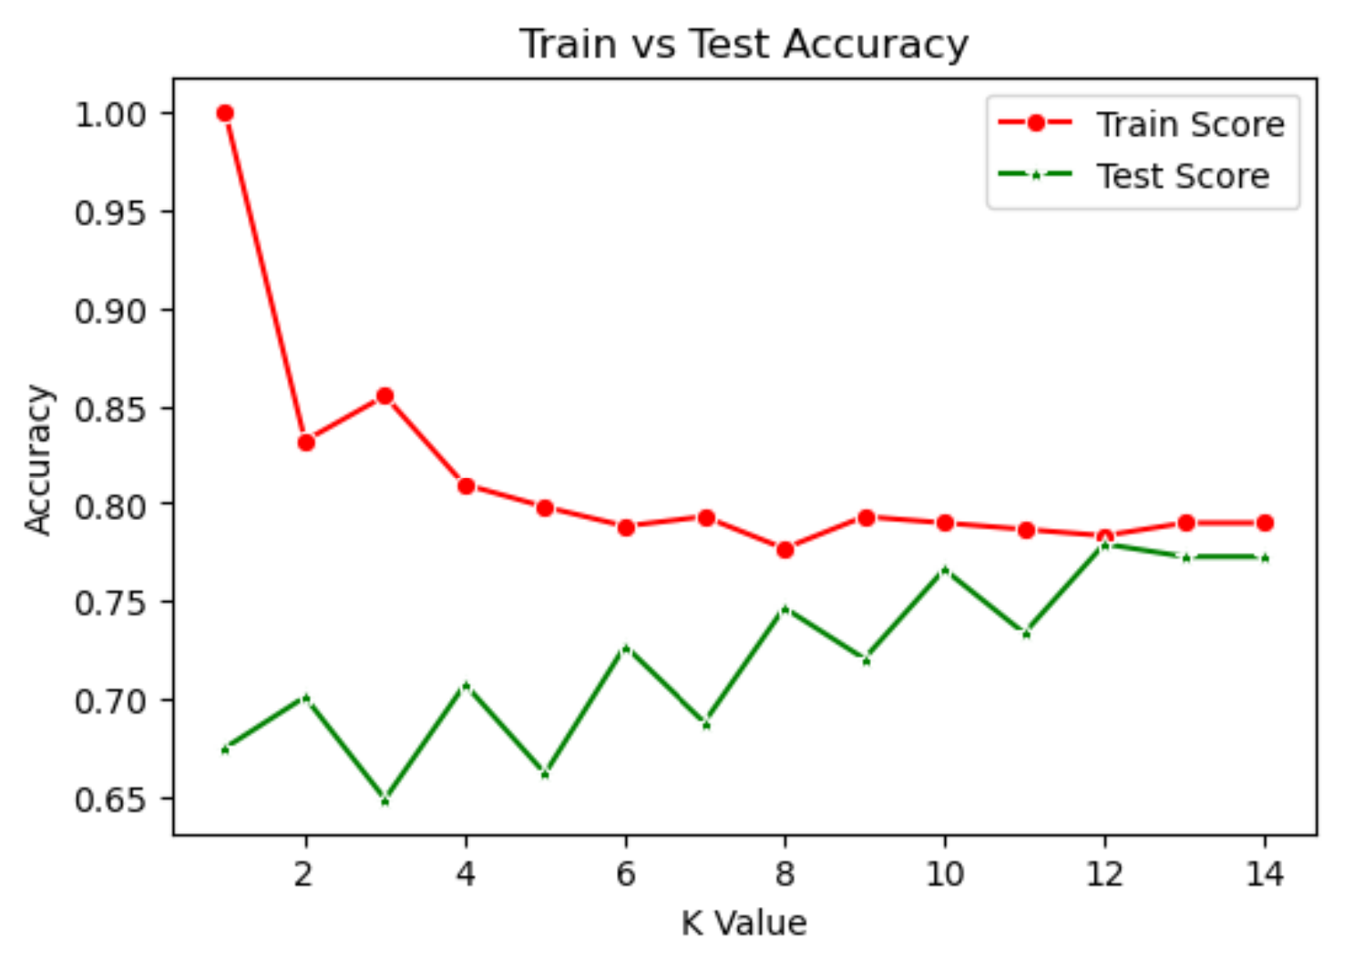
K-Nearest Neighbors (KNN) Model
Initial model overfitted the training data (100% accuracy at k=1)
Cross-validation used to prevent overfitting and select optimal

Slide 15
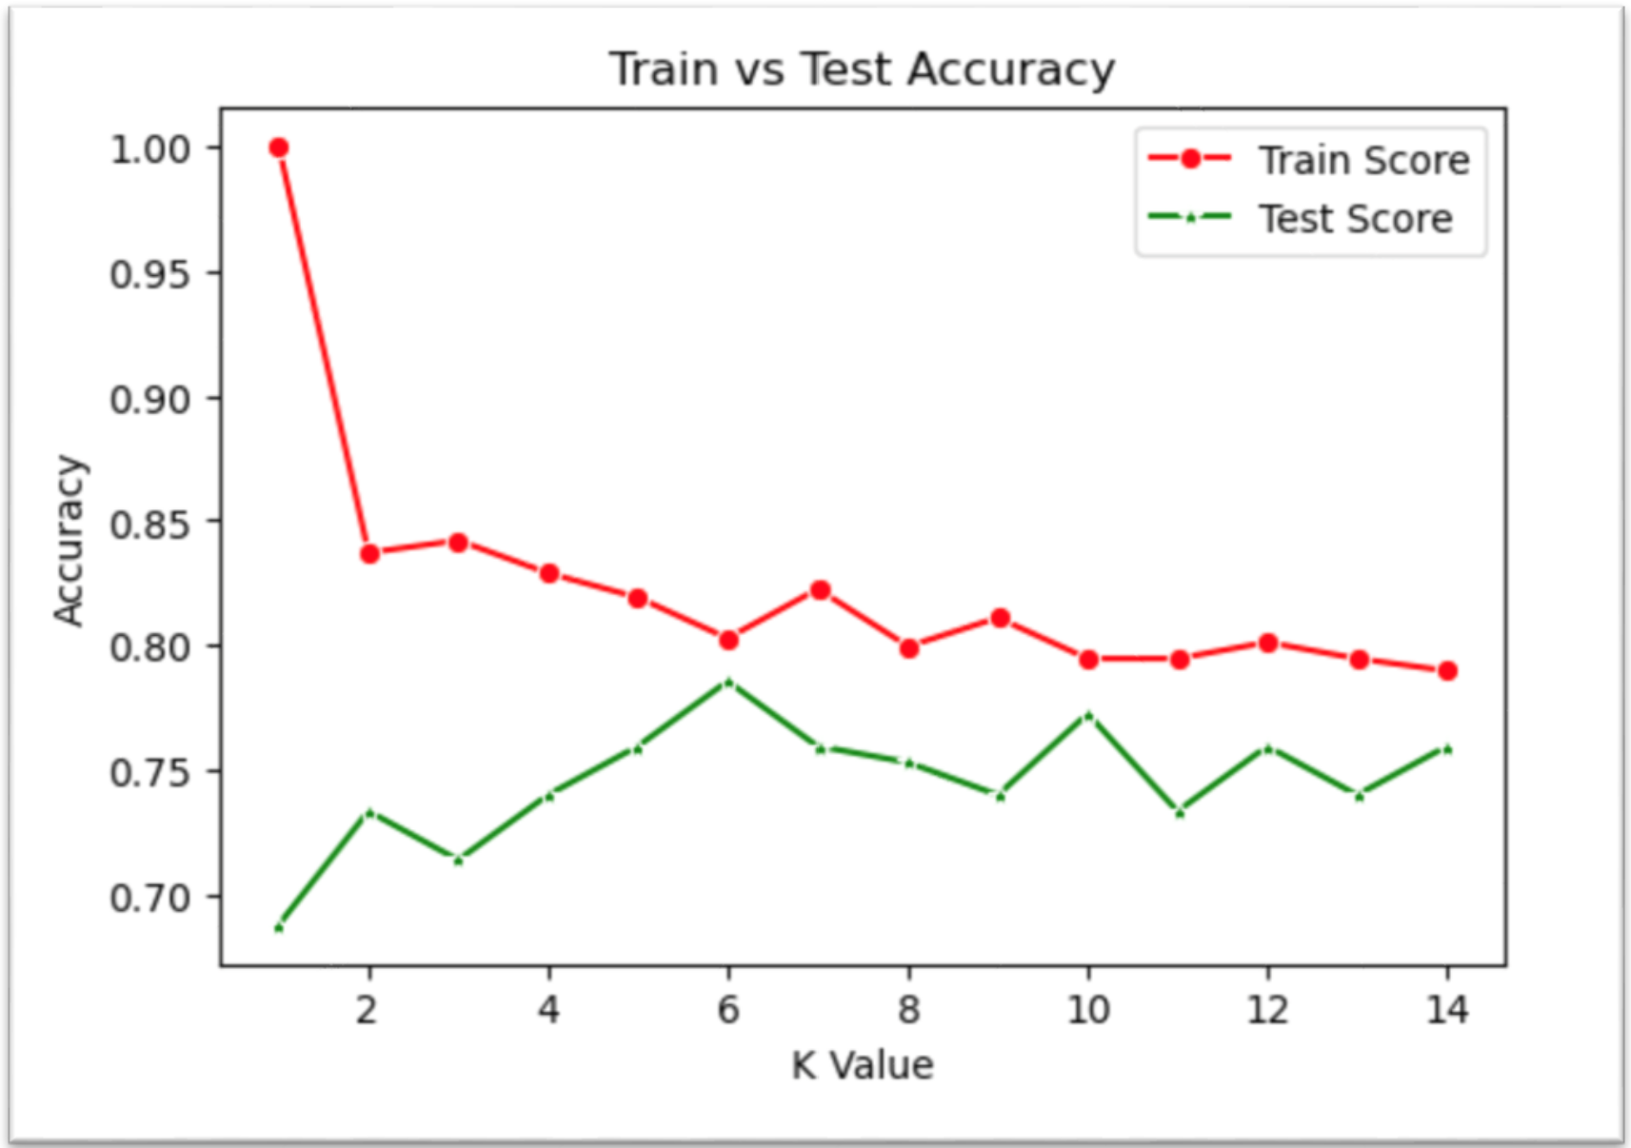
K-NN with ANOVA Features
With only selected features model performance (78.57% accuracy at best k=6)
Used ANOVA for feature selection

Slide 16
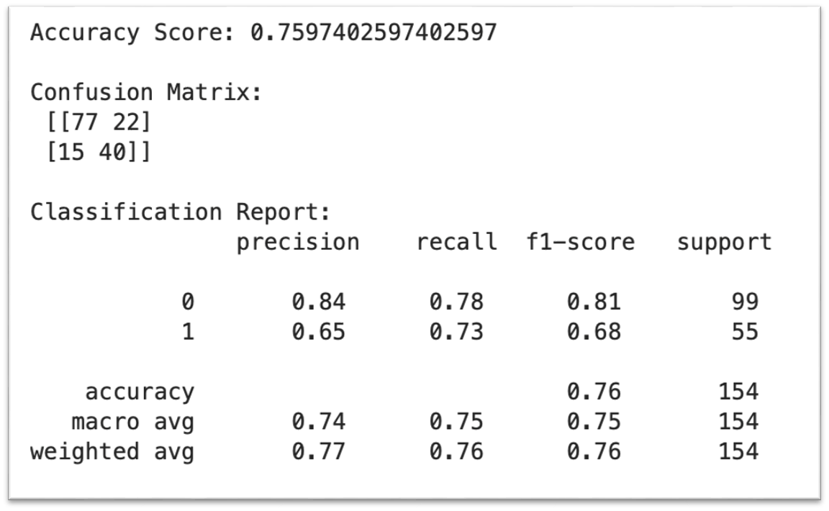
K-NN with ANOVA Features

Slide 17
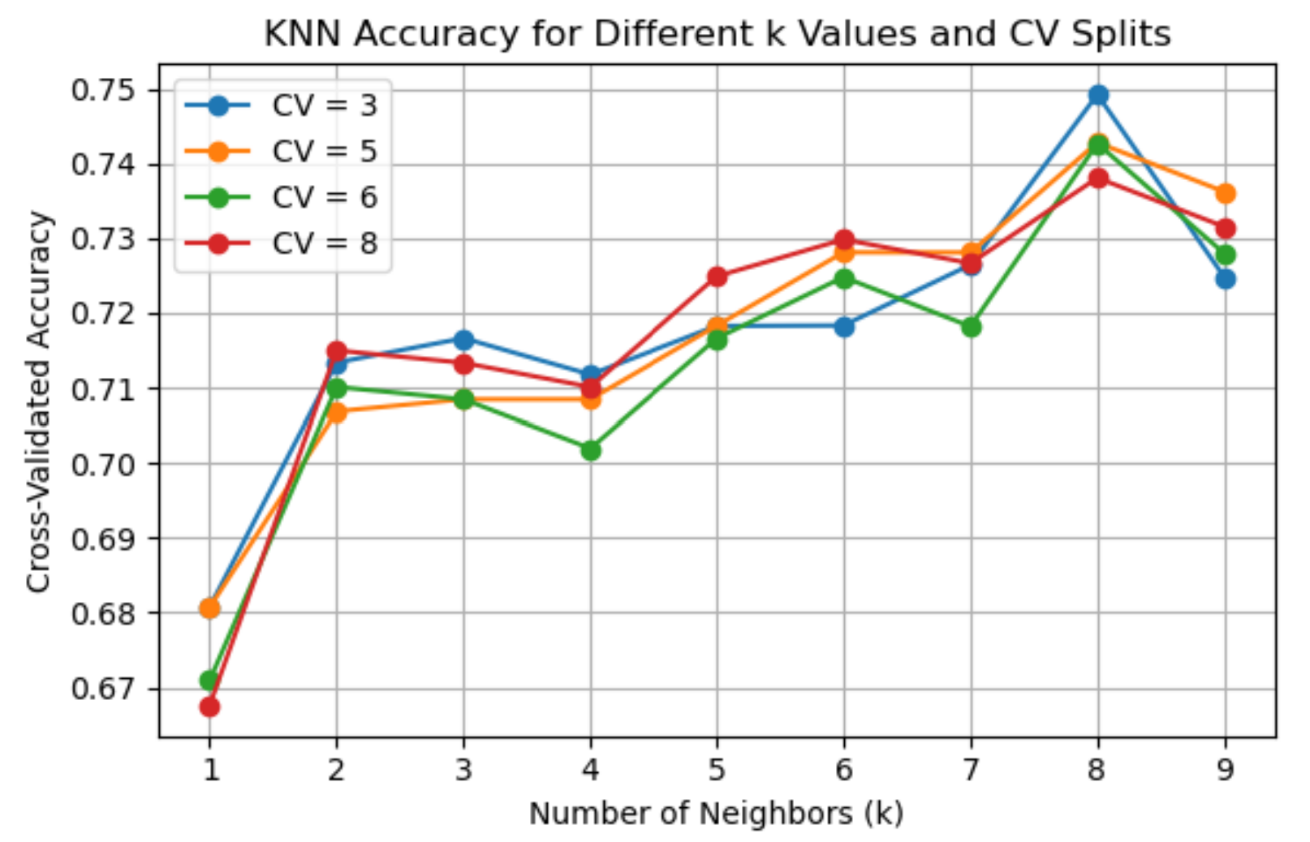
K-NN Accuracy with Different CV Splits
Tried multiple values of k with CV= 3,5,6,8 to improve generalisation
We got the best k at CV = 3 with an accuracy of 0.7492

Slide 18
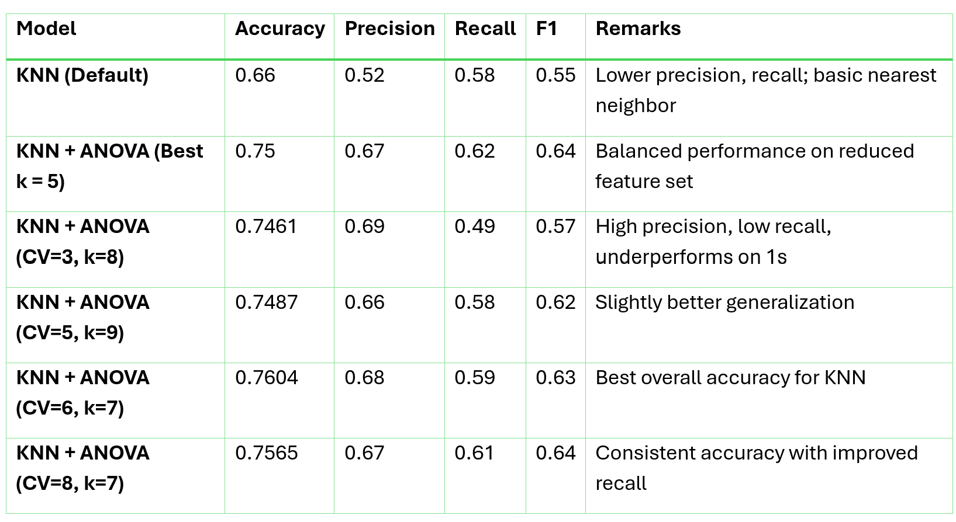
KNN Model Evaluation

Slide 19
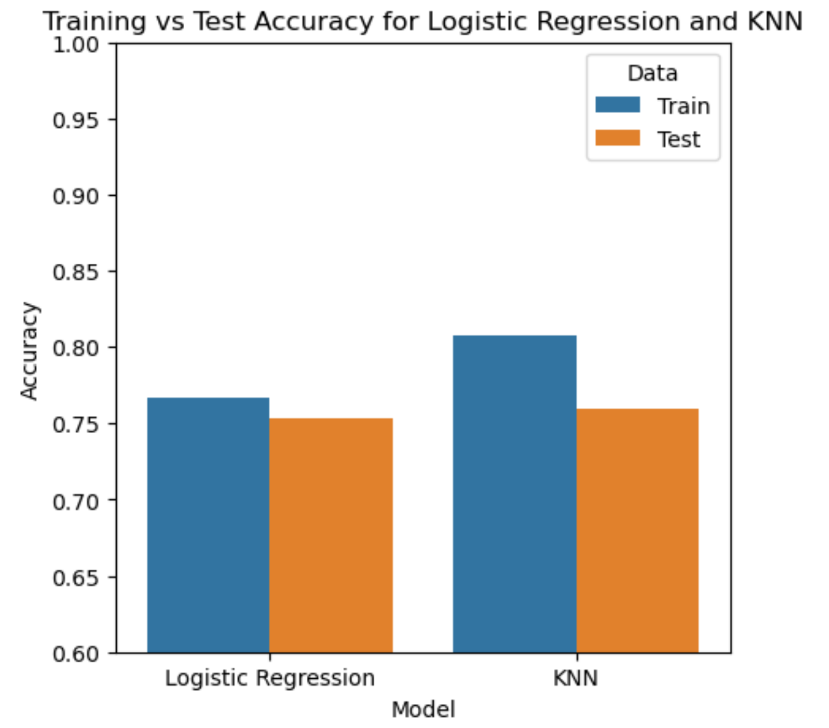
Model Comparison

Slide 20
Conclusion & Discussion
Data-driven approach helped identify key predictors like Glucose, BMI, and Age using ANOVA.
Cross-validation improved generalization and reduced overfitting across models.
Evaluation included metrics beyond accuracy: Recall, Precision,& F1-Score better medical applicability.

Slide 21
Future Work
Incorporate Advanced Models like SVM
Handle Class Imbalance
Add more data to improve models performance.

Slide 22
References & Acknowledgments
Dataset Source: OpenML - Pima Indians Diabetes Database.
Libraries Used: Pandas, NumPy, Matplotlib, Seaborn, Scikit-learn
Related Work Referenced:
A Deep Learning Model for Early Detection of DiabetesPMC Article ID: PMC10107388
Guided By: Professor Dr. Yeil Kwon

Slide 23

Thank You
Thank you! We appreciate your time and look forward to your feedback!

