Slide 1

Note: The data and information in this document is reflective of a hypothetical situation and client. This document is to be used for KPMG Virtual Internship purposes only.
Sprocket Central Pty Ltd
Data analytics approach
[Division Name] - [Engagement Manager], [Senior Consultant], [Junior Consultant]

Slide 2
Note: The data and information in this document is reflective of a hypothetical situation and client. This document is to be used for KPMG Virtual Internship purposes only.
Agenda
Contents
1. Introduction
2. Data Exploration
3. Model Development
4. Interpretation

Slide 3
Note: The data and information in this document is reflective of a hypothetical situation and client. This document is to be used for KPMG Virtual Internship purposes only.
Introduction
Customers Analysis
1. Age distributions
2. Number of bike purchases in 3 years(percentages)
3. Job industry category.
4. Wealth segments
5. Number of cars own on each states

Slide 4
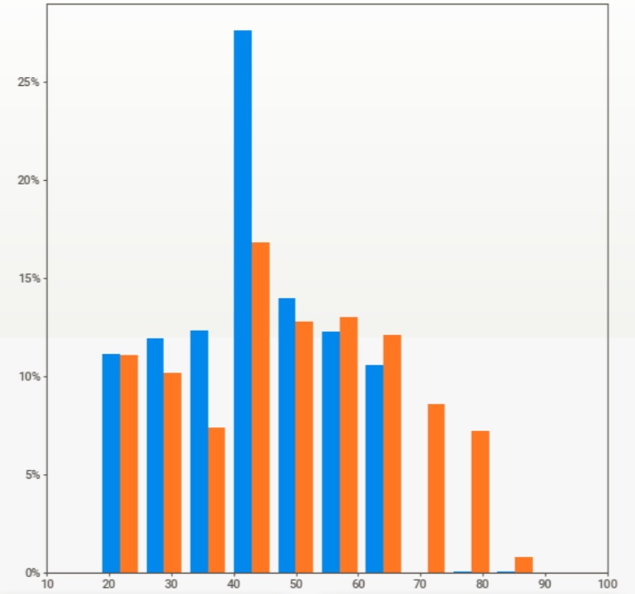
Note: The data and information in this document is reflective of a hypothetical situation and client. This document is to be used for KPMG Virtual Internship purposes only.
Data Exploration
Customers’ age distribution
From the histograms we observe that:
Age - (42 - 48) has maximum new costumers.
Age - (40 - 50) has maximum old colstumers.
So comparing both there is a drastic increse of new costumers in age group between (59-89)
Age group of (18 - 25) the ratio remaining almost same.
So from the comparision the age group between (40 - 50) must be focused more.
It is clearly seen that there is 5% increase in the above mentioned age group as comapred to othe age groups in new coustumer list dataset and 10% increses in the costumer demographic dataset.

Slide 5
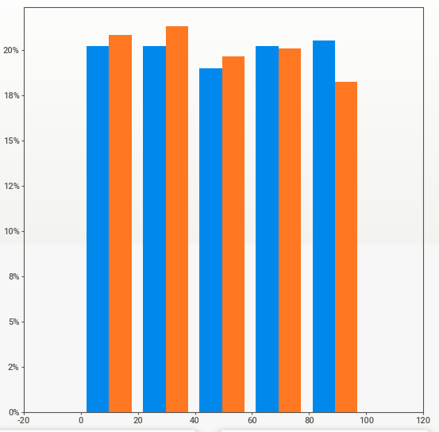
Note: The data and information in this document is reflective of a hypothetical situation and client. This document is to be used for KPMG Virtual Internship purposes only.
Model Development
Bike purchases last 3 years
As we can see, our new customers mostly Female with 50.6% purchases , Male contributed to 47.7% purchases with 23,765 bikes
So we should focus on advertises on Female customers than Male customers

Slide 6
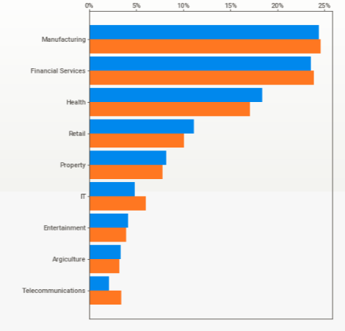
Note: The data and information in this document is reflective of a hypothetical situation and client. This document is to be used for KPMG Virtual Internship purposes only.
Interpretation
Job industry category
We can see that in job industry category the people belonging to manufacturing and fainancial services comparises more than other sectors.
In both the datasets it is having same senario so suggestion would be to focus strongly on manufacturing and fainance sector and also to develope a startegy for grabbing the hold on other sectors.

Slide 7
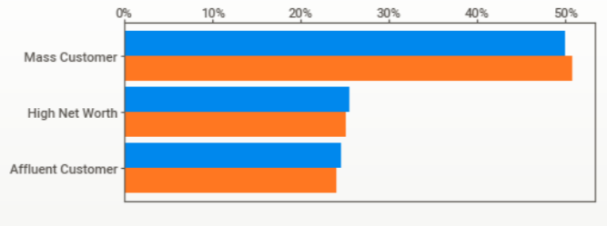
Note: The data and information in this document is reflective of a hypothetical situation and client. This document is to be used for KPMG Virtual Internship purposes only.
Interpretation
In all ages, the number of Mass Customers is the highest so we should focus on this social class.
After that, we should focus on High Net Customer.
Then Affluent Customers but mostly second and third quadrant

Slide 8
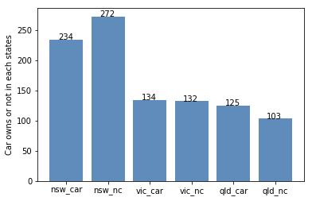
Note: The data and information in this document is reflective of a hypothetical situation and client. This document is to be used for KPMG Virtual Internship purposes only.
Interpretation
Numbers of cars owned
NSW should be considered the most since numbers of customers don’t own cars is significantly larger than that own.
VIC and QLD has more customers that own car that who don’t but we can try to have something so that those owns car will buy bikes.

Slide 9
Note: The data and information in this document is reflective of a hypothetical situation and client. This document is to be used for KPMG Virtual Internship purposes only.
Appendix

Slide 10
Note: The data and information in this document is reflective of a hypothetical situation and client. This document is to be used for KPMG Virtual Internship purposes only.
Appendix
All supporting items in that attachment.

