Slide 1

Fatherhood STEP Data Leaders Change Initiative Region IV Jeff Gold Joseph Guion

Slide 2
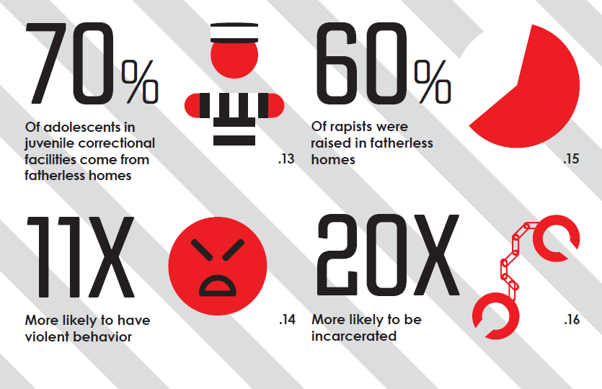

Slide 3
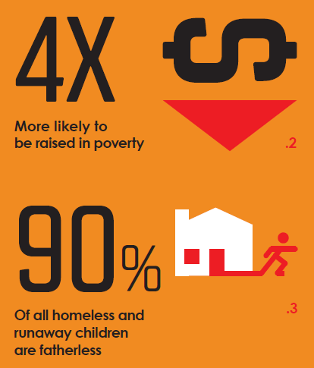
Research NFI 24/7 Dad Outcome Evaluation Results 2005-2006 NFI InsideOut Dad Program in Maryland and Ohio Prisons Evaluation Report U.S. Department of HHS Fathers’ Involvement with Their Children. Urban Institute and NORC Child Welfare Casework With Non-Resident Fathers of Children in Foster Care.

Slide 4
Hypothesis: Fathers that engage in father-focused services will be more involved in case planning and demonstrate enhanced parenting abilities.

Slide 5
Change Initiative Activities
Competency Drivers:
Training
Coaching
Organization Drivers:
Quality Assurance
Outcome Data
Leadership:
Program Funding

Slide 6
Evaluating Progress

Slide 7
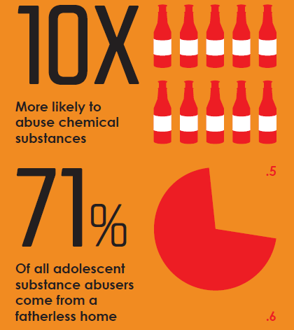
Learn More
Jeff Gold, Program Manager
364 West Middle Turnpike
Manchester, CT 06040
(860) 533-3711
Jeffrey.Gold@CT.GOV
Joseph Guion, Program Manager
250 Hamilton Street
Hartford, CT 06106
(860) 418-8309
Joseph.Guion@CT.GOV

