Slide 1
Predicting Wellness Package Buyers
MLOps pipeline on GitHub Actions · Advanced Machine Learning and MLOps
Deakin Applied AI Master Bridge Program · Mohammad Alrashed · 22 October 2026 · v1.0

Slide 2
Contents / Agenda
Executive Summary
Data Registration
Data Preparation
Model Building with Experimentation Tracking
Model Deployment
Automated GitHub Actions Workflow
Output Evaluation
Appendix

Slide 3
Executive Summary
Problem: “Visit with Us” picks customers to call by hand. Only 19% of contacted customers bought a package.
Solution: an XGBoost model scores each customer’s chance to buy. GitHub Actions retrains it on every push and commits the new model. A Streamlit app serves it.
Result: on unseen customers the model finds 82% of buyers, and 86% of its “will buy” calls are right (F1 0.84, ROC-AUC 0.96).
Recommendations:
  Call the top-scored 20% of leads first. That list holds 86% of all buyers.
  Target passport holders, single and younger (≤25) customers, and Executives. They buy 2–3× more than average.
  Use the Basic package as the entry offer. Higher tiers convert at 8–16%.
  Plan 5–6 follow-ups for warm leads. Buy rate rises from 17% at 3 calls to 40% at 6.
0.84
Test F1 (buyers)
0.96
Test ROC-AUC
86%
of buyers in top-20% scored leads

Slide 4
Data Registration
Master folder: tourism_project/ holds everything the pipeline needs.
  data/ keeps tourism.csv under version control.
  model_building/ holds data_register.py, prep.py and train.py.
  deployment/ holds app.py, its requirements and the model the pipeline commits.
Registration: the dataset lives inside the private GitHub repo. No external data store is needed.
data_register.py: checks the file exists, checks all 20 expected columns and a binary target, then logs a SHA-256 hash, the shape and the class counts.
In GitHub Actions: the register-dataset job runs the script and uploads tourism.csv as the registered-data artifact.
Deakin-AIML-Bridge-Tourism-
Wellness-MLOps/ (private)
├─ .github/workflows/
│ └─ pipeline.yml
└─ tourism_project/
├─ requirements.txt
├─ data/
│ └─ tourism.csv
├─ model_building/
│ ├─ data_register.py
│ ├─ prep.py
│ └─ train.py
└─ deployment/
├─ app.py
├─ requirements.txt
└─ best_tourism_model_v1.joblib

Slide 5
Data Preparation
Load: prep.py reads tourism_project/data/tourism.csv from the checked-out repo.
Remove columns: “Unnamed: 0” (a saved index) and CustomerID (a unique key) carry no signal.
Clean: merge the Gender typo “Fe Male” into Female. Drop 117 exact duplicate rows so no record sits in both train and test. Impute missing values (none in this release).
Split: 80/20, stratified on ProdTaken, random_state = 42. Both sets keep the 19.3% buyer rate.
Hand-off: Xtrain, Xtest, ytrain and ytest CSVs are uploaded as the data-splits artifact for the training job. This replaces the Hugging Face upload in the original brief.
Stage | Rows | Columns
Raw dataset | 4,128 | 21
After column drop | 4,128 | 19
After de-duplication | 4,011 | 19
Train (80%) | 3,208 | 18 + target
Test (20%) | 803 | 18 + target
Buyer rate: 19.3% in both train and test.
Features: 12 numeric, 6 categorical.
Link to Appendix slide on data background check

Slide 6
Model Building with Experimentation Tracking
Inputs: the data-splits artifact from the data-prep job.
Pipeline: StandardScaler on numeric and OneHotEncoder on categorical columns, then XGBClassifier with scale_pos_weight ≈ 4.18 for the 19% buyer class.
Tuning: GridSearchCV over 24 combinations (n_estimators, max_depth, learning_rate, colsample_bytree), stratified 5-fold CV, F1 scoring.
Tracking: every combination is logged to MLflow as a nested run (params, mean and std CV F1). The parent run logs best params and test metrics.
Best: max_depth 7, 200 trees, learning_rate 0.1, colsample 0.7. CV F1 0.781.
Commit: best_tourism_model_v1.joblib, model_metadata.json and tuning_results.csv are pushed back to deployment/.
Metric | Train | Test
Accuracy | 1.000 | 0.940
Precision | 1.000 | 0.864
Recall | 1.000 | 0.819
F1 | 1.000 | 0.841
ROC-AUC | 1.000 | 0.961
Test confusion matrix (803 customers)
 | Pred. no | Pred. buy
Actual no | 628 | 20
Actual buy | 28 | 127
Train scores of 1.0 show overfitting. Test scores stay strong, so v1 ships, with regularisation queued for v2.
Link to Appendix slide on data background check

Slide 7
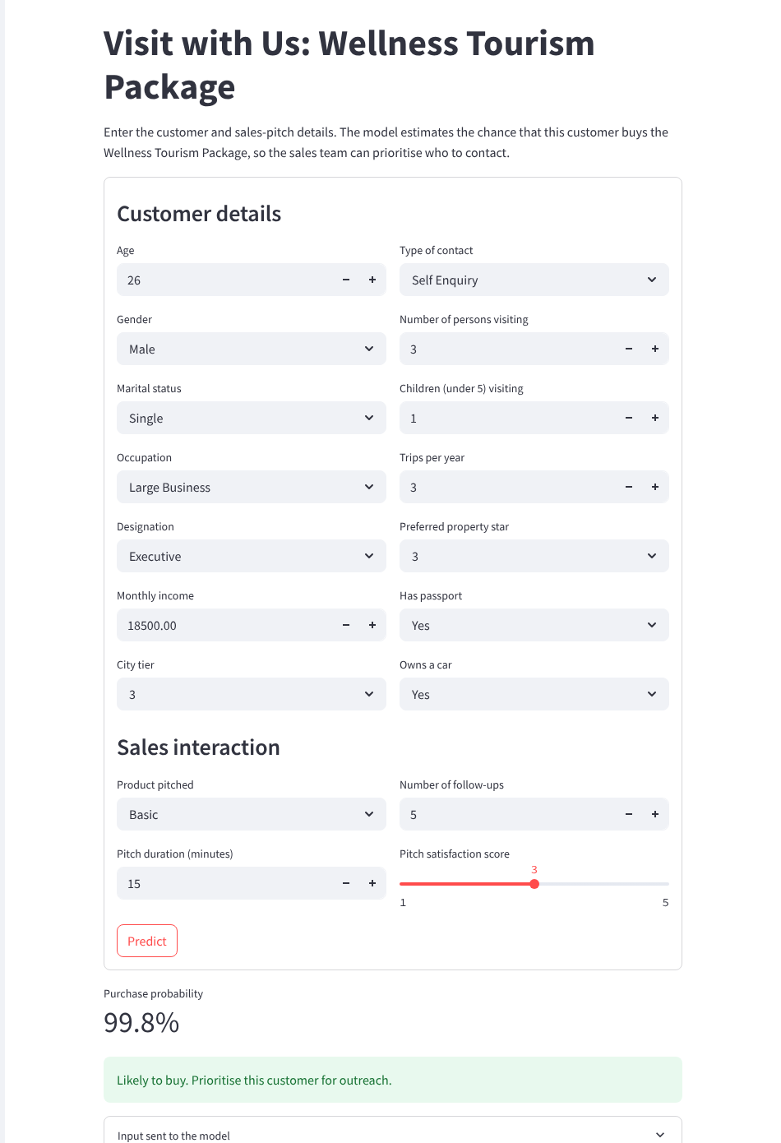
Model Deployment
app.py: loads best_tourism_model_v1.joblib and model_metadata.json from its own folder, so the path works on Streamlit Cloud.
Inputs: 18 form fields are collected into a one-row DataFrame with the training column names. The pipeline does its own scaling and encoding.
Output: purchase probability, a buy / don’t-buy flag at threshold 0.5, and a model card in the sidebar (version, date, test metrics).
Dependencies: deployment/requirements.txt pins streamlit 1.44.1, scikit-learn 1.6.1, xgboost 2.1.4, pandas 2.2.3 so the model loads with the versions it was trained on.
Hosting: Streamlit Community Cloud → repo DatariusAI/Deakin-AIML-Bridge-Tourism-Wellness-MLOps, branch main, file tourism_project/deployment/app.py, Python 3.11.

Slide 8
Automated GitHub Actions Workflow
pipeline.yml: lives in .github/workflows/. It runs on every push to main and on manual “Run workflow”.
Three chained jobs: each uses Python 3.11 and installs tourism_project/requirements.txt. Data moves between jobs as artifacts.
Auto-update: the last step commits the new model to main with “[skip ci]”, so the commit does not retrigger the pipeline. permissions: contents: write lets the bot push.
1 register-dataset
2 data-prep
3 model-traning
Validate schema
Upload registered-data
Clean + split 80/20
Upload data-splits
MLflow server + GridSearch
Commit model to main
Job name “model-traning” is kept as given in the course template.

Slide 9
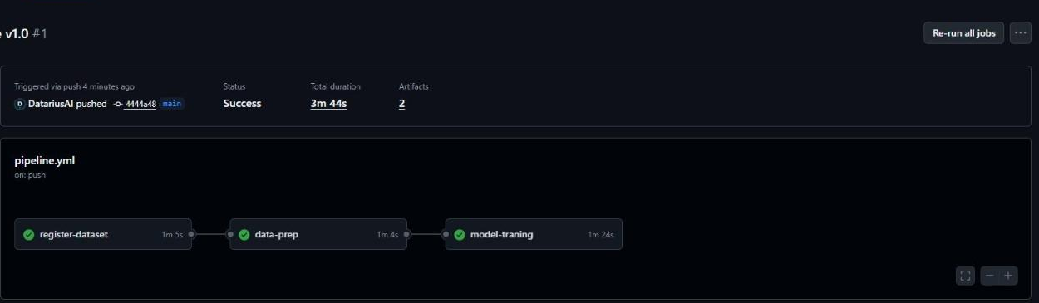
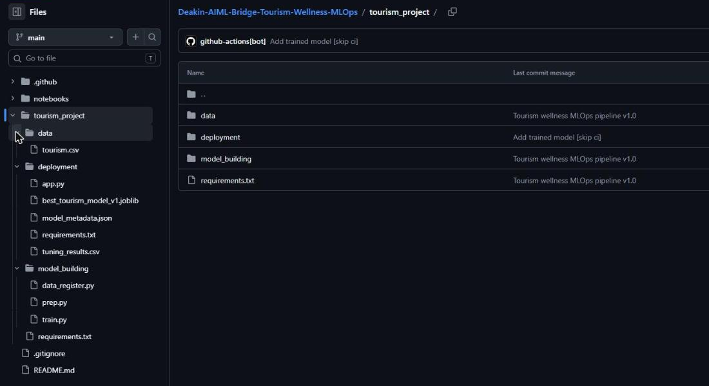
Output Evaluation
GitHub (private): https://github.com/DatariusAI/Deakin-AIML-Bridge-Tourism-Wellness-MLOps
Workflow runs: https://github.com/DatariusAI/Deakin-AIML-Bridge-Tourism-Wellness-MLOps/actions
Streamlit Community Cloud: deploy from the repo (see slide 7) and paste the …streamlit.app URL here.
Streamlit app
A single, Executive, passport-holding 26-year-old pitched Basic scores 99.8%: “Likely to buy”.
Run #1 on push: all 3 jobs green in 3m 44s.
github-actions[bot] committed best_tourism_model_v1.joblib to deployment/.

Slide 11
Dataset Overview and Registration
Source: “Visit with Us” customer and sales-interaction records (tourism.csv, course-provided).
Size: 4,128 customers × 20 fields, no missing values. 117 exact duplicates were removed.
Target: ProdTaken (1 = bought). 797 buyers (19.3%), so the classes are imbalanced.
Features: customer profile (Age, CityTier, Occupation, Gender, MaritalStatus, Passport, OwnCar, Designation, MonthlyIncome, trips, party size) and pitch data (TypeofContact, ProductPitched, DurationOfPitch, NumberOfFollowups, PitchSatisfactionScore).
Registration: committed at tourism_project/data/tourism.csv and validated by data_register.py on each run.

Slide 12
Experimentation Tracking Details
Model: XGBoost in one sklearn pipeline. 24 combinations × 5 folds = 120 fits.
Grid: n_estimators {100, 200}, max_depth {3, 5, 7}, learning_rate {0.05, 0.1}, colsample_bytree {0.7, 1.0}.
Logged per run: params, mean_cv_f1, std_cv_f1 (nested). Parent run: best params, scale_pos_weight, threshold, train/test metrics and the model artifact.
Finding: depth matters most. Every depth-7 run beats every depth-3 run (0.73–0.78 vs 0.60–0.64 CV F1).
Worst runs | mean CV F1 | std
d3 n100 lr0.1 cs0.7 | 0.611 | 0.017
d3 n100 lr0.05 cs0.7 | 0.605 | 0.027
d3 n100 lr0.05 cs1.0 | 0.596 | 0.027

Slide 13
GitHub Actions Workflow Details
Trigger: on.push.branches = [main] plus workflow_dispatch.
Each job: checkout@v4 → setup-python@v5 (3.11) → pip install -r tourism_project/requirements.txt.
register-dataset: python data_register.py → upload-artifact registered-data.
data-prep: python prep.py → upload-artifact data-splits (4 CSVs).
model-traning: download data-splits → nohup mlflow ui --port 5000 → python train.py → git add / commit “[skip ci]” / push.
Code updates: the notebook push cell writes files to main through the GitHub API. Each push to main starts a new run, so code and model stay in step.
Job · step | Result
register-dataset (1m 5s) | ✔ success
Install Dependencies | ✔
Register Dataset | ✔
Upload Registered Dataset | ✔
data-prep (1m 4s) | ✔ success
Install Dependencies | ✔
Run Data Preparation | ✔
Upload Train Test Splits | ✔
model-traning (1m 24s) | ✔ success
Install Dependencies | ✔
Download Train Test Splits | ✔
Start MLflow Server | ✔
Model Building | ✔
Commit Trained Model | ✔

