Slide 1
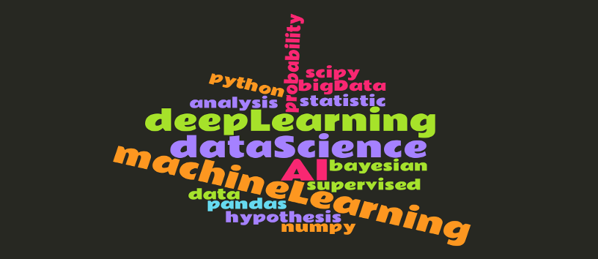
Data Revolution
(Levente Laszlo)

Slide 2

WHO?
A colourful bunch, different backgrounds

Slide 3
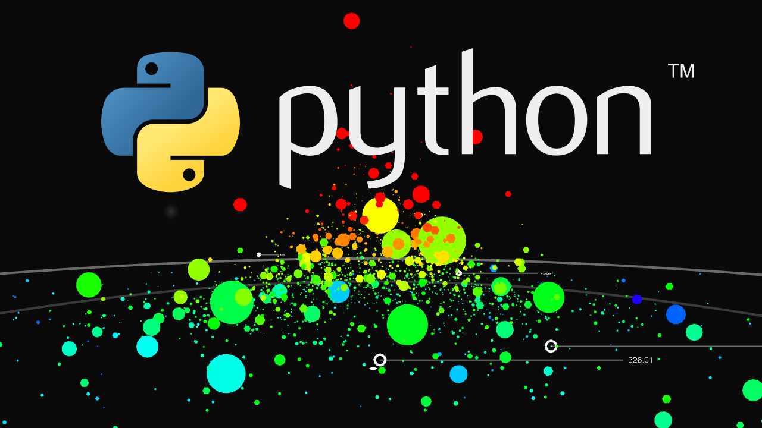
Python & DataScience

Slide 4
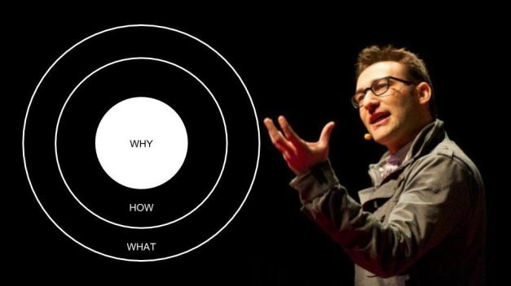
WHY?

Slide 5

Boost commitment, motivation
Share your failures and successes
Ask for help

Slide 6
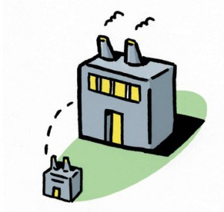
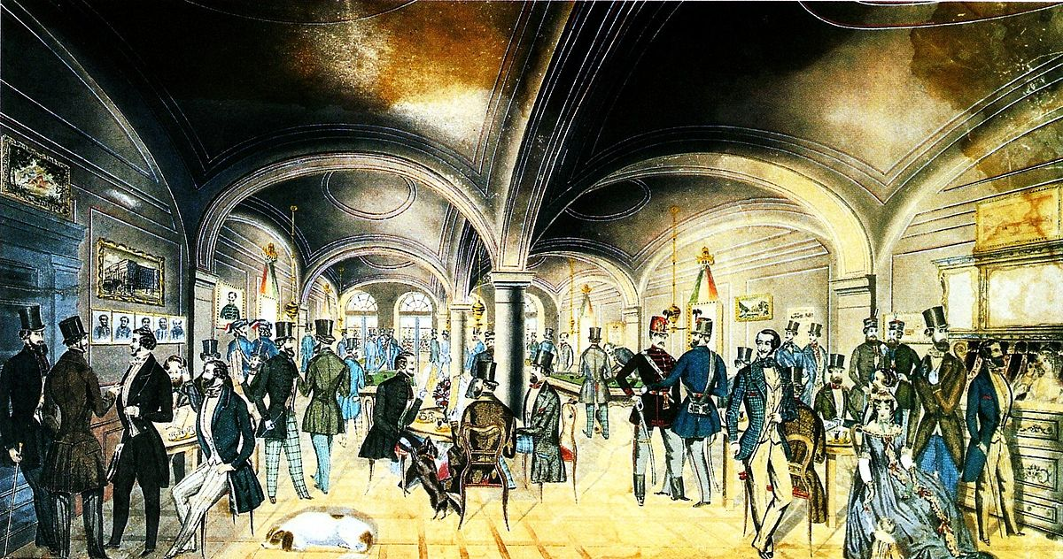
Spin-off of Pylvax

Slide 7
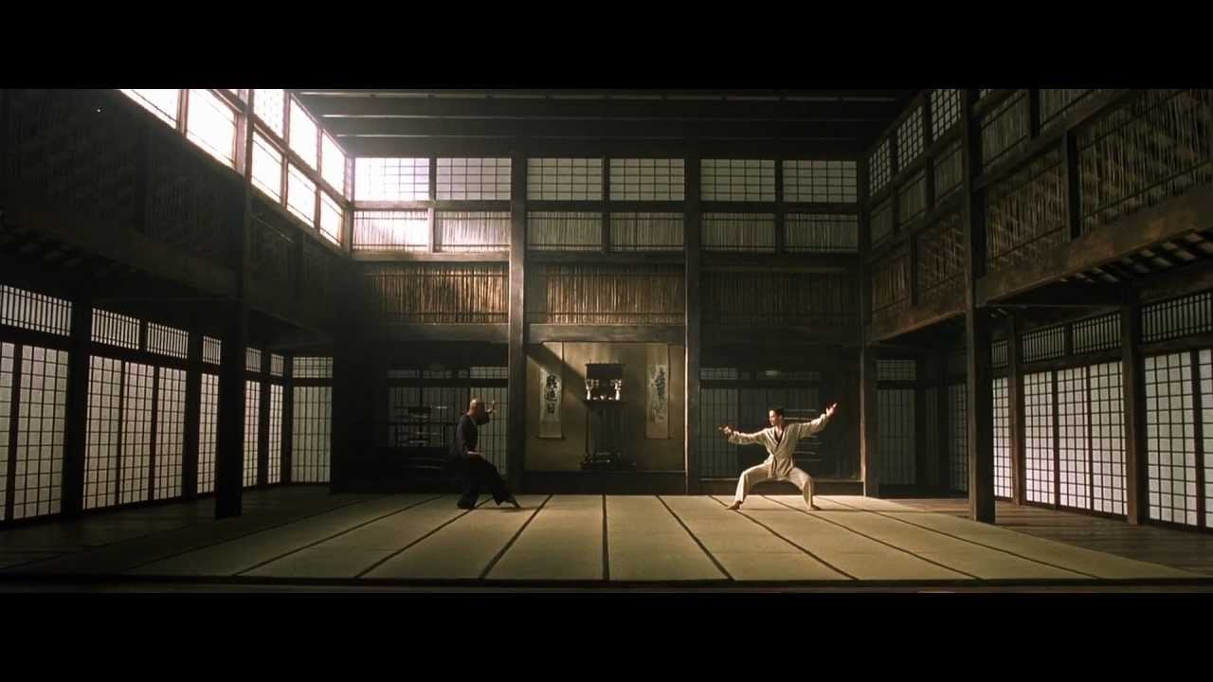
Practice, practice, practice

Slide 8
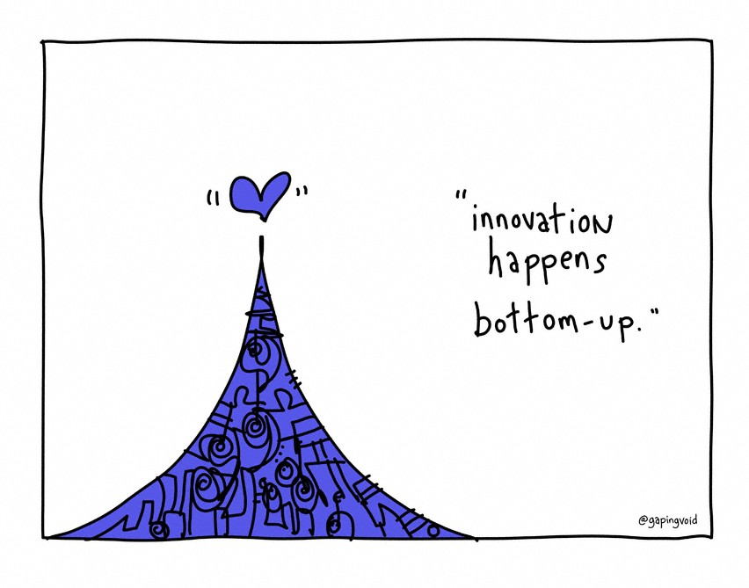
Bottom Up Model

Slide 9

Facebook
facebook.com/groups/datasrev
Slack
slackin-datasrev.herokuapp.com
GitHub
github.com/DatasRev
Live
saturday @2PM,
Yellow Zebra Bar

