Slide 1
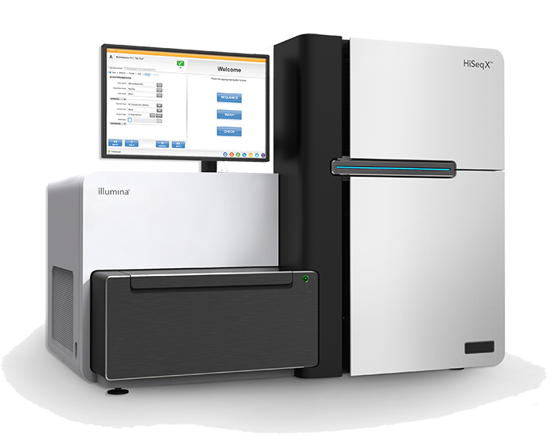
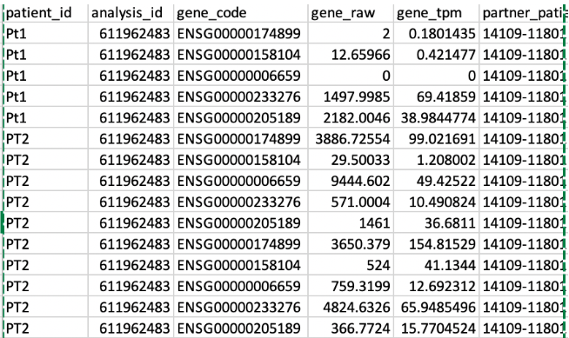
BIOINFORMATICS WORKSHOP
From Raw
Biological Data
to Structured
Information
[ IMAGE PLACEHOLDER ]
IMAGE: DNA sequencer / Illumina machine
Search: 'Illumina sequencer machine photo'
— this workshop bridges these two worlds —
How Biological Signals Become Usable Data
[ IMAGE PLACEHOLDER ]
IMAGE: Clean pandas DataFrame table screenshot
Search: 'pandas dataframe screenshot python'
Souhil MOKEDDEM
For: Biology · Medical · Data Science Students

Slide 2
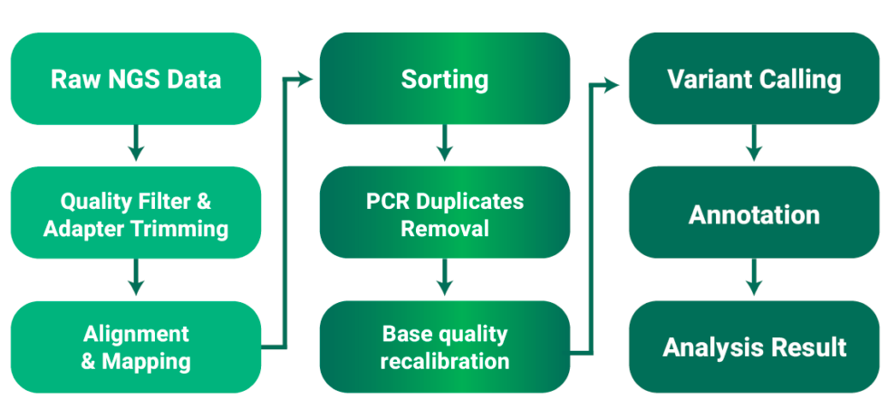
OVERVIEW
What We'll Do Today
Five stages — from biological sample to analyzable dataset
Raw Data
Quality
Control
Filtering
Transform
Usable
Dataset
01
02
03
04
05
FASTA / FASTQ
files from sequencer
Inspect & measure
data quality
Remove bad reads,
trim adapters
Sequences →
numeric features
Clean structured
table / matrix
Each step has a scientific purpose — nothing is arbitrary.
Souhil MOKEDDEM
Bioinformatics Workshop

Slide 3

FOUNDATIONS
What Is Biological Data, Really?
Biological data = measurements extracted from living systems
Generated by machines: sequencers, scanners, mass spectrometers
Outputs as text files, tables, or signal readouts
It is almost always noisy, incomplete, or mixed with errors
Like a weather sensor — reads something physical, writes a file
[ IMAGE PLACEHOLDER ]
Source | Biological Signal | Raw Format
Blood sample | DNA sequence | FASTA / FASTQ
Tumor tissue | Gene expression | Count matrix
Brain scan | Neural activity | Signal file
Souhil MOKEDDEM
Bioinformatics Workshop

Slide 4
SEQUENCING HISTORY
Where It Started — 1st Generation Sequencing
1977
1990
2003
Today
Sanger
Sequencing
invented
Human Genome
Project
launched
HGP
completed
13 years later
Same genome
in 2-3 days
< $300
Frederick Sanger (1977) — first practical DNA sequencing method, Nobel Prize 1980. (1st was Maxam–Gilbert, chemical)
Human Genome Project (HGP) — international effort, 1990–2003, cost ~$3 billion
Produced the first full map of human DNA — 3 billion base pairs
Sanger method: accurate but slow — reads one fragment at a time
Could only sequence short pieces (~800 bp) one at a time — not scalable
Cost comparison: 1990s genome → ~$3 billion · 2000s → ~$100 million · Today → under $300
Souhil MOKEDDEM
Bioinformatics Workshop

Slide 5
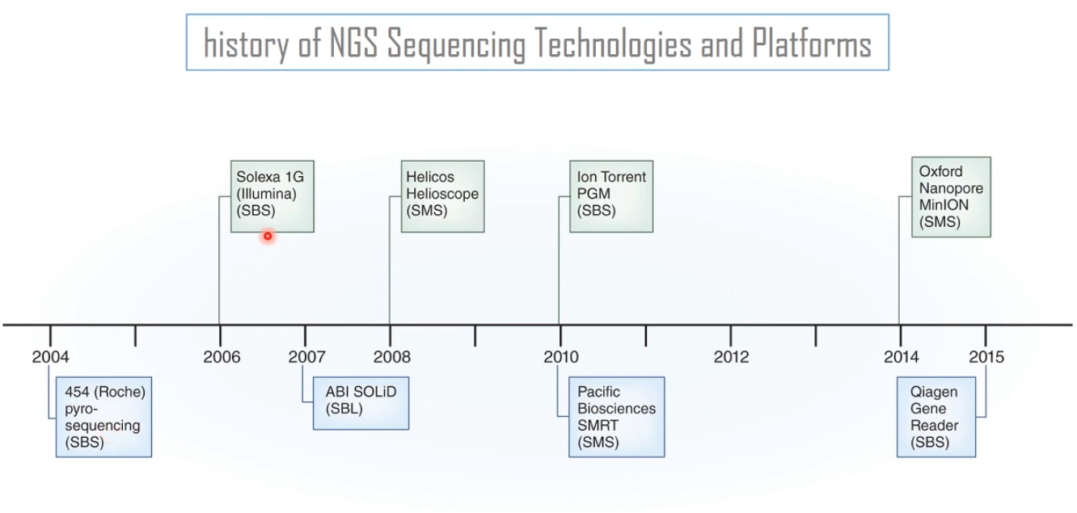
SEQUENCING HISTORY
2nd Generation — The NGS Revolution (Illumina)
Next-Generation Sequencing (NGS) emerged ~2005 — completely changed the field
Key idea: sequence millions of short fragments in parallel — not one at a time
Illumina is the dominant platform — used in >80% of sequencing worldwide
Reads are short: ~100–250 bp each, but you get hundreds of millions of them
An entire genome in 1–2 days, at a fraction of the cost of Sanger
Output: FASTQ files — raw reads + quality scores
 | Sanger (1st gen) | NGS — Illumina (2nd gen)
Read length | ~800 bp | 100–250 bp
Speed | Hours per read | Genome in 1–2 days
Cost | $3 billion (HGP) | ~$200–600
Output | FASTA | FASTQ
Souhil MOKEDDEM
Bioinformatics Workshop

Slide 6
SEQUENCING HISTORY
3rd Generation & Types of Biological Data
3rd Generation (PacBio, Oxford Nanopore)
Types of Biological Data
Genomic DNA
Long reads — up to 10,000+ bp in one piece
Better at repetitive or complex regions of the genome
Still improving in accuracy — the future of sequencing
Oxford Nanopore: portable, real-time sequencing in a USB device
Used in: structural variation, long-range assembly, direct RNA sequencing
Full genome sequence — FASTA / FASTQ
RNA / Transcriptome
Gene expression levels — FASTQ → count matrix
Epigenomics
Methylation, chromatin — BED / BigWig files
Metagenomics
Mixed microbial samples — FASTA / FASTQ
Proteomics
Protein quantities — tab-separated tables
Common raw file formats: FASTA · FASTQ · BAM / SAM · BED · VCF · Count matrix (CSV)
Souhil MOKEDDEM
Bioinformatics Workshop

Slide 7
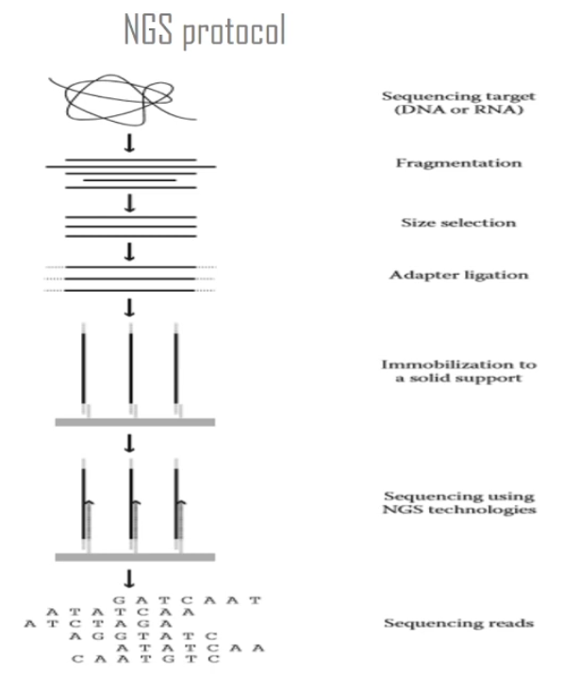
SEQUENCING
How We 'Read' DNA
DNA is the instruction manual inside every living cell
Sequencing = reading the order of letters (A, T, G, C) in DNA
Modern sequencers break DNA into millions of short pieces called reads
Each read is a short string of ~100–150 letters
The machine outputs all reads as a text file — this is your raw data
One experiment can produce 30–100 GB of raw files
[ IMAGE PLACEHOLDER ]
IMAGE: DNA → fragments → sequencer → text file
Search: 'next generation sequencing workflow diagram simple'
Source: genome.gov / Wikipedia Commons
Analogy
Imagine shredding a book into millions of tiny paper strips — each strip has only a few words. A sequencer does exactly this to DNA and outputs the strips as text.
Souhil MOKEDDEM
Bioinformatics Workshop

Slide 8

DATA FORMAT
Meet FASTA — The Language of Biological Sequences
What's inside a FASTA header?
Plain text format for storing DNA / RNA / protein sequences
Two parts per entry: a header (starts with >) and the sequence
Each letter = one nucleotide: A · T · G · C
Unknown base = N (machine couldn't read it clearly)
>seq1 organism=Homo_sapiens gene=BRCA1 chr=17:43044295 len=80
^ID ^species ^gene name ^genome location ^length
The header (>) can carry: sequence ID, species, gene name, chromosome position, strand, length, and sample metadata — all in one line.
>Sequence_1 Sample:BloodA | Len:50
ATGCTTACGGATCGAATGCTAGCATGCTAGCTAGCGATCG
>Sequence_2 Sample:BloodA | Len:50
NNATGCTAGCTGCATCGATCGATCGATCNNCGATCNNC
^ N = unknown base (machine error)
Key insight: FASTA is a plain text file — but it contains noise, errors and unknowns.
Souhil MOKEDDEM
Bioinformatics Workshop

Slide 9
DATA QUALITY
Why Raw Data Cannot Be Used Directly
Unknown bases (N)
Duplicates
Machine couldn't read the letter — unreliable positions
Same molecule sequenced multiple times — inflates counts
Example: ATGCNN ATCG — the two N's are complete unknowns. Any analysis using them is a guess.
Example: Gene A appears 1,000 times instead of 10 — but 990 are PCR copies. Count is 100x inflated.
Low quality reads
Contamination
Confidence score too low — data is essentially a guess
Data from another organism accidentally mixed in
Example: Phred Q8 = 84% accuracy. If 1 in 6 bases is wrong, any downstream count will be wrong.
Example: Human sample contains 5% mouse DNA from the lab. Every mouse gene will show false expression.
Short reads
Adapter sequences
Fragment too small — can't anchor it to the genome
Synthetic machine tags must be removed before analysis
Example: 'ATGC' appears in thousands of places. A 15 bp read can't be placed uniquely — it's useless.
Example: AGATCGGAAGAGC... is an Illumina adapter — not your DNA. It maps to nothing and creates noise.
Souhil MOKEDDEM
Bioinformatics Workshop

Slide 10
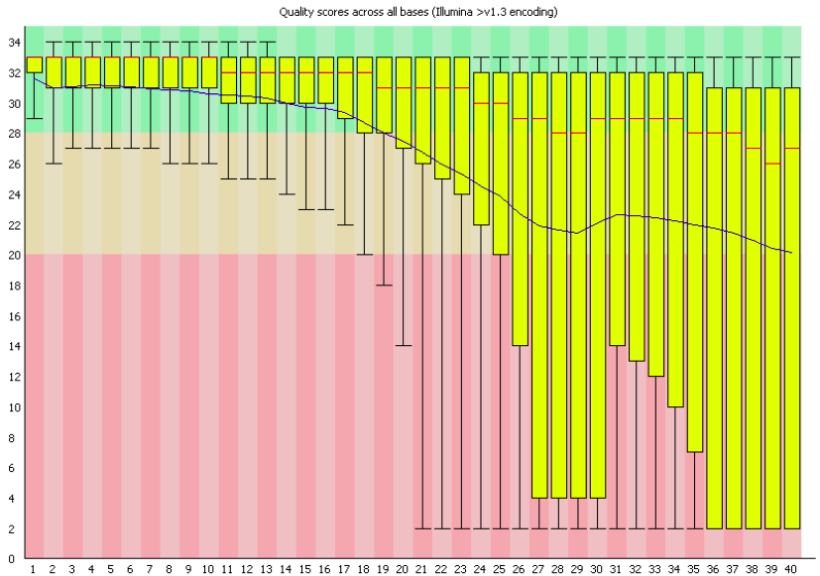
QC
Quality Control — Separating Signal from Noise
QC = systematically measuring data quality before using it
Answers the question: how reliable is my data?
Per-base quality score
How confident was the machine at each position?
Read length distribution
Are reads long enough to be useful?
GC content
Is the base composition biologically normal? ,
Human → ~40–45%, Some bacteria → can be 30%,70%
Duplication rate
How many reads are just copies of each other?
N content
What fraction of bases are unknown (N)?
FastQC per-base quality plot
Standard tool: FastQC (Simon Andrews, Babraham Institute)
Souhil MOKEDDEM
Bioinformatics Workshop

Slide 11
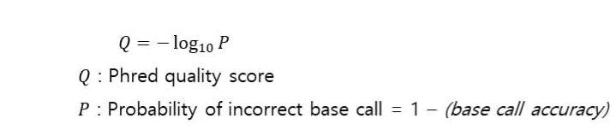
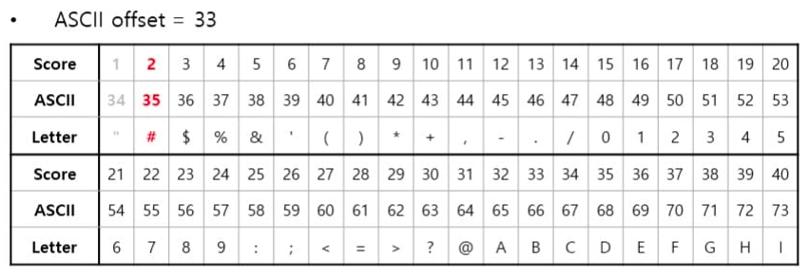
DATA FORMAT
FASTQ — Quality Scores Built Into the File
FASTA header: >
FASTQ header: @
Used for stored, curated sequences (e.g. reference genomes, databases). No quality scores — just sequence. Example:
>gene_BRCA1 chr17:43044295
ATGCTTACGGATCG...
Used for raw sequencer output — includes quality scores. Looks like FASTA but adds 2 extra lines. Example:
@Read_001 instrument:NB501 run:12 lane:1 tile:1101
ATGCTTACGGATCGAATGCTAGC...
1.
Header (@)
How ASCII quality characters decode to Phred scores:
Read ID + instrument + run + lane + tile position
Character | ASCII value | Phred score | Accuracy
! | 33 | Q0 | — worst
5 | 53 | Q20 | 99% accuracy
? | 63 | Q30 | 99.9% — gold std
I | 73 | Q40 | 99.99% — best
2.
Sequence
DNA string: A / T / G / C / N
3.
Separator (+)
Just a + sign — marks end of sequence
4.
Quality
ASCII Phred+33 — one character per base
Formula: Phred = ASCII value − 33 (Phred+33 encoding)
@Read_001 Sample:BloodA chr1:12345
ATGCTTACGGATCGAATGCTAGCATGCNN
+
IIIIIIIIHHHHHHHHGGGGGGGG!!!!!
Q40Q40 ... Q30 ... Q0 = bad
Souhil MOKEDDEM
Bioinformatics Workshop

Slide 12
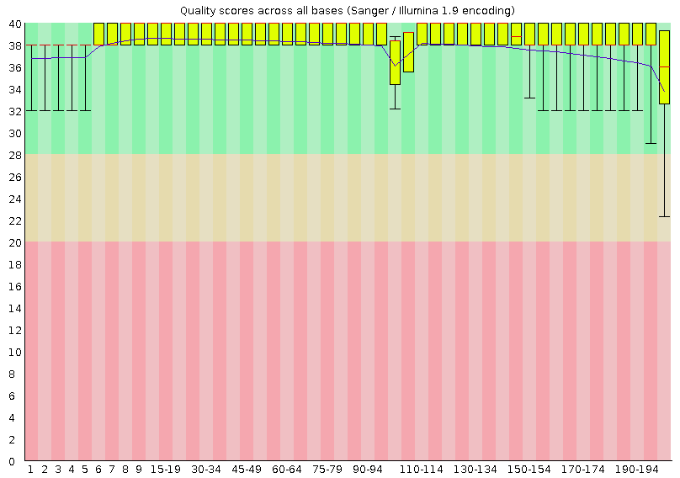
PREPROCESSING
Filtering — Keeping Only What We Can Trust
1.
Quality filtering
Remove reads with average Phred < 20 (below 99% accuracy per base)
2.
Length filtering
Remove reads shorter than 50 bp (too short to anchor to a genome)
3.
N-base filtering
Remove reads with more than 5% unknown (N) bases
4.
Adapter trimming
Cut synthetic sequences that the machine attaches to both ends
5.
Deduplication
Remove reads that are exact copies — PCR artifacts
Common tools: Trim Galore · Fastp
Souhil MOKEDDEM
Bioinformatics Workshop

Slide 13
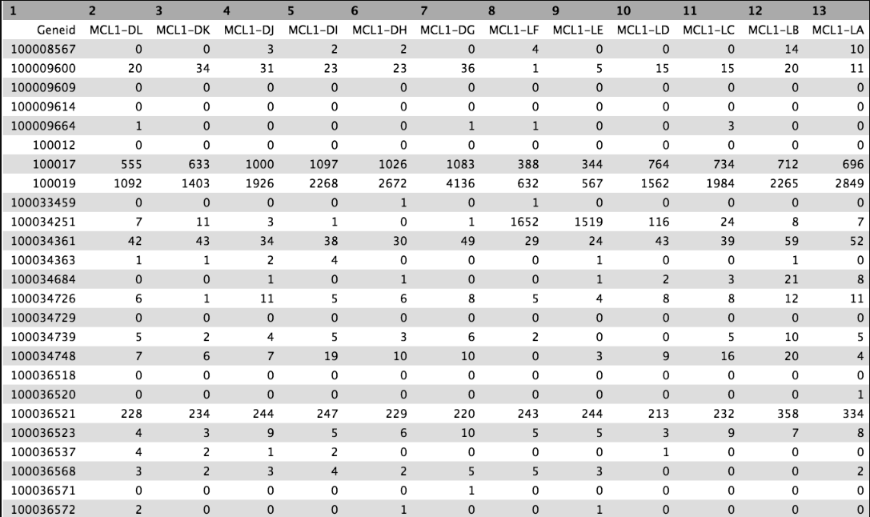
TRANSFORMATION
Turning Sequences Into Something Analyzable
After cleaning, we still have millions of text strings — not a table.
Cleaned
Sequences
Count /
Encode
Numeric
Matrix
[ IMAGE PLACEHOLDER ]
IMAGE: Gene expression count matrix
Search: 'RNA-seq count matrix gene expression table'
Counting: how many reads land on each gene? → count matrix
Encoding: convert sequence to numeric vector (A=[1,0,0,0])
Aggregation: per-sample summary statistics → feature table
End result: rows × columns matrix — just like a normal dataset
Rows = samples / patients | Columns = genes / features
Example — what the output table looks like:
Sample | BRCA1 | TP53 | EGFR
Patient_A | 1240 | 320 | 88
Patient_B | 85 | 4102 | 214
Patient_C | 990 | 411 | 1876
Once you have a table of numbers, you are in data science territory.
Rows = patients · Columns = genes · Values = read counts
Souhil MOKEDDEM
Bioinformatics Workshop

Slide 14
FULL PICTURE
The Complete Journey — Sample to Dataset
Biological Sample
— Every step is logged and reproducible
INPUT
Blood / Tissue / Cells
Sequencing Machine
Illumina / PacBio
Raw FASTQ File
— Skipping any step introduces downstream errors
RAW DATA
Millions of reads + quality scores
Quality Control
FastQC — inspect every metric
Filtering & Trimming
CLEANING
Remove bad reads, cut adapters
Transformation
— Universal across all genomics research
Sequences → numeric features
Structured Dataset
DataFrame / CSV / Count matrix
Analysis
OUTPUT
Statistics · ML · Visualization
— End-to-end: biology → data science
Souhil MOKEDDEM
Bioinformatics Workshop

Slide 15
DATA SCIENCE CONNECTION
Biological Data vs. Regular Data
Aspect | Regular Dataset | Biological Dataset
Format | CSV, Excel, JSON | FASTA, FASTQ, BAM
Noise source | Missing values, typos | Machine errors, biology
Scale | Thousands of rows | Millions of reads
Features | Known columns | Must be derived (genes)
Preprocessing | Normalize, impute | QC, trim, align, count
Domain | Business context | Biology context
Good news for data scientists
Good news for biology students
You already know the preprocessing mindset. Only the file format is new.
You don't need Python to understand why each pipeline step makes sense.
Souhil MOKEDDEM
Bioinformatics Workshop

Slide 16
REAL WORLD IMPACT
Why This Matters in Real Medicine
Cancer Genomics
Alzheimer's Research
Pandemic Tracking
Sequencing tumor vs. normal tissue
Poor QC → false targets → wrong therapy
Gene expression in brain tissue
Bad filtering → misleading biology signals
Viral genome sequencing (COVID-19)
Low quality → wrong variant classification
Rare Disease Diagnosis
Drug Response Prediction
Data quality
is a patient
safety issue.
Finding mutations in patient genomes
Noisy data → missed or false diagnoses
ML models on patient gene expression
Dirty data → biased model → wrong drugs
Not just a technical concern.
Souhil MOKEDDEM
Bioinformatics Workshop

Slide 17

DEMO
Let's Run the Pipeline Together
1.
Load 30 raw simulated sequencing reads (FASTQ-like structure)
2.
Calculate QC metrics: quality score, read length, N-fraction
3.
Inspect data quality — see the problems before we fix them
4.
Apply quality filters and log the reason for each removed read
5.
Transform clean sequences into a numeric feature table
6.
Produce a per-sample summary ready for downstream analysis
Python · pandas only · No specialized libraries · Fully runnable
Souhil MOKEDDEM
Bioinformatics Workshop

Slide 18
KEY TAKEAWAYS
What You Should Walk Away Knowing
Biological data starts as raw, noisy text files (FASTA / FASTQ)
QC is non-negotiable — you must measure quality before trusting data
Filtering removes unreliable data, not random data
Transformation converts sequences into structured numeric datasets
The pipeline is reproducible, logical, and domain-transferable
Data quality in biology directly impacts scientific and medical conclusions
You don't need to be a biology expert — but understand what each step protects against
Raw Data
QC
Filtering
Transform
Dataset
Souhil MOKEDDEM
Bioinformatics Workshop

Slide 19
Questions?
No bad questions in this room.
Souhil MOKEDDEM
Resources to Continue Learning
“Raw data is not knowledge.
Cleaned, structured data is.”
–
FastQC Documentation
bioinformatics.babraham.ac.uk/projects/fastqc
–
Galaxy Project (no-code bioinformatics)
usegalaxy.org
Souhil MOKEDDEM
–
NCBI FASTA format reference
ncbi.nlm.nih.gov
Contact
–
pandas Documentation
mokeddemsouhil968@gmail.com
pandas.pydata.org
LinkedIn: souhil-mokeddem-aa979435b
–
Bioinformatics Data Skills — Vince Buffalo (O'Reilly)
linkedin.com/in/souhil-mokeddem-aa979435b
Souhil MOKEDDEM Bioinformatics Workshop

