Slide 1

Attendance Monitoring System by Facial Recognition using ESP32cam & OpenCV2
Name:
Harshit Verma

Slide 2

Introduction to Attendance Monitoring System
An attendance monitoring system is designed to track and manage the attendance of employees or students in an organization or educational institution. It provides a digital solution to efficiently record attendance and monitor punctuality. The system uses Facial recognition to mark the attendance and provide the attendance in a excel sheet format.

Slide 3

Motivation for Project
1
Efficiency Improvement
The system aims to streamline the process of attendance tracking, reducing administrative burden and manual data entry errors.
2
Enhanced Accuracy
By leveraging technology, the project seeks to minimize inaccuracies in attendance records and ensure precise reporting.
3
Data Analysis
The analysis of attendance data can provide valuable insights into employee or student attendance patterns and trends, aiding in decision-making.

Slide 4
Components Used for the System:
ESP32-CAM Board AI-Thinker (x1)
(For facial capture)
FTDI MODULE (x1)
(For flashing Program into the ESP module)
Micro-USB Cable (x1)
Jumper Wires (x5)

Slide 5
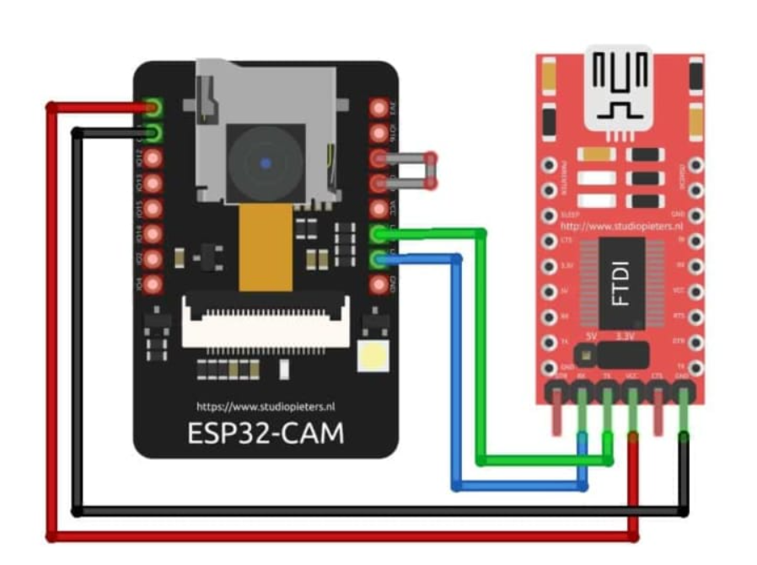
Circuit Diagram
Input Data
Processing Unit
Output Interface
Attendance data is presented through an intuitive interface for easy access and monitoring by administrators and users.
Initial data such as employee IDs, Facial Image serve as input to the system for attendance capture.
The processing unit analyzes the input data and identifies attendance patterns, lateness, or absences.

Slide 6
Development Process
1
Planning
Initial phase involve requirements gathering, feasibility study, and resource allocation
2
Design
Creation of system architecture, user interface, and database design based on detailed analysis and specifications.
3
Implementation
Development and integration of system components, including testing and debugging for functionality assurance.

Slide 7
Development Process
4
Deployment
Deployment phase includes deploying the project into a cloud based or a local based server integrating with the Database.
5
Testing
This phase requires multiple testing of the model with given dataset for further improvement or delivery of the product.
6
Maintenance
After final delivery, maintaining the product with the feedback response from the customer also plays a vital role in product management.

Slide 8
Inference:
95%
4GB
Accuracy Improvement
Record Storage
The system aims to achieve an 95% or higher accuracy in attendance capture and reporting, minimizing discrepancies.
With a capacity for storing up to 50,000 records, the system ensures a robust and scalable data management solution.

Slide 9
Thank You

