Slide 1

Next Word Prediction by Data Whisperers
Parth Dave - 100872777
Tahseen Siddiqi - 100889810
Nilax Gajjar - 100872763
Krupa Shah - 100888278

Slide 2
Scope
A next word predictor suggests the word while typing.
The Aim is to create AI driven system that predict and forecast the next highest probable word least 3 predictions.
Utilizes Natural Language Processings, deep learning, and LSTM models.
Deployment will be on AWS container, and code will be posted on Github. https://github.com/Datawhisperers-Durham/NextWordPrediction

Slide 3
Why Neural Network?
Pros
Model non-linear and complex problems.
Can generalize and predict invisible data.
Able to perform more than one functions simultaneously.
Information storing in the entire network and not in a database so also if few data
disappear, the network stay functioning. NN are fault-tolerant systems.
Cons:
Requires High end devices
It ia referred as black box because we can not depict from where/how we got the prediction.

Slide 4
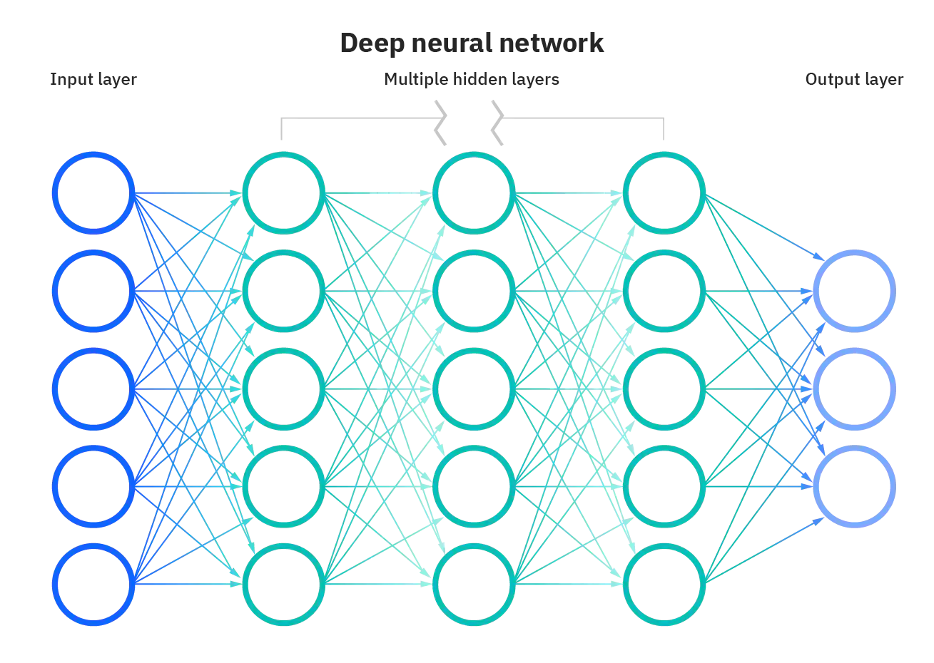
RNN vs LSTM
RNN (Recurrent Neural Network)
LSTM (Long short term memory)
Caption: IBM Cloud Neural network

Slide 5
Tech Stack
Programming Language:
Python, Javascript
Software:
Jupyter Notebook
Deployment
AWS Container
Algorithm:
Long Short terms memory (LSTM)
Testing
Cross-entropy for probability testing
GUI
React Chat page to test the model predictions

Slide 6
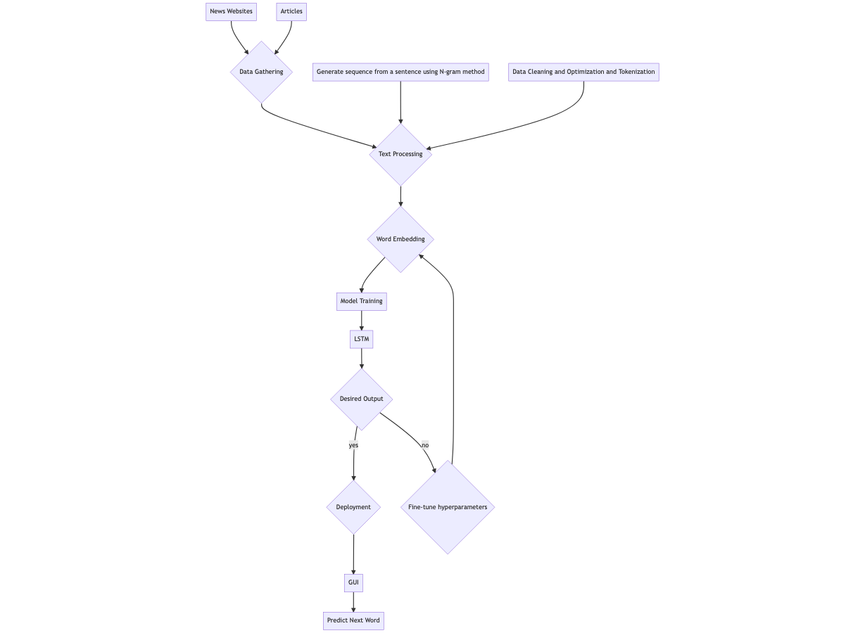
Architecture
Steps:
Data Gathering
Text Processing
Word Embedding
Desired Output
Fine-tune Hyper parameter
Deployment
Test model via our custom website
Predict the next word testing

Slide 7
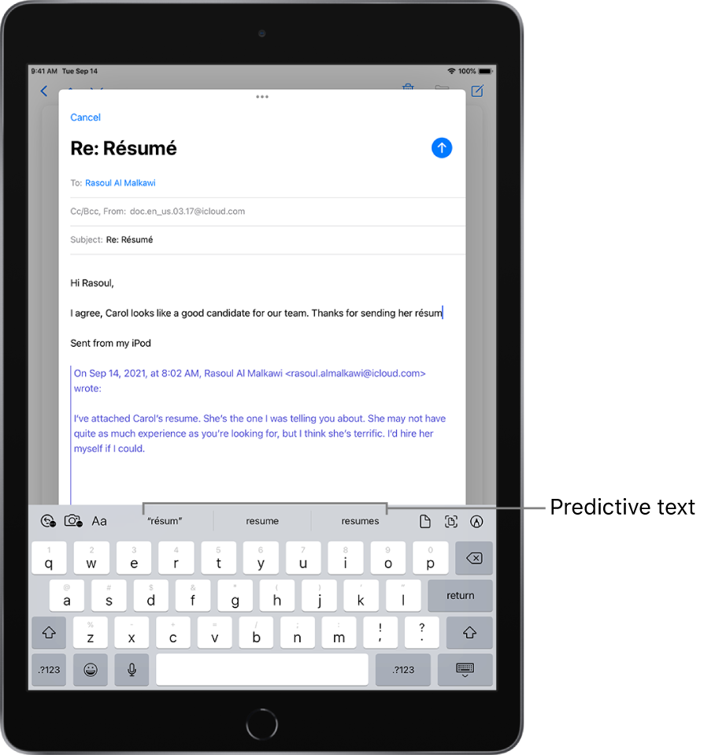
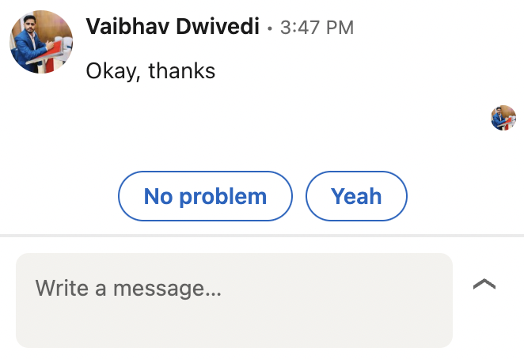
Use Cases
Most used use case is predicting the word while typing emails, messages, keyboards, or notes.

Slide 8
Thank you

