Slide 1


Slide 2
Introduction
The Sakila DVD Rental Store is a sample database that models the operations of a movie rental business. It includes comprehensive data on films, customers, rentals, payments, staff, and store locations. The dataset captures real-world business processes such as inventory management, customer transactions, and rental activities. Overall, it provides a structured environment to explore insights related to sales trends, customer preferences, and operational efficiency

Slide 3
Data Cleaning
Some missing postal codes and phone numbers were identified and handled appropriately.
Duplicate records were checked and removed to ensure data consistency.
Data gaps were present but have been addressed during preprocessing.
All other fields were reviewed and found to be consistent, requiring no further cleaning.

Slide 4
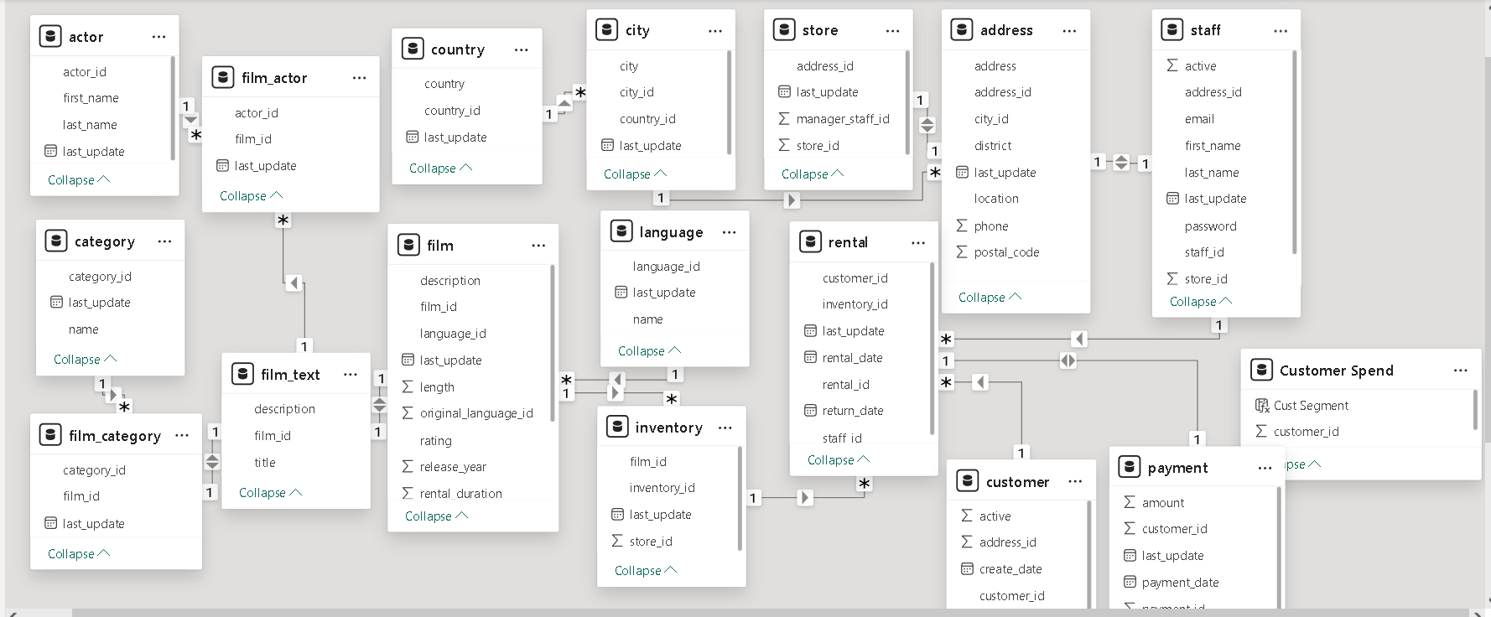
ERD(Entity Relationship Diagram)

Slide 5
Repeat Customers
All customers in the dataset are repeat customers, indicating strong customer retention. There is no evidence of new customer acquisition during the period, suggesting limited growth in the customer base. The business relies heavily on existing customers for revenue. While retention is strong, opportunities for expansion appear limited.

Slide 6
Top Rented Movie Top Rented Movie
Bucket Brotherhood, Zorro Ark, and Scalawag Duck have the highest rental rates, indicating strong customer demand. These films consistently perform better compared to others in the dataset. Their popularity suggests a higher preference among customers. Focusing on such high-demand titles can help optimize inventory and maximize revenue.

Slide 7
Staff-customer correlation
Staff 2 demonstrates a higher level of customer satisfaction compared to Staff 1 based on the available proxy metrics. Customers served by Staff 2 show better service outcomes, indicating more efficient handling of rentals. This may reflect stronger operational performance and customer interaction. In contrast, Staff 1 shows relatively lower satisfaction levels. Overall, Staff 2 appears to deliver a better customer experience.

Slide 8
Seasonal Trends
India, the US, and China have the highest number of customers compared to other countries, contributing significantly to the overall customer base. Customer concentration is notably higher in these regions, indicating strong market presence and demand. These countries play a key role in driving business performance and represent important areas for strategic focus and growth.

Slide 9
Language wise Distribution
Medium and high-value customers contribute more to overall rentals, indicating stronger engagement. Low-value customers show comparatively lower rental activity. This suggests that higher-value segments are more active and drive demand. Language-based preference cannot be analyzed as all films are in English.

Slide 10
Overall Sales revenue
There is a steady growth in both rental volume and revenue over time, indicating strong customer loyalty. Repeat customers continue to contribute consistently to sales, driving overall business growth.

Slide 11
Staff performance
Staff 2 demonstrates higher customer satisfaction compared to Staff 1, indicating better service efficiency. This suggests more effective handling of customer interactions and rental processes. Staff 1 may have comparatively lower performance in delivering consistent service quality. Improving efficiency could help enhance overall customer experience.

Slide 12
High spend customer analysis
High-spending customers show a strong preference for specific film categories. Their rental behavior indicates a higher inclination toward certain genres compared to others. This highlights targeted viewing patterns among premium customers. Focusing on these categories can help improve recommendations and drive revenue growth.

Slide 13
Inventory Level
High and medium availability of films support better customer satisfaction and higher rental frequency. Customers are more likely to rent and return when inventory is sufficiently available. In contrast, low availability leads to reduced repeat rentals and lower customer engagement. This highlights the importance of maintaining optimal inventory levels.

Slide 14
Peak hours of Store
Peak hours at each store indicate periods of highest customer activity. During these times, increased staffing is required to handle demand efficiently. Proper staffing ensures faster service and better customer experience. Optimizing staff allocation during peak hours can improve overall operational efficiency.

Slide 15
Language Distribution
The dataset contains films only in the English language, with no presence of other languages. This indicates a lack of diversity in language distribution. As a result, language-based preference analysis cannot be performed. All customer interactions are limited to English-language content.

Slide 16
Customer Preference
Customer preferences vary across locations, reflected in differences in film categories and ratings. Certain regions show higher demand for specific genres and content types. This indicates the influence of local tastes on viewing behaviour.

Slide 17
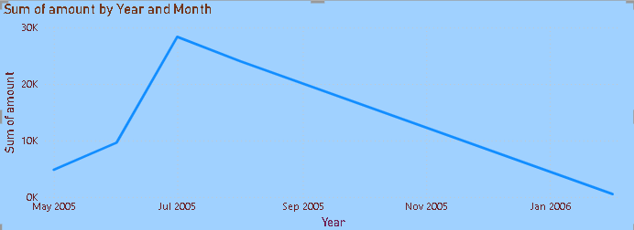
Sales Revenue by Month
Rental activity shows a sharp spike in July 2005, indicating a surge in demand during that period. Following this peak, there is a gradual decline in rentals until February 2006. This trend suggests a temporary increase followed by a steady decrease in customer activity.

Slide 18
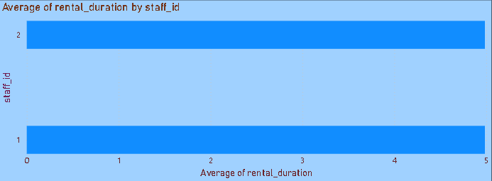
Average Rental Duration by Staff
Both staff members exhibit a similar average rental duration, indicating consistent handling of rental processes. This suggests uniformity in service efficiency across staff. There is no significant variation in how rentals are managed between them. Overall, performance remains balanced in terms of rental duration.

Slide 19
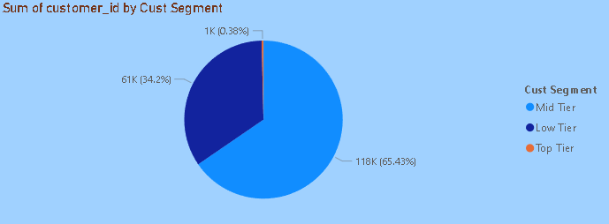
Customer Segment Revenue
The mid-tier segment generates the highest sales compared to both top and low-tier customers. This indicates that medium-value customers contribute the most to overall revenue. Their consistent purchasing behavior makes them a key driver of business performance.

Slide 20
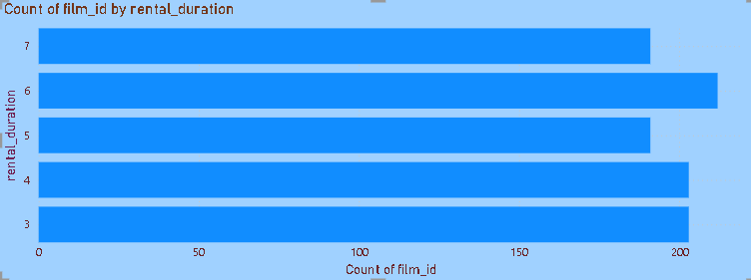
Distribution of films by rental duration
The majority of films have a rental duration of 6 days, indicating a standard rental period across the dataset. This suggests uniformity in rental policies for most titles. Such consistency helps streamline operations and customer expectations.

Slide 21
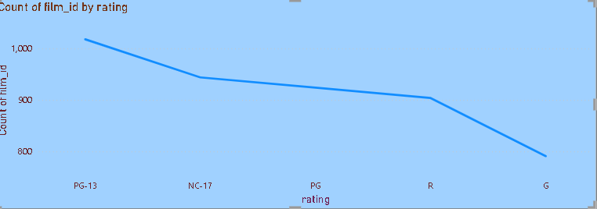
Inventory distribution by rating
PG-13 rated films dominate the inventory, indicating a higher focus on content suited for a broader audience. In contrast, G-rated films have minimal stock, suggesting lower availability or demand. This reflects a preference for moderately mature content in the inventory mix.

Slide 22
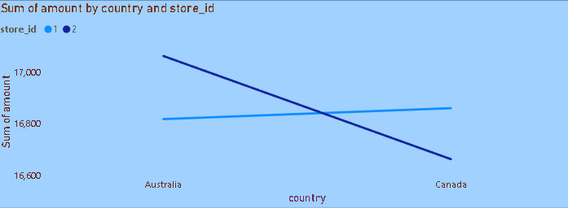
store performance by country
Store 1 maintains consistent performance across all locations, showing stable operations. Store 2, however, performs strongly in Australia but underperforms in Canada, highlighting location-specific variability in rental activity.

Slide 23
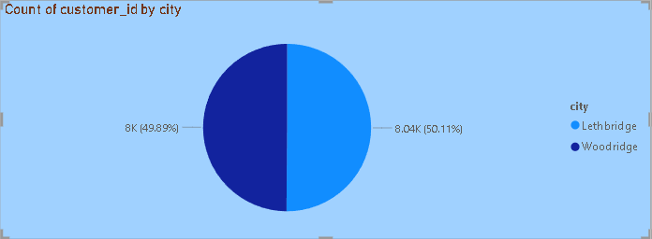
Customer distribution by city
Lethbridge and Woodridge exhibit similar rental counts, reflecting consistent customer engagement in both locations. This suggests comparable demand patterns and stable performance, making them reliable markets for targeted promotions and inventory planning.

Slide 24
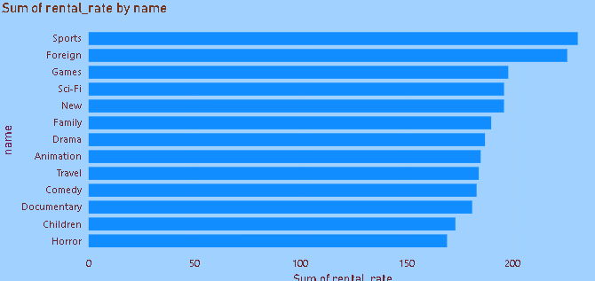
Top category
Sports and Foreign films carry higher rental prices, indicating strong demand and perceived premium value. In contrast, Music and Classics are priced lower, appealing to a broader audience and encouraging frequent rentals. This pricing pattern suggests opportunities to optimize revenue by balancing premium and high-volume categories.

Slide 25
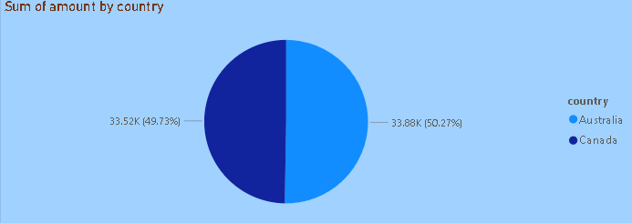
rental revenue by country
Australia and Canada show similar revenue, while other locations contribute little or none. This highlights strong regional concentration and the need to focus on key markets for better performance.

Slide 26
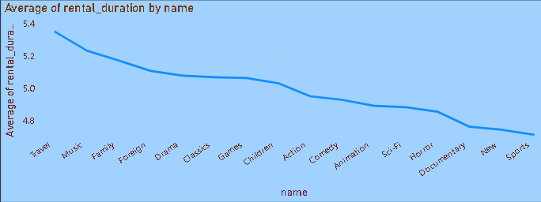
Average rental duration for category
Travel and Music categories tend to have longer rental periods, reflecting slower consumption or greater customer engagement. In contrast, Sports and News titles are returned more quickly, indicating faster turnover. Understanding these patterns can help optimize inventory, manage availability, and tailor promotions for different film categories.

Slide 27
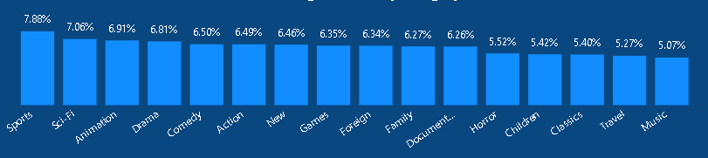
Percentage of sales by category
Sports and Sci-Fi films contribute a higher percentage of total sales, highlighting their popularity and revenue impact. In contrast, Travel and Music categories generate a smaller share of sales. Focusing on high-performing categories while strategically promoting lower-performing ones can help boost overall revenue.

Slide 28
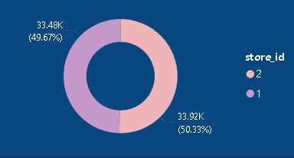
store revenue
Store 2 records slightly higher sales compared to Store 1, indicating stronger performance in select locations. Monitoring these trends can help identify strategies to maintain and grow sales further.

Slide 29
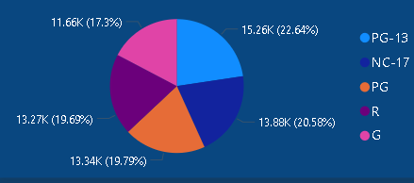
revenue by film rating
PG-13 films generate the highest revenue, reflecting strong customer preference. Other ratings contribute moderately, while G-rated films bring in the least. This highlights the importance of focusing on popular ratings to maximize rental income.

Slide 30
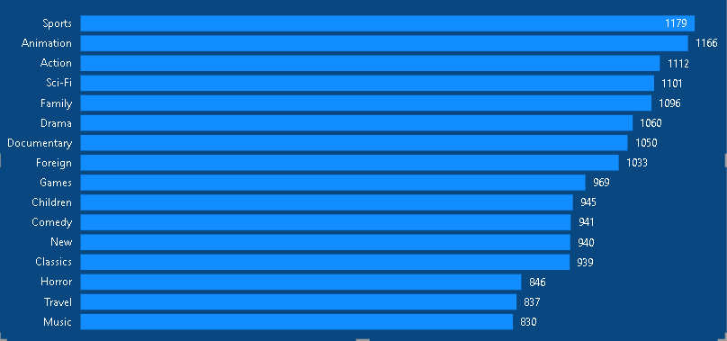
Customer purchase by category
Sports and Animation films are the most frequently rented, showing strong customer demand. In contrast, Travel and Music categories are rented less often. Prioritizing high-demand categories can help optimize inventory and drive overall rental performance.

Slide 31
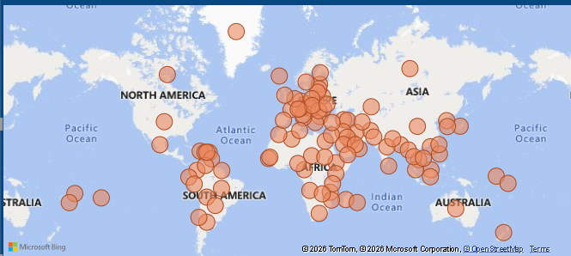
customer distribution
The majority of customers are concentrated in Asia, Africa, and South America, showing strong demand in these regions. Other regions have fewer customers, highlighting opportunities to expand reach and tailor services in underrepresented markets.

Slide 32
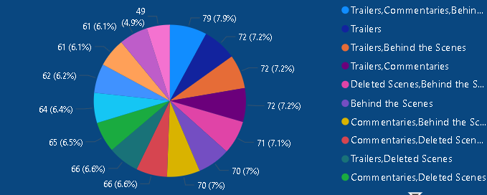
Special features split
Trailers and commentaries are the most accessed extras, indicating high customer interest. In contrast, Deleted Scenes and Behind-the-Scenes content are less popular. Focusing on high-demand extras can enhance engagement and drive additional rentals.

Slide 33
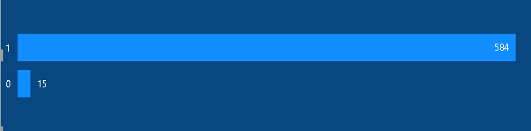
Active customers
Most customers are actively renting films, while only a small fraction remain inactive. This indicates a strong, engaged user base driving consistent rental activity.

Slide 34
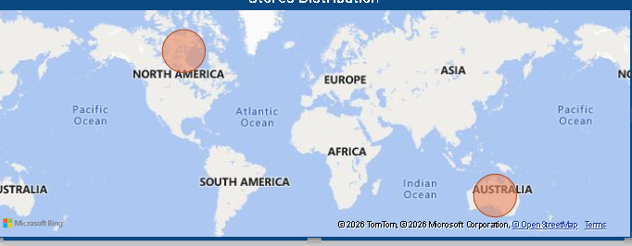
Store distribution
The stores are located in North America and Australia, covering key markets. Most customers are active, driving consistent rentals. Expanding to additional locations can capture more demand and further increase revenue across regions.

Slide 35
Summary
Business performance is driven by popular films and frequent renters, with rental demand varying across locations. Mid-tier films and PG-14 titles dominate rentals, while staff rental durations are largely consistent across stores, supporting smooth operations. Peaks in rental activity occur seasonally, with Store 1 performing steadily and Store 2 showing location-specific variation.
Focus on promoting top-rented films, improving engagement in underperforming locations, maintaining staff efficiency, and balancing inventory to drive overall rental growth.

Slide 36
Thank you

