Slide 1


Slide 2
Introduction
Northwind Traders is a global trading company that specializes in supplying a wide range of products to businesses across multiple industries. The company acts as a key intermediary between suppliers and customers, ensuring efficient procurement, distribution, and delivery of goods. With a diverse product portfolio that includes categories such as beverages, dairy products, and condiments. Northwind Traders serves clients across different regions. Its operations focus on maintaining strong supplier relationships, timely order fulfillment, and consistent product quality, making it a reliable partner for businesses worldwide.

Slide 3
Data Cleaning
Missing shipping dates were identified and handled by imputing values using the median shipping duration.
The average was initially considered, but it was slightly higher due to outliers, so the median was chosen for better accuracy.
Data gaps were present but have been addressed during preprocessing.
All other fields were reviewed and found to be consistent, requiring no further cleaning.

Slide 4
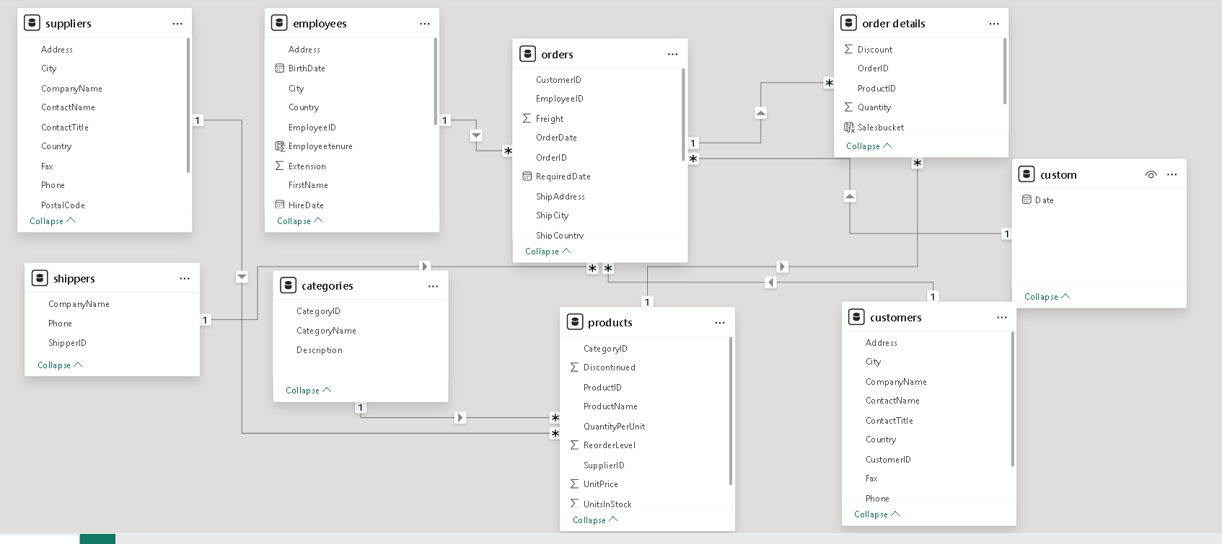
ERD(Entity Relationship Diagram)

Slide 5
High-Value Customers
A notable segment of customers demonstrates both high value and repeat purchasing behavior, contributing significantly to overall revenue. These customers exhibit strong loyalty and consistent engagement, making them a critical driver of business performance. Focusing on retaining and nurturing this segment can further enhance revenue growth and long-term customer relationships.

Slide 6
Overall Contributions of Products
Revenue is heavily driven by a few top product categories, including Beverages, Condiments, and Meat/Poultry. These categories contribute a significant share of total revenue, indicating a concentration of demand. This suggests that business performance relies strongly on key product segments, highlighting opportunities to further optimize and promote these high-performing categories while exploring growth in others.

Slide 7
Average Purchase Interval
Purchase frequency varies across countries, with Spain showing the longest repeat purchase interval, followed by Norway. This indicates slower customer re-engagement in these regions compared to others, suggesting potential opportunities to improve retention and increase purchase frequency.

Slide 8
Distribution of Employees
Sales Representatives form the majority of the workforce across locations.Employee distribution is spread across cities in the UK and USA, with key presence in London, Seattle, and Tacoma.Managerial roles (Sales Manager, VP) are limited, indicating a lean leadership structure.Support roles like Inside Sales Coordinator have minimal representation.

Slide 9
Hire Date Trend
Hiring remains consistent over time, indicating stable and controlled workforce growth. This steady pattern suggests that the organization follows a planned recruitment strategy rather than sudden or reactive hiring. Such consistency reflects operational stability and a balanced approach to scaling the workforce in line with business needs.

Slide 10
Supplier Distribution & Pricing
An increase in the number of suppliers is associated with a decrease in average product pricing. This suggests that higher supplier competition leads to more competitive pricing, benefiting cost efficiency. It indicates that supplier diversity can help control prices and improve overall procurement strategy.

Slide 11
Multi-Category Suppliers
Some suppliers operate across multiple product categories, which contributes to increased product availability and stock levels in the region. This multi-category presence helps ensure better inventory coverage, reduces stockouts, and supports consistent supply across different product segments.

Slide 12
Suppliers Distribution
A higher number of suppliers are concentrated around top-selling product categories such as Beverages and Condiments. This indicates strong supplier participation in high-demand segments, ensuring better availability and competitive pricing for these products. It also reflects the market’s focus on popular categories that drive significant sales.

Slide 13
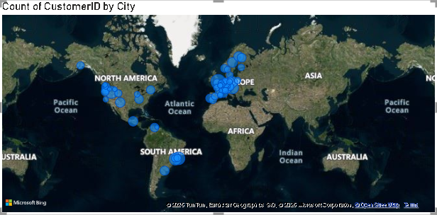
Customer Distribution
Customer distribution is highest across Europe, indicating a broad and widespread presence in the region. However, the USA holds the largest share individually, making it the single biggest contributor to the customer base. This highlights both regional spread in Europe and strong market concentration in the USA.

Slide 14
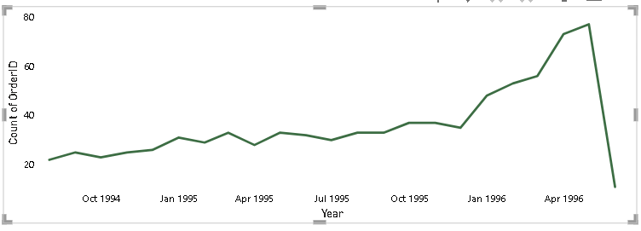
Customer Orders Trend
Customer orders show a gradual upward trend over time, indicating steady growth in demand. A noticeable spike in May 1996 suggests a surge in order activity, possibly driven by end-of-cycle deal closures. This is followed by June 1996, which appears to mark the closing phase of the period, with a slight decline in order volume.

Slide 15
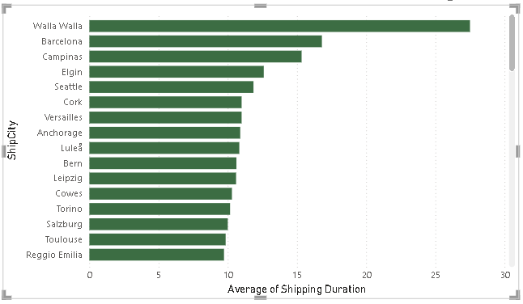
Average Shipping Duration
Shipping duration is highest for Walla Walla compared to other cities, indicating relatively slower delivery performance in this location. This may be due to logistical challenges, distance, or operational factors affecting shipment timelines.

Slide 16
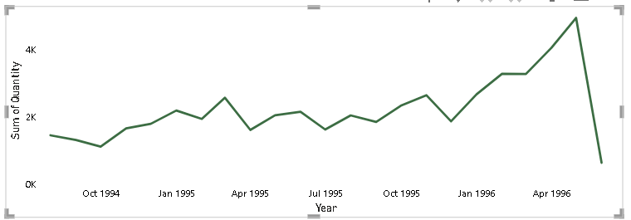
Order Volume over Time
Order volume reaches its peak in May 1996, likely driven by closing sales and end-of-cycle deal finalizations. This is followed by June 1996, which marks the closing phase of the period, with a slight decline in order activity.

Slide 17
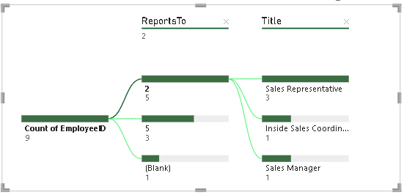
Employee Hierarchy
Sales Representatives operate within a mixed reporting hierarchy, reporting either to Sales Managers or directly to the VP. Additionally, Sales Managers report directly to the VP, indicating a layered yet flexible organizational structure.

Slide 18
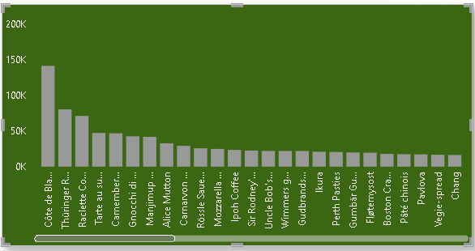
Product Summary
Sales volume is highest for products such as Côte de Blaye, Thüringer Rostbratwurst, and Raclette Courdavault, indicating strong customer demand for these items. In contrast, products like Geitost and Chocolade have the lowest sales volume, reflecting comparatively weaker demand.

Slide 19
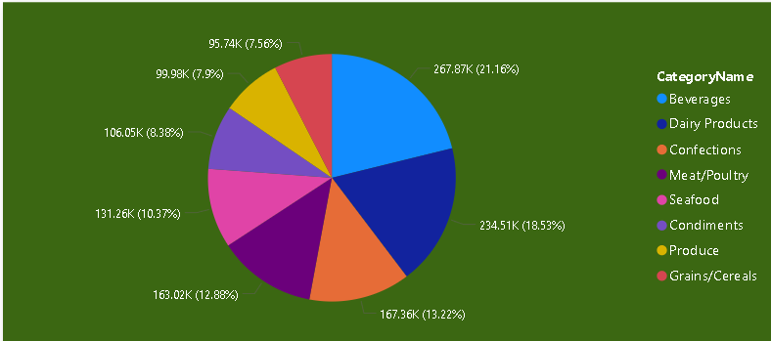
Revenue by Category
Beverages, Condiments, and Dairy Products are the top revenue-generating categories, contributing significantly to overall sales. This indicates strong customer demand and consistent performance within these categories, making them key drivers of business revenue.

Slide 20
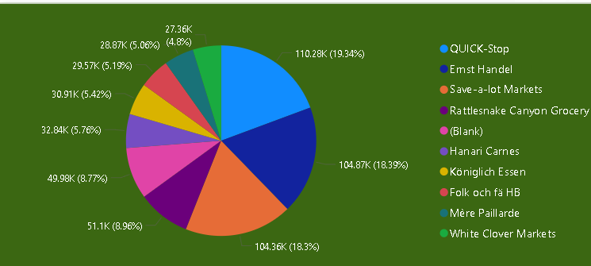
Premium Customers
Premium customers include Quick-Stop, Ernst Handel, and Save-A-Lot Markets, indicating that these clients contribute high value through frequent and/or high-volume purchases. These customers play a key role in driving overall revenue and business performance.

Slide 21
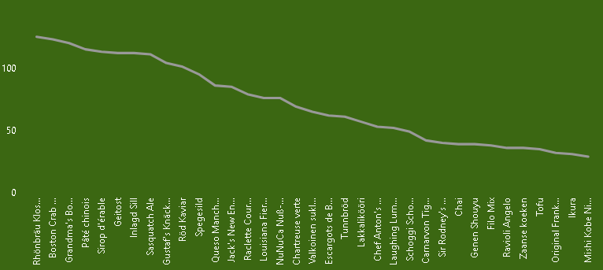
Available Inventory Units
Units in stock are highest for products such as Rhönbräu Klosterbier and Boston Crab Meat, along with several other items maintaining high inventory levels. This indicates strong stocking for key products, possibly to meet consistent demand or ensure availability.

Slide 22
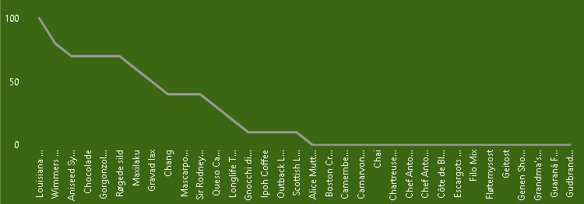
Pending Order Quantity
Pending order quantities are highest for products such as Louisiana and Wimmers, indicating higher unmet demand or delayed fulfillment for these items. Other products show comparatively lower pending quantities, suggesting better order fulfillment or lower demand.

Slide 23
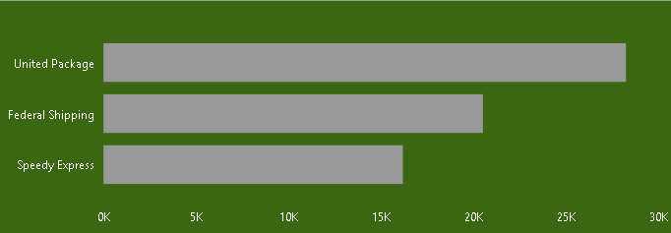
Shipper Revenue
Shipper revenue is highest for United Package, followed by Federal Shipping, while Speedy Express contributes the least. This indicates that United Package handles a larger share of high-value shipments, making it the top-performing shipper.

Slide 24
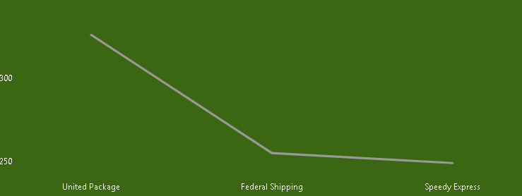
Order Volume by Shipper
Order volume is highest for United Package, indicating it handles the majority of shipments. Federal Shipping and Speedy Express have nearly equal order volumes, showing a balanced distribution between these two shippers.

Slide 25
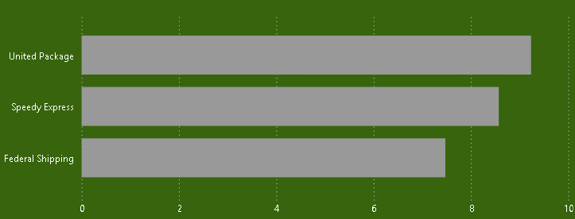
Average Shipping Distribution
Average shipping duration is highest for United Package, followed by Speedy Express, while Federal Shipping has the lowest. This suggests relatively slower delivery performance for United Package compared to the others.

Slide 26
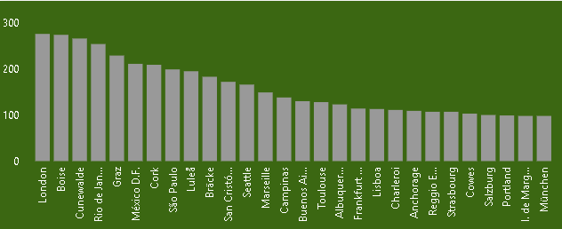
City wise Delivery Duration
City-wise delivery distribution is highest in London, Boise, and Cunewalde, indicating these locations handle the largest share of deliveries. This suggests strong demand and higher operational activity in these cities compared to others.

Slide 27
Summary
Business performance is driven by a few key products and high-value repeat customers, with demand varying across regions. Order trends show steady growth with peaks during closing periods, while logistics performance differs by city and shipper. Supplier diversity supports competitive pricing and product availability.
Focus on strengthening top-performing products, improving retention in low-frequency regions, optimizing shipping efficiency, and balancing inventory to drive overall growth.

Slide 28
Thank you

