Slide 1
Photolithography
Presented by:
d Raghu babu
222004026

Slide 2
Why Photolithography
• Low cost IC manufacturing
-Due to large number of lithographic steps needed in IC manufacturing, lithography typically accounts for about 30% of cost of manufacturing.
-Photolithography cost minimize result in low cost IC
•Ultra miniaturized electronic device manufacturing
-With photolithography ultra miniaturized IC manufacturing is possible resulting in miniature electronic device

Slide 3
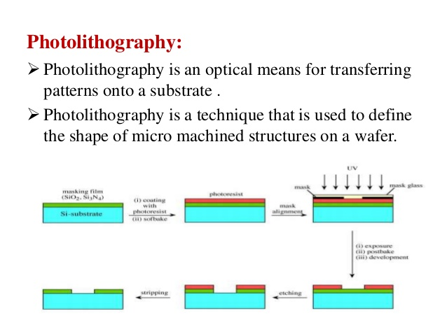

Slide 4
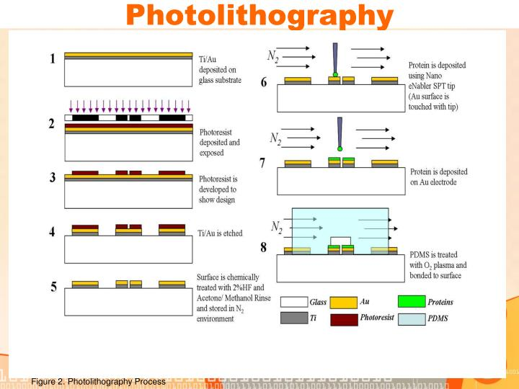

Slide 5
Basic Process of Lithography
•Substrate
-Base layer consists of either glass, silica etc.
•Depositing Film
-A thin layer of SiO2 coated at the top of substrate
•Pattern the Film
-Imaging the pattern from the template to the film
•Etching
-Removing the unnecessary part of the film and keeping the required pattern.
-Can be performed using different chemicals( acids)

Slide 6
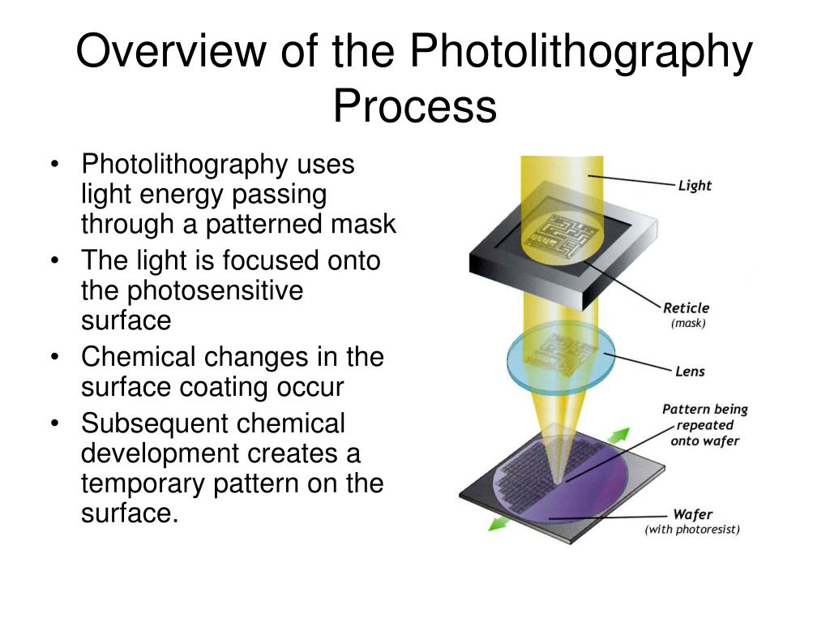

Slide 7
Summary
•Photolithography uses three basic process steps to transfer a pattern from a mask to a wafer : coat, develop, expose.
• The pattern is transferred into the wafer’s surface layer during a subsequent process.
• Capacity enhancement is dependent on wavelength and numerical aperture.

Slide 8
THANK YOU

