Slide 1


Movie Recommendation System using SVD
This presentation explores the development of a movie recommendation system using Singular Value Decomposition (SVD), a powerful matrix factorization technique. We'll delve into the problem of information overload in movie discovery, the dataset used, the tools employed, and the step-by-step process of building, evaluating, and improving such a system. The goal is to enhance user experience by providing personalized and accurate movie suggestions.
By:
Dathrija Tellakula

Slide 2






Problem Statement
Information Overload
Lack of Personalization
Users struggle to find relevant movies amidst the vast number of available titles. The sheer volume of content makes manual browsing inefficient and overwhelming.
Generic recommendations often fail to cater to individual tastes and preferences, leading to user dissatisfaction and decreased engagement with streaming platforms.
Predict User Preferences
Enhance User Experience
Our primary goal is to accurately predict how a user would rate an unseen movie. This forms the core of a truly personalized recommendation engine.
By providing highly relevant suggestions, the system aims to improve user satisfaction, increase content consumption, and foster a more engaging platform environment.

Slide 3


Dataset: MovieLens 100K
The MovieLens 100K dataset is a widely used benchmark for recommendation systems. It comprises 100,000 movie ratings collected from 943 unique users on 1682 different movies. Each rating is on a discrete scale from 1 to 5, indicating the user's satisfaction with the movie. Beyond ratings, the dataset also includes valuable user demographic information such as age, gender, and occupation, which can be leveraged for deeper insights.
A key characteristic of this dataset is its inherent data sparsity, with only about 6.3% of all possible user-movie ratings present. This sparsity poses a significant challenge for recommendation algorithms, as it means most of the user-item matrix is empty, requiring robust methods to infer missing preferences.

Slide 4




Tools
Python
The primary programming language for its versatility in data analysis, machine learning, and its rich ecosystem of libraries. We'll leverage its powerful capabilities for data manipulation and model building.
Surprise Library
A Python scikit for building and analyzing recommender systems. It provides off-the-shelf algorithms, including a robust SVD implementation, and various evaluation metrics to assess model performance effectively.
Key Libraries
We'll utilize Pandas for efficient data handling and manipulation, NumPy for numerical operations, and Scikit-learn for general machine learning utilities and data splitting.

Slide 5








Preprocessing
Load Data
The MovieLens data is loaded and structured specifically for the Surprise library. This involves converting the raw data into a format that includes user IDs, movie IDs, and their corresponding ratings, which is essential for the library's functions.
Split Data
The loaded dataset is then divided into training and testing sets. A common 80/20 split is applied, where 80% of the data is used to train our SVD model, and the remaining 20% is reserved to evaluate its performance on unseen data.
Handle Missing Values
Given the inherent sparsity of the MovieLens 100K dataset, methods for handling missing values are crucial. While SVD inherently deals with sparsity, for other models, imputation or other strategies might be considered.
Scale Data
Depending on the specific algorithm and data characteristics, scaling or normalizing the rating data can be beneficial. This ensures that features contribute equally to the model training process, preventing features with larger values from dominating.

Slide 6

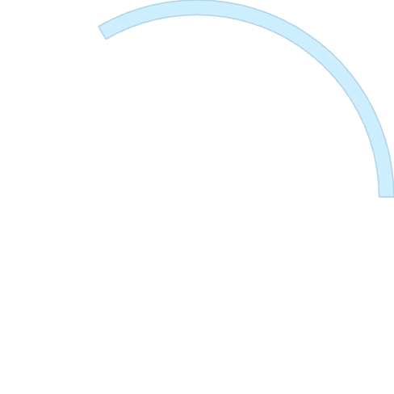



SVD Model
Latent Factors
The decomposition reveals "latent factors" which are abstract features representing underlying user preferences (e.g., preference for action movies, comedies) and movie characteristics (e.g., genre, director's style). These factors are not directly observable but are inferred from the ratings.
2
Dimensionality Reduction
SVD decomposes the original user-item matrix into three smaller matrices, effectively reducing its dimensionality. This process helps in uncovering hidden patterns and relationships within the data.
1
Surprise SVD Parameters
n_factors: Number of latent factors to discover (e.g., 50, 100).
n_epochs: Number of iterations for the training process (e.g., 20).
3
lr_all: Learning rate, controlling the step size during optimization (e.g., 0.005).
reg_all: Regularization term, preventing overfitting (e.g., 0.02).

Slide 7



Implementation
Recommend Top N Movies
Evaluate Performance
Make Predictions
The accuracy of the model's predictions is assessed using standard evaluation metrics: Root Mean Squared Error (RMSE) and Mean Absolute Error (MAE). These metrics quantify the difference between predicted and actual ratings.
For a specific user, we predict their ratings for all movies they haven't seen using model.predict(user_id, item_id). These predictions are then sorted in descending order to identify the top N movies with the highest predicted ratings, which are then recommended to the user.
Train the Model
Once trained, the model is used to predict ratings for movies in the test set. The model.test(testset) method generates predictions for all user-movie pairs present in the test set, allowing us to compare them with actual ratings.
The SVD model is instantiated with chosen parameters and then trained on the designated training set using model.fit(trainset). During this phase, the model learns the latent factors from the provided user-movie ratings.

Slide 8
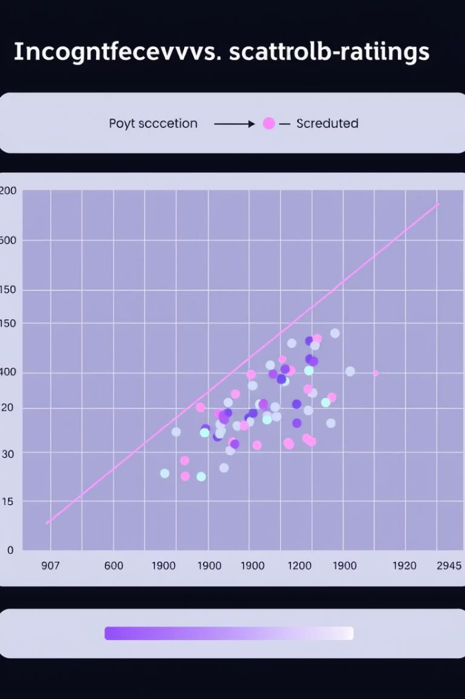

Results
RMSE
0.92
MAE
0.72
Our SVD model achieved a Root Mean Squared Error (RMSE) of approximately 0.92 and a Mean Absolute Error (MAE) of about 0.72. These metrics indicate that, on average, our predictions deviate by less than one star from the actual user ratings, which is a strong performance for a recommendation system. For example, for User ID 196, the top 5 recommended movies included "Star Wars (1977)", "Fargo (1996)", "Return of the Jedi (1983)", "Princess Bride, The (1987)", and "Godfather, The (1972)".

Slide 9

Challenges
Cold Start Problem
Data Sparsity
New users or new movies lack sufficient rating data, making it difficult for the SVD model to generate accurate recommendations. This is a common hurdle for collaborative filtering systems.
Even with existing users and movies, the vast majority of possible ratings are missing. This sparsity can limit the model's ability to discover robust latent factors and make precise predictions.
Scalability
Model Interpretability
As datasets grow exponentially larger (millions of users and movies), the computational demands for SVD decomposition can become prohibitive. Efficient algorithms and distributed computing are often required.
SVD's latent factors are abstract, making it challenging to directly interpret why a specific recommendation was made. Understanding the underlying reasons can be crucial for debugging and gaining user trust.

Slide 10




Conclusion
The implementation of SVD proved effective in building a movie recommendation system that can predict user preferences with reasonable accuracy. The model successfully captures latent factors from sparse rating data, offering personalized suggestions that enhance the user experience.
1
2
3
Hybrid Models
Metadata Enrichment
System Deployment
Combining SVD with content-based filtering (using movie genres, actors, etc.) could improve recommendations, especially for the cold start problem.
Incorporating additional features like user reviews, movie descriptions, and sentiment analysis could provide richer data for the model to learn from.
Future work includes integrating the recommendation engine into a web application for real-time recommendations and conducting A/B tests to compare different algorithms in a live environment.
References
Sarwar, B., Karypis, G., Konstan, J., & Riedl, J. (2000). Application of Dimensionality Reduction in Recommender Systems - A Case Study. In ACM WebKDD Workshop.
Koren, Y., Bell, R., & Volinsky, C. (2009). Matrix Factorization Techniques for Recommender Systems. Computer, 42(8), 30-37.
MovieLens 100K Dataset: https://grouplens.org/datasets/movielens/100k/
Surprise Library Documentation: http://surpriselib.com/

