Slide 1

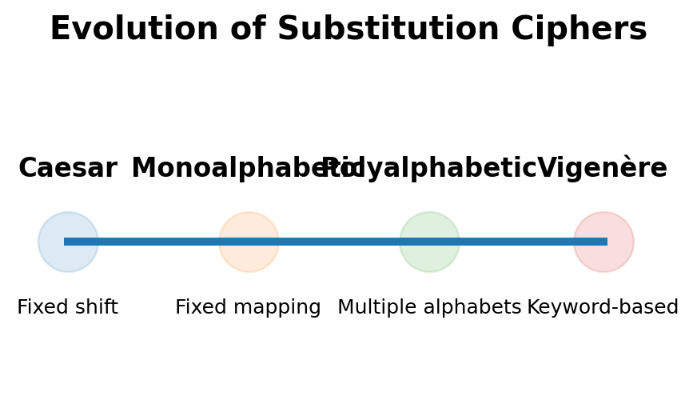
From Caesar to Vigenère: Evolution of Substitution Ciphers
Name :- Lekkala Dattu Kumar
Reg No :- 192324141
Course Code :- CSA5107
Course Name :- Cryptography and Networks Security
Incharge :- P.Jesu jayarin

Slide 2


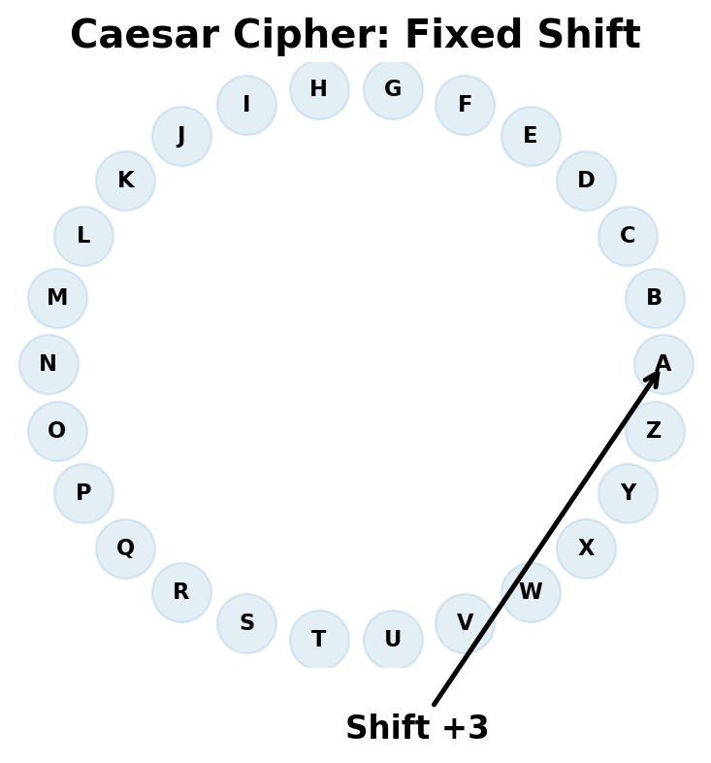
Introduction
Substitution ciphers replace plaintext characters with other characters to produce ciphertext.
Caesar Cipher uses a fixed shift for every letter and provides the basic foundation of substitution encryption.
Vigenère Cipher extends the idea using a keyword and multiple substitution alphabets.
The evolution demonstrates how changing the substitution pattern can make basic cryptanalysis more difficult.
Objective: implement, compare, encrypt/decrypt, and analyze Caesar and Vigenère ciphers.

Slide 3
Literature review
Classical substitution ciphers form the foundation for understanding modern cryptography.
Caesar is a monoalphabetic technique: the same shift is applied throughout the message.
Monoalphabetic substitution improves the key space but still preserves strong frequency patterns.
Vigenère is a polyalphabetic technique that changes the substitution according to a repeating keyword.
Frequency analysis is therefore more direct against Caesar than against basic Vigenère.

Slide 4
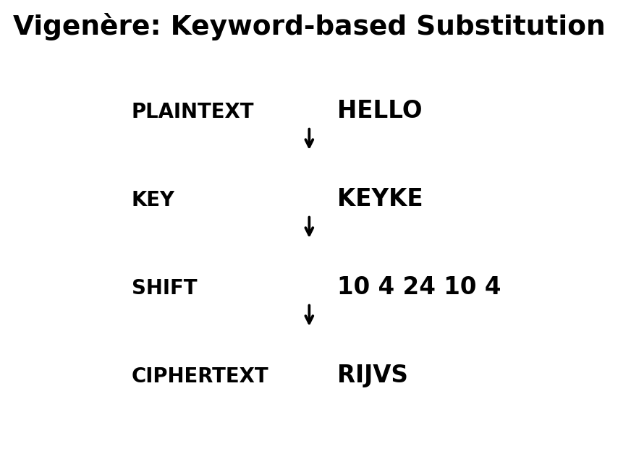
Methodology
Input: plaintext and secret key/shift.
1. Convert letters to numerical values (A=0 to Z=25).
2. Caesar: apply C = (P + K) mod 26.
3. Vigenère: apply Cᵢ = (Pᵢ + Kᵢ) mod 26.
4. Decrypt using the corresponding inverse operation.
5. Validate that decrypted text matches the original plaintext.
Example: HELLO + KEY → RIJVS.

Slide 5
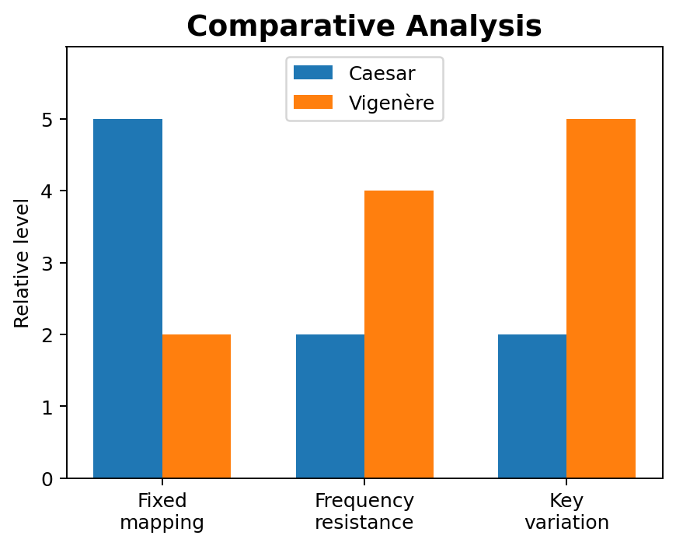
Results and Discussion / Conclusion
Results:
• Caesar: HELLO with shift 3 → KHOOR.
• Vigenère: HELLO with key KEY → RIJVS.
• Vigenère changes substitutions across positions and reduces simple frequency patterns.
Conclusion:
• The experiment validates the evolution from fixed to polyalphabetic substitution.
• Both are classical ciphers and are not suitable for modern secure communication.

